Slide 1
WORLD CAFE
2022
CREATING PATHWAYS TO OPPORTUNITIES: EMPLOYMENT FOR ALL!
Presenters:
Crystal Thomas and Catherine Rinehart Mello
State Office of Policy Planning and Innovation
Department on Disability Services
Notes:
We brought together: Job seekers, employed individuals with disabilities, family members, service providers, advocacy organizations, education and various state agencies.

Slide 2
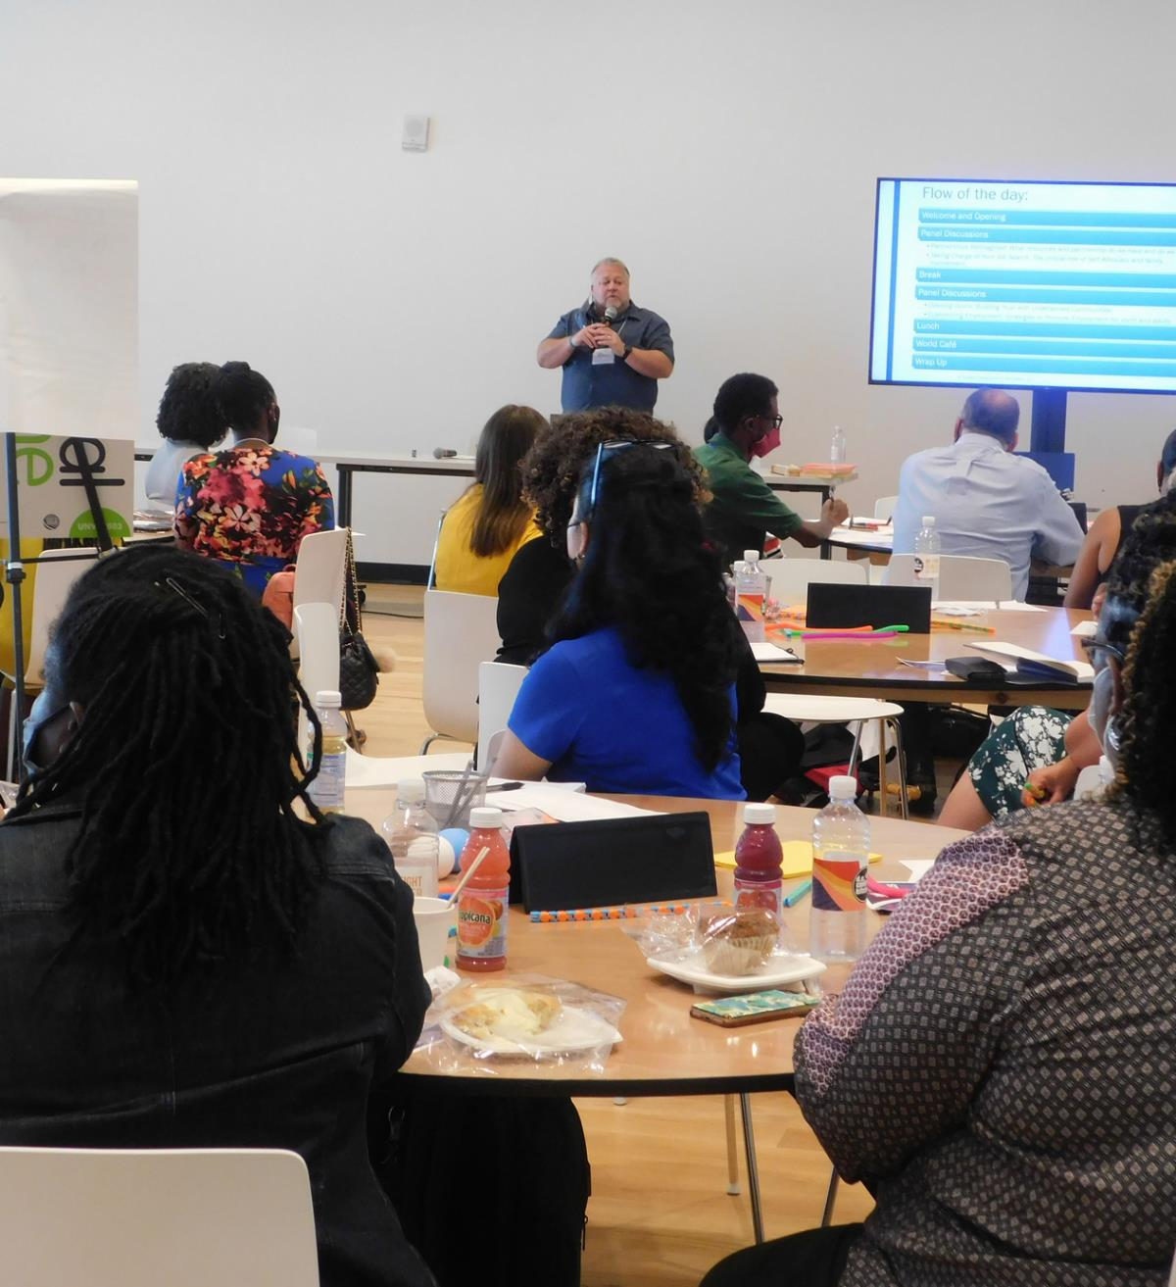
WHAT IS A WORLD CAFE?
Notes:
A World Café is a structured conversational process for knowledge sharing in which groups of people discuss a topic at several small tables. We used this creative and engaging format through which we collectively discussed ways to improve employment outcomes for District residents with disabilities. We brought together about 70 people which included: Job seekers, employed individuals with disabilities, family members, service providers, advocacy organizations, education and various state agencies.

Slide 3
DISABILITY AND EMPLOYMENT BY THE NUMBERS
DISTRICT OF COLUMBIA
NATIONAL
The employment rate was 33.2% for working-age people with disabilities in DC and was 83.8% for working-age people without disabilities.
The employment rate in the U.S. was 39.2% for people with disabilities and 80.7% for people without disabilities.
2019
2019
Notes:
-*Working age is 16-64
-As you can see as of 2019, the employment rate for people with disabilities was slightly lower than the national average.
-Andy, Windslow and Darryl presented DC and national data the during the event.

Slide 4
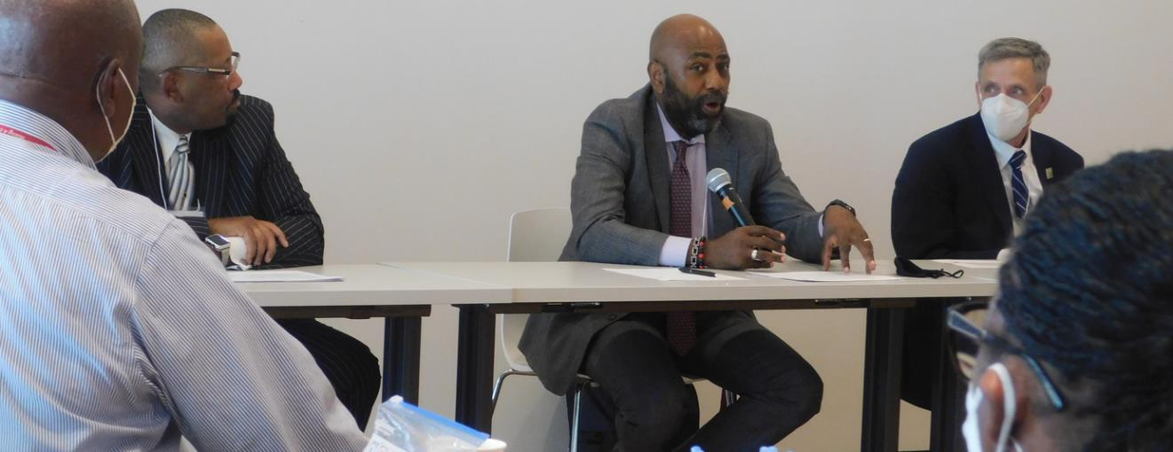
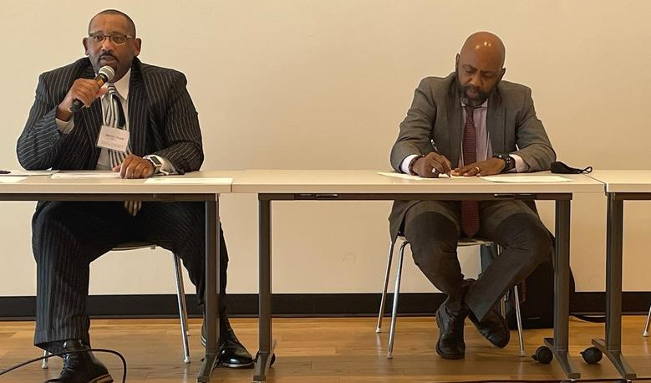
DISABILITY AND EMPLOYMENT BY THE NUMBERS
DEVELOPMENTAL DISABILITIES ADMINISTRATION
REHABILITATION SERVICES ADMINISTRATION
Almost all working aged individuals have an employment related goal
All working aged individuals engage in discovery assessments
147 people have Supported Employment Services out of 331 who are employed
As of July 2022 RSA served 5,514 individuals and 449 are employed YTD
Mental Health, IDD, Autism are most common disability categories of people served
Notes:
*if it is relevant*
-Of those employed so far in 2022, there are 57 successful case closures with intellectual or developmental disabilities year-to-date.
RSA-Active cases as of July 2022
Mental/Behavioral Health disorders – 991
Intellectual Disability – 485
Autism – 207
Combined other possible* Developmental Disabilities – 525
Deaf/Hearing Impaired – 128
Blind/Visually Impaired -- 134

Slide 5
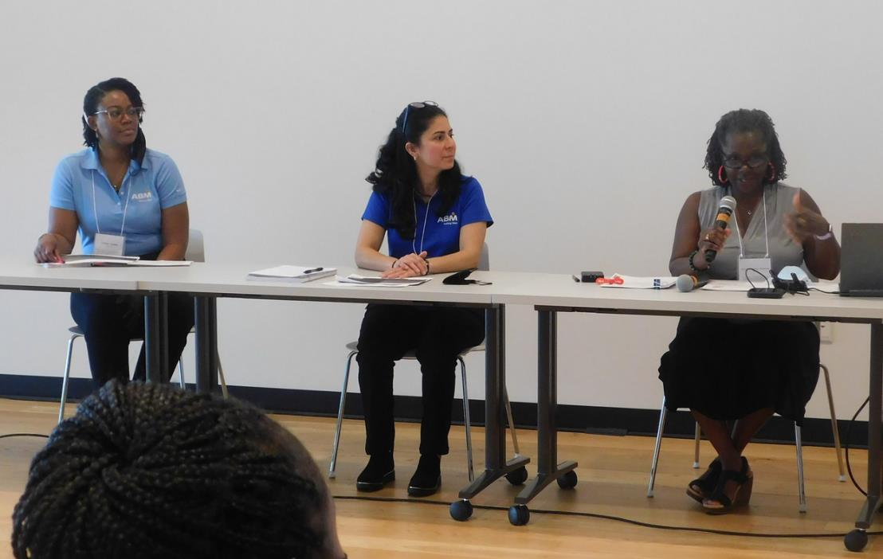
Panels
1
Partnerships Reimagined: What Resources and Partnerships Do We Have and What Do We Need?
2
Taking Charge of Your Job Search: The Critical Role of Self-Advocacy and Family Involvement
3
Engaging Diverse Communities Through Innovation and Engagement
4
Customizing Employment: Strategies to Promote Employment for Youth and Adults
Notes:
After which we asked people to make notes on initial reactions:
-What did you hear that energized and inspired you?
-What challenges come to mind that would need to be addressed?

Slide 6
PARTNERSHIPS REIMAGINED
RSA SERVICES
CURRENT PARTNERHSHIPS
ABM INDUSTRIES
RSA Overview
Programs and Resources
DC Government Agencies
Employers
CVS
United Health
Walgreens
US Dept. of Transportation
Hired 16 RSA Clients to date
Career Days
Employer Spotlights
Mock Interviews
Notes:
Sylvia Baily Charles, DDS's Business Relations Specialist gave brief overview of RSA services and resources. She then discussed existing partnerships with DC government and DC employers with include both private industry and the Federal Government.
Irene Iyamu and Karen Gamez from ABM talked about their partnership with RSA including how they have have helped recruit people with disabilities by.. (read the slide)

Slide 7
TAKING CHARGE OF YOUR JOB SEARCH
JOB SEEKER STORIES
JOB CORPS
NATIONAL FED. OF THE BLIND
Carlos Zacarias
Dajan Chambers Purvis
Juanita Wells
Training and apprenticeship program
Interpersonal skill training
Job Placement
Training and Education
Advocacy
Technology
Notes:
Shontae Waldrip (Vocational Counselor)-RSA hosted the panel.
-Khalid Muhammad from Job Cops discussed thei

Slide 8
ENGAGING DIVERSE COMMUNITIES
ETHIOPIAN AND ERITREAN COMMUNITY
OUTREACH:LATINX
BUILDING TRUST
Hosting an annual conference
Increase participation in VR
Expanding relationship and engagement
Ethiopian and Eritrean Special Needs Community
Information sharing
Advocacy
Volunteer
Follow through on commitments
Local events and info sessions
Notes:
Mark Agosto and Alison Whyte discussed their work the the Latinex Community. Azeb Adere shared her experience as a board member coordinating family supports as part of Ethiopian and Eritrean Special Need Community.
The panel asked participants to think about who was missing from the conversation and is not trying to access services. They discuss the ideas of be present in the community as a starting point for building trust which will take time and consistency.

Slide 9
CUSTOMIZED EMPLOYMENT
BENEFITS
DDS AND CE
DISCOVERY
DC Learners and Earners
People Planning Together
Guided Group Discovery
DSP Academy
ACRE Training
Focus on Tasks, Not Job Title
Connects Who Job Seeker is with Where Employment Could Be
Creates a Vision Based on Person
Economic Security
Health Benefits
Valued Social Role
Relationship Opportunities
Notes:
Rebecca Salon and Chandra Connolly Discussed Customized Employment and current CE projects.
**Rebecca's slide**
-Makes the connection between “who is the jobseeker” to “where” employment could occur
-Creates a vision of where the job seeker might be at their best in a work setting
Based on Discovery information, identifies an individual’s conditions for employment, individual preferences. potential contributions, possible career fields and vocational themes
Focuses on tasks to be performed, not job titles
Focuses on achieving employment, not about whether or not the person can work

Slide 10
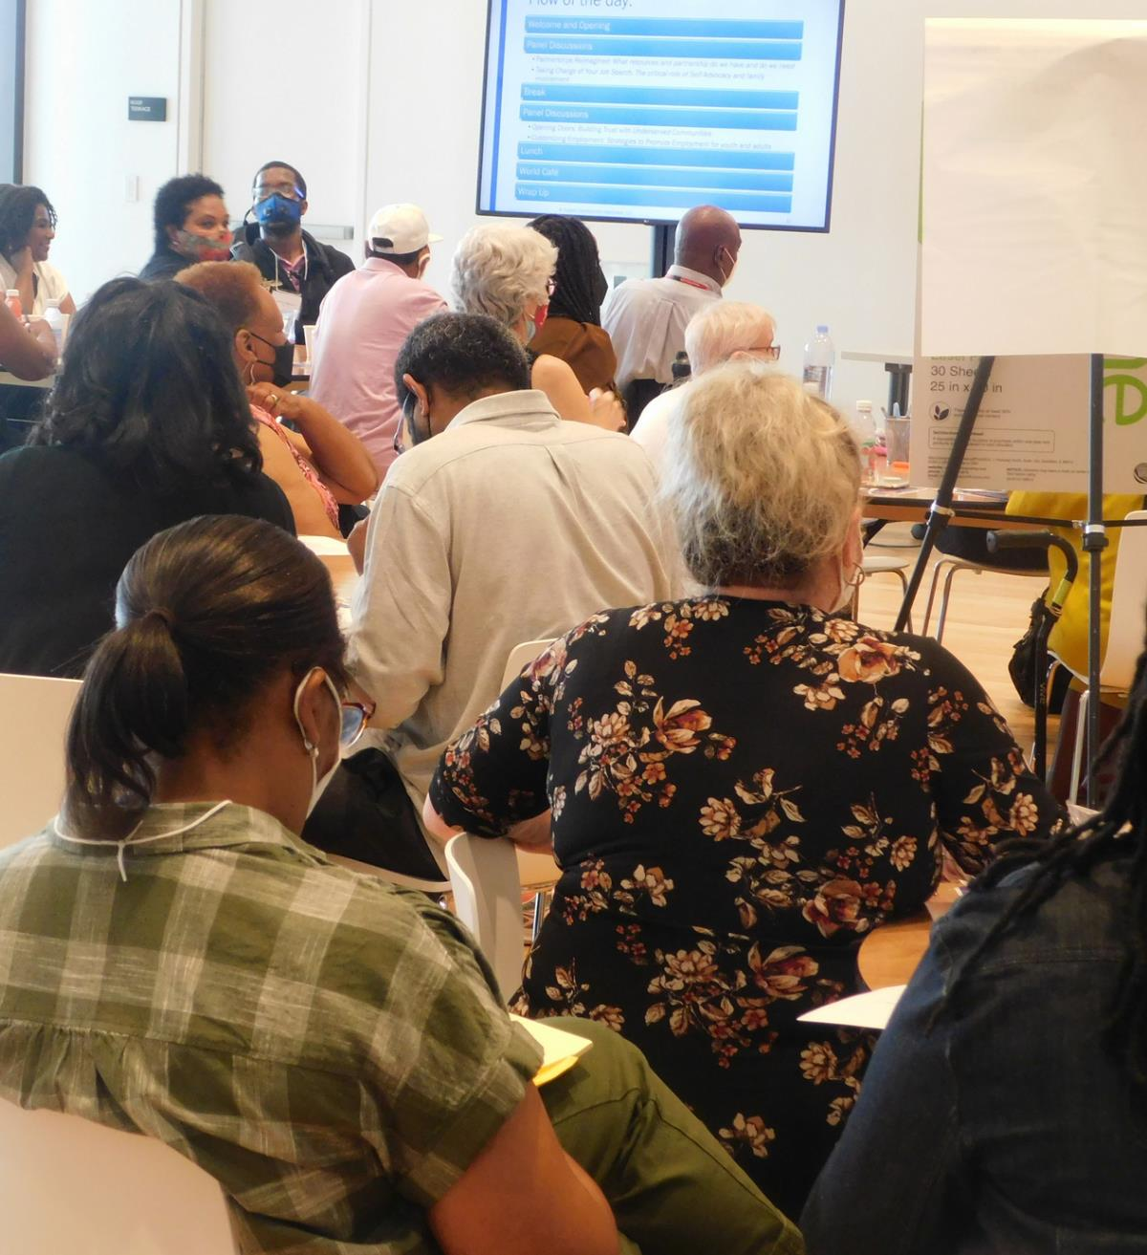
CAFE
FOUR ROUNDS
EVERYONE DISCUSSES EACH TOPIC
DECIDE BY CONCENSUS ON TOP 3 RECOMMENDATIONS
Notes:
Intentional table selection-making sure diverse perspectives were talking to each other
Examples of questions we asked-
We asked participants to discuss:
-Who is missing from the conversation
-What is needed to build trust so that they are part of the conversation
-What must be done so people are connected to careers and career pathways?
-How does customized employment help us define employment for all?
-How do we empower people with disabilities to share their strengths and contributions with employers?

Slide 11
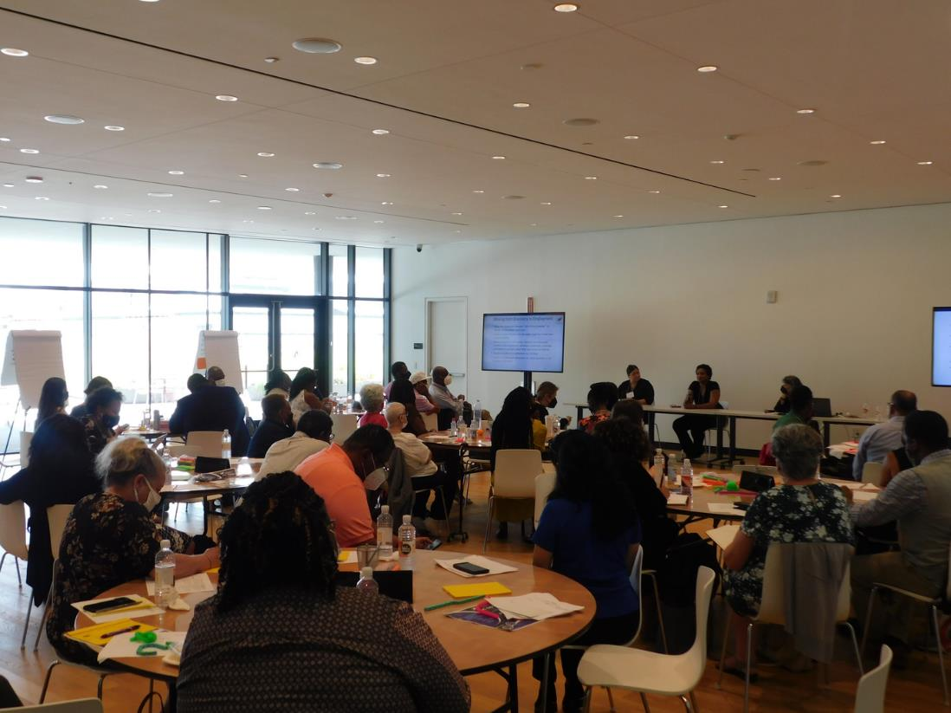
INITIAL ANALYSIS
Notes:
~There was a lot of overlap from the recommendations; we developed themes –Catherine will discuss the themes as well as possible recommendations for next steps. Are there any questions?
-We appreciate all of the thoughtful input and energy that those who participated in the World Cafe put into
-We collected a lot of information and are still digesting it and considering follow up goals and actions
-The following are themes from the recommendations during the cafe rounds that crossed topic areas.

Slide 12
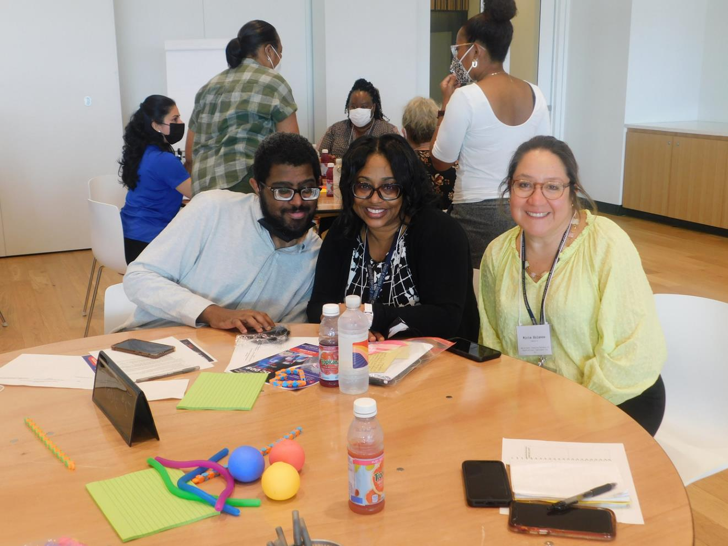
THEMES 1
OPPORTUNITIES FOR DISCOVERY AND CAREER EXPLORATION
Notes:
-Participants recommended working with youth and job seekers who do not have a work history to identify strengths and skills starting with independent living and personality. Youth and Adults with disabilities should have many opportunities and experiences to help the expand their skills and determine which environments and tasks work well for them. Cafe Participants also emphasized to need to review skills and experiences the person has gained on a regular basis and potentially review their career trajectory is their priorities have changed.

Slide 13
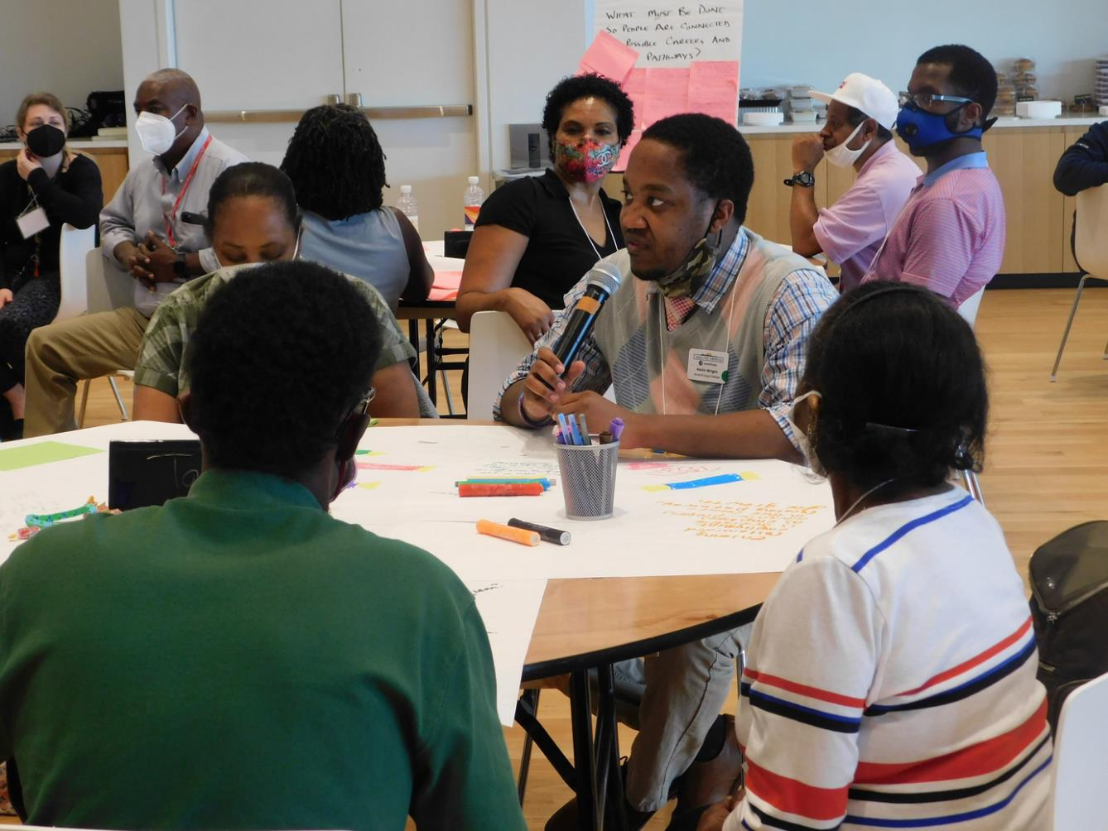
THEMES 2
TALK ABOUT EMPLOYMENT EARLIER AND OFTEN
Notes:
-Young people should have opportunities for discovery and career exploration as early as elementary school
-We need to engage with parents early talk about success stories of young adults with similar backgrounds to the target audience.
-One of my favioriate quotes, that became a recommendation that we need to be encourging children with disabilities to "dream big" including participation in events like career days
-This includes making sure that we are engaging diverse communities and schools in these conversations and this work.

Slide 14
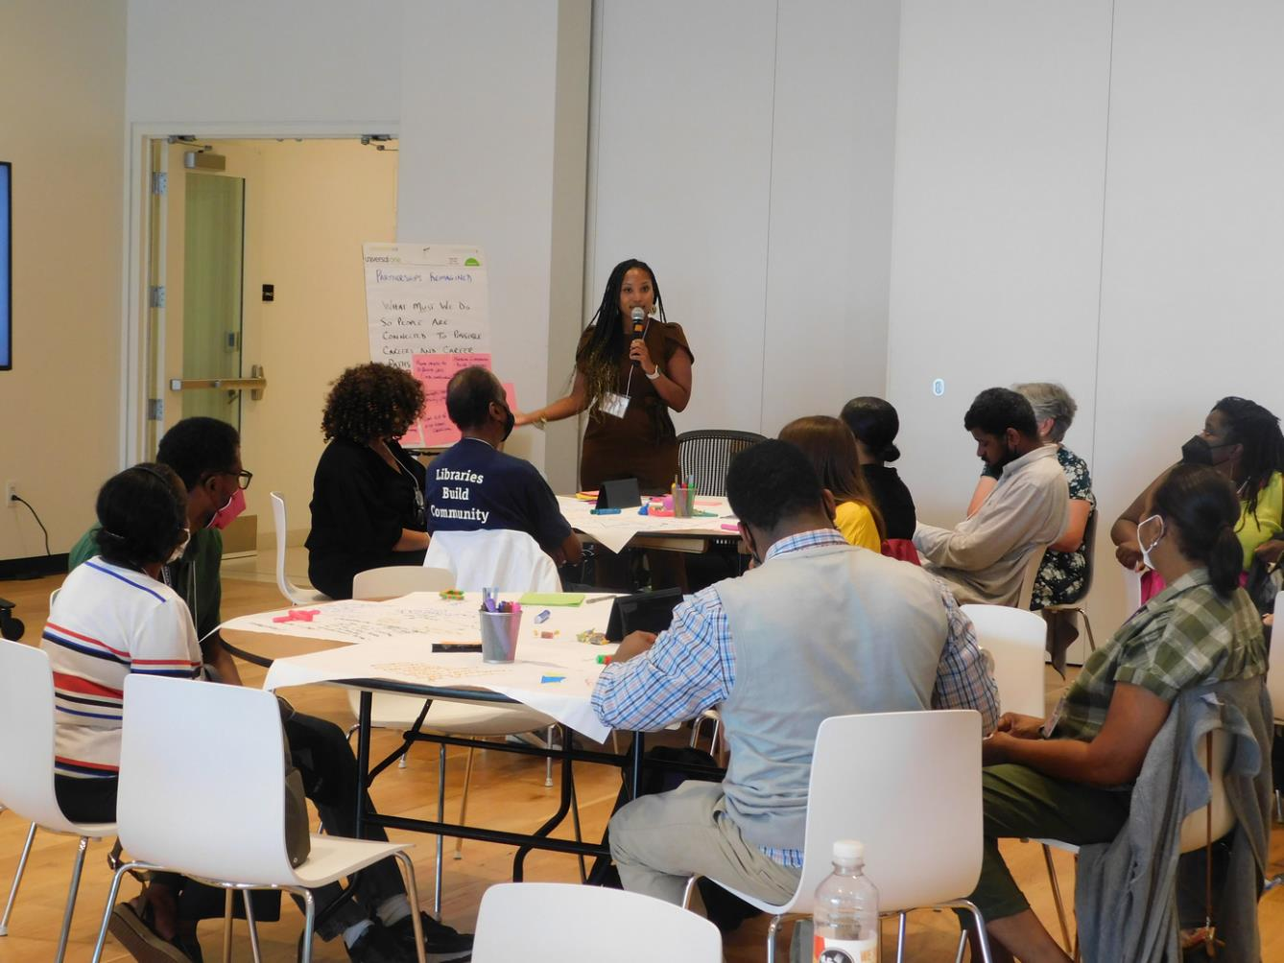
THEMES 3
CONNECTING WITH EMPLOYERS AND MARKETING INDIVIDUAL STRENGTHS
Notes:
Examples of recommendation under this theme were-Discussions about making the business case for Customized Employment and talking about success stories from the employer's perspective.
-Making sure that people have opportunities to practice activities like filling out applications and interview skills so that they can feel comfortable and confident when interacting with employers
-Thinking about non traditional ways like video resumes to demonstrate skills to potential employers
-Helping people think about their personal or family network to for making connections with employers as well as partnerships that DC Government has.

Slide 15
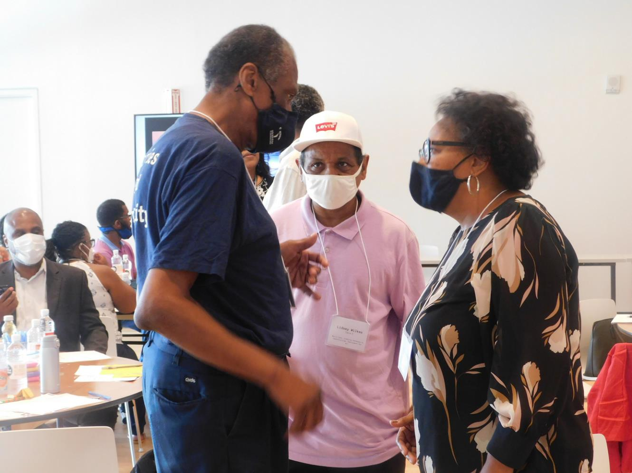
THEMES 4
OPPORTUNITIES FOR MENTORSHIP
Notes:
-One of the other things that stood out was a recommendation that came from two job seeker at the table I facilitated. One person said, "I know how to do a lot of things and I could help teach another person how to do those things too". We heard recommendations about helping people make connections to self advocacy groups be part of a supportive community and gain opportunities to connect with mentors who could help them build self advocacy skills and confidence.
-Additionally we heard recommendations about about more formalized mentorships for job seekers as well as mentorship on the job to help support the individual.
-

Slide 16
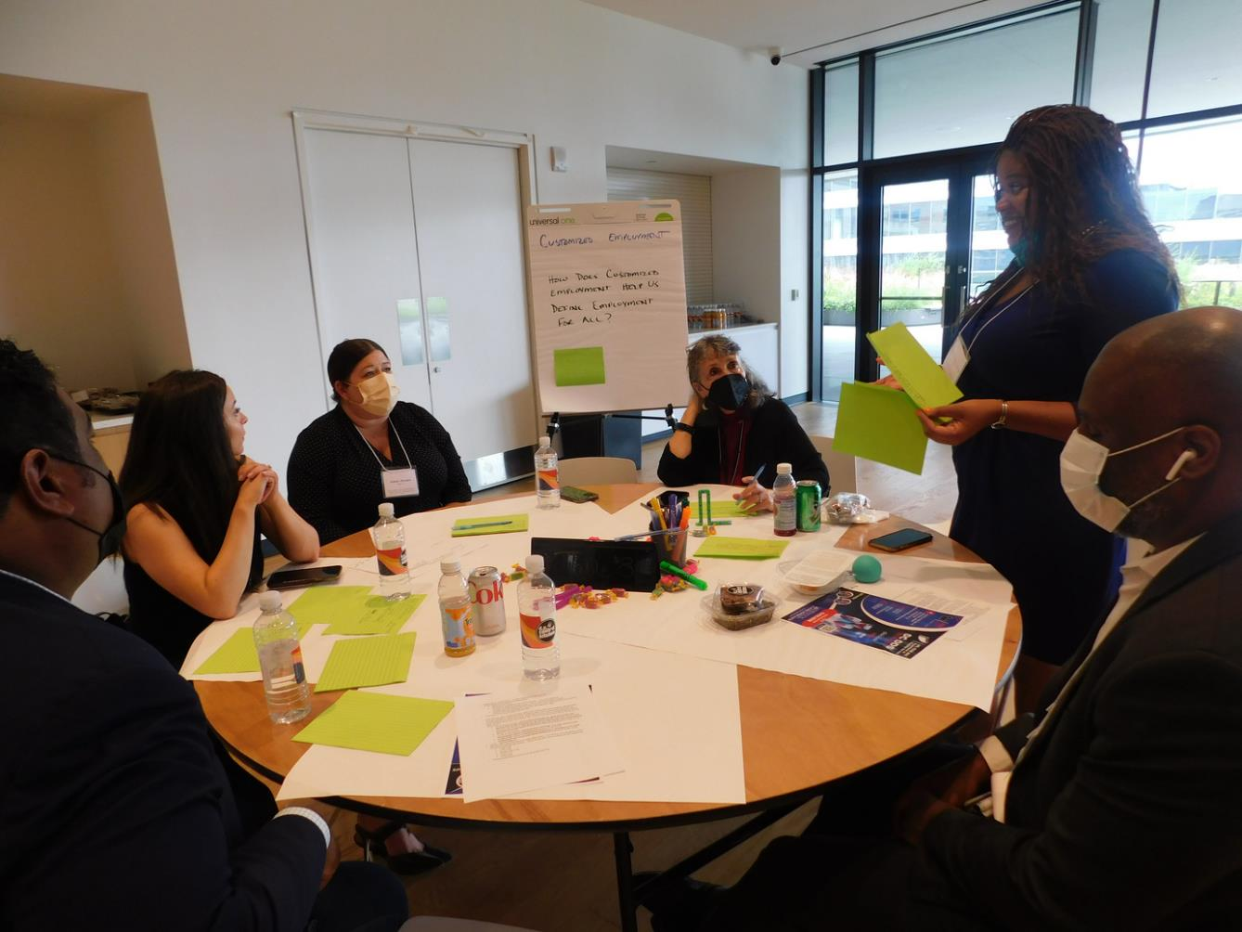
THEMES 5
USE TECHNOLOGY TO SUPPORT EMPLOYMENT
Notes:
I will note that this recommendation came before a great Tech Fest a couple of weeks ago where people got the opportunity to engage with assistive technology. Participants at the World Cafe discussed ideas to use tech for assessments, to assist with completing tasks on the job. They generally recommended using technology to support people in getting and keeping employment.

Slide 17
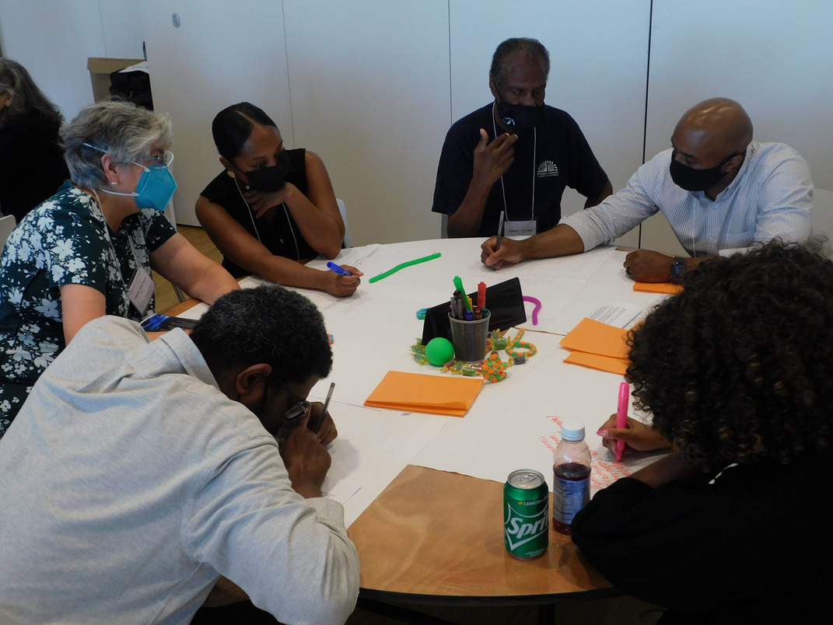
THEMES 6
MAKE DC GOVERNMENT A MODEL EMPLOYER
Notes:
Whether this is in hiring practices, work place cultures, or customization our Cafe participants recommended that the DC Government should start with ourselves and be able to speak from experience as an employer if we are asking other employers to change their practices to be more inclusive.

Slide 18
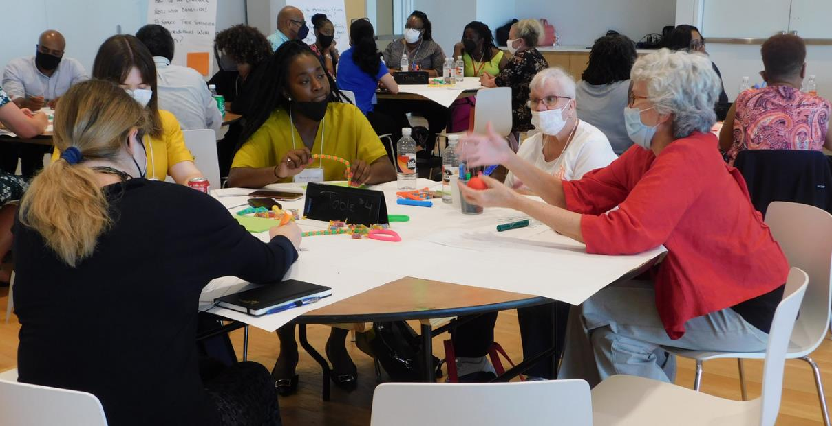
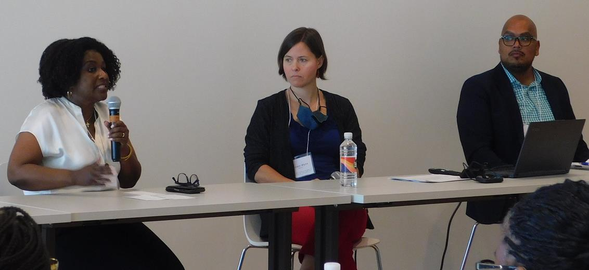
POSSIBLE AREAS FOR GOAL DEVELOPMENT
Consider increase some initiatives currently in practice
Increase Outreach and Communication
Notes:
1)We do have partners and partnerships with people doing some great work so we many need expand some these. For example, Guided Group Discovery
and People Planning Together**Rebecca/Crystal anything else to highlight for expansion?
2) We also heard that people may not know about all of the resources and opportunities available we may be looking a different ways of getting resources and information into all 8 Wards and ensure that it is accessible to diverse communities.

Slide 19
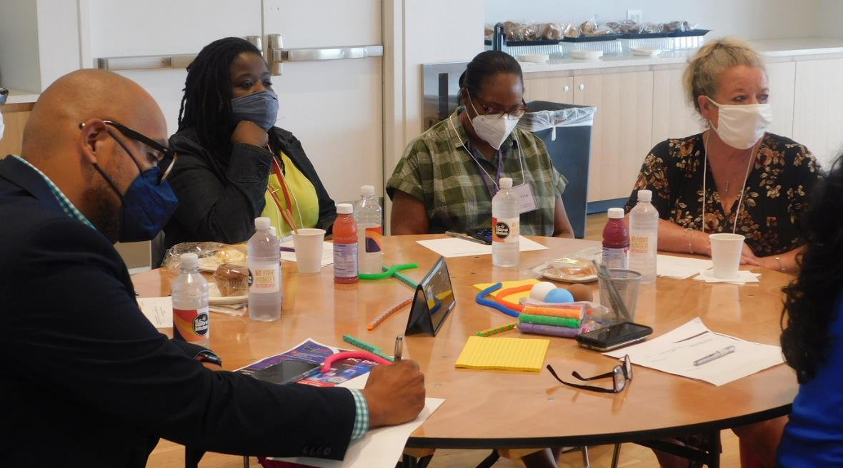
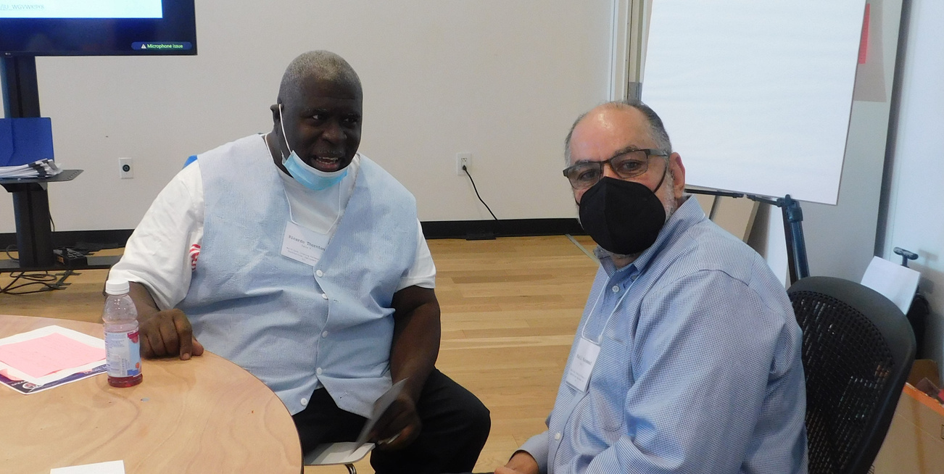
POSSIBLE AREAS FOR GOAL DEVELOPMENT 2
COORDINATION WITH PARTNER ORGANIZATIONS
TRAINING AND INFORMED CHOICE
Notes:
We will be looking at partnerships and coordination of supports that are going well and think about ways to expand those. We are certainly investigating new resources and partnerships that may address the recommendations.
2)Similarly we are considering ways to help people develop job search skills as well as specific job skills that help them meet the needs of employers. We also are considering how to make sure that all people get information about career pathways and training opportunities so that they can make informed decisions about the career they want to pursue

Slide 20
Next Steps
1
WRITE A REPORT ON CAFE RECOMMENDATIONS
2
ENGAGE STRATEGIC PARTNERS
3
DEVELOP GOALS TO ADDRESS WORLD CAFE PRIORITIES
4
PRESENT REPORT AND GOALS
Notes:
2) to consider potential projects or activities that would address the recommendation.
3) With our partners, we will develop specific goals and action steps to address the priorities
4) Be back in front of this group and others to present the full report and follow up goals and action steps.
Again we appreciate the feedback from our cafe participants and look forward to continuing to work with toward the goal of employment for all.

Slide 21
Questions?
Crystal Thomas
crystal.thomas2@dc.gov
Catherine Rinehart Mello
catherine.rinehartmello@dc.gov
NEIL
TRAN
Content
Department

