Slide 1
Individualized Day Supports: Supporting a Successful Launch of this New Service
DC DDA Webinar for Providers and DDA Staff
May 27, 2014

Slide 2
Welcome
After today, we will be transitioning from webinars to monthly Community of Practice teleconferences
Future CoP teleconferences will be the third Friday of every month, from 10:00am to 12:00pm.
Please save these dates and ensure other key staff also have these dates

Slide 3
Important Updates from DDA
The FAQ has been updated – questions from March training day have been answered
Visit DDA’s dedicated webpage for IDS
http://dds.dc.gov/page/individualized-day-supports-toolkit

Slide 4
On-Going Community Integration Plan
Due 30 calendar days after service start date
Transmit via email to DDA Service Coordinator
Service Coordinator will review, verify completeness and upload CIP into MCIS
Form introduced today must be used by all IDS providers

Slide 5
On-Going Community Integration Plan
If you have passed the 30 calendar day deadline for someone you are already delivering IDS to, you have 7 calendar days from today (May 27) to submit the On-Going Community Integration Plan

Slide 6
On-Going Community Integration Plan
Updated On-Going CIP should be transmitted to the Service Coordinator via email whenever:
A significant change(s) is made to the CIP
Otherwise quarterly, along with the quarterly report
DDA expects more frequent changes will be made during the first quarter/year of service, as you get to know the person and the community opportunities that are the best fit for the person

Slide 7
Making Changes to the On-Going CIP
Always document in notes any changes that are made to the On-Going CIP and why.
Always document in notes any deviations to the schedule in the On-Going CIP and reasons for this.
Only a significant change(s) requires the IDS provider to submit the updated On-Going CIP to the Service Coordinator via email

Slide 8
What counts as a “Significant” Change?
A person’s IDS authorization is changed – increased or reduced
A person’s goal(s) change which results in a change in activities and the related skill goals for those activities
A person’s schedule of activities is significantly changed

Slide 9
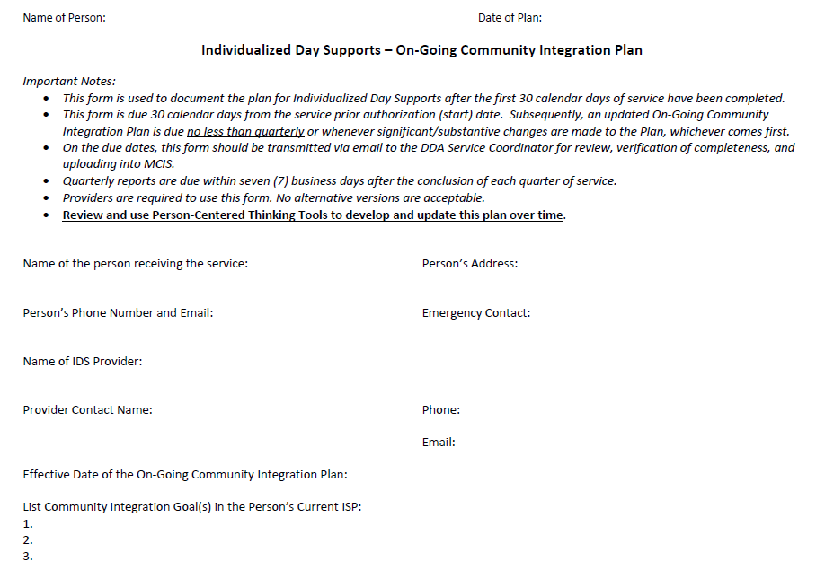
Page One

Slide 10
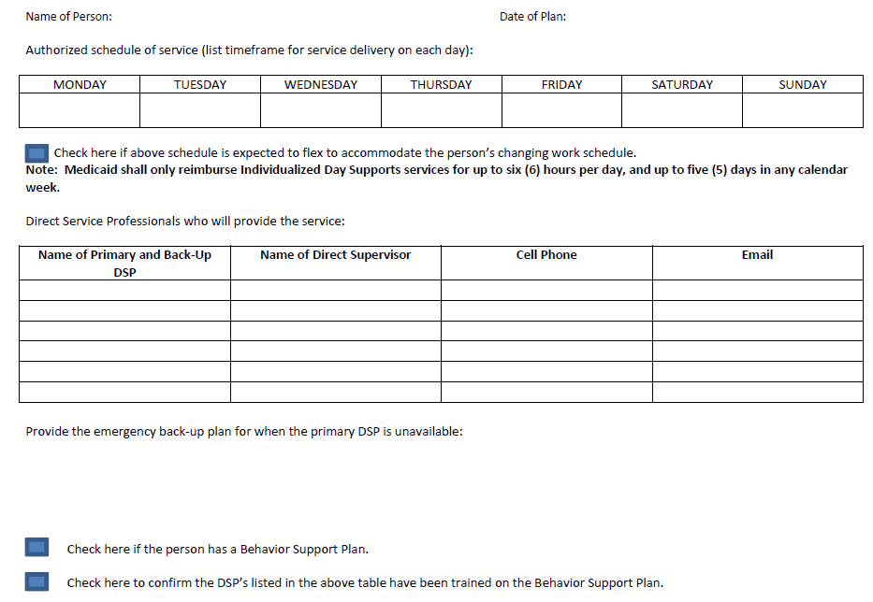
Page Two

Slide 11
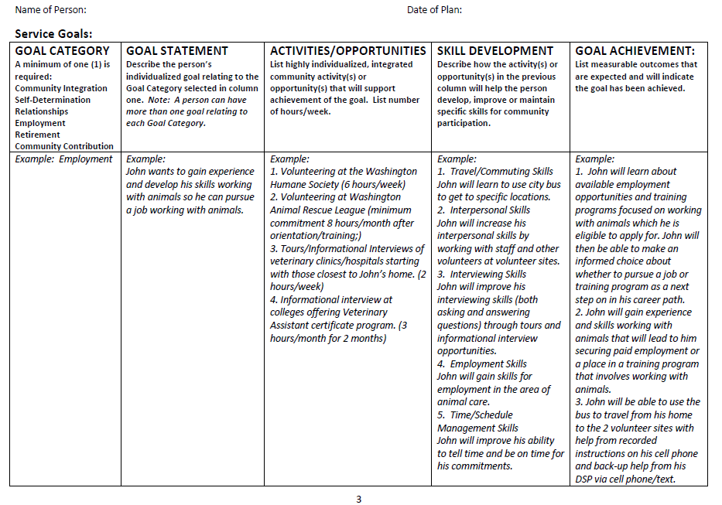
Page Three

Slide 12
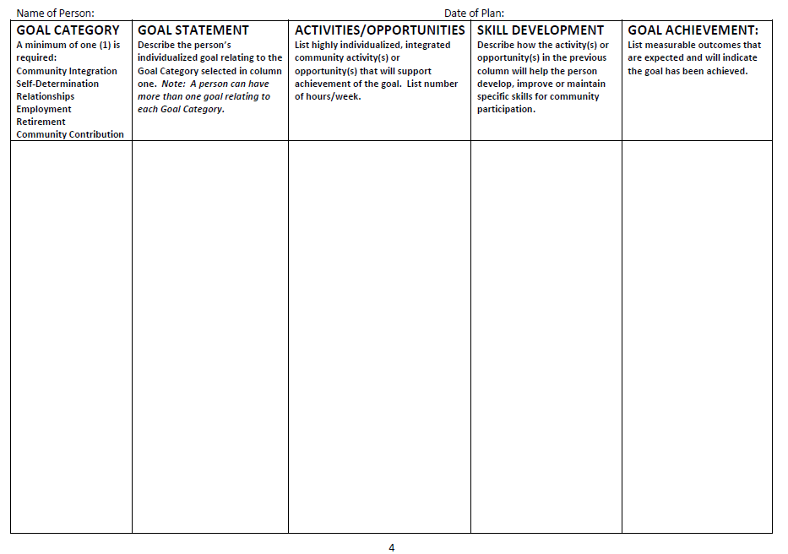
Page Four

Slide 13
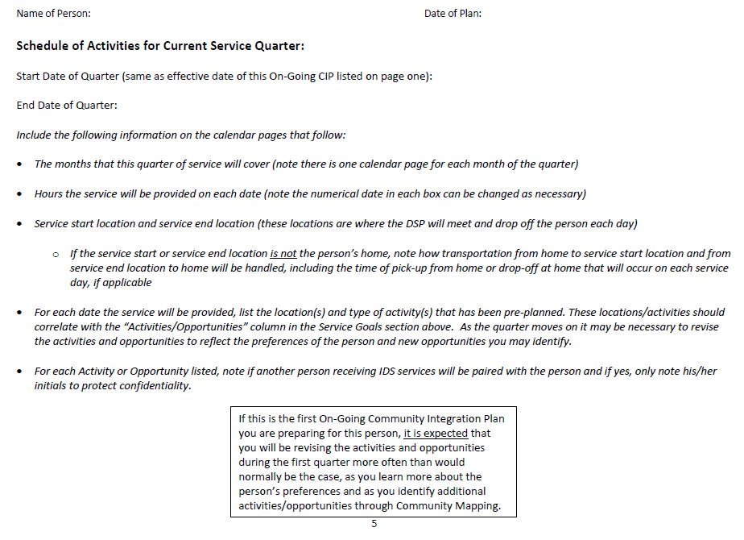
Page Five

Slide 14
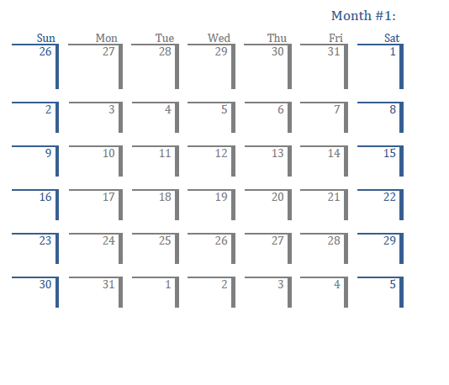
Pages 6-7-8

Slide 15
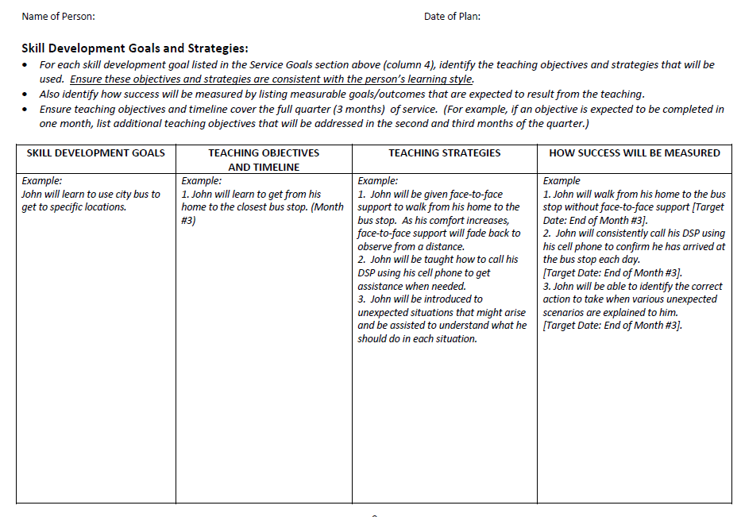
Page 9

Slide 16
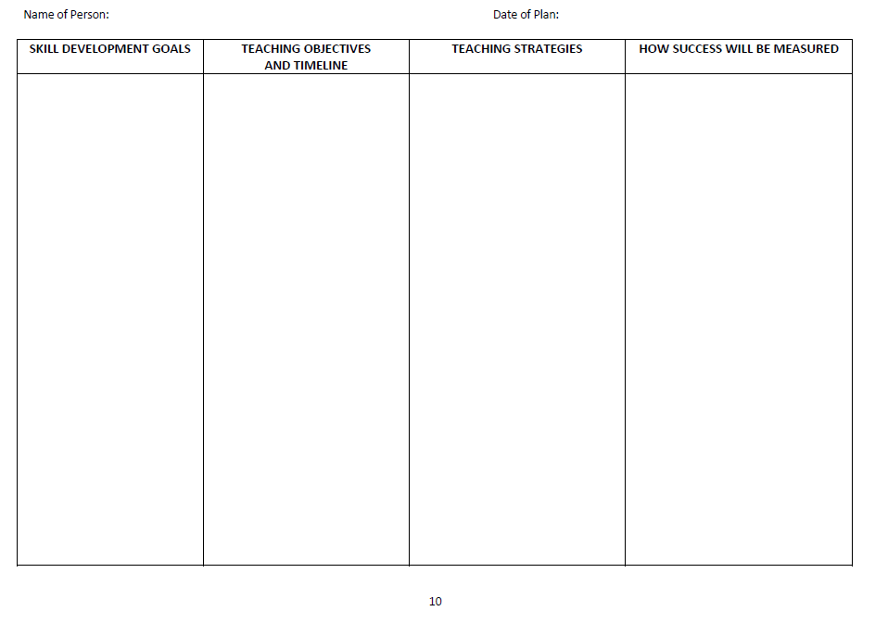
Page 10

Slide 17
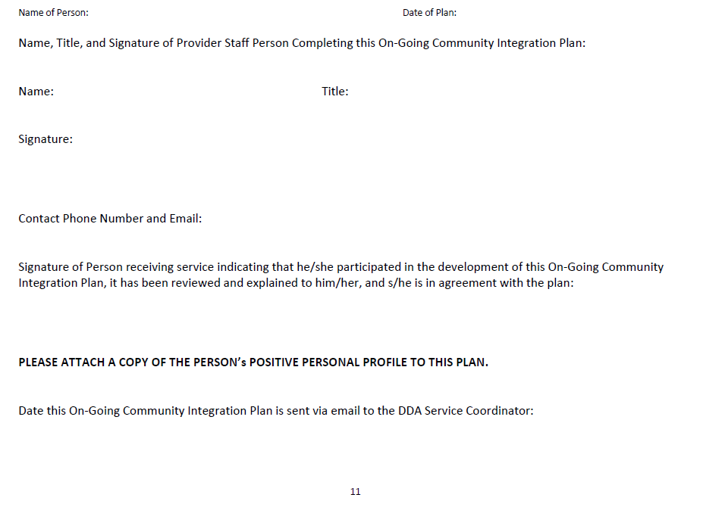
Page 11

Slide 18
Join Us for CoP Monthly Calls
Future CoP teleconferences will be the third Friday of every month, from 10:00am to 12:00pm.
Please save these dates and ensure other key staff also have these dates
Next CoP Call is Friday, June 20, 2014
10:00am to 12:00pm
Please suggest topics that you’d like to discuss by emailing Genni Sasnett gsasnett@hotmail.com

