Slide 1
My Vision for Myself on a Human Rights Committee
by: Steven Powe
Toolkit for Serving on a Human Rights Committee by Steven Powe (May 2018)

Slide 2
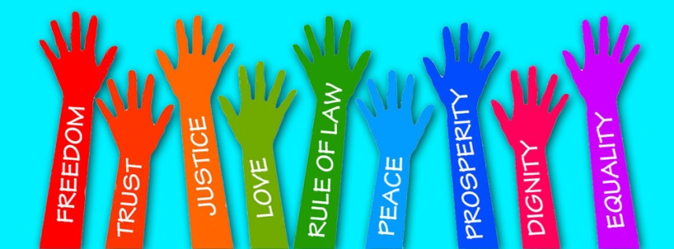
Icebreaker: 3 Questions
What is your name?
What is your favorite color?
What human rights are most important to you?
Notes:
3 Questions: What is your name? What is your favorite color?
What human rights are most important to you?
(examples might include: voting, dating, controlling your own money, employment, marriage)

Slide 3
This Training Will . . .
Help you share why you want to be on a Human Rights Committee.
Help you say what supports you need to serve on a Human Rights Committee.
Set goals for being a strong advocate on a Human Rights Committee to make sure people’s rights are protected.

Slide 4
Questions to Think About:
Have you ever been to a meeting where you didn’t say anything?
Did you ever wish you had support so that you could speak up?
Notes:
Have you ever been to a meeting where you didn’t say anything or no one listened to you?
It doesn’t feel too good, does it? You should have the power to say what is right for you… no one else should decide what is right for you.

Slide 5
Why is it important for people with I/DD to be advocates on Human Rights Committees?
To let their voice be heard
Learn how to advocate for themselves and others
Good experience!
Learn new things
Important to know your rights

Slide 6
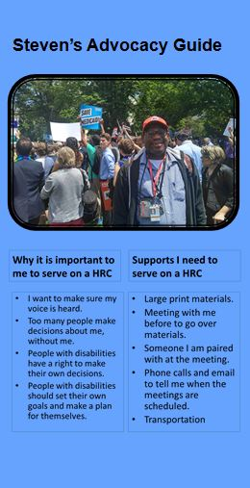
Why develop a guide for serving on a Human Rights Committee for yourself?
To develop a better understanding of human rights and how to protect them.
To create a vision for yourself as a Human Rights Committee member.
To help others understand how to support you as a Human Rights Committee member.
Notes:
This is a new training and something we are proud to be doing here.

Slide 7
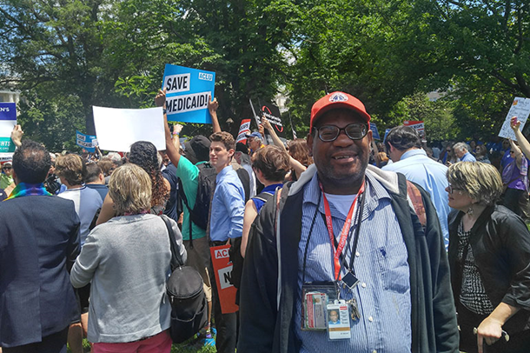
My Information: You know you best
Ask Yourself:
Why do I want to be on a Human Rights Committee?
Who can help?
What steps can I take to get me there?
What don’t I want?

Slide 8
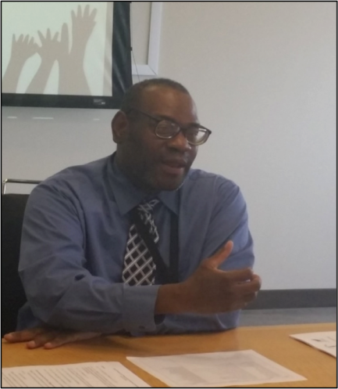
Why is it important to ME to serve on a Human Rights Committee?
I want to make sure my voice is heard.
Too many people make decisions about me, without me.
People with disabilities have the right to make their own decisions.
People with disabilities should set their own goals and make a plan for themselves.

Slide 9
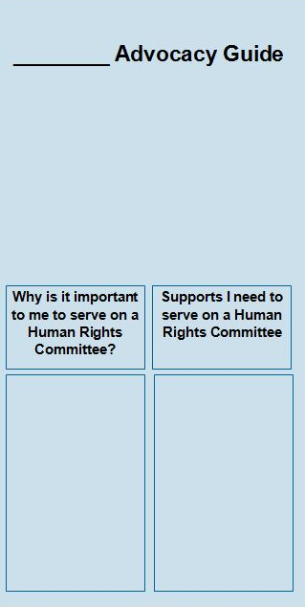
What about you??
Front Page of Guide
Notes:
On the front page of the guide I handed out there is a box that says “Why is it important to me to serve on a Human Rights Committee?”. Think about why it is important to you to serve on a Human rights Committee and write them down in the box below. Those things may be like you want your voice to be heard, you want to learn more about rights, you want to help protect people’s rights, or others. This is your guide, so add whatever is important to you. Does anyone need any help thinking about what to write?

Slide 10
Supports I need to serve on a Human Rights Committee
Large print materials.
Meeting with me before to go over materials.
Someone I am paired with at the meeting.
Phone calls and email to tell me when the meetings are scheduled.
Transportation
Notes:
These are some of the supports I (Steven) need to serve on a Human Rights Committee. You may need similar supports or different supports.

Slide 11
What about you??
Front Page of Guide
Notes:
On the front page of the guide next to where you wrote now why it is important to you to serve on a Human Rights Committee, you can write down supports you need to serve on a Human Rights Committee. Some of those supports could be transportation, help reading or learning about the materials, large print or sign language. Can you think of other support you may need to be a successful Human Rights Committee members.

Slide 12
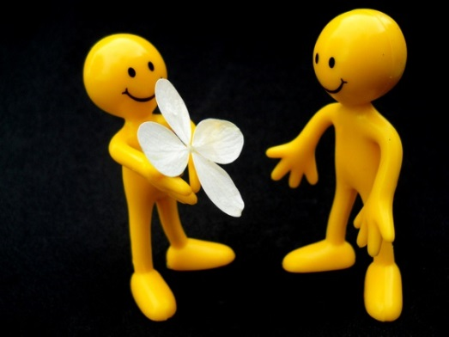
ACTIVITY Why You Would Be a Great Human Rights Committee Member
Caring
Good Thinker
Leader
Friendly
Public Speaker
Good Listener
Notes:
Now we are going to do an exercise, get up and moving. Think about reasons you would be a great Human Rights Committee member. These things may include: good listener, advocate, friendly, take up for other people, leader, smart, kind, good speaker, innovative, creative, etc.

Slide 13
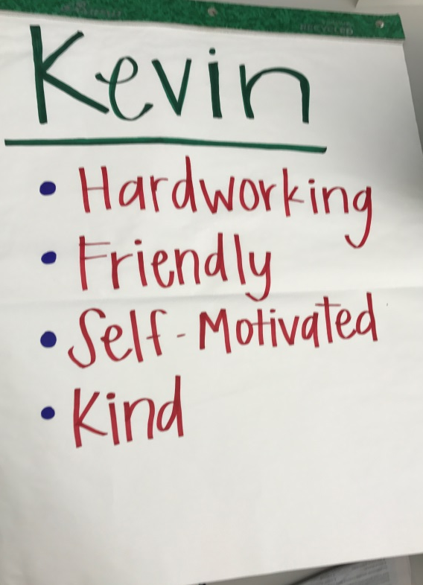
Instructions
Part 1:
Use the paper at your table
Write your name on top of the paper
Write 3 things about yourself that would make you a good Human Rights Committee member
Notes:
1. Get a piece of paper and a marker. Write your name at the top like here in the slide. I will help you if you need it.
2. Write 3 things about yourself that would make you a good Human Rights Committee member. This may be hard for some of you since others may have told you not to brag and talk about yourselves. It’s time to let go and brag about the things that you are proud of!
3. Go ahead and write the 3 things on your paper. I will give you a few minutes.

Slide 14
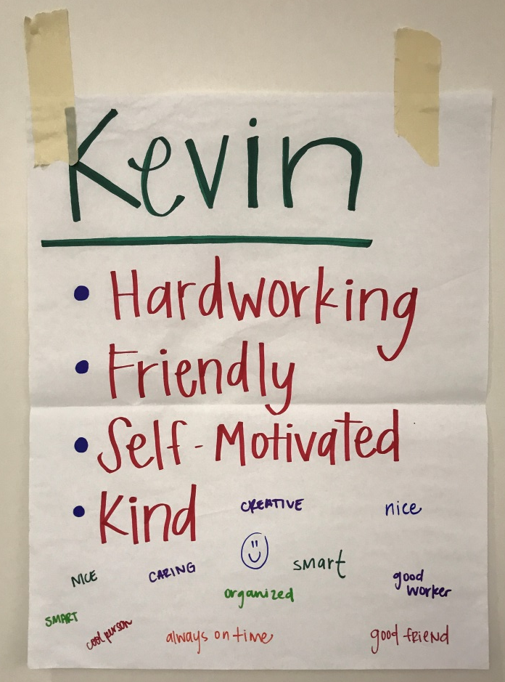
Part 2:
Tape your paper to the wall
Walk around and write on each person’s paper
Write at least one reason why they would be a good Human Rights Committee member
Notes:
4. The next part of this activity I would like for everyone to tape their paper to the wall and stand next to it.
I want everyone to go around to other people’s pieces of paper and add things that they like about that person and one reason why they would be a good Human rights Committee member.
This will be easy if you know each other. If you don’t, just look around and think of something nice to say even though you don’t know them very well or at all. Please do not add anything that is too personal or not nice about the person. Keep it positive. I will give you all a few minutes to do this. Go ahead and get started.

Slide 15
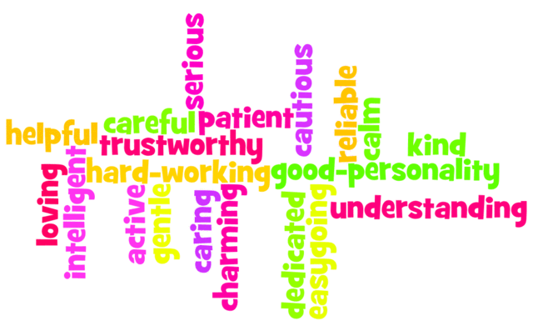
Share and Debrief
Are there things that you are proud of?
Are there things you saw in others you would want to work on for yourself?
What goals would you make for yourself?
Notes:
OK, could everyone please go and stand in front of their own paper? Read all the good things people said about you. What do you think about what is written about you?
Sometimes we find it hard to believe nice things people say about us. We can be really hard on ourselves.
Sometimes we focus on things that we don’t like about ourselves. We all have great things about us. We should stop and listen to people’s compliments and accept them.
Are there things you saw in others you would want to work on for yourself? Think of those things and make goals for yourself to learn about those different things. For example, if you saw that someone was a good public speaker, and that is something you need to work on. Set that as one of your goals and make steps to become a better public speaker.

Slide 16
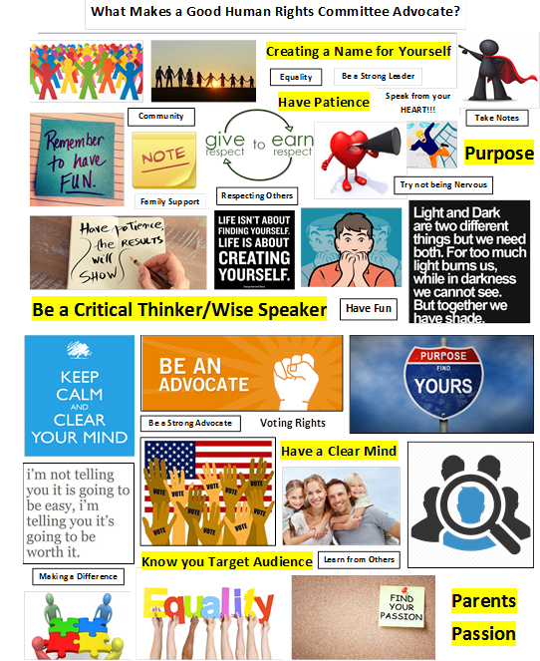
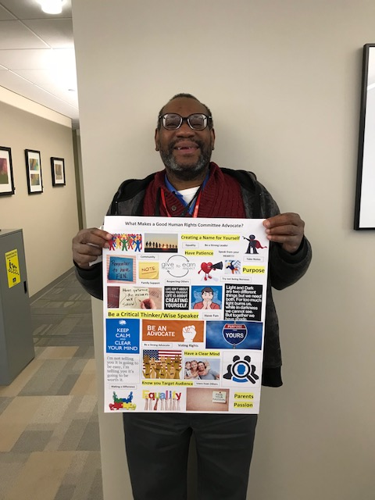
Human Rights that are Important to Me
Notes:
We are now going to work on your list of the human rights that are most important to you.
As you identify what are the most important rights to protect for other people you can create a vision board to show all the rights that are important to you:
My vision board includes….

Slide 17
ACTIVITY Make Your Own Vision Board
What rights are most important for you to protect?
Cut out pictures or draw/write your own
Glue or Tape them to the back of your guide
Share your vision board
Notes:
I am going to hand out two sheets of paper with pictures of different rights. Cut out the ones that are important to you and glue them to a blank piece of paper. Some of those rights are:
Living in the community
Access to money
Voting
Having a girlfriend or boyfriend/ get married
Travel
You can also Write/ Draw Your Own

Slide 18
Notes:
The next activity we are going to do is create a trajectory or road map. This is where we can map our vision and the steps we can take to get us towards our goals. I’ll go through mine and then I will see if there are any questions.

Slide 19
Inside of Guide
Notes:
Now it is your turn. On the inside of your trifold guide there is a blank trajectory or road map. Does anyone have any questions before we get started?
When everyone is finished would someone like to share.

Slide 20
My Values and Beliefs
Mistakes are okay-learn from them
You can protect your own rights and you can protect the rights of others
People with disabilities have the power to change things and make things better for you and others
People can help you but remember that it’s always your decision for what you want to do
Notes:
Values and beliefs go right along with what rights are important to you. Here are some of my values and beliefs.

Slide 21
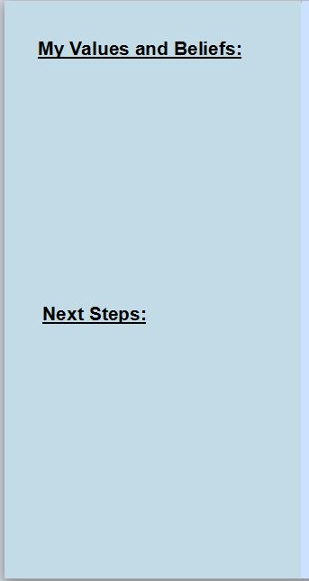
What about you??
Inside Flap of Guide
Notes:
On the inside flap of your trifold guide, there is a place for you to write down your values and beliefs. An example of a value and belief, is the everyone is equal! It is okay if you cannot think of any right now. This is something you can work on later as well.

Slide 22
After the Training: Next Steps
4 ways to use your guide:
Have a plan to learn more about human rights.
Identify a Human Rights Committee to join and apply to be a member
Share with Human Rights Committee chair.
Find a supporter.
22
Notes:
Finally it is time to think about next steps. Think about the next few things you will do with this guide or things you will do to either learn more about rights or help you get on a human rights committee. Some of those ways to use your guide include; sharing it with a human rights committee chair, find someone to help support you, and continue to plan to learn more about human rights.

Slide 23
What are your next steps? How can we continue to support you?
Inside Flap of Guide
Notes:
You can write your next steps on the bottom portion of the inside flap of your guide. If you can give specific on maybe who you want to support you or who you can talk to about being on a human rights committee. Does anyone have any questions or want to share?

Slide 24
Please let us know how we can make this training better! Contact us at Steven Powe at stevenpowe985@yahoo.com or Rebecca Salon rebecca.salon@dc.gov
Notes:
Thank you all so much for coming. If you have any ideas on making this training better take some time to write them down or talk to me before you leave. You can also email Rebecca and I at a later date if you can think of anything.

Slide 25
About My Fellowship
The SARTAC Fellowship is a year-long opportunity for self-advocates to develop and grow their skills as leaders in the self-advocacy movement. Fellows will work with a supporting host organization on policy issues or a project that can help develop their leadership skills.

Slide 26
This training used materials adapted by the DC Department on Disability Services and Project ACTION! from trainings and tools developed by The Learning Community for Person Centered Practices and the University of Missouri Kansas City Institute for Human Development, University Center for Excellence in Developmental Disabilities.
Notes:
Finally I should wanted to acknowledge some organizations that helped me put this training together. If anyone has any further questions, please let me know. Thanks again for coming.

