Slide 1

Service Coordination Activities Public Health Emergency Unwinding
Community Forum
July, 28 2023

Slide 2
Federal Public Health Emergency
Ended May 11, 2023
Flexibility of using Companion will be ending
  Flexibility of Companion remains in effect for 6 months (Until November 11, 2023)

Slide 3
As we approach the end of the PHE, DDS wants people supported to:
  Reconnect with their communities consistent with their identified preferences, choices and assessed needs
  Have a smooth transition to day programs, including Individualized Day or Employment services
  Utilize technology to promote inclusion and self determination

Slide 4
Prior to the Federal Public Health Emergency (PHE)
Companion Services were only included in the ISP after considering appropriateness of other waiver services such as
  Day Habilitation
  Employment Readiness
  Individualized Day
  Supported Employment

Slide 5
End of PHE: What to expect?
Amendments to Individual Support Plans (ISPs):
Service Coordinators are scheduling meetings with people supported and their teams to discuss their return to Day Habilitation, Individualized Day, Employment Readiness, or Supported Employment Services. ISPs will be amended accordingly.
Transition to Full-time Day Programs or Employment Services:
Persons supported and their support team may decide to transition to full-time day and/or employment services immediately or within an alternative timeframe if the duration of Companion Services does not exceed the limits below.
Changes to Companion Services
Full time companion services (5 days per week, 8 hours per day for a maximum of 40 hours per week) will be considered the most integrated setting for the following:
  Retirees
  Persons who previously had five (5) days a week of Companion Services authorized prior to the PHE and wish to continue
  Persons with a documented health or medical reason that prevents them from engaging in other day or employment services.

Slide 6
Schedule and Criteria for Companion Service Authorizations

Slide 7
Notification to Stakeholders
Presentations at Community and Provider Forums on the Unwinding Plan
Presentation at the DDS Provider Fair
Transmittal to DDS Providers
Letters to Families, Advocates, and Guardians of persons supported

Slide 8
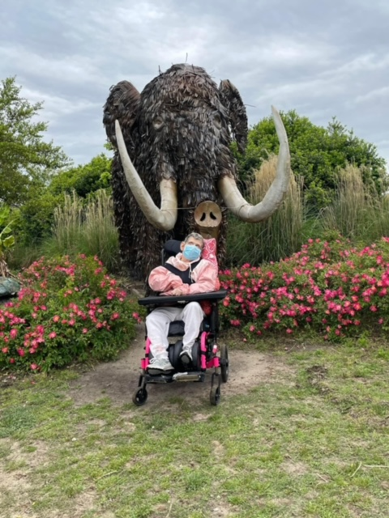
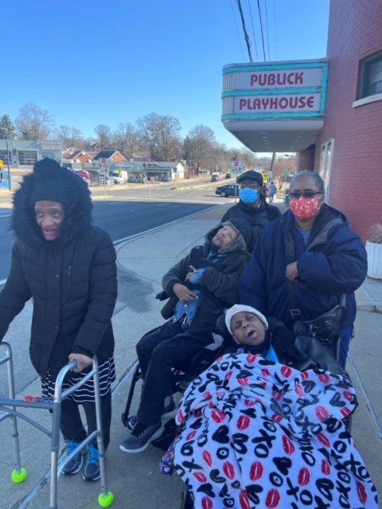
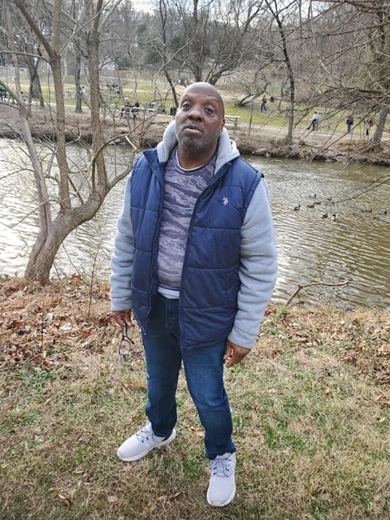
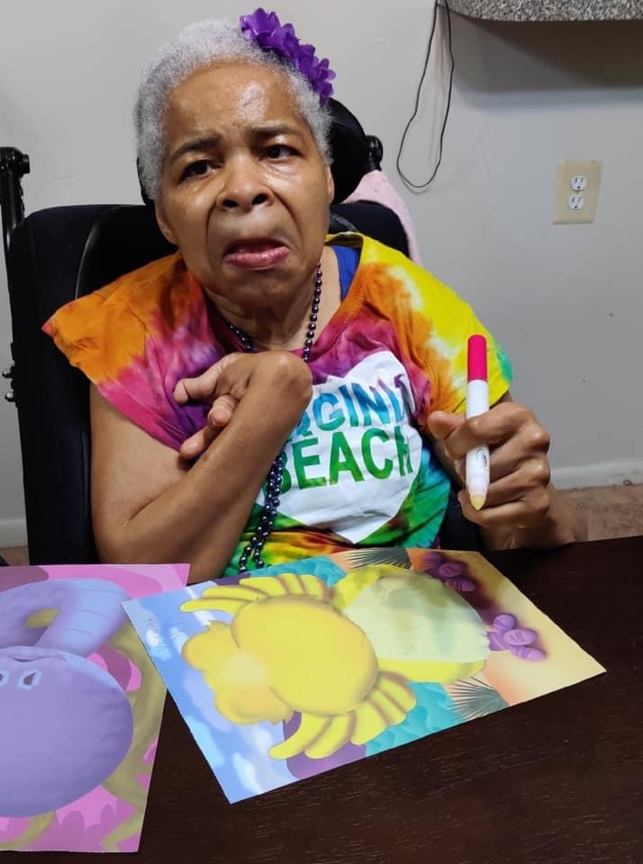
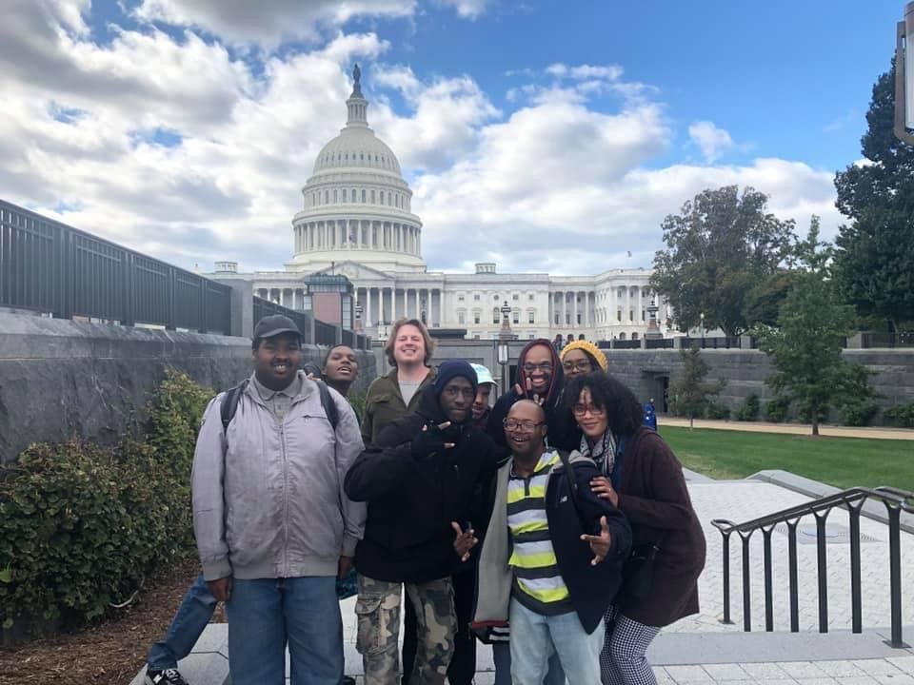

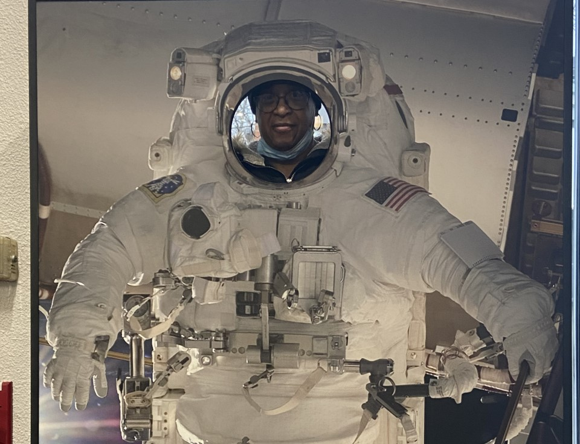
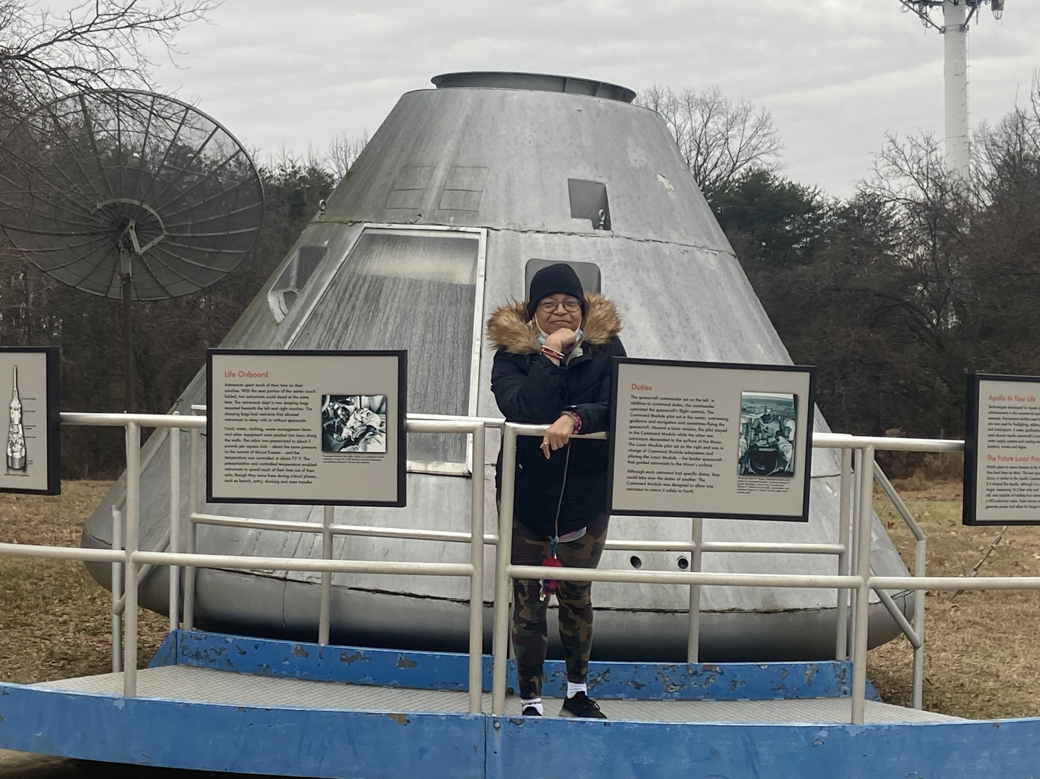
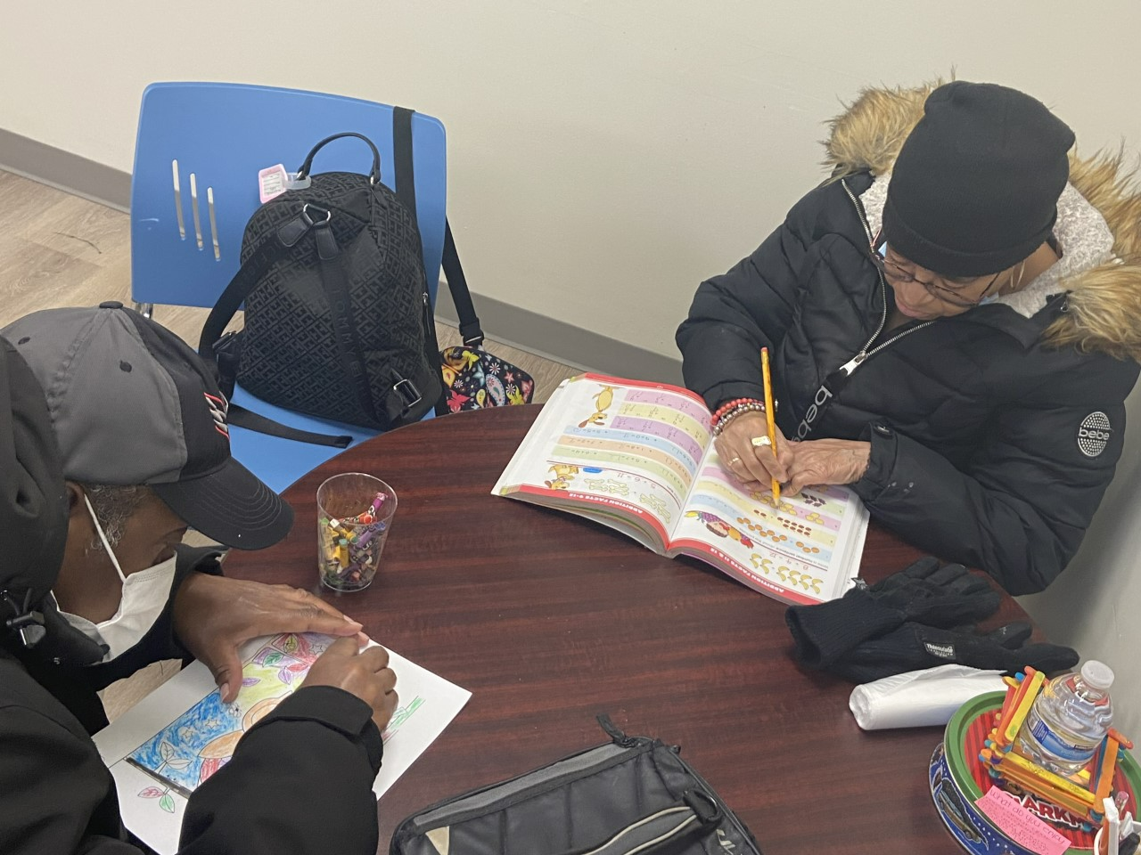

Slide 9


Questions?
If you have case specific questions regarding unwinding from the Public Health Emergency (PHE), please contact your assigned Service Coordinator
or
Assigned Supervisory Service Coordinator or Program Manager: Theresa Burrage, Latryce Hilliard, Charles Manu, Adrienne Dezurn, Patrick Balogun, Joseph Melendez, Tisharra Albright, Carolyn Smith, Kittrell Jones-Williams, Katrina Patterson, Robin Exton, Rhode Bernadel or Musu Fofana

