Slide 1
Traveling Around Your Community
“A guide to teaching people to use their public transportation system”

Slide 2
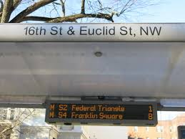
Staff Competency
Before beginning, staff should ensure that they are knowledgeable about:
Stations and coordinating color lines
Bus timing and location
Fare System
Reasonable waiting times
Appropriate entering and exiting
General rules and manners of using Metro Rail system
What to do in case of an emergency
Knowledge of the persons you are servings specific needs

Slide 3
Evaluation
Begin by doing an evaluation of the person being supported!!
What accommodations will the person need if any?
Are their particular environments that the person does not like (i.e. noisiness, horns, crowd etc.) This may be of particular consideration when supporting someone with autism.
Is the person aware of safety signs and procedures (such as crossing the street and obeying crosswalk etc.)

Slide 4
Evaluation
Does the person display behaviors that could pose a danger (i.e. bolting or darting into traffic)? If so is staff trained in the appropriate interventions to assist with public transportation use
Would the person have negative reaction to wind created by advancement of the train as it approaches? If so, are there appropriate interventions to minimize reaction?
Staff should conduct a basic assessment to determine level of support needed to facilitate travel goals and outcomes.
Based on the information obtained and given you will Be able assess where to start with travel training!

Slide 5
Making a selection
Be careful not try to teach too much too fast
Decide:
What mode of transportation you will introduce first
What specific location you will confine training to (too large an area may present problems with retention)
What are the important steps you want the person to master in 90days. (Should be no more than 5-7 steps per 30 days)
How many days a week will you support the person in learning these skills

Slide 6
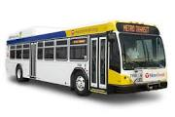
Training Example
Goal: Mr. Doe will use the metro bus to travel in Brookland area of his community independently.
Objective1: Mr. Doe will successfully and independently board and disembark bus from house to Aldi supermarket three days a week over a 90 day training period.
Step 1: Mr. Doe will stand at T18 bus stop and wait for bus to arrive
Step 2: Mr. Doe will board bus upon arrival
Step 3: Mr. Doe will present form of payment to bus driver
Step 4: Mr. Doe will make his way to the nearest empty seat
Step 5: Mr. Doe will ring buzzer just before approaching landmark for Aldi
Step 6: Mr. Doe will appropriately exit the bus at the nearest exit.

Slide 7
The Training Coach
In order to execute the training program on slide 4, the training coach will have to spend time supporting the person to learn the following first:
Nearest T-18 bus stop to home
Safety when stepping up on the bus
How much money will be need for bus or facilitate obtaining metro access or smart trip card
Safety measures when walking from front of bus to a seat (i.e hold on to bars while walking; as the bus moves and stops suddenly)
Landmark leading up to destination
How and when to signal buzzer to stop at the desired location
Identifying which exit to use when disembarking from bus (location of seating)
Safety procedures when stepping off of bus

Slide 8
Next Steps
It is important to ensure the person is really comfortable with executing all the steps in the outlined objective before moving to a new set of skills.
It may have taken 12 months before you get to the point of using the outlined objective on slide 4 because you may spend 30-90 days just supporting the person to identify theT-18 bus stop.
Then another 30-90 days supporting the person to learn bus safety.
DON’T RUSH THE TRAINING AND SUPPORTS

Slide 9
Fading
When you think the person has gotten the hang of things start fading your prompting:
Initially-Lots of Verbal , gestural, or hand of hand supports
After 1-2 weeks-scale back prompts from 10%-50% less based on how fast the person is progressing
After 30 days- scale back prompts from 60%-90 less again depending on the person’s progress
When the person has demonstrated proficiency, supports should be minimized to merely shadowing for one or two trips and providing gentle feedback or reminders before moving to the next objective in the process.

Slide 10
Things to Remember
Be Practical in what objectives you are trying to achieve
Permanent learning is achieved through consistent repetitive instruction
Permanent learning is a build up {one skill achieved building on the next}
Be sure to understand the needs of the person you are supporting this will make your training more practical

Slide 11
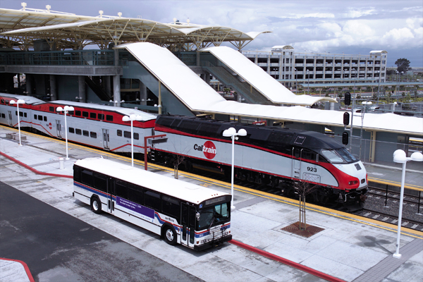
BUS vs TRAIN
Pros of Bus
For people just being introduced to the transit system the bus might be a more practical start as the Metro Bus system utilizes letters and numbers and is more of a straight path from one corridor to the next.
Also the person can see landmarks and commit these landmarks to memory as they are traveling through the city. Another advantage is that bus stops might be more readily accessible to the person’s home then perhaps walking to a metro station especially during inclement weather.

Slide 12
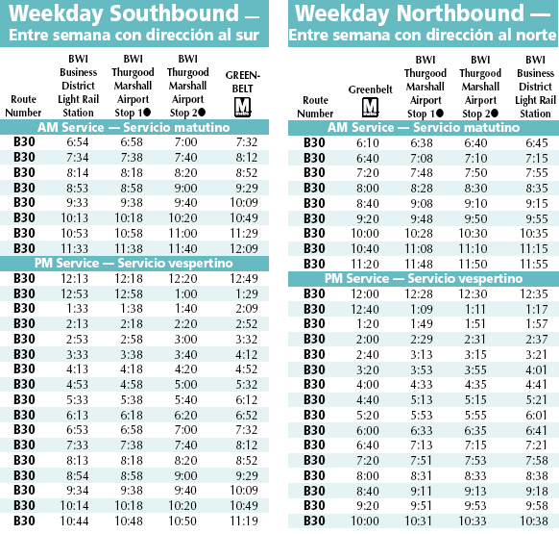
BUS vs TRAIN
Consideration for using the Metro Bus
Learning the scheduling and timing of specific bus routes and Reading the Schedule

Slide 13
BUS vs TRAIN
Positives for using the Train
People who are more advanced in traveling skills or prefer using the train system may prefer to learn the Metro Rail system.
The Metro Rail system is a fast effective way to get from one part of the city to the next.
When time is of the essence or distance may be a factor teaching someone to learn how to travel by train will allow them to have more options in terms of where they live, work or play!

Slide 14
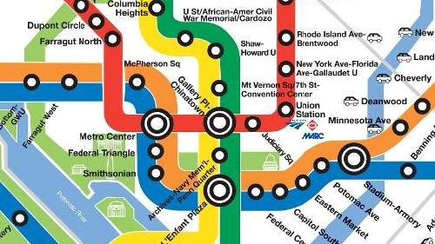
BUS vs TRAIN
Considerations for using the Train
The Metro Rail system can be difficult to master. Using the Metro Rail system in the DMV, people will have to be familiar with not only colors but which train lines intersect as well as each stop along that particular train line.
Another consideration is train safety ensuring that people are comfortable with standing on the train platforms as well as using escalators or elevators as the metro is underground and relies on stairs, escalators, or elevators to get to train level.

Slide 15
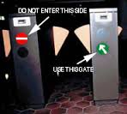
Getting to the train platform
You should hold the card on the diagram that is similar in design to the one on your card
Wait until the duel sided yellow barrier opens up
Walk through immediately
Metro card should be kept in a secure place on you person, i.e. your wallet or purse

Slide 16
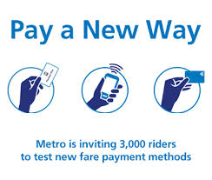
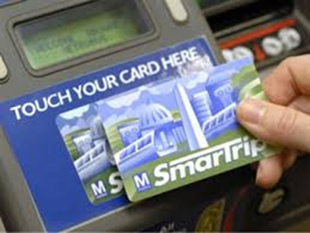
Putting money on my metro fare card?
Locate the Fare card machine inside any Metro Station or can be purchased and loaded at some local store like CVS.
Place the amount of money required for your trip (or more if you are a frequent user)
Hold the card up to the diagram that is similar in design to your card
Wait for the green light to confirm your purchase

Slide 17
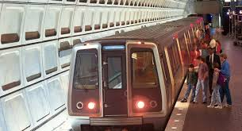
Rules for the Metro Do’s and Don’ts
DO’s: • Let passengers get off the train before you board.
• Put trash in trash bins and newspapers in the newspaper recycling bins.
• Stand at least two feet behind the edge of the platform.
• Follow official instructions at all times. Try to remain calm in emergencies.
• Step carefully over the gap between the train door and the platform.

Slide 18
Rules for the Metro Do’s and Don’ts
Don’ts
Eat, drink, smoke or litter on Metro vehicles or in stations. Metro Transit Police issue citations or make arrests to enforce this law.
Try to block or force train doors open. They do not reopen like elevator doors!!
Touch the train doors when they are opening or closing.
Lean against the train doors.
Run in the station .
Sit on the platform edge.

Slide 19
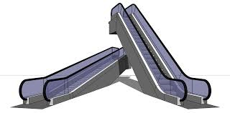
Escalator Do’s:
Stand to the right facing forward. Walk on the left.
Hold the handrail but don't lean on it.
Keep feet away from the sides.
Make sure you have no dangling clothing or loose shoelaces that could get caught.
To stop an escalator in an emergency, use the emergency button. Emergency stop buttons are at the top and bottom of the escalators on the right hand side near the floor under a flap.

Slide 20
Escalator Don’ts
Don’t Ride barefoot
Don’t Ride up or down on the escalator
Don’t Sit on the steps or the handrail
Don’t take the escalator if you are using a stroller, wheelchair or handcart or have a heavy load. Use an Elevator every station has an elevator ask the attendant for assistance if needed.

Slide 21
Obtaining a Metro Access Card
The Application
Read in its entirety prior to completing
Write legibly
Use blue or black ink only
Ask questions for most accurate information

Slide 22
The Metro Access Form
Fill out each section in it’s entirety!!
Last Name______________________________ First Name______________________________ Middle Initial ________
Street Address: Apartment #:
7. Written Diagnosis (es) and ICD-9CM and/or DSM Code(s): ______________________________________
8. HYPERTENSION: Eligibility for service is determined by a functional assessment, which is conducted by a certified/licensed therapist with the Transit Accessibility Center. Applicants may be required to walk/travel up to 1/2 mile. In order to ensure the safety of the applicant, a blood pressure (B/P) reading is taken prior to starting the assessment. If the applicant’s resting B/P is Application revision date: July 2012 Page 7 of 9
160/100 or higher, the assessment will be suspended pending certification by the health care provider that the applicant can complete the assessment. If you are currently treating the applicant for hypertension and certify that he/she is cleared to complete the functional assessment, we may proceed without referring the applicant back to you for evaluation and certification.

Slide 23
Obtaining a Metro Access Card
When Completing the sections:
Most of the information you will need can be found:
Health Passport
The Person’s Records (Programming or Clinical Book)
MCIS System
BE VERY THOROUGH WHEN COMPLETING

Slide 24
Obtaining a Metro Access Card
The Medical Section
Must be filled by the person’s Primary Care Physician or A Licensed Registered Nurse
Ensure that the doctor includes a pertinent diagnosis in the health section (Intellectual Disabilities is not enough!) The person must carry a diagnosis that will greatly impede their medical health such as: Diabetes, Hypertension, Asthma, etc.
Offer to take the application to the health care professional and wait for it
Express the urgency of form being completed ASAP
Once completed by health care professional, you must set appointment for Metro-access immediately.
You only have 60 days to complete the entire process!

Slide 25
Obtaining a Metro Access Card
Submitting The Application
All assessments for Metro-Access are by appointment only or you can email completed application to cohonek@wmata.com
To schedule an appointment, call 202-962-2700 and select option 5 or TTY 202-962-2033.
When your assessment has been scheduled you need to do the following:
Bring the original(Not a Copy) application to the scheduled appointment date.
Please ensure the applicant brings a picture ID or Birth Certificate/Social Security
Please ensure the applicant arrives ½ hour before the scheduled appointment date.
After scheduling appointment you will be asked to submit your application
Submit form to: The Transit Accessibility Center is located at Metro headquarters
600 Fifth Street NW, Washington, DC 20001.
Office hours are:
Mon: 8 a.m. - 4 p.m.
Tue: 8 a.m. - 2:30 p.m.
Wed-Fri: 8 a.m. - 4 p.m.

Slide 26
Obtaining a Metro Access Card
About the Metro Access Interview
Try to arrive at least 30 minutes early
Staff should attend the interview with persons supported
Representative from transit agency will do the questioning
Do not provide too much information
Be sure you are receiving the correct card not just card for metro-access but also for rail and bus
If at all possible see if card can arrive to directly to a main office or secure location.

Slide 27
Obtaining a Metro Access Card
Now You are ready to ride!!
Visit for form and more information
http://www.wmata.com/accessibility/metroaccess_service/

