Slide 1
Return to Community Based Day Services (CBDS)
DDS Community and Provider Forum
Friday, January 27, 2023

Slide 2
Companion Services & Flexibility of Appendix K
Effective March 11, 2020, companion services could be provided up to 5 days per week by the person’s family member, other legally authorized representative or residential provider
Will remain in effect until 6 months after the end of the Public Health Emergency (PHE)
Health and Human Services (HHS) has committed to providing 60 days’ notice of the end of the Federal PHE.

Slide 3
Return to Day Services
As we approach the end of the PHE, DDS wants people supported to:
Be fully integrated in the community
Have a smooth transition back to community- based day supports
Flexibility of Companion will be modified to decrease the frequency of companion services

Slide 4
Plan to decrease Companion Services
On the date the PHE ends: Companion services will not be authorized for more than 3 days a week
3 months after the PHE ends: Companion will not be authorized for more than two days a week
6 months after the PHE ends: Companion services will not be authorized unless the IDT has considered and ruled out other waiver services
The IDT may determine prior to the end of the PHE that the person may immediately transition back to fulltime day and/or employment
Full time Companion services may be assessed as the most integrated setting for the following:
Retirees
Persons who previously had five (5) days a week authorized prior to the PHE and wish to continue
Persons with a documented health or medical reason that prevents them from engaging in other day and/or employment services

Slide 5
Team Meetings & Authorizations for Companion Services
Modifications to companion services are consistent with DDS’s Most Integrated Policy
Prior to HHS notification & during routine IDT meetings, SCs will ensure the person’s day or employment supports are reviewed to ensure the person is in the most integrated setting
Service Coordination will review authorization requests for full time or continued companion services to ensure alignment with the person’s needs
Persons may transition to full employment/day services prior to the end of the PHE

Slide 6
Day Program Providers
Currently, 48 Day Programs are operating to provide day services to people supported by DDA.
Services Authorized:
Day Habilitation
Small Group Day Habilitation
Employment Readiness
Individualized Day Supports
Supported Employment

Slide 7
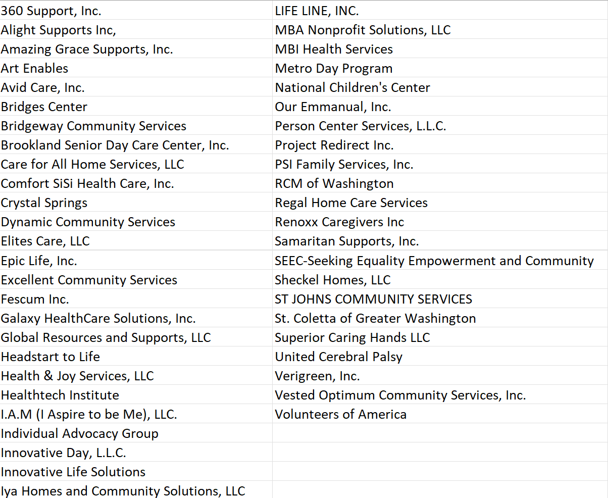
Day Program Providers

Slide 8
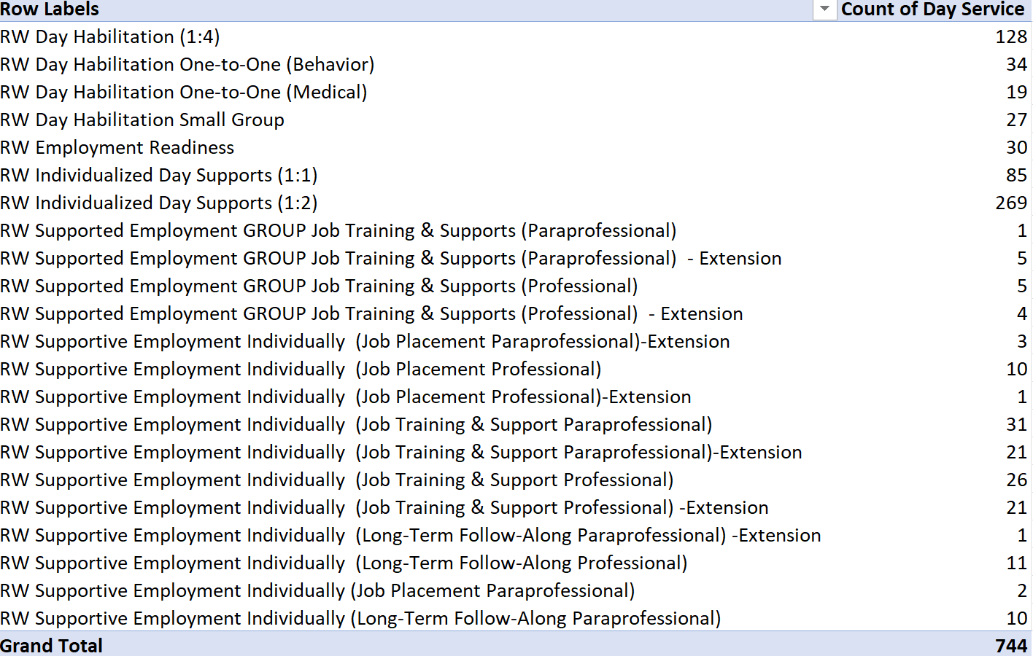
Services Authorized

Slide 9
Apprehensions to Returning to Community Based Day Supports:
Availability of Transportation
Uncomfortable with using public transportation
MTM continues to provide transportation
Service Coordinators (SCs) and provider staff are available to assist with arranging transportation
SPCD and MTM will coordinate a meeting to address barriers
Comfortability & Safety
Uptake in COVID case & Health Related Risk
Some people supported are not comfortable with wearing mask
Day Program Providers continue to follow DC Health COVID Guidelines
SPCD monitors the safety and well-being of all person supported
SPCD track and monitors reported COVID positive cases and exposures daily

Slide 10
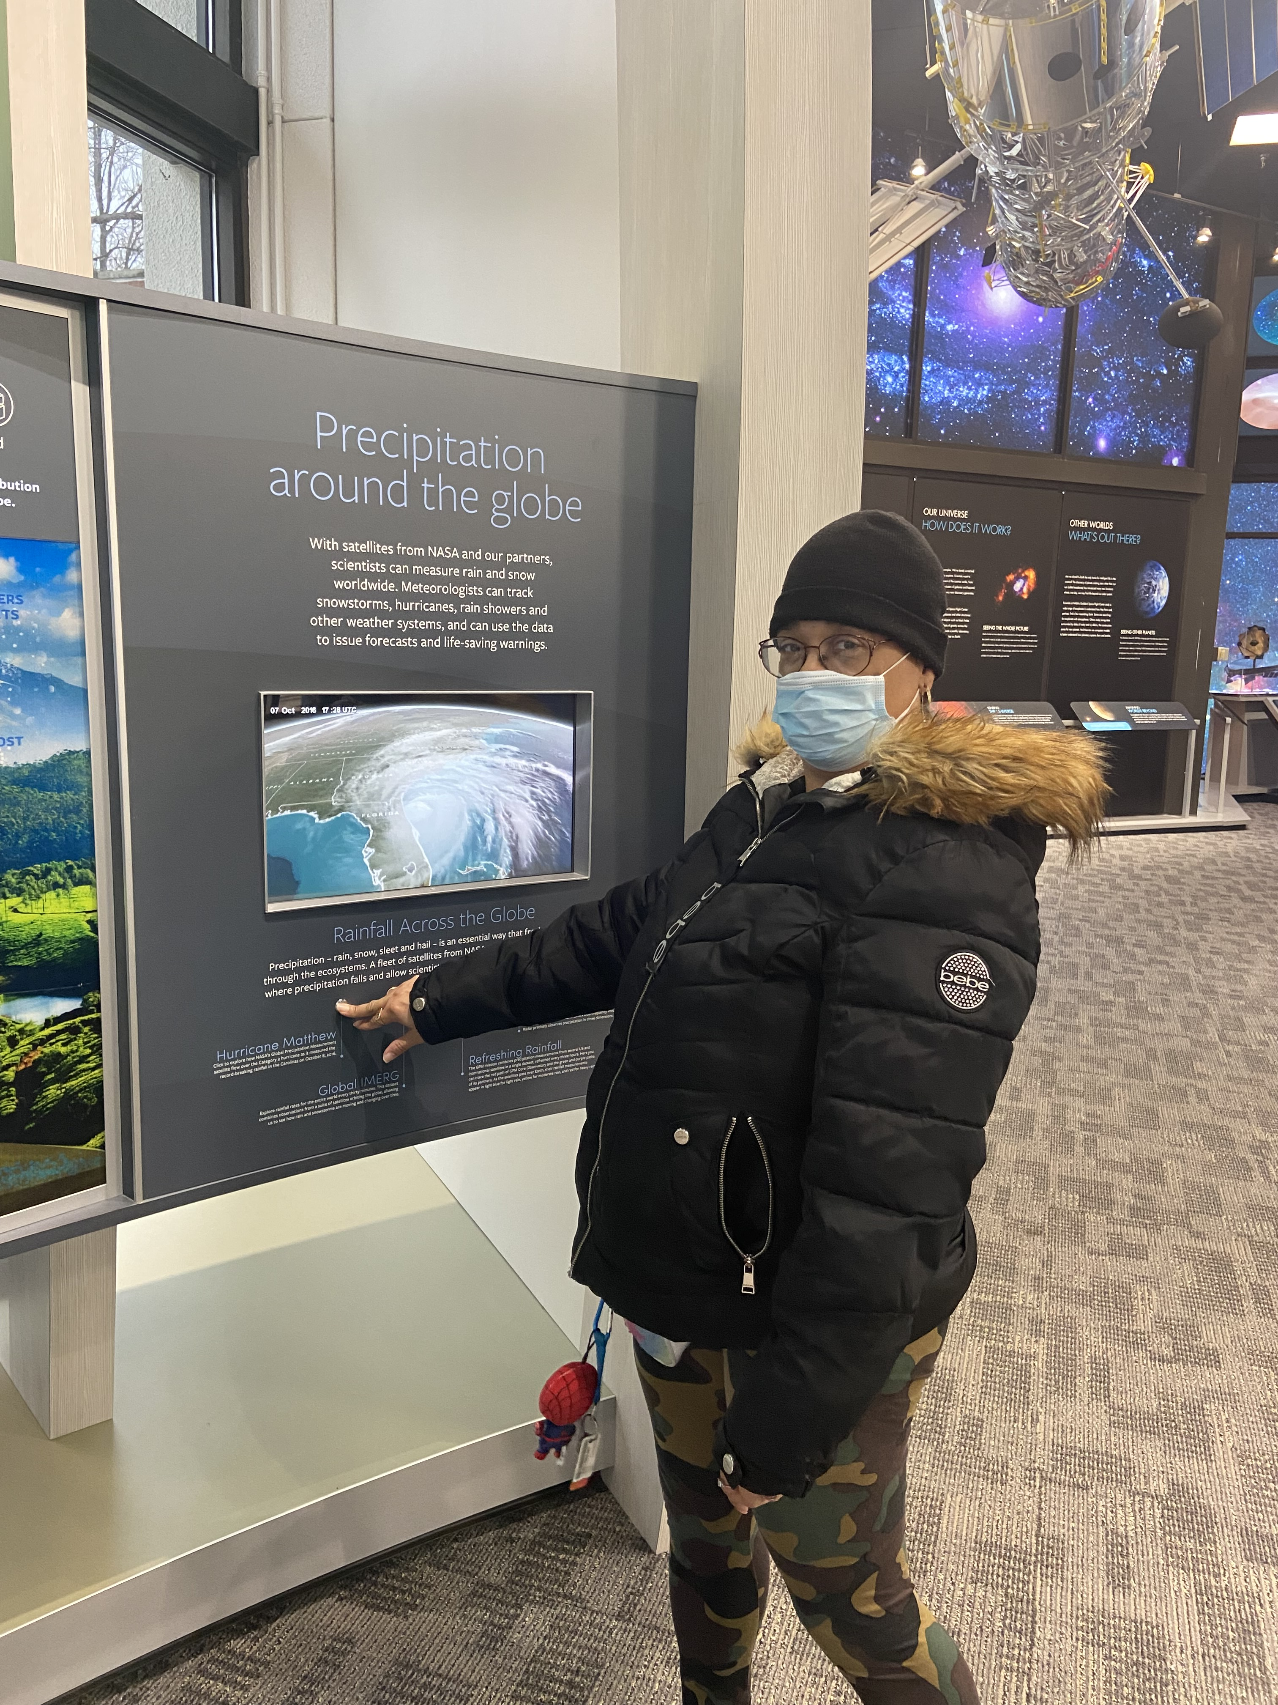
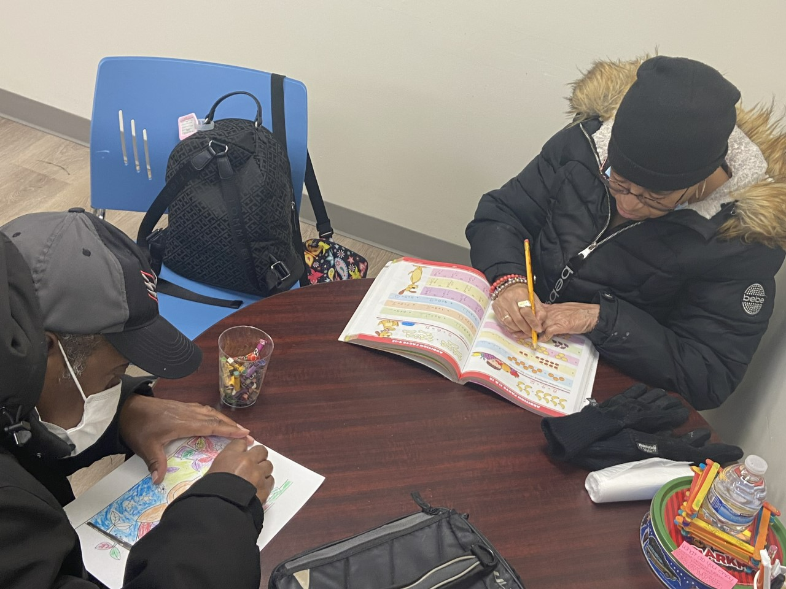
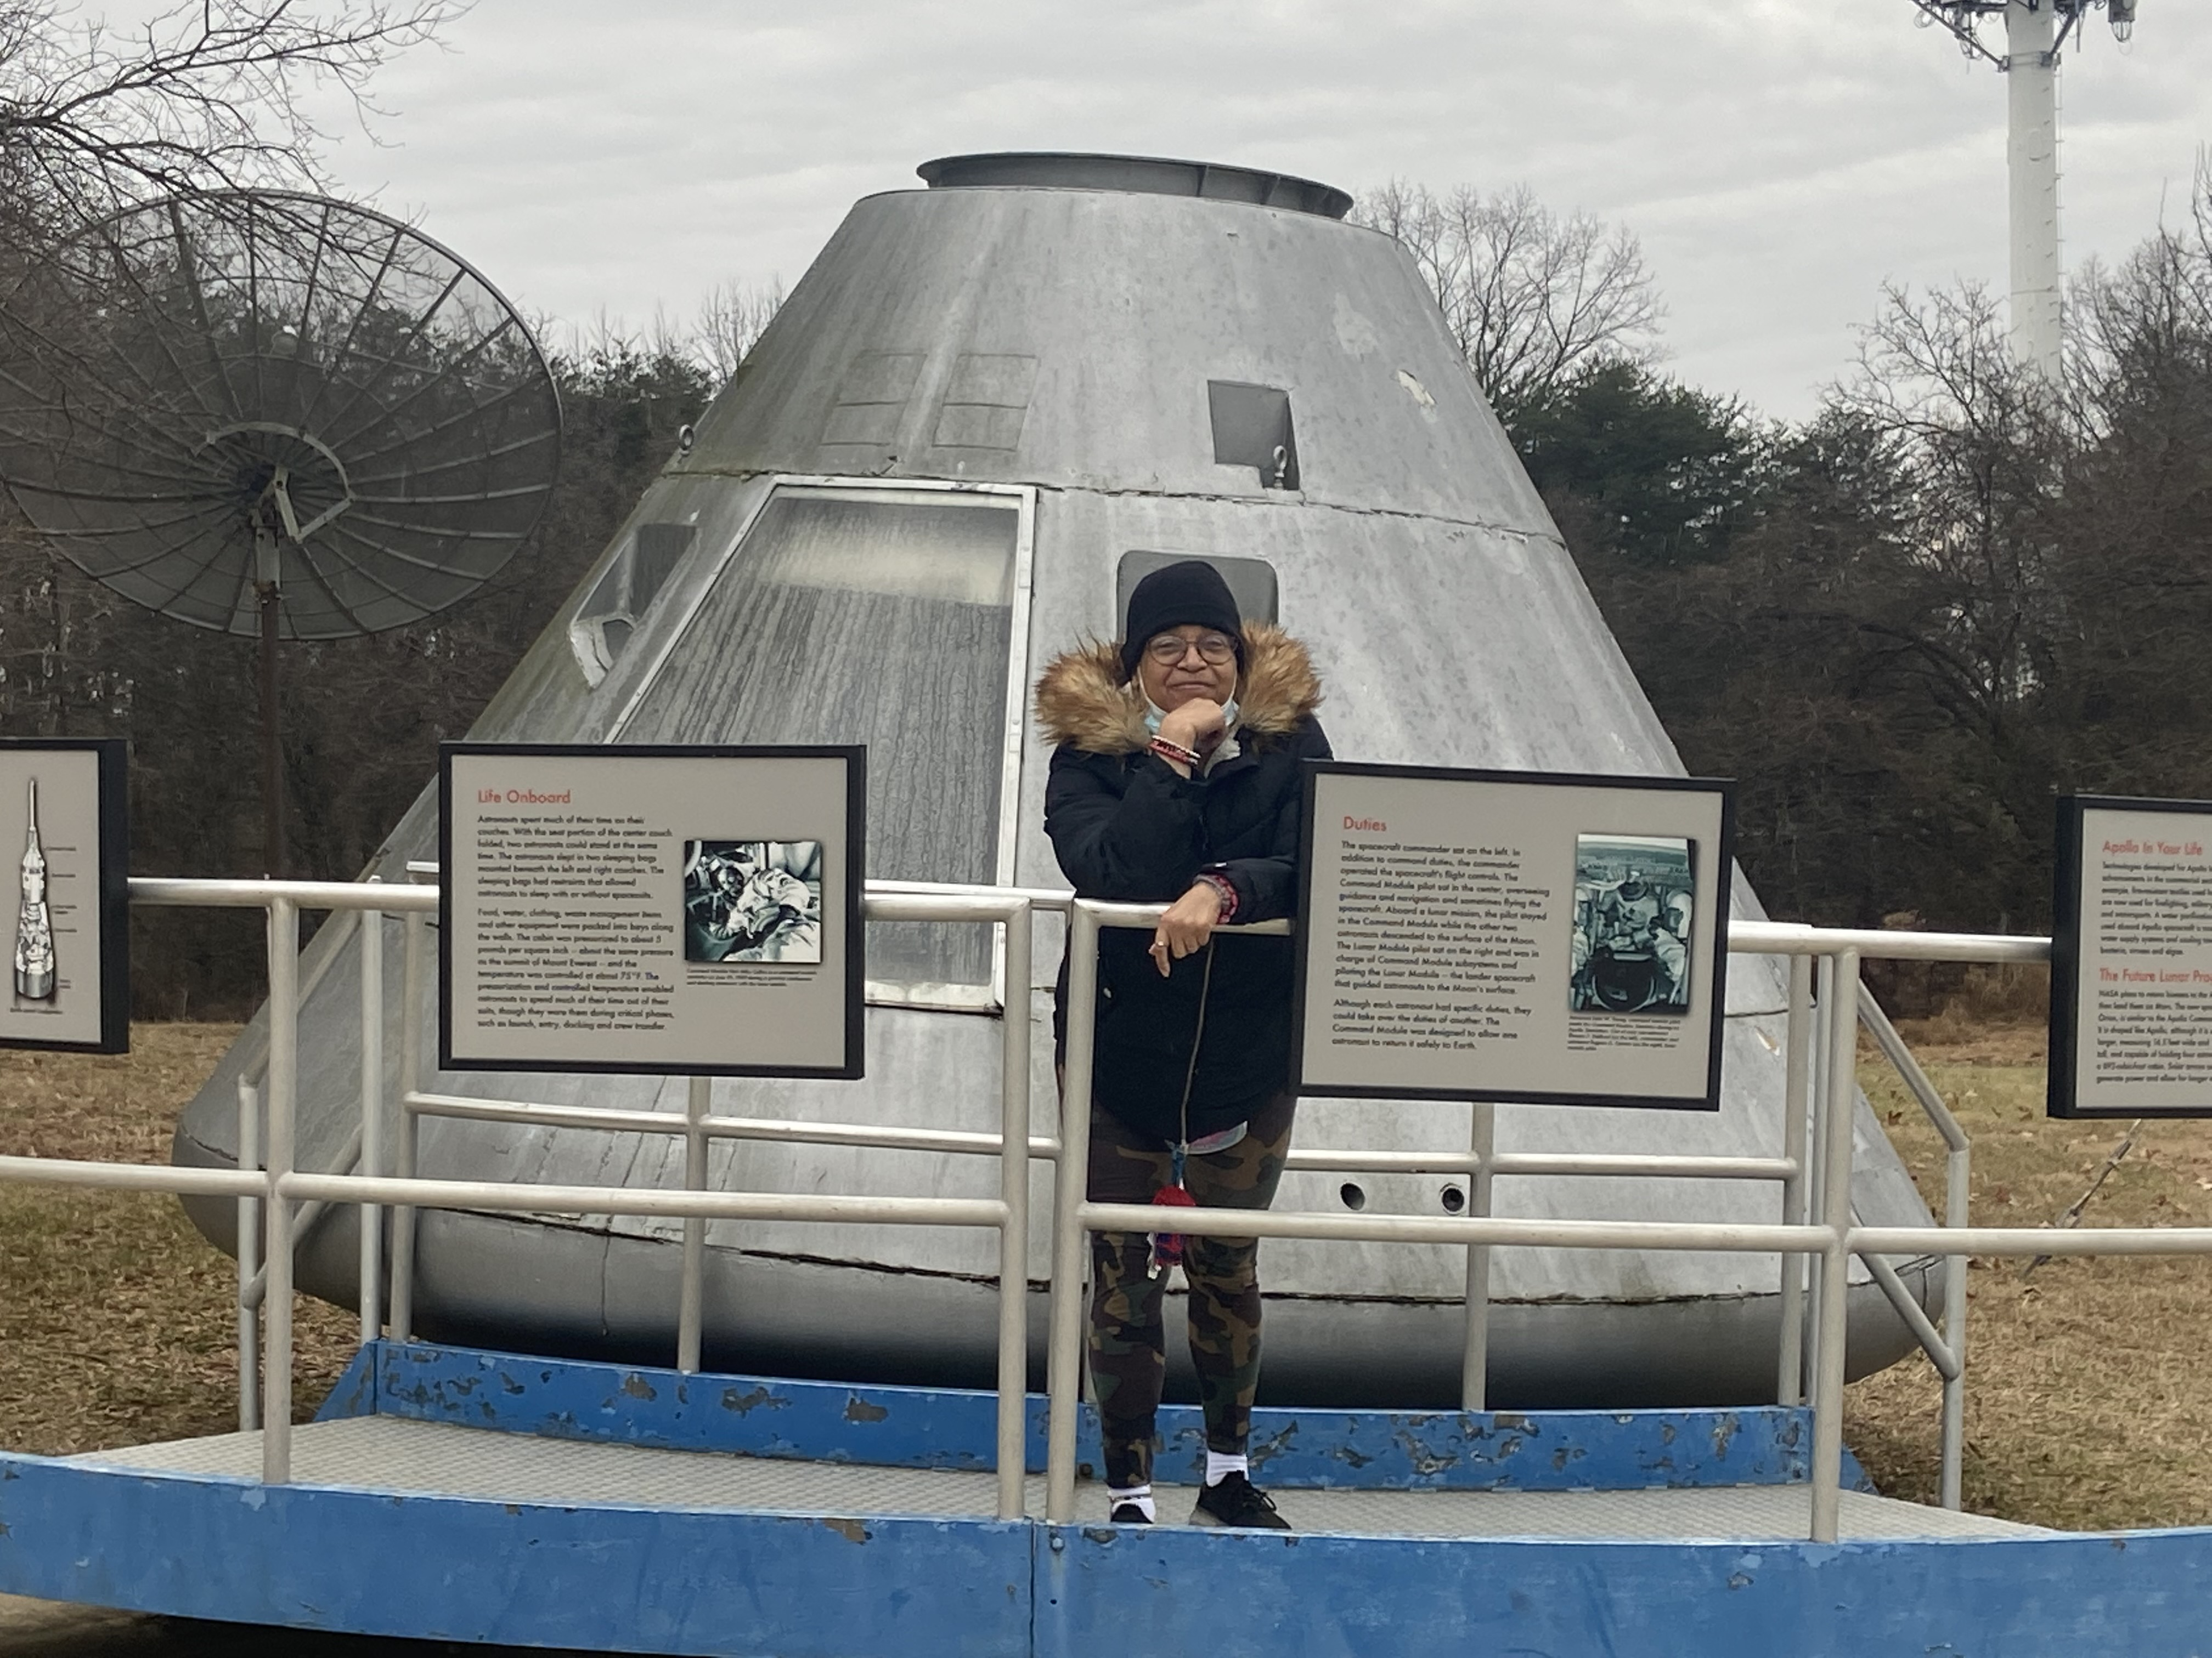
Companion to Community P.W. & R.C. attends Verigreen Inc. Individualized Day Services 5 days a week.

Slide 11
Companion to Community Continued…
Quotes from P.W. & R.C.
What do enjoy most about your day program?
P.W. enjoys trying new things with different art projects
P.W. enjoys seeing her staff (Monique), and her friends at the day program
R.C. enjoys the fact that he can participate in art projects
Since your return to the day program, how has your day improved?
P.W. stated is happier at the day program because she can go out in the community and see new faces
R.C.’s day is better because he can physically go on community outings to walk and do more

Slide 12
Questions?

