Slide 1
Remote Support Services Overview
2022 HCBS Advisory Committee Meeting
1/24/2022
1

Slide 2
Introduction
The COVID-19 Public Health Emergency has changed the landscape of service delivery. The District would like to move forward with modernizing how we deliver services through innovation with a person-centered approach.
The District is proposing to expand beyond the 20% service limitation for Remote Service Delivery for In-home Supports, Supported Living Periodic and add Remote Support Services language to our waiver renewal for In-home Supports, Supported Living Periodic, Employment Readiness, Supported Employment, and Clinical Services as detailed on the next slide.
Please note: Supported Living Periodic with transportation will not be eligible for the Remote service delivery option.
The proposed change will allow for continued Remote Service Delivery post the Public Health Emergency for the services indicated. The Remote Support Services will be a separate billable service with a specialized rate different from the In- person service delivery model.
The rate methodology for the Remote Support Services will be discussed in detail in a forthcoming meeting.
2

Slide 3
Expanded Remote Support Services
Behavioral Supports
Creative Art Therapies
Employment Readiness
Family Training
In-home Supports
Parenting Supports
Speech, Hearing and Language
Supported Employment
Nutrition
Fitness
Bereavement
Supported Living Periodic
3

Slide 4
Why Should Remote Support Services be considered?
The service fosters independence by combining technology and service delivery to allow for contact with trained staff when the individual needs assistance.
Remote supports can assist individuals to live more independently or help support a safe transition to independent living with the use of equipment such as motion sensors, door sensors and a two-way audio-video communication device.
4

Slide 5
How are Remote Support Services Delivered?
Remote Support (RS) enables a person to be more independent and less reliant on staff to be physically present to receive support. The remote caregiver can interact, coordinate supports, monitor, and/or respond to the person's needs through equipment capable of live two-way communication
Remote Services can be delivered in four different delivery models:
Active Support: real-time oversight during scheduled times. The remote caregiver is monitoring the system in real-time and responding immediately as needed.
On-Demand Active Support: real-time oversight only when needed. This type of “as needed” live real-time support is typically started when a triggering event occurs (from a sensor of some type) indicating the need for immediate support.
Scheduled Check-In: remote caregiver checks-in with the person at scheduled times. These are typically centered around ADL’s or can be a simple wellness check.
Drop In: a remote caregiver checks-in at random times to ensure the wellness of the person supported to determine if they need any assistance.
5

Slide 6
Who is eligible to receive the service?
Remote Support Service are not covered in the State Plan, Medicare, or other third-party resources. This service is offered exclusively through the waiver when participants meet eligibility criteria specified in the published Remote Support Services policy guidance.
Prior to seeking funding for Remote Support Services through the waiver, the Service Coordinator is responsible for exploring community based non-waiver options and ensuring any applicable services through the state plan have been exhausted. Documentation that demonstrates this criterion has been met must be noted in the persons Individual Service Plan (ISP).
6

Slide 7
Who could benefit from Remote Support Services:
Persons receiving In-Home Support and Supported Living Periodic services who can benefit from remote support services and are able to access remote support equipment
Persons receiving the identified clinical services remotely residing in eligible settings that are billed in hourly increments
Note: Daily rate services will not be approved
7

Slide 8
Approval Process for Remote Services
The individual has a completed Person-Centered Remote Support Tool that is administered by the support team that identifies support needs, preferences, outcomes and tech solutions
Approval by the person’s support team of the completed tool determining if the person is a candidate for Remote Supports and identifies how many hours the individual can receive.
The persons’ support team, through the person-centered planning process, will ensure that the use of this service is in accordance with privacy considerations for the participant and is in accordance with the participant’s preferences for service delivery.
The frequency and duration of this service are based upon the participant’s needs as identified and documented in the participant’s remote support service plan.
8

Slide 9
Who can Provide Remote Support Services?
Local IDD Waiver providers who have been certified to provide Remote Support Services.
Remote Support Services may also be sub-contracted to vendors who provide Remote Support Services monitoring for the Supported Living Periodic and In-home Supports.
Links to some vendors who currently offer this service:
SimplyHome
Remote Monitoring For Seniors and Disabled | Rest Assured
Sengistix
Night Owl Support Systems | Building Relationships with Remote Monitoring (nossllc.com)
SafeinHome | Remote Supports Technology
9

Slide 10
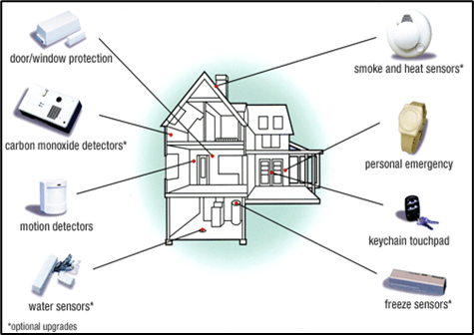
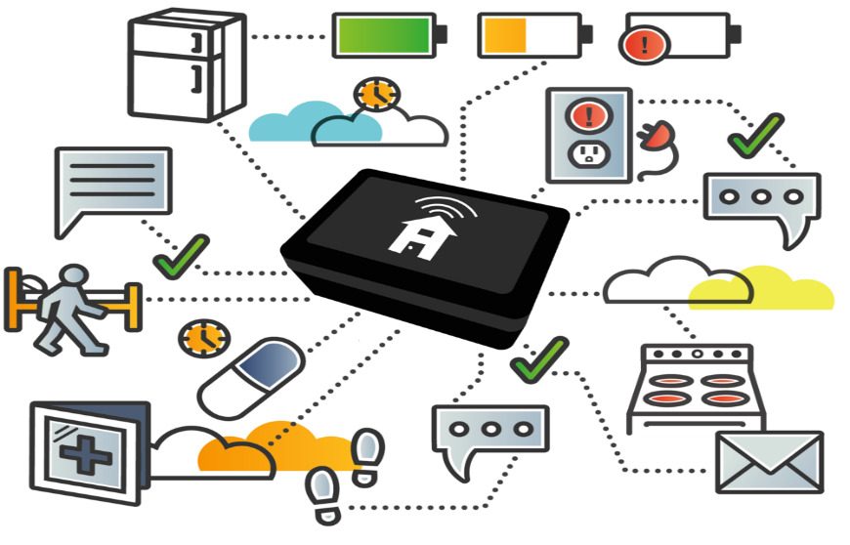
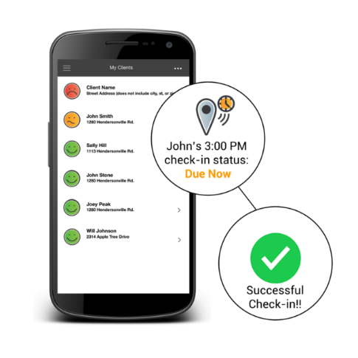
Examples of Technology used to Enhance Remote Support
Detectors:
Carbon Monoxide
Motion
Sensors:
Door/Window
Water
Smoke
Heat
Freeze
Reminders:
Check-Ins
Medications
Hub - devices can be connected through one central point to trigger alerts & notifications
10

Slide 11
Service Delivery
Hourly Remote Support Services
If an individual is approved for remote support services, a separate service authorization will be issued indicating the frequency of usage.
A hybrid model may also be used for In-person and Remote Support hours where two service authorizations will be issued to cover the in-person service hours and the remote support service hours
Please note: Electronic Visit Verification requirements must be maintained for the in-person hours for Supported Living Periodic and In-home Supports.
A maximum of 8 hours of remote support services can be issued for these two services
11

Slide 12
Requirements for Remote Support Plan
The remote support staff shall have detailed and current written protocols for responding to an individual's needs as specified in the individual service plan, including contact information for the backup support person to render assistance when necessary, and times when remote support will be provided.
The individual service plan shall set forth the protocol to be followed should the individual request that the equipment used for delivery of remote support be turned off.
Required remote support content in the ISP must include:
Justification statement that explains how remote support benefits person, promotes independence, assist in outcome achievement, assures health and safety etc. Also, justify the need for any other service such as the need for Assistive Technology services for the purposes to acquire Equipment rental/purchase
Description of person’s personal preferences and how the delivery of remote support will reflect them. This should reflect the utilization of person-centered tools and exhibit how support strategies have been developed to meet the summarized preferences
12

Slide 13
Requirements for Remote Support Plan Continued
Verification that a risk assessment was completed and reviewed through the utilization of individual person-centered tools and other assessment results by the planning team to ensure the appropriate technology solutions and/or support strategies have been identified to address any risk areas
Description of the required Remote Support equipment function, purpose, features, general location in home, person and family knowledge of and how to use equipment (e.g., turn on and off, how to request assistance remotely, etc.)
13

Slide 14
Requirements for Remote Support Plan Continued
Response time as per requirements defined by the team. In situations requiring a person to respond to person’s residence, the response time should not exceed 30 minutes
Response type includes face-to-face and/or telephone, depending on how to optimally respond to the person supported particular need at that time to ensure health and safety
In emergency situations, remote support caregiver should call 911, and
Documentation of the event as outlined by DDS’ Incident Reporting policy.
14

Slide 15
Requirements for Remote Support Provider
Complete SHIFT Training
The Remote Support Provider shall provide initial and ongoing training to its staff to ensure they know how to use the monitoring equipment
Remote support shall be provided in real time, not via a recording, by awake staff at a Monitoring location using the appropriate connection. While remote support is being provided, the remote support staff shall not have duties other than remote support.
The Remote Support Provider shall have a backup power system (such as battery power) in place at the remote monitoring location site in the event of electrical outages. Please note: This requirement only applies to In-home Supports and the Supported Living Periodic-Remote Service.
If services are unable to be delivered remotely, the backup support person shall arrive at the individual’s locating within 30 minutes when a request for in-person assistance is made.
15

Slide 16
Remote Support Provider Requirements Cont…
The Remote Support Vendor shall provide an individual who receives remote support with initial and ongoing training on how to use the remote support system as specified in the individual service plan.
The remote support staff shall have detailed and current written protocols for responding to an individual's needs as specified in the individual service plan, including contact information for the backup support person to render assistance when necessary and times when remote support will be provided.
The Remote Support Vendor shall have an effective procedure for notifying emergency personnel such as police, fire, emergency medical services, and psychiatric crisis response entities.
16

Slide 17
E-mail Questions to IDDRenewal2022@dc.gov
17

