Slide 1
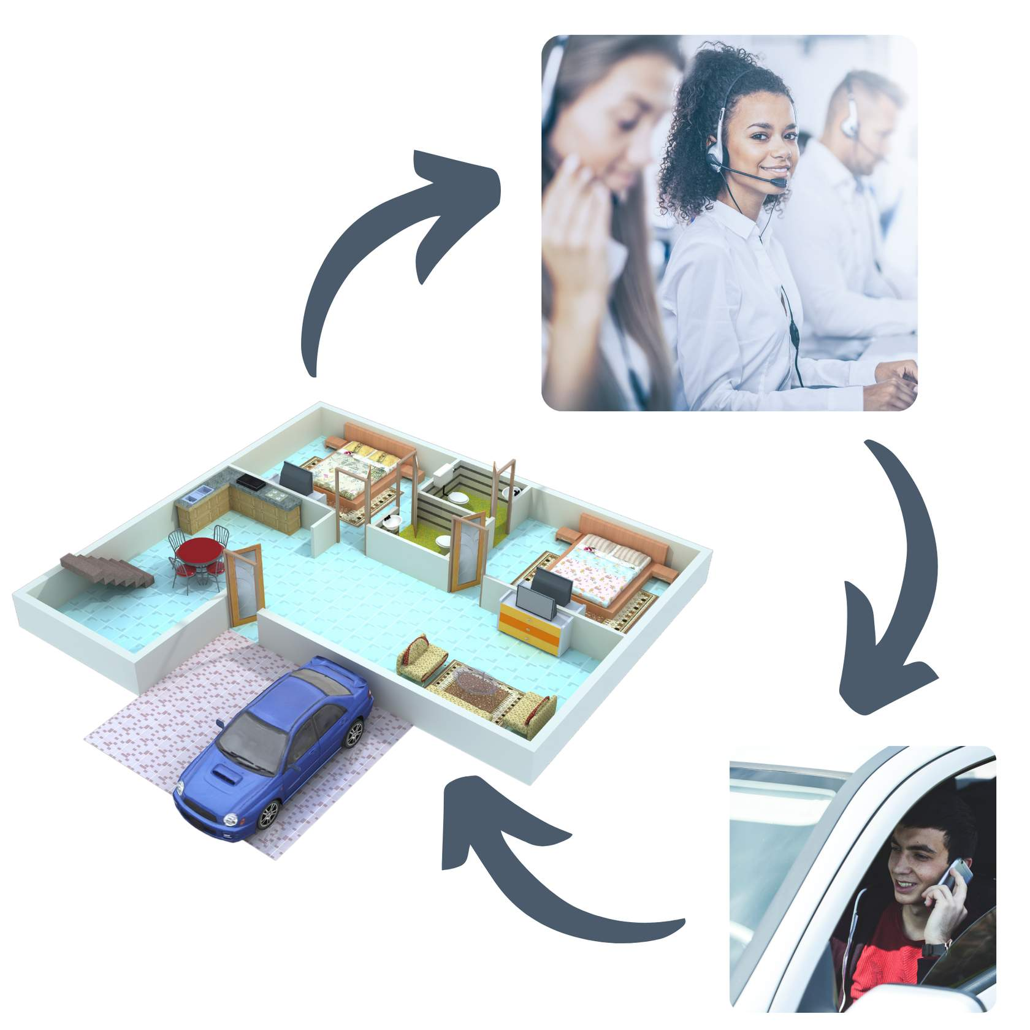
“Remote Support” (RS) is not the absence of a direct support professional; it is support provided by more than one professional, from a distance.
RS is a "tech service" only in the sense that tech is used as a tool to connect a human caregiver (Remote Support Professional - RSP) to a human receiving support (person supported).
The RSP assists the person with all deliverables outlined in the person's Remote Support Plan.
Enables people to do for themselves and in the event "hands-on" support is needed, a on-call local backup responder is dispatched to the home by the RSP.
RS is responsive in nature and is not continuous Monitoring/Surveillance
Notes:
Setting the stage of defining what Remote Support is

Slide 2
Establishing Policy Framework
Is the policy ensuring ……
Not being too prescriptive and creates an environment for innovation ?
Assessment & Planning is Person-Centered?
Outcomes & Independence is the focal point?
Safety Measures & Response Standards are in place if in-person intervention needed?
Tech and Power Failure is addressed?
Rights & Privacy are protected?
Notes:
We first wanted to figure out what questions we wanted policy to answer. Some of the questions were (read out list on slide). After we give you an overview of this draft, we will ask you the same question.

Slide 3
Remote Support Policy Statement
INDEPENDENCE & INTEGRATION
RISK MITIGATION & PRIVACY PROTECTION
PERSON-CENTERED
OUTCOME DRIVEN
It is the policy of DDA to ensure that supports delivered remotely (“remote supports”) are planned and provided in a manner that is person-centered and reflects the identified interests, support needs, preferences, and desired outcomes of the person receiving supports.
Remote supports shall be planned and delivered to allow the person to achieve maximum independence with minimal reliance on in-person staff while maintaining social engagement and community involvement. DDA shall address risks inherent in the use of technology by requiring appropriate safeguards and emergency response protocols.
Notes:
Listing the questions led us to drafting the Remote Support Policy Statement. The focus of DDA’s policy is to ensure….

Slide 4
Remote Support Planning: Assessing Interest
The policy standardizes that at a minimum Remote Support and/or Assistive Technology will be explored annually.
Remote Support shall be used as a method of service delivery when it is:
Requested by the person and/or their decision maker for allowable services
Address needs, preferences, and outcomes
Provided consistent w/the rules of the service to be delivered remotely
Documented in the ISP

Slide 5
Remote Support Planning: Social Isolation
“Remote Supports are intended to augment in-person services, and shall not be used as the sole method of service delivery used to support persons with ID/DD.”
DDS has drafted this standard in efforts to mitigate social isolation being an unexpected consequence experienced by people receiving services Remotely.
Remote Supports should NEVER be the only form of support someone receives, and the person should always have interactions with other paid staff and natural supports during other times in their lives.
Notes:
Remote Support Regs via Waiver Renewal specifies: If the duration of remote supports provided to an individual are greater than or equal to 50% of the approved total support hours a person receives in any calendar month, then the Provider, on-call staff, or person designated in the Individual’s Support Plan (ISP) must make in an in-person check in during the following month.

Slide 6
Remote Support Planning: Allowable Services
Remote Support is not a service but is alternative method to deliver existing services:
Behavioral Supports,
Bereavement Counseling
Creative Art Therapies,
Day Habilitation,
Employment Readiness,
Family Training
Fitness training
Nutrition(eval/consult)
Occupational Therapy
Parenting Supports
Sexuality Education
Speech, Hearing, and Language
Supported Employment
Supported Living with/out transportation
Supported Living periodic with/out transportation

Slide 7
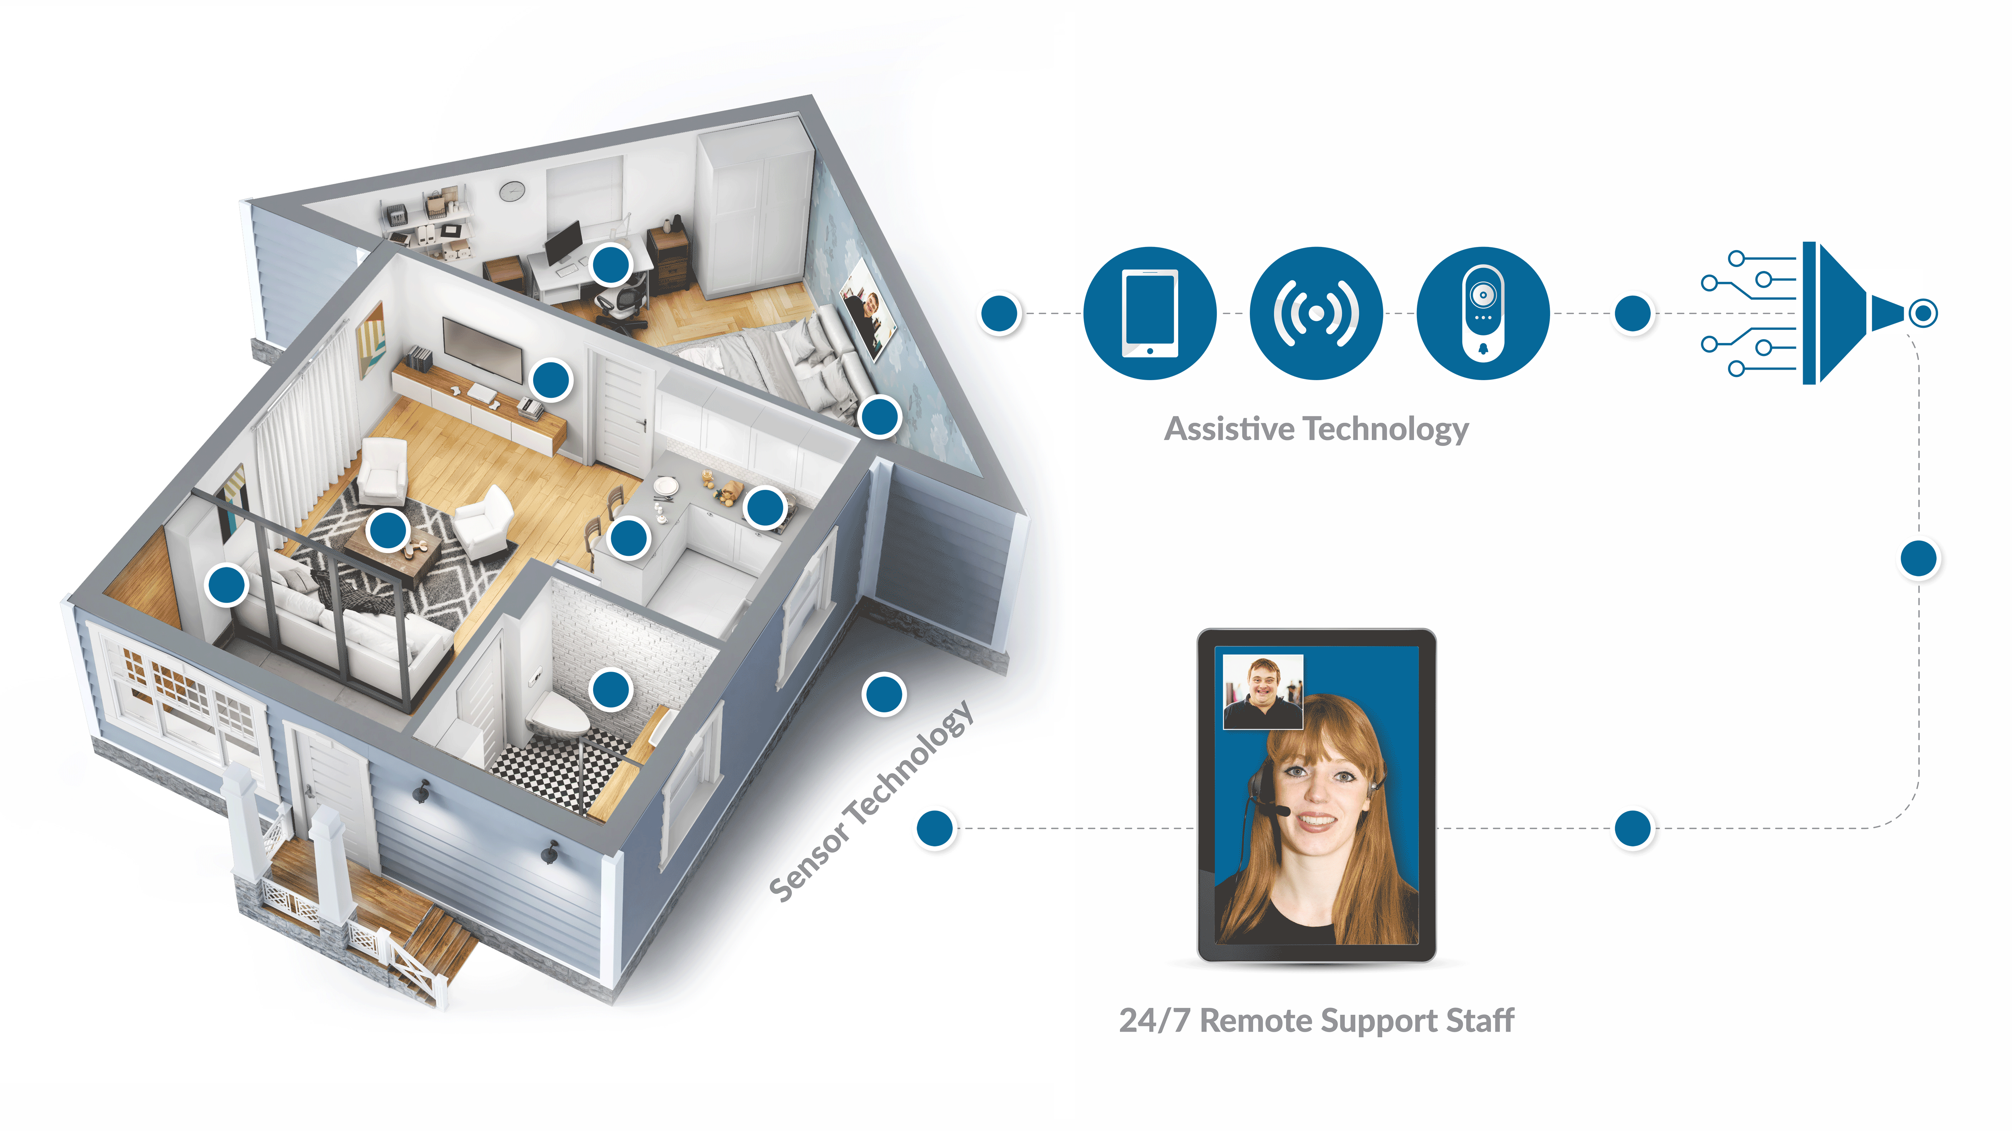
Provision of Services via Remote Supports
Tech can also be implemented to alert a RSP and improve response rate to the person supported needs.
Tech can also be acquired for the person supported to utilize as tools to independently complete daily tasks.
The policy specifies tech being explored for a person to receive RS must meet the person’s identified outcomes, strengths, and assessed needs. Tech identified through this process shall be acquired via Assistive Technology Services (includes installation & training).
*Motion sensing system;
*Radio frequency identification;
Live video feed;
Live audio feed;
*Web-based monitoring system;
*Sensor detection monitoring systems; or
Another device that facilitates live two-way communication.
*For purposes of remote support services, this tech/equipment is only for residential services only, meaning those services available to persons under supported living services
Notes:
Policy ensures the planning process does not begin with what can remote supports do. Instead, ensures the persons interests, outcomes, and needs are explored first, followed by if those needs can be met through remote supports. The procedure will elaborate on the steps to be taken by support teams to comply with this standard in the policy

Slide 8
Provision of Services via Remote Supports
Providers must have completed all applicable DDS required training & SHIFT certified in Enabling Technology Credential, or Enabling Technology Integration Specialist Certification programs, or equivalent.
Providers are also required to develop, maintain, and enforce written policies, approved by DDS, which ensure:
Information Security compliance
Emergency Response procedures
In-person back-up response onsite within 30 minutes
For Emergencies and/or after request for physical DSP intervention
Informed Consent (tech operation & placement)
Human Rights Committee review of Remote Support Plans
Compliance w/all DDA policies and procedures (e.g., Incident Reporting Procedures)
Notes:
“DDS Required Trainings” are a reference to the training requirements that are outlined in detail in the Remote Support Regs via Waiver Renewal. The Regs specifies professionals delivering RS must complete that Phase trainings 1-3

