Slide 1
Community & Provider Forum
April 28, 2023
Public Health Emergency Unwinding Plan

Slide 2
Agenda
Appendix K: Operational Plan for Unwinding from the Public Health Emergency (PHE)
Service Coordination Preparation to Support Persons for the Ending of the PHE
IDD/IFS Waivers- What’s new?
DD Expansion
Remote Supports Services (RSS) Delivery
My Life, My Way Program: Participant-Directed Services (PDS)

Slide 3
Unwinding From The PHE
On January 30, 2023, the Biden Administration announced that the PHE will end on May 11, 2023. DDS has created a three-phase approach to returning to normal operations. The first phase is Service Coordination scheduling IDT meetings, as needed, to prepare supported persons for the ending of the PHE, the second phase is unwinding of program & service authorization flexibilities, and the final phase is the return to normal operations. Flexibilities and enhanced rates will cease 6 months post the ending of the PHE, effective November 11, 2023.
Notes:
DDS fulfilled its role by utilizing various temporary flexibilities that allowed persons served to receive continuous coverage of quality Home and Community-Based services. Since implementing these changes, DDS has been planning for the end of the PHE and the return to normal operations.

Slide 4
Unwinding From The PHE
Month 1: May 2023
Unwinding related activities begin
Service Coordinators facilitate IDT meetings to assist persons with making an informed choice about meaningful day options
Unwinding related activities are being finalized
May
June
July
Aug
Sept
Oct
Nov
Month 6: November 2023
Last month to complete all unwinding related activities
New Remote Support Services rates.
Expanded settings ends.
Modification of service scope or coverage ends.
Enhanced rates end.

Slide 5
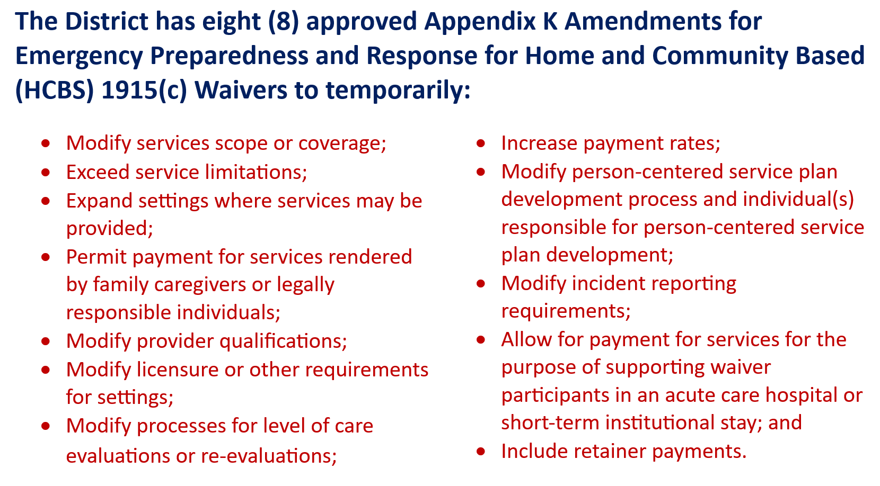
Unwinding From The PHE
Notes:
1915(c) waivers include the IDD and IFS waivers.

Slide 6
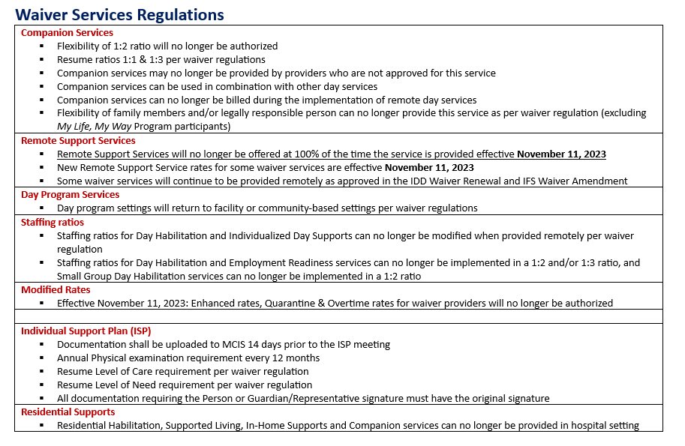
Flexibilities Cease 6 Months Post End Date of PHE
Notes:
Day Habilitation, Employment Readiness, and Small Group Day Habilitation staffing ratios were approved 4/25/2023 and are effective October 1, 2022. The transmittal for the new day program staffing ratios will be forthcoming.

Slide 7
Flexibilities Cease 6 Months Post End Date of PHE

Slide 8
IDD and IFS Waiver Regulations
The following links are the standards governing the eligibility for services for persons enrolled in the Home and Community-Based Services (HCBS) Waivers for Individuals with Intellectual and Developmental Disabilities (IDD) and Individual and Family Support (IFS), and conditions of participation for professionals and providers of services to receive reimbursement.
IDD Waiver Regulations:
DCMR IDD Waiver Regulations: Chapter 29-19
IFS Waiver Regulations:
DCMR IFS Waiver Regulations: Chapter 29-90
Notes:
Provider and community members may review the waiver regulations for normal operations of services.

Slide 9
Return to Community-Based Services
Service Coordination & IDT Activities in Preparation for the ending of the PHE
The Draft Meaningful Day Assessment and Plan (MAP) tool was developed in collaboration with:
Provider Representatives (Precious Myers-Brown, St. Johns Community Services and Danielle Darby, RCM)

Slide 10
As we approach the end of the PHE, DDS wants people supported to:
Reconnect with their communities consistent with their identified preferences, choices and assessed needs
Have a smooth transition back to meaningful day supports
Utilize technology to promote inclusion and self determination

Slide 11
End of PHE: What to expect?
IDTs
Identify the next steps necessary adjust to the new normal
Incorporate lessons learned from the pandemic into meaningful day supports
Complete the Meaningful Day Assessment and Plan (MAP) for all persons receiving 3 or more days a week of companion services ensure alignment with the identified preferences and needs of the person
Assess the need for amendments to current, day service authorizations or return to in person or virtual day support
SC
Returned to in-person ISP meetings and in-person monitoring effective February 2022
Will initiate person-centered MAP meetings and quarterly reviews for persons receiving 3 or more days a week of companion service to ensure it continues to provide the person supported with a meaningful day
Providers
Required to upload individualized day and residential schedules to MCIS, and maintain meticulous documentation of meaningful day activities
Support the person to explore in-person or virtual day support options, and share details of exploratory activities with the team
Ensure the companion schedule is available for team review during the MAP meeting

Slide 12
What is the Meaningful Day Assessment & Plan (MAP)
The Meaningful Day Assessment and Plan (MAP) is to be completed by the Interdisciplinary team for all persons receiving 3 or more days a week of Companion Services.
MAP will assist interdisciplinary teams with determining the need for amendments to current day authorizations and/or return to community based, in-person or virtual day supports, consistent with their identified preferences and needs.
The person’s companion provider shall ensure the companion schedule is available for team review during the MAP meeting.

Slide 13
Section I: Current Day Supports
1. What services are you currently authorized to receive?
2. What day supports were you receiving as of March 1, 2020?
Section II: Community Participation Preferences
3. What would I like to do to experience a meaningful day (Check all that apply): Explore new interests, hobbies by participating in a community-based day program Explore educational and skill building opportunities to increase independence Socialization with friends and peers Increase engagement in physical activity Explore Employment options or get a job Volunteer, self-advocacy and other community contribution activities Obtain Support to make an informed choice about the day setting that best meets my needs Obtain support to explore assistive technology and remote support options that best meet my needs 4. Would you be interested in participating in a virtual day program? Yes or No Recommended Next Steps: Explore New Interest/Hobbies via the Internet or in person, refer to IDS, Day Habilitation, Supported Employment, or Employment Readiness programs, explore membership in Community recreation centers, gyms, visit various community based or virtual day programs, explore assistive technology options to facilitate participation in virtual day supports

Slide 14
Section III: Barriers to Community Participation
5. What are your barriers to virtual, hybrid or in person, community participation (check all that apply) I have been unsuccessful in obtaining a community program that meets my needs Access to two-way audio/video communication Internet Connectivity I need support to make an informed choice about the day or support setting that best meets my needs I am concerned about COVID and hesitant to return to community-based day supports Transportation I have a documented health concern that is a barrier to community participation My medical condition is: Temporary - the team will review my community participation needs by: (Date) Permanent (complete Section V only) Program I want to attend is not ready to accept participants Other: Recommended next steps: Obtain an advocate, assist with accessing public transportation options including MTM, referral for assistive technology or remote support services, conduct virtual or in person visits with various day support options

Slide 15
Section IV: IDT Review of Companion Supports *Complete for persons who plan to continue three (3) or more days a week of companion services
6. Companion Services are provided by: Current Residential Provider Family (Relationship): SDM Other Paid Support: 7. Check all that apply I am retired or aged 65 or older I received 3 to 5 days a week of Companion Services prior to the PHE I am afraid to go out in the community and would prefer to participate in virtual day opportunities` None of the above criteria apply: (complete questions 9 and 10)

Slide 16
Section IV: IDT Review of Companion Supports *Complete for persons who plan to continue three (3) or more days a week of companion services
8. Are you currently participating in any of the following activities? Please check all that apply: Explore new interests and hobbies virtually or in person: Specify interest or hobby: Explore virtual or in person educational and skill building opportunities to increase independence: Specify interest or hobby: Explore virtual or in person socialization with friends and peers Increase engagement in physical activity Specify activities: Explore Employment options or get a job Specify vocational or job search activities: Volunteer, self-advocacy and other community contribution activities Specify interest, hobby or volunteer association: Support to make an informed choice about the day setting that best meets my needs (check all activities that have occurred) Talked with providers or people who have used other support options Visited and observed different types of programs Debrief with my support team Talked with people who have used the various service options Obtained support to explore assistive technology and remote support options that best meet my needs? Specify type of assistive technology: Other:

Slide 17
Sample Questions for each Activity
Explore new interests and hobbies virtually or in person:
Specify interest or hobby:
Name of Provider
Service:
Frequency
Location:
The service meets my needs:
Strongly agree
Agree
Disagree
Strongly disagree
Explore virtual or in person educational and skill building opportunities to increase independence:
Specify interest or hobby:
Name of Provider
Service:
Frequency
Location
The service meets my needs for independence:
Strongly agree
Agree
Disagree
Strongly disagree

Slide 18
Section V: Outcome of MAP Meeting
Next Steps (Select all that apply) | Name/Title of Person Responsible | Due date
ISP amended to update day support goals
Daily schedule updated
Refer for the following services or supports (check all that apply) Individualized day supports (IDS) Day Habilitation (DH) Employment Readiness (ER) RSA Remote day supports Adult Day Health Programs (ADHP) Other:
Refer for Assistive Technology Assessment
Person will continue to receive 3 or more days a week of companion services because they are: Retired or aged 65 or older Received 3 to 5 days a week of Companion Services prior to the PHE A documented, permanent health concern that is a barrier to community participation A documented, temporary health concern that is a barrier to community participation. Team will review day support needs by: Other (specify)
Current residential or companion provider will explore virtual day supports with various providers

Slide 19
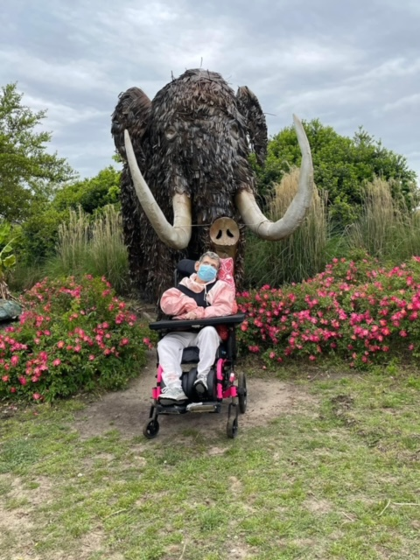
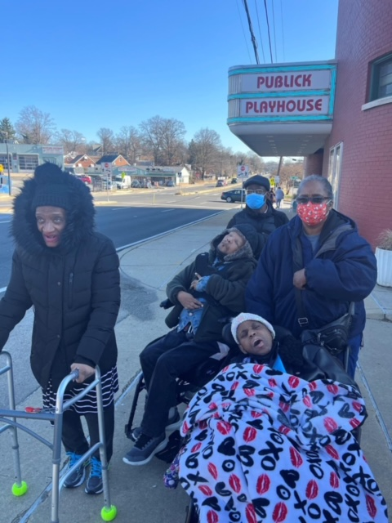
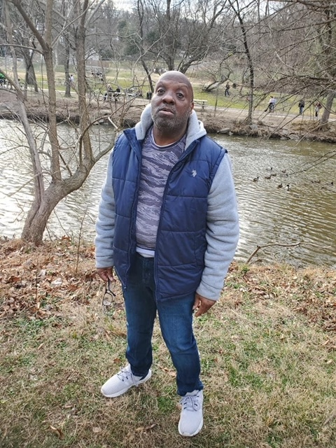
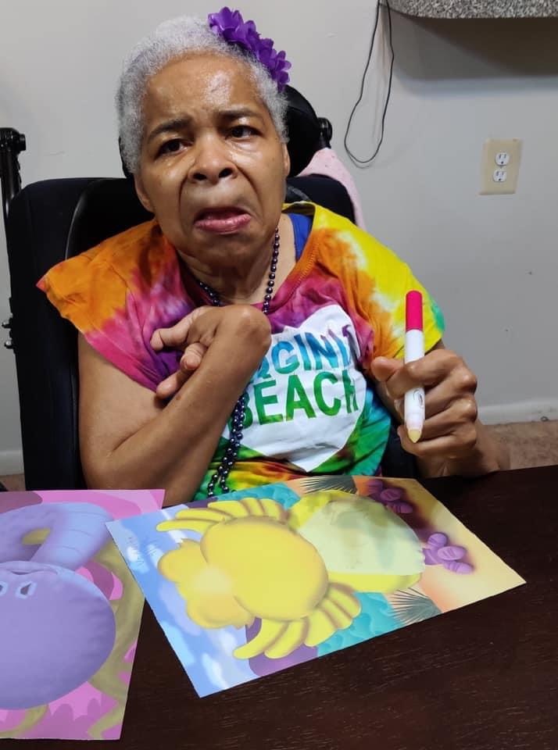
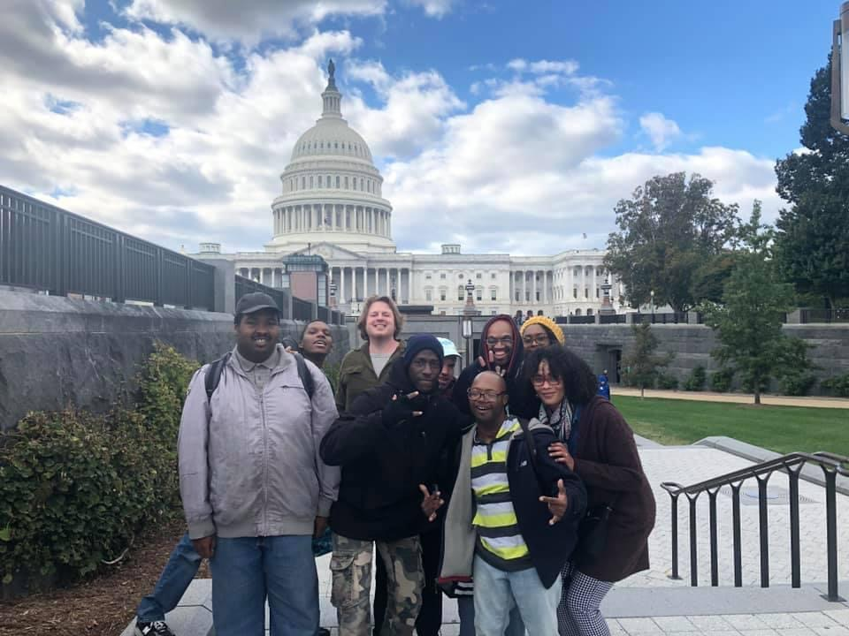
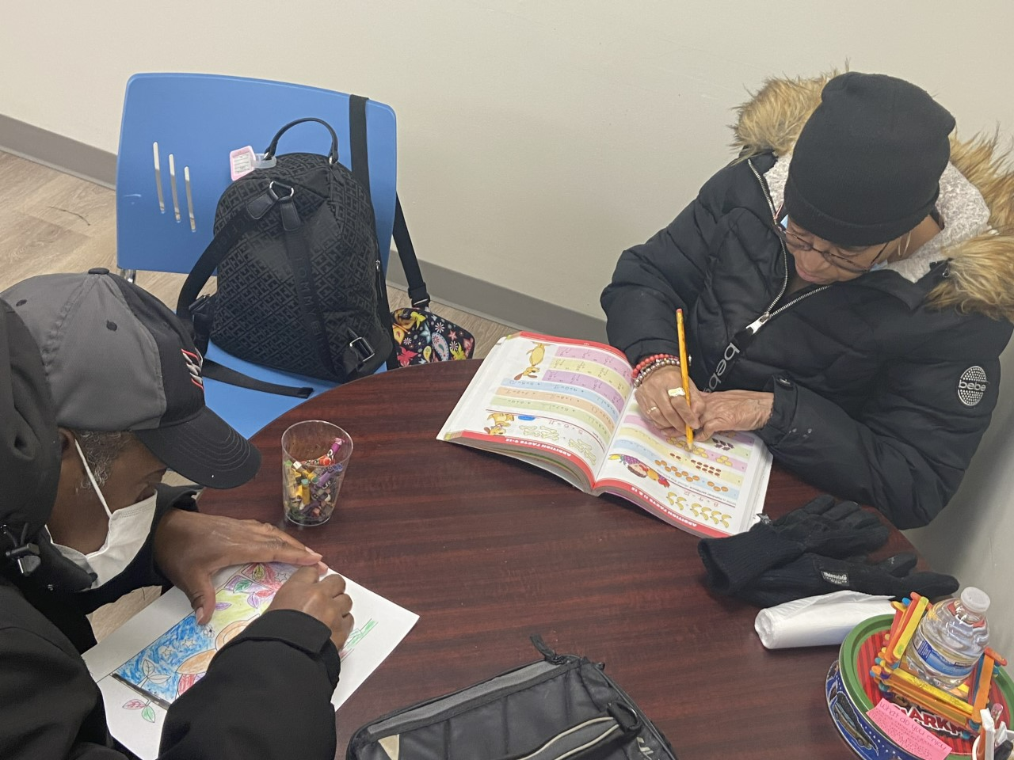

Slide 20
Intellectual and Developmental Disabilities (IDD) Waiver Renewal Individual and Family Support Waiver Amendment

Slide 21
Changes to IDD and IFS Waivers
The District has expanded IDD and IFS waiver eligibility to include persons with Developmental Disabilities (DD) without a diagnosis of an Intellectual Disability (ID).
The District added a new service delivery in the IDD and IFS waivers to include Remote Supports Services (RSS).
Additionally, there was a new service added to the IFS waiver: Participant-Directed Services (PDS), My Life, My Way Program.

Slide 22
IDD and IFS Waiver Enrollment
IDD Waiver
Waiver Year 1 unduplicated recipients: 1943
Currently enrolled: 1827
Available waiver slots: 116
IFS Waiver
Waiver Year 3 unduplicated recipients: 90
Currently enrolled: 12
Available waiver slots: 78
Notes:
IDD waiver slots increase by 20 each waiver year. IFS waiver slots increase by 30 each waiver year. Currently enrolled and available waiver slots are as of March 31, 2023. The IDD Waiver has 17 applications pending and the IFS Waiver has 8 pending applications.

Slide 23
IDD Waiver Services
Assistive Technology
Behavioral Supports
Bereavement Counseling
Companion Services
Creative Art Therapies
Day Habilitation
Dental
Employment Readiness
Family Training
Fitness Training
Host Home Services
Individualized Day Supports
In-Home Supports
Massage Therapy
Nutrition Evaluation/Consultation
Occupational Therapy
One-Time Transitional Services
Parenting Supports
Personal Care Services
Physical Therapy
Residential Habilitation
Respite Services
Sexuality Education
Skilled Nursing Services
Speech, Hearing and Language
Supported Employment
Supported Living w/without Transportation
Supported Living Periodic w/without Transportation
Notes:
The Individuals with Intellectual and Developmental Disabilities (IDD) waiver is the comprehensive waiver which provides residential supports and does not have a monetary cap.

Slide 24
IFS Waiver Services
Assistive Technology
Behavioral Supports
Bereavement Counseling
Companion Services
Creative Art Therapies
Day Habilitation
Education Supports
Employment Readiness
Family Training
Fitness Training
Individualized Day Supports
In-Home Supports
Massage Therapy
Nutrition Evaluation/Consultation
Occupational Therapy
Parenting Supports
My Life, My Way Program: Participant-Directed Services (PDS)
Personal Care Services
Physical Therapy
Respite Services
Sexuality Education
Skilled Nursing Services
Speech, Hearing and Language
Supported Employment
Notes:
The Individual and Family Support (IFS) Waiver provides supports to persons who reside in their natural home, who do not require/need residential supports, and has a $75,000 cap for services and supports. Educational Supports and PDS are specific to the IFS Waiver.

Slide 25
Remote Supports Services
Remote Support Services (RSS) are provided to persons enrolled in the Home and Community Based Services (HCBS) Waiver who can utilize equipment/technology needed for remote supports services as recommended by the support team and assessed by the shift enabling technology provider.
The support team will utilize the Assessing Interest in Remote Supports and Technology tool to assess the person’s ability to benefit at different levels/hours of RSS engagement to determine how many hours the person can engage in this service delivery for the appropriate waiver service(s).
A hybrid model will be used for in-person and remote supports service hours where two service authorizations will be issued to cover the in-person service hours and the remote support service hours. RSS have a GT modifier code in the procedure code for eligible waiver services.
Notes:
The tool will be implemented 6 months post the end of the PHE. Currently being modified.

Slide 26
Remote Supports Services
Remote Supports Services (RSS) will be available to participants six (6) months post the ending of the Public Health Emergency (PHE). RSS will enable persons to be more independent and less reliant on staff to be physically present to receive support. RSS will be available for the following IDD and IFS Waiver services:
Behavioral Supports
Bereavement Counseling
Creative Art Therapies
Day Habilitation
Employment Readiness
Family Training
Fitness Training
Nutrition Evaluation/Consultation
Occupational Therapy
Parenting Supports
Sexuality Education
Speech, Hearing and Language
Supported Employment
Supported Living w/without Transportation
Supported Living Periodic w/without Transportation

Slide 27
Remote Supports Services Rates
Remote Support Services (RSS) will be a separate billable service with a specialized rate different from the in-person service delivery rate in some circumstances. RSS rates for the following services will maintain the same rates:
Bereavement Counseling Services
Creative Art Therapies Services
Fitness Training Services
Nutrition Evaluation/Consultation Services
Occupational Therapy Services
Parenting Supports
Sexuality Education Services
Speech, Hearing and Language Services
Supported Employment Services
Notes:
RSS separate billable service will be identified by the GT modifier in the procedure code for the waiver service(s) available through this service delivery model.

Slide 28
Remote Supports Services Rates
Remote Support Services (RSS) rates for the following services will have specialized rates different from the in-person service delivery rates:
Day Habilitation
Employment Readiness
Supported Living w/without Transportation
Supported Living Periodic w/without Transportation
The transportation component of supported living with transportation remote supports and supported living periodic with transportation remote supports will maintain the same rates as in-person rates.

Slide 29
Remote Supports Services Delivery Limitations
Waiver services that cannot be delivered remotely 100% of the time and has a requirement for in-person visits include the following:
Behavioral Supports
Bereavement Counseling
Creative Art Therapies
Day Habilitation (RSS can be provided no more than 4 hours per day)
Employment Readiness (RSS can be provided no more than 4 hours per day)
Family Training
Fitness Training
Nutrition Evaluation/Consultation
Occupational Therapy
Parenting Supports
Sexuality Education
Speech, Hearing and Language
Supported Employment
Supported Living Periodic
Supported Living daily requires in-person visits and may be delivered remotely up to 75% of the time the person receives supported living services per day.
Notes:
DDS will upload the IDD/IFS Waiver Rates Crosswalk to the providers dashboard in MCIS/the new case management system upon final approval from DHCF, which includes the base rates and RSS rates, and service limitations for each waiver service. For SL, in-person staff will be available to the person for 2 hours at the beginning and ending of each shift and therefore there will be 100% coverage for persons supported.

Slide 30
Remote Supports Services Staffing Ratios
Supported Living remote supports services staffing ratio for awake (daytime) hours is 1:6 and must have active, continuous engagement and contact with the remote support platform. Supported Living overnight staffing ratio is 1:15. Staff should be available during the service hours and document that they are continuously engaged with the person and/or the remote supports responder platform to bill for hourly services rendered. Corresponding on-call remote supports staffing ratio during waking (day) hours is 1:10 and sleeping hours is 1:20.
Day Habilitation 1:1, Day Habilitation, Day Habilitation Small Group and Employment Readiness remote supports services staffing ratio are 1:6 and must have active, continuous engagement and contact with the remote support platform. Staff should be available during the service hours and document that they are continuously engaged with the person and/or the remote supports responder platform to bill for hourly services rendered.
Notes:
The IDD/IFS Waiver Rates Crosswalk will also include staffing ratios for RSS. RSS definitions are pending approval from DHCF and upon approval will be posted to DDS website.

Slide 31
What is Participant-Directed Services (PDS)
Participant-directed services are long-term care supports and services that help people of all ages across all types of disabilities maintain their independence and determine for themselves what mix of personal care services and supports work best for them. Participant-directed services are sometimes referred to as consumer-directed or self-directed services.
Participant-directed services are not intended to replace agency services. Instead, they provide an alternative to those who want it.
Family Caregiver Alliance

Slide 32
Participant-Directed Services (PDS)
Self-Direction may be a great service if:
PEOPLE want more flexibility with their services on their own or choosing to elect a representative.
PEOPLE are ready to make decisions about their services on their own or with their representative.
PEOPLE want to take more responsibility for managing their services.

Slide 33
Services Offered through PDS – My Life, My Way Program
PDS allows participants to have the responsibility for managing all aspects of service delivery in a person-centered planning process.
In-Home Supports
Individualized Day Supports (IDS) 1:1
Companion Services 1:1
Respite (Daily-out of home)
Individual-Directed Goods and Services (IDGS)

Slide 34
Individual-Directed Goods and Services (IDGS)
Individual-Directed Goods and Services (IDGS) are services, equipment, or supplies not otherwise provided through the IFS Waiver or the Medicaid State Plan that:
Relate to a need or goal identified in the person-centered Individual Support Plan (ISP);
Maintain or increase independence; and
Promote opportunities for community living and inclusion.
IDGS are only available if the individual does not otherwise have the funds to purchase the good or service, or the IDGS is not available through another source.

Slide 35
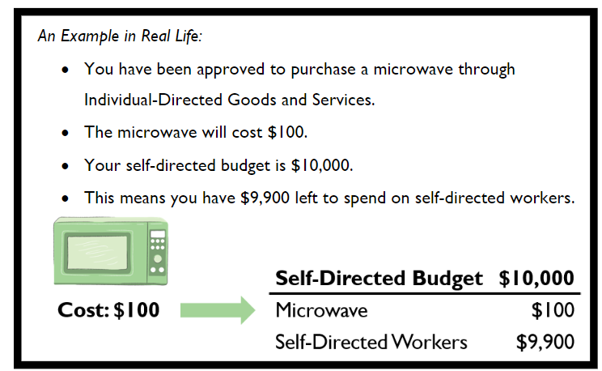
Individual-Directed Goods and Services (IDGS)
IDGS are purchased from the IFS Waiver budget (spend cap of $2,500/yr.).
IDGS are only available to waiver participants who are enrolled in the Participant-Directed Services (PDS) program, under the IFS Waiver.

Slide 36
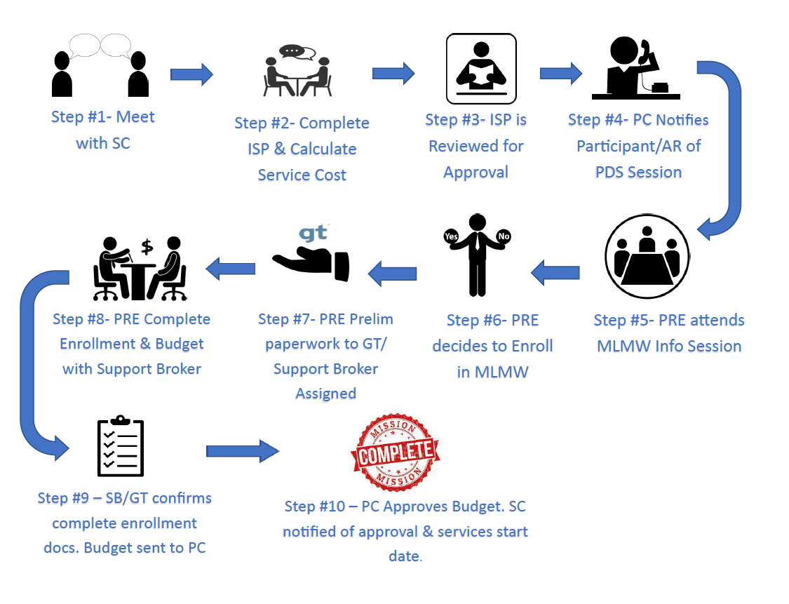
My Life, My Way Program Enrollment Process

Slide 37
PDS Budget
Participants manage their PDS budget which allows them to choose the services that best fit their needs.
IFS Waiver Budget Cap: $75,000 (including IDGS spend cap of $2,500/yr.)
Hire their own staff, Participant-Directed Worker(s) (PDWs)
Determine employer payrate – range determined by DHCF
GT Independence oversees their budget utilization, and process payroll.
GT will upload monthly budget summaries into MCIS for SCs to view.
GT will monitor monthly spending by completing monthly & quarterly meetings
GT will allocate and file appropriate federal and local taxes for each PDW

Slide 38
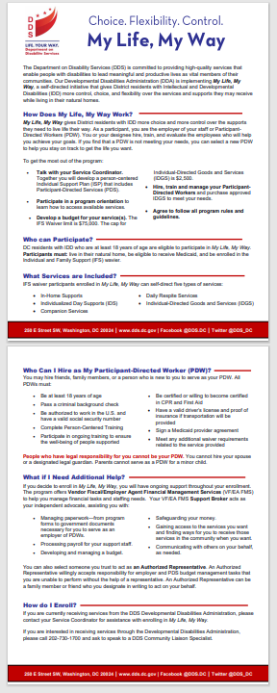
My Life, My Way Fact Sheet
The My Life, My Way (PDS) Fact Sheet is uploaded to DDS website at: https://dds.dc.gov/page/medicaid-waiver-information

Slide 39
Questions?
If you have questions regarding Remote Supports Services (RSS) and unwinding from the Public Health Emergency (PHE), please contact Bernetrice Parker, Medicaid Waiver Program Specialist at bernetrice.parker@dc.gov or Pamela Harmon, Supervisory Medicaid Waiver Specialist at pamela.harmon@dc.gov.
If you have questions regarding Participant-Directed Services (PDS), please contact Shana Holmes, PDS Program Coordinator at shana.holmes@dc.gov.
If you have questions regarding persons returning to meaningful day supports and the MAP, please contact Service Planning and Coordination Division (SPCD) Program Managers: Musu Fofana at musu.Fofana@dc.gov; Robin Exton at robin.exton@dc.gov; Rhode Bernadel at rhode.Bernadel@dc.gov; or Sherin Moses at sherin.moses@dc.gov.

