Slide 1




OFFICE OF Financial empowerment & EDUCATION
Financial Foundations and OFEE Offerings
August 23, 2023

Slide 2

Who am I?
Jay Savoy, Community Outreach Specialist
Financial Education Trainer
Speaker

Slide 3
Who We Are
Empower and educate residents on financial matters
Provide financing for District small businesses
Cultivate a regulatory environment that protects consumer and attracts and retains financial services firms to the District
DISB regulates financial services businesses in the District by administering District of Columbia insurance, securities and banking laws, rules, and regulations.

Slide 4
An overview of the office of financial empowerment & education
Provides resources to promote financial equity and generational wealth.
Partners with stakeholders to provide innovative financial education initiatives that safeguard the financial future of Washingtonians.
Promotes inclusiveness and resilience through financial education.
Access to resources for all residents.

Slide 5




Our vision
Financial education is key to financial empowerment and independence.
We believe that every Washingtonian has the right to a fair shot through financial education and, with it, the ability to make positive decisions.

Slide 6
Ofee programs & resources
Bank on DC
Earned Income Tax Credit Campaign (EITC)
Financially Fit DC
Opportunity Accounts
Financial Empowerment Center (FEC)

Slide 7
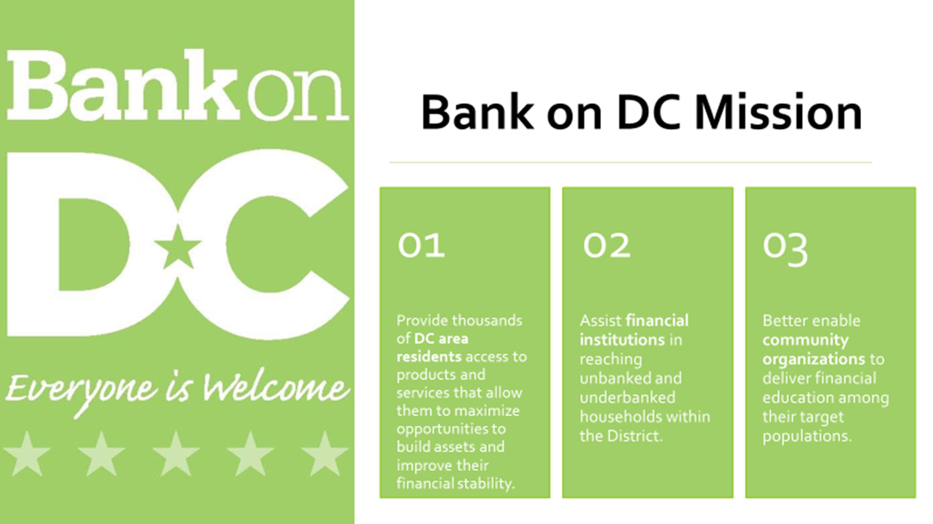
Bank on DC
Notes:
Bank on DC involves :
Affordable checking and savings account that serves the needs of the community. These accounts have no monthly fees, no minimum balance and no transaction fees.
Second chance accounts that accepts those that may have had issues with banking accounts in the past
Acceptance of foreign IDs as primary identification (Ecuadorian, Mexican, El Salvadorian)
Financial Education Classes

Slide 8
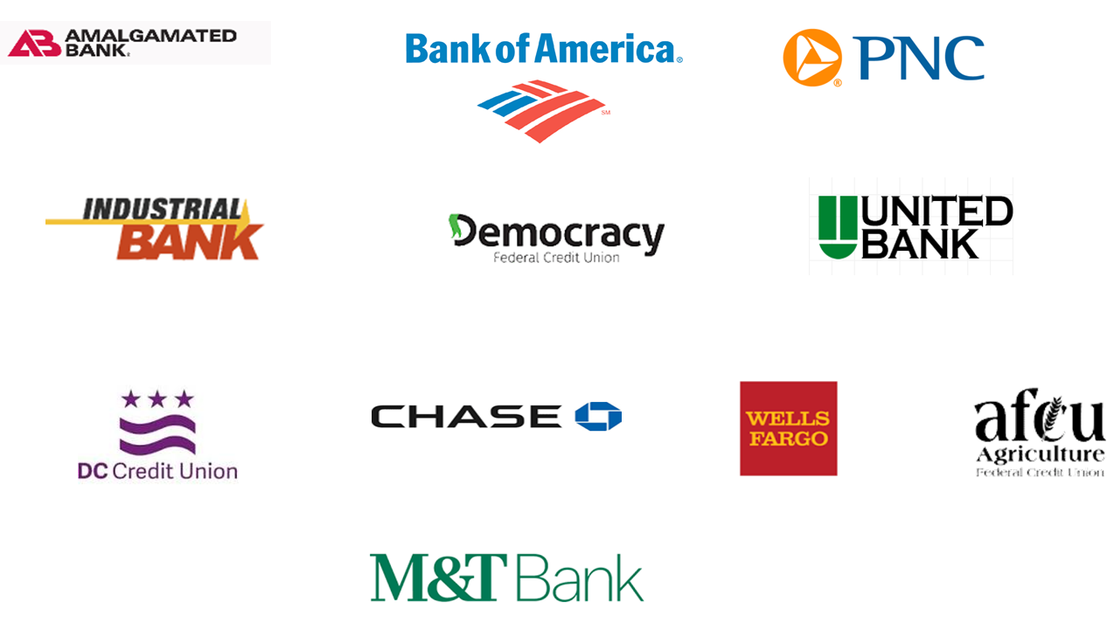
Current bank on dc financial institution partners

Slide 9
How to connect
OFEE Program Contact:
Jazman Hicks
202-442-8596
Jazman.hicks@dc.gov
BankOnDC.org

Slide 10
Eitc marketing campaign
Federal and DC Earned Income Tax Credit (EITC)
Funded by DISB and operated by Capital Area Asset Builders (CAAB)
Serviced 6,300 taxpayers with over $8.7 million in federal plus state/local refunds
IRS Certified and Trained tax preparers
Free tax preparation sites throughout DC
Tax preparation sites include Community Tax Aid, UPO, and Catholic Charities
Notes:
Campaign is from January through tax day

Slide 11

More information on eitc
DISB EITC Campaign Info
disb.dc.gov/eitc
IRS EITC Info
irs.gov/credits-deductions/individuals/earned-income-tax-credit-eitc
DC EITC Info
eitc.dc.gov

Slide 12
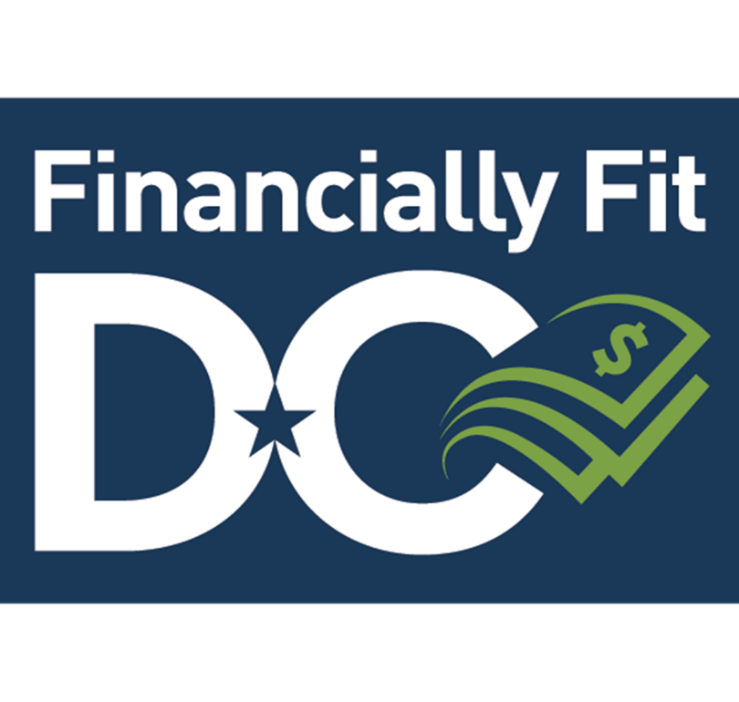
Financially fit dc
Online and mobile self-directed financial assessment tool
Helps users identify short-term needs and set lifetime goals through a personalized financial playbook.

Slide 13
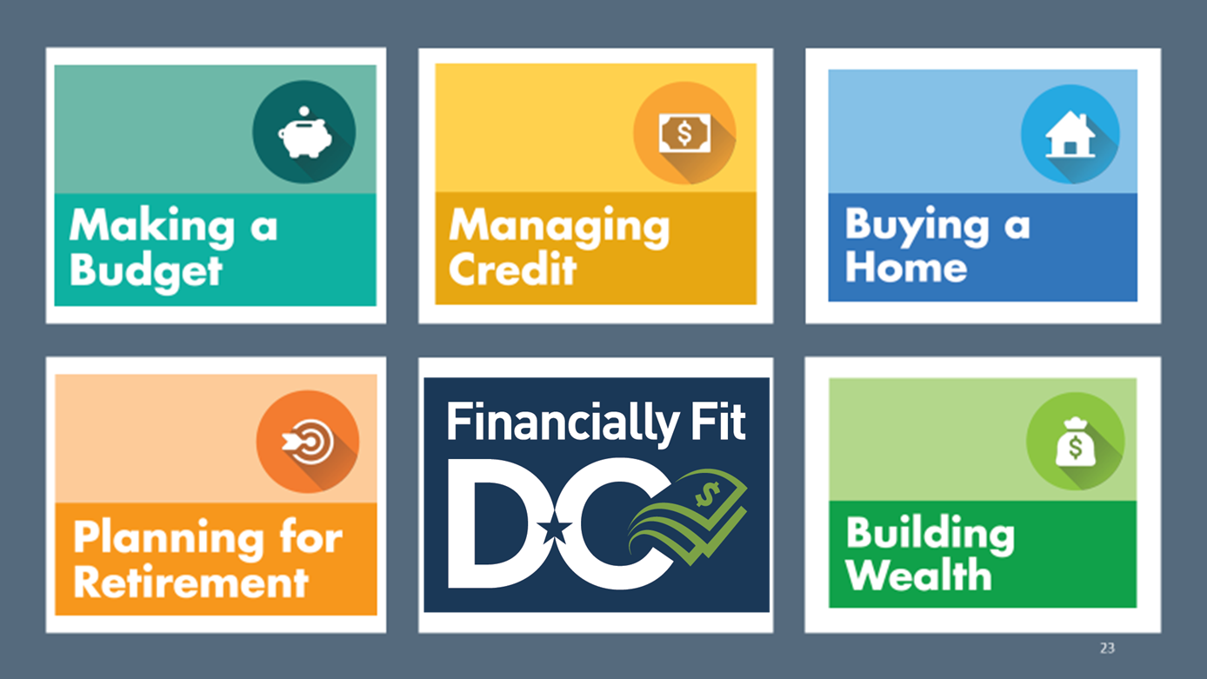
Financially fit dc topics

Slide 14

How to connect
Sign up TODAY!
https://welcome.financiallyfitdc.com/

Slide 15
Opportunity accounts (matched savings program)
Administered by Capital Area Asset Builders (CAAB)
4:1 matched savings program
Savings up to $7,500 for qualified participants
Funds available for:
education
first-time home purchases
renovations/repairs
small business development
retirement.
Money management and asset-specific training

Slide 16

How to engage
OFEE Program Contact:
Kamaria Mabry, PMP
202-442-7640
Kamaria.Mabry@dc.gov
Click here for more information

Slide 17
Financial empowerment center overview
One-on-one financial counseling at no charge to all DC residents.
All sessions are confidential.
The Financial Empowerment Center is physically located at
UPO-Petey Greene Center 2907 Martin Luther King Jr. Ave SE Washington, DC 20032
Banking access
Credit improvement
Debt reduction
Savings
Counseling can be virtual, via phone, or in-person.

Slide 18

Financial counseling model
Client Counseling Steps:
Discuss your financial situation and goals
Financial Assessment
Set Goals and Strategy
Ongoing Support and Goal Attainment
Schedule an appointment with a Financial Counselor

Slide 19

How to get started
Call:
(202) 682-6572
Email:
fec@upo.org
Walk-ins:
During normal business hours
9:00 am – 5:00 pm

Slide 20
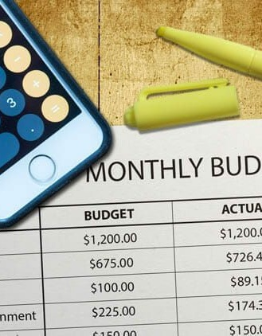
Budgeting
“A budget is more than just a series of numbers on a page; it is an embodiment of our values.”
– Barack Obama

Slide 21

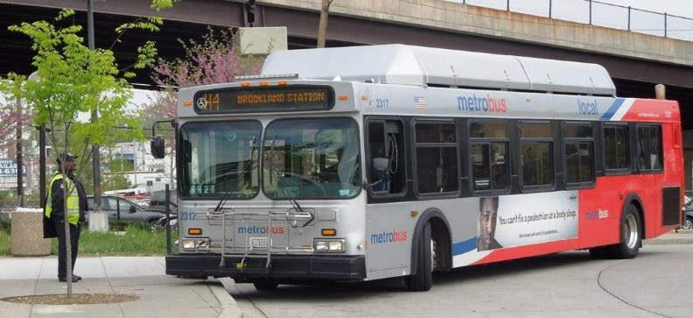

Prioritize Your Spending!
Needs
Anything necessary for survival
(food, shelter, and water)
Obligations
Something you agreed to uphold
(utilities, subscriptions, credit cards)
Wants
Things that you may desire to have
Notes:
To introduce the next section on prioritizing your spending, provide participants with a definition of a need, obligation, and want.

Slide 22

Why Create a Budget?
A Budget:
  Is a step-by-step plan for meeting expenses in a given period of time
  Helps you reduce anxiety
  Gives you a sense of control over your money
  Helps you build assets

Slide 23

Income
Gross income = total income
Net income = total income - deductions
Deductions:
  Federal Income tax
  Social Security and Medicare Tax
  State and Local Income Tax
  Court-Ordered Garnishments
  Voluntary Deductions
Notes:
What are FICA Taxes?
The Federal Insurance Contributions Act (FICA) tax is comprised of the Social Security and Medicare taxes that are withheld by federal law. ... Social Security taxes fund retirement benefits, benefits for the dependents of retired workers, and benefits for the disabled and their dependents.
There are certain taxes on income that everyone has to pay, and FICA taxes are at the top of the list. And employers must withhold these taxes from employee paychecks and pay them to the Internal Revenue Service (IRS).
FICA taxes are the Social Security and Medicare taxes paid by individuals and employers. FICA taxes are called payroll taxes because they are based on the amounts paid to employees.
Retirement benefits
Disability benefits
Family benefits
Survivor benefits
Medicare benefits
Voluntary Deductions
While income taxes, FICA and garnishments are the standard deductions from an employee's paycheck, there can be many others. Often, health insurance, life insurance, retirement plans and flexible spending accounts are offered as fringe benefits for employees. The amounts that the employee pays are deducted from their paychecks. These voluntary deductions vary from business to business.

Slide 24




Expenses
Fixed expenses do not change from month to month.
Flexible expenses often change from month to month.
  You may have some control over how much you pay.
  Shop for the best value before committing to any payments.

Slide 25
Budget Steps
Track
Keep track of your daily spending
Determine
Determine your monthly income and expenses
Find ways to decrease spending
Increase
Find ways to increase income
Decrease
Where does my money come from? go?

Slide 26
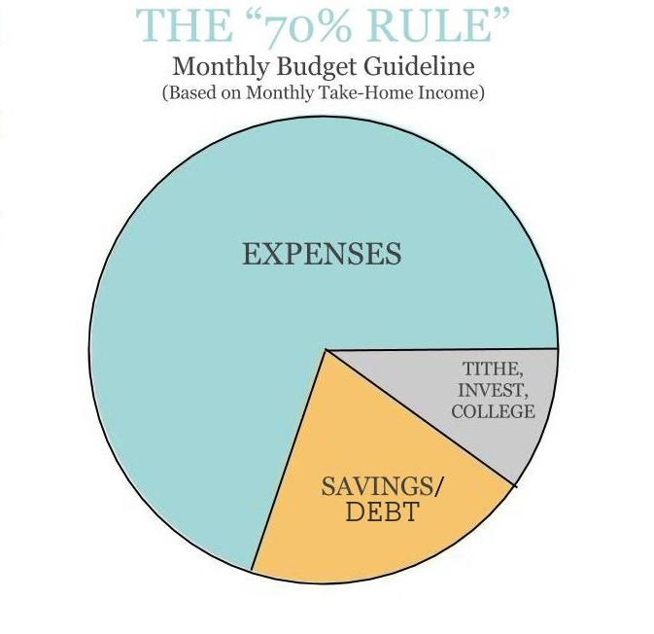
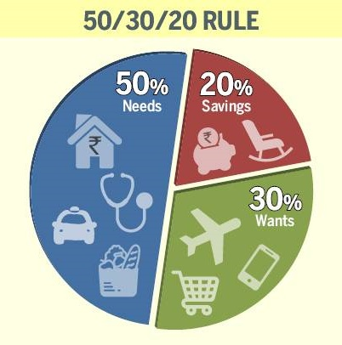

Slide 27

Saving
Do not save what is left after spending but spend what is left after saving.
– Warren Buffett

Slide 28

Pay Yourself
First!
What does it mean to “pay yourself first”?
Why would you want to save money before paying your bills?
What are some of the things you might want to save money for?
Notes:
Add Testimonial in the beginning. This may be a section that most will disagree with.
The idea behind paying yourself first is that you are setting your self up for a strong financial future. If you always pay your bills first before paying yourself, you will never have enough money
The idea behind setting up an emergency fund is to protect yourself against unforeseen costs, it’s like having your own back. An emergency fund also protects you against job loss.
It should be noted that most Americans don’t have $400 available if an emergency was to happen!
Now that we understand why we should
prioritize spending, and pay ourselves first, we can move on to our budget.
What does it mean to “pay yourself first”?
Put money in savings before paying your bills
Why would you want to save money before paying your bills?
What are some of the things you might want to save money for?

Slide 29

Save with a goal in mind
Tailor the product used to the time needed to save
Notes:
Take a poll- What are some ways to save? If I wanted to save for vacation or move what would be the best way to do that?
(Short Term)Emergency Fund = Savings Account
(Mid-Term) Car, Vacation, Etc.= Money Market/ Certificate of Deposit
(Long Term) Retirement (401k, IRA, etc.)= Investments (i.e. Stocks, Bonds, mutual funds) ** Investment vs Saving conversation.

Slide 30

Savings Account
Keeping your money “in the bank”
Often limits the number of deposits and withdraws per month
Need to keep a minimum amount
Earns interest
Insured by the federal government

Slide 31
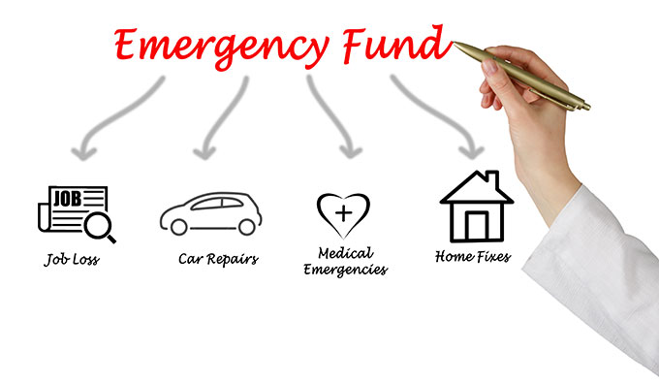
Emergency Fund
Having your own money set aside to cover unexpected expenses can save you money, because you won’t pay interest, fees, or other costs that come from borrowing the money you need.

Slide 32

Saving for Retirement
Defined benefit vs. defined contribution plans
Estimating retirement expenses and inflation
Individual Retirement Accounts (IRA)
Notes:
What is the greatest asset you have for creating wealth right now? Time!
Traditional IRA contributions are tax-deductible on both state and federal tax returns for the year you make the contribution; withdrawals in retirement are taxed at ordinary income tax rates. Roth IRAs provide no tax break for contributions, but earnings and withdrawals are generally tax-free.
A defined benefit plan, most often known as a pension, is a retirement account for which your employer ponies up all the money and promises you a set payout when you retire. A defined contribution plan, like a 401(k) or 403(b), requires you to put in your own money.

Slide 33

Credit
“If you don’t take good care of your credit, then your credit won’t take good care of you.” – Tyler Gregory

Slide 34
What is Credit?
The ability to borrow money
Sometimes called a loan
A promise you make to pay back money
Paid back with interest
Notes:
Credit is:
The ability to borrow money
Sometimes called a loan
A promise you make to pay back money you borrowed with interest.

Slide 35

Why is Credit Important?
Is convenient when you do not have cash
Is useful in times of emergencies
Allows you to pay for purchases over time
Employment
Housing
Insurance
Notes:
-Credit is convenient especially when you don’t have the funds you need when you need them
-Credit us useful in an emergency. Like if I have a flat tire in the middle of the night and I need to pay for a tow truck
-Credit allows you to pay for things you need and want over time.
-Credit is used to help determine if you are eligible for jobs, getting insurance, renting an apartment or buying a house
- Are there any other reasons why credit is important

Slide 36
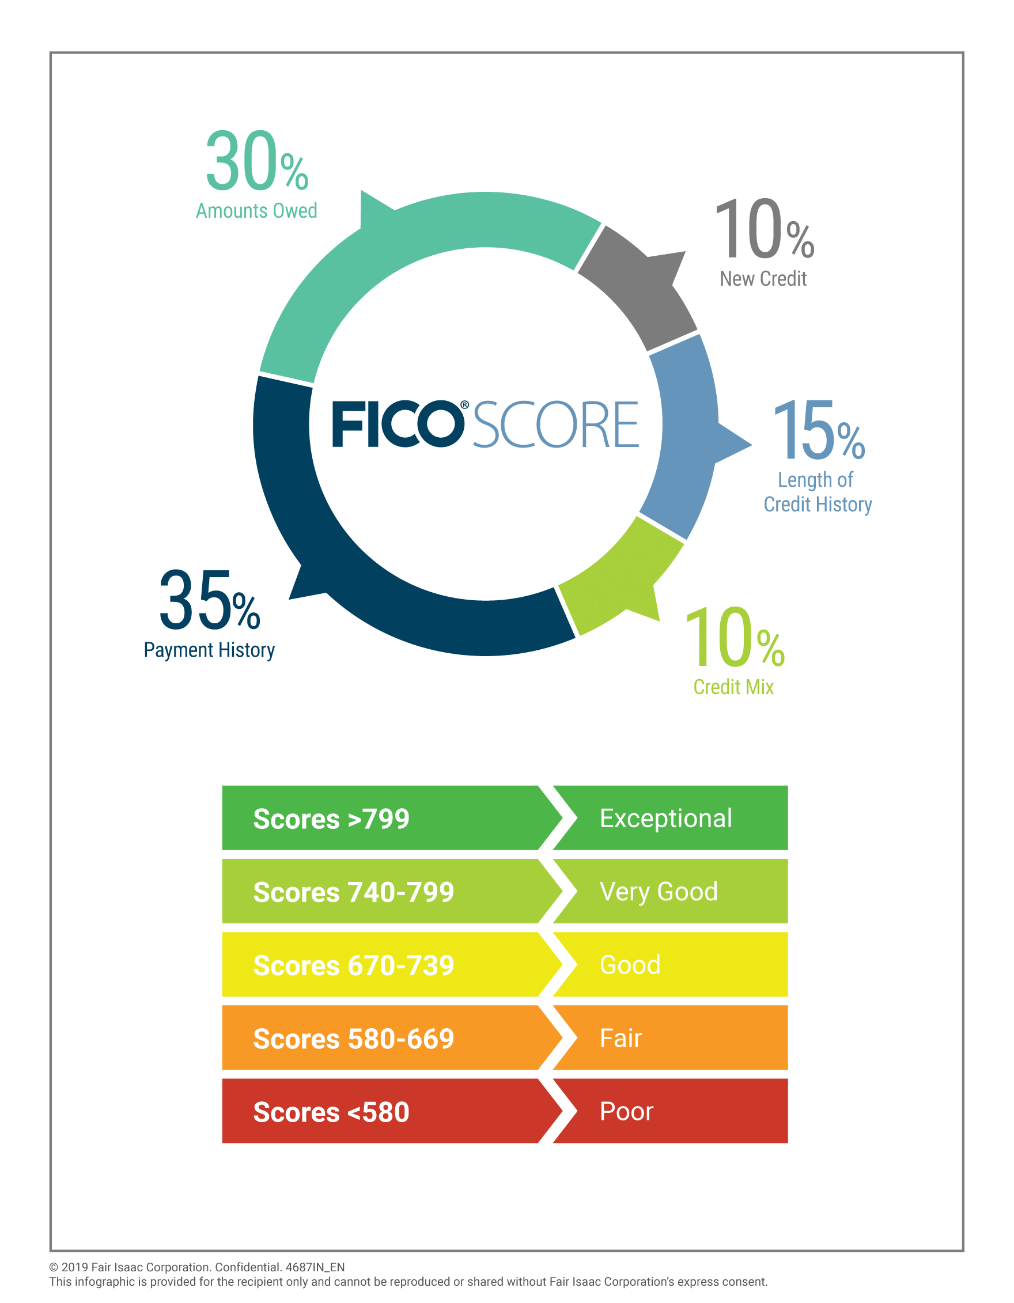
Notes:
-Credit is you borrowing money against your good name. Think of your credit score as an adult report card.
-The credit report is your report card and the score is your GPA. You want the report and score to both be good.
-Credit scores range between 300 and 850. The higher the score the better.
-Imagine your teacher giving you your syllabus on the first day, on the syllabus is a break down of what categories make up your grade. It should be noted that 65% of your grade is your ability to PAY YOUR BILLS ON TIME AND THE AMOUNT THAT YOU OWE.
That’s ultimately how you build your credit!

Slide 37



Getting free, annual credit reports
Where does the credit report come from?
The largest nationwide agencies include:
Online: Get a free copy of your credit report at AnnualCreditReport.com
By mail: Download and complete the Annual Credit Report Request Form and mail it to:
Annual Credit Report Request Service
P.O. Box 105281
Atlanta, GA 30348-5281
Notes:
-Here is information about where you can see your credit report -There are three credit bureaus
-These agencies sell your information to banks and lenders so that they can decide if you are credit worthy.
-Any company you borrow money from will report it to the credit bureaus
-You can get a free copy of your report every year for free from each bureau.
-It is important to pull your credit report at least one a year to check it for errors.
-If you do find a mistake you can contact each bureau to correct it. They will walk you through the steps you need to take.

Slide 38

Sources of Credit
Banks
Credit Unions
Retail Stores
Finance Companies
Savings and Loans Associations
Internet Stores
Notes:
What are other sources of credit?
What sources of credit should be avoided? Why?

Slide 39
Improving your credit score
Pay bills on time
2
Don’t open a lot of new accounts too rapidly
3
Correct Mistakes
4
Keep balances low on revolving credit
5
Pay off debt
6
Check your credit report
1
Notes:
Divide the group into teams of two to three. Ask the teams to think about ways to improve their individual credit scores. Have them write down their suggestions.
After a few minutes, call time. Display ”Slide 3: Improving Your Credit Score.” Ask the teams whether they came up with any of the suggestions listed on the slide.
• Pay bills on time. The best thing you can do to improve your score is to pay your bills on time. You can begin to improve your credit history immediately by making at least the minimum payments on time. Delinquent payments and collections can have a significant negative impact on your score.
• If you have missed payments, get current and stay current. The longer history you have of paying your bills on time, the better your score will be.
• If you have been managing credit for a short time, don’t open a lot of new accounts too rapidly. New accounts will lower your average account age or the length of time you have the account. People who have had accounts for longer periods of time and have paid them on time tend to have higher scores. Additionally,
if you open up several new accounts rapidly, it will appear that there is a risk of you utilizing all of this new credit. Thus, this additional credit could lower your score.
• Correct mistakes. Your credit score is a reflection of the information in your credit report. If your credit report contains negative information, it will negatively impact your credit score regardless of whether or not the information is accurate. Review your reports from all three credit bureaus for accuracy once a year, as well as several months before applying for a loan. If you discover inaccuracies in your report, follow the procedure to correct the information.
• Do your rate shopping for a loan within a focused period of time. Some scores, such as FICO scores, distinguish between a search for a single loan and a search for many new credit lines, in part by the length of time over which inquiries occur. For example, some scores count all rate inquiries for car loans or mortgage loans in a two-week period as one inquiry.
• Keep balances low on credit cards and other “revolving credit.” High outstanding debt can negatively affect a score.
revolving credit: credit that is automatically renewed as debts are paid off (i.e. Credit cards)
• Pay off debt rather than moving it around. The most effective way to improve your score in this area is by paying down your revolving credit. In fact, owing the same amount but having fewer open accounts may lower your score.
• Remember, it’s okay to request and check your own credit report. When you request your own report, it is considered a consumer inquiry. This won’t affect your score, as long as you order your credit report directly from one of the credit-reporting agencies or through an organization authorized to provide credit reports to consumers.

Slide 40
Banking
“The amount of money currently in your bank account is a fact. The amount you spend today is a choice. And the way you reconcile both is through clarity.”
- Sarah Ban Breathnach

Slide 41

Reasons to put money in the bank
Safety – insured and fraud protection
Convenience – remote account opening and access, mobile app, direct deposit, remote deposit
Cost – avoid check cashing fees
Security – fraud protection and theft protection
Secure Financial future – a relationship with a bank helps you build a better financial future
Notes:
Now that you know more about who we are and what we do> let’s talk about why having a banking account is important.
Here are some of the reasons we want to keep our money in a bank or credit union
Having a banking account saves you time and money. If you have an account, you can get direct deposit. So, your paycheck can be automatically put into your account. That way you don’t have to rush to get to the bank or pay fees for cashing a check. Remember that DC residents spend over $800 a year on fees to access their own money.
Having a banking account is:
Safety – insured and fraud protection
Convenience – remote account opening and access, mobile app, direct deposit, remote deposit
Cost – avoid check cashing fees
Security – fraud protection and theft protection
Secure Financial future – a relationship with a bank helps you build a better financial future

Slide 42

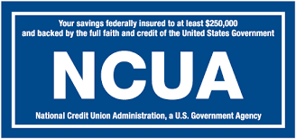
Insured Financial Institutions
Banks
For-profit
Anyone can join
More accessible
Shareholder Owned
FDIC ($250k)
Credit Union
Not for profit
Membership required
Less accessible
Member Owned
NCUA ($250k)
Notes:
-Keeping your money in a financial institution has many advantages and both banks and credit unions are a good place to keep your money
-both are insured, offer remote account opening and remote access, and you can get direct deposit into your account at each
-The big difference between a credit union and a bank is who can join.
-anyone can join a bank, but you need to be a member of a credit union. To become a member, you need to meet certain criteria for example working for a certain employer, live in a particular area, or have a family member who is already a credit union member.
Example of Credit unions include, Andrews Federal Credit Union, Apple Federal Credit Union and DC Credit Union.

Slide 43




Types of Accounts
Checking
Where my cash is!
Spending Account
Direct Deposit
Your paycheck comes here
Savings
Emergency fund
Lower rate of return
Money Market
Savings account
Higher minimum balance
Higher rate of return
Check writing feature
Certificate of Deposit
Predictable goals
Pledge your money
Higher interest rate
Notes:
-Here is a list of the types of accounts you can find at a financial institution
-You use different accounts for different purposes related to your finances!
-You can tailor your goals according to your account type.
Checking Account
Uses a check as the primary manner of withdrawing money
Can also use a check to make purchases
Most have ATM/Debit cards attached to them
Savings Account
Keeping your money “in the bank”
Often limits the number of deposits and withdraws per month
Need to keep a minimum amount
Money Market Account
Money is deposited, just like in a savings account
Instead of just sitting in the bank, the money is invested
A very safe investment, but lower returns
Certificate of Deposit
Money is held in an account for a fixed period of time
There’s an agreed upon rate of return prior to the deposit
Advanced notice must be given to withdraw the money

Slide 44
Opening and Maintaining a Bank Account
Open the account and go through account verification.
Make deposits and withdrawals.
Record interest and fees.
Keep track of your account balance.
Notes:
More information to this regard, please visit Bankondc.org

Slide 45

Q & A
Do you have any questions?
How will you apply this information?

Slide 46
Thank You
Contact
Name: Jay Savoy
Phone: 202-442-7811
Mobile: 202-717-0246
Email: jasmine.savoy1@dc.gov
General Inquiries:
Department of Insurance, Securities and Banking
202-727-8000
disb@dc.gov

