Slide 1


Department on Disability Services (DDS)
New Employee Orientation
2014
Notes:
Last updated 11-15-12

Slide 2
Introduction
DDS New Employee Orientation
Andre’ White, Human Resources Specialist
(Employee Benefits)
Native of Washington, DC
I love to read books and I was voted MOST Talkative in High School
Please share with us your:
Name
Your New Position you will be joining us as
Something about yourself

Slide 3
Today’s Schedule
DDS New Employee Orientation
Introduction to Agency
Benefits
Presentation by Union Representative
ID Credentials
  Travel to DC Human Resources, 441 4th Street, NW with Form 50 from DDS HR Department
  Upon return, e-mail the 5 digits on the back of your ID to rosel.boone@dc.gov for internal building access
  Building Key Cards
Notes:
If the Building Key Card or Key is lost, stolen or damaged beyond repair, the employee must pay a $15.00 replacement fee.
If separated from DDS, each employee will return the Key Card, keys, and DC Government ID badge to Human Resources at Exit Interview.

Slide 4
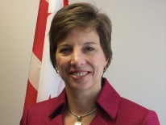
Message from the DDS Director
Dear Fellow Employee:
Welcome to the Department on Disability Services (DDS). We are glad you are here.
As a member of the DDS Team, you play an important role in helping the Agency accomplish its goals.
Whether you are interacting directly with someone requesting or receiving our services or behind the scenes
supporting the DDS Team, your performance is important in determining the success of DDS.
We aim to provide the highest quality services to individuals with disabilities in the District of Columbia.
I expect you, as a member of the DDS Team, to perform your job to the best of your ability to
constantly look for better ways of delivering services and to exhibit integrity and commitment to our mission
each and every day.
I am pleased you’ve joined our team, and I sincerely hope that your affiliation with DDS will be a
rewarding one.
Sincerely,
Laura Nuss
Director

Slide 5
DDS Director’s expectations for all DDS staff members
Collective problem-solving, coordination, and cooperation across units and divisions
Routine and regular communication between supervisors and staff, between and among supervisors and management
  Individual accountability

Slide 6
DDS Mission Statement
To provide innovative, high quality services that enable people with disabilities to lead meaningful and productive lives as vital members of their families, schools, workplaces and communities in every neighborhood in the District of Columbia.

Slide 7
Composition of DDS
DDA Deputy Director, Cathy Anderson
RSA Deputy Director, Andrew Reese
DDD Division Director,
Marc Young
DDS Director, Laura Nuss

Slide 8
Department on Disability Services
Office of the Director: Provides executive management, policy direction, and strategic planning for the entire agency.
Human Capital Administration: (HR, Training) Recruits and selects employees; provides on-going training and assessment as well as overseeing organizational leadership and culture.
IT Department: Develops, implements, and maintains DDS’s technology infrastructure; establishes and oversees technology policies and standards; provides technology services and support for DDS staff.
State Office of Disability Administration (SODA): Leads efforts in agency strategic planning, program development, research, and policy analysis.
Quality Assurance: Ensures DDA’s compliance with all federal and District mandates and regulations to promote positive outcomes for people with intellectual and developmental disabilities.

Slide 9
Additional Programs that support DDS
Office Of The General Counsel: Responsible for all legal affairs for DDS; ensures execution of the laws, regulations and policies that guide agency functioning.
Office of Chief Financial Officer: Responsible for the agency’s budget and financial management.

Slide 10
Developmental Disabilities Administration (DDA)
Developmental Disabilities Administration: The mission of DDA is to provide oversight and coordination of all services and supports provided to eligible persons with developmental disabilities in the District of Columbia.
Intake and Eligibility
Service Planning and Coordination
Health and Wellness
Provider Resource Management
Medicaid Waiver

Slide 11
Rehabilitation Services Administration (RSA)
Rehabilitation Services Administration: The mission of the RSA is to provide comprehensive vocational rehabilitation and independent living services to persons with disabilities, which will maximize their quality of life and promote their employability and economic self-sufficiency.
Current programming includes:
    Vocational Rehabilitation Services
    Randolph-Sheppard Business Enterprise Program
    Supported Employment Program

Slide 12
Disability Determination Division (DDD)
  The Disability Determination Division makes disability determinations for two federal programs that provide benefits based on disability.
      Social Security Disability Insurance (SSDI): Monthly disability benefit payment paid out to a worker for which a disability claim is filed.
      Supplemental Security Income (SSI): Disability benefits are payable to
  adults or children who are disabled or blind, who have limited income and
  resources, and who meet the living arrangement requirements. The program
  is designed to provide benefits to meet basic needs such as food, clothing,
  and shelter.

Slide 13

Tell me about my new job…

Slide 14
Tour of Duty
What time do I report for work?
The regular tour of duty for District employees is 8:15 am to 4:45 pm. If an alternate schedule is needed, please discuss with your immediate supervisor.
Who do I call when to report an absence from work?
Call your supervisor if possible before your tour of duty begins but at least within 3 hours.
Snow Days/Emergency Closing:
Closures are at the discretion of the Mayor and/or his designee. An announcement will be sent via e-mail correspondence from the Director of DDS for emergency closures or in the case of inclement weather, via broadcast on the DC Government website, local television stations and news radio programs.
Notes:
WTOP

Slide 15
Annual Leave and
Sick Leave
Full Term Employees accrue annual leave each pay period.
Years of Employment: | Annual Leave Accrual pay period:
0 to 3 | 4 hours =13 days
4-15 | 6 hours =20 days
15+ | 8 hours=26 days
Full Term Employees accrue 4 hours of Sick leave each per pay.

Slide 16
HR Forms
Form I-9, Employment Eligibility Verification
Overtime/Compensatory Time Disclosure Statement
Form W-4
Employee Withholding Allowance Certificate
Notification of Employment of Relatives Form
Statement of Prior Federal Service
DDS Emergency Contact Information
Drug Free Workforce Notification Form
Appointment Affidavit

Slide 17

HR Policies
Dress Code Policy
Sexual Harassment Policy
Equal Employment Opportunity
Americans with Disabilities Act (ADA)
Visitor’s Policy

Slide 18
Equal Employment Opportunity
The District of Columbia Government is an Equal Opportunity Employer. The District Government prohibits discrimination in employment because of race, color, religion, national origin, sex, age, marital status, personal appearance, sexual orientation, family responsibilities, matriculation, political affiliation, or physical handicap.

Slide 19
Americans with Disabilities Act (ADA)
Americans with Disabilities Act of 1990:
  Prohibits private employers, state and local governments, employment agencies and labor unions from discriminating against qualified individuals with disabilities in job application procedures, hiring, firing, advancement, compensation, job training, and other terms, conditions, and privileges of employment.
  An individual with a disability is a person who:
  Has a physical or mental impairment that substantially limits one or
  more major activities;
  Has record of such an impairment; or
  Is regarded as having such an impairment.

Slide 20
Sexual Harassment Policy
Sexual Harassment is prohibited by the DC Human Rights Act of 1977 (as well as Title VII of the federal Civil Rights Act of 1964).
Sexual Harassment may include, but is not limited to, verbal harassment or abuse, subtle pressure for sexual activity, patting or pinching, brushing up against another employee’s body, or demands for sexual favors.
Filing a Formal Complaint:
If you believe that you have been the victim of sexual harassment or any other type of unlawful discrimination in the District of Columbia, call the Office of Human Rights at 202-727-3900.
Remember: Sexual Harassment may constitute a criminal offense and may also subject the harasser to a civil suit.
Notes:
Sexual Harassment by supervisors and or/co-workers is prohibited in the District of Columbia workplace.
Both females and males may be victims of sexual harassment.

Slide 21
Dress Code
  Business attire should be worn at all meetings including consumer meetings. Clothing should be clean, pressed, and wrinkle free.
  Men: Dress pants and a dress shirt or sweater
  Women: Dress pants/skirt and a dress shirt/sweater or a professional dress
  Examples of inappropriate attire includes:
    Ripped, torn, acid washed jeans
    T-shirts or Tank Tops
    Sweat clothes/Leisure attire
    Spaghetti straps or halter dresses or tops
    Shorts
    Short skirts more than 3 inches above the knee
    Extremely tight pants which include stretch pants, leggings, jeggings
    Flip-Flops or athletic shoes
    Hats, caps or hair wraps (unless for medical, cultural or religious
    accommodations.)
  For casual Friday’s, the addition of dress jeans is acceptable as long as they contribute to the appearance of professional dress.
Notes:
It is always important to project the image of a knowledgeable public servant for the consumers and vendors who seek our guidance and input.

Slide 22
Visitor Policy
ALL DDS visitors in the building must go to the first floor reception area, sign in, and receive a badge.
Visitors must wear a name badge while in the building.
All visitors must be escorted by a DDS staff member to final destination.

Slide 23
HIPAA and PHI
Health Insurance Portability and Accountability Act (HIPAA)
  Legislation that established standards for the privacy and security of medical records and information
  This legislation established regulations that provide standards for electronic transmission of Protected Health Information (PHI).
Protected Health Information (PHI)
  PHI is individually identifiable health information related to a person's past, present, or future physical or mental condition, provision of health care, or payment for health care.
DDS and HIPAA…
Understanding the rights under HIPAA is important in protecting an individual’s personal health information.
You must have a signed authorization in order to disclose PHI.
The agency has designated certain employees to receive PHI.
Notes:
Tell staff they will receive additional HIPAA training

Slide 24
HIPAA Do’s and Don’ts
Follow safeguards for PHI that is transmitted by fax or e-mail.
Don't leave sensitive information on voicemail.
File away promptly and secure folders that contain PHI.
Make sure written authorizations (consent) to use and disclose PHI are received.
Avoid verbal discussions of PHI within earshot of people who don't have a need to know.
Remind people that only the "minimum necessary" PHI should be disclosed except for treatment purposes.

Slide 25
Language Line Services are available
The DC Language Access Act of 2004: DC agencies must provide equal access to programs, activities, and services for residents that speak limited or no English.
DDS Staff have the access to over-the-phone interpretation 24 hours a day, 7 days a week for clients in need of this service.
Place the Limited English Speaker (LES) on conference hold and dial the Language Line Services toll-free number.
    1-877-245-0386 (operator)
    1-866-874-3972 (automated)
Enter on your telephone keypad or provide the representative
    DDS Six-digit Client ID number-- “511321”
    Your Organization Name-- “Department on Disability Services”
      Press 1 for Spanish
      Press 2 for all other languages (Speak the name of the language at the prompt)
      Press 0 or stay on the line for assistance.
    An interpreter will be connected to the call.
When the interpreter is connected, conference in the LES.

Slide 26
People Soft
The Employee Self Service (ESS) Module of PeopleSoft Payroll (ePay), allows employees to manage payroll-related activities via their computer
District e-Pay users can:
Change federal W-4 tax exemptions
Review and print current and previous PeopleSoft pay stubs;
Update direct deposit allocations/allotments, and change bank account information;
Review net pay, supplemental adjustments and prior period adjustments;
Review sick and annual leave accruals and balances; and
Enter weekly hours worked
For more information and access, visit:
https://pshcm.dc.gov

Slide 27
PeopleSoft
All DC Employees must obtain a PeopleSoft User ID and Password. (Contractors are not eligible for ESS.)
Once your PeopleSoft application is submitted, you will receive two emails.
  Confirmation of your submission.
  Your User ID and Temporary password
After you obtain your Username and Password, you are ready to enter the system. Log on to: https://pshcm.dc.gov/

Slide 28
e-Time = money
THE DEADLINES ARE HARD DATES – NO GRACE PERIOD.
NO TIME,
NO PAY

Slide 29
e-Performance
What is e-Performance?
The performance management
  module in PeopleSoft.
How is e-Performance used?
  To plan, track and
  evaluate the performance
  of an employee.

Slide 30
Benefits for District Employees*
Your HR Team is here to help with…
Health, Dental, Optical Benefits (includes family and domestic partners)
Group Life Insurance
Flexible Spending Accounts
Short and Long Term Disability Insurance
Defined/ Deferred Compensation Plan
Indemnity Plan
Commuter Benefits
*Benefits are not available to contracted employees

Slide 31
Health Benefits
Current Plans available:
Health Plans: Aetna Healthcare (HMO/PPO/CDHP)
Kaiser Permanente (HMO)
United Healthcare (HMO Choice Plan)
DC government contributes up to 75% towards premium cost
The District provides comprehensive optical and dental coverage for all non-union employees and union employees covered by the compensation unit 1 and 2 agreement.
The District pays 100% of the premium cost for the employee for the following:
Dental Plan: Cigna Dental Health, Inc. (PPO Dental is optional for an additional premium cost)
Optical Plan: Quality Plan Administrators
Notes:
FTEs only

Slide 32
Group Life Insurance
Employees are eligible for DC Employees Group Life Insurance (DCEGLI). The cost of the monthly premium is shared with the District.
Employees pay 2/3 of the total cost and the District pays 1/3.
Basic Plan:
Term life insurance provides coverage equal to an employee’s annual salary rounded to the next thousand plus an additional $2000.
Notes:
Define FEGLI

Slide 33
Employees with the Basic plan can add the following options:
Option A: $10K coverage, rates based on age.
Option B: Provides coverage up to five times the employee’s annual salary, rates determined by age and employee’s salary.
Option C: Provides three coverage options for eligible spouse (10K, 25K, & 50K) and $10K coverage for each eligible child. The cost is determined by age and coverage option selected.

Slide 34
Short/Long Term Disability Insurance
These insurance programs are OPTIONAL for employees.
Programs are administered through the Standard Insurance Company.
The programs are designed to lessen the financial burden for an employee that may require an extended leave due to injury or illness.
Benefits may be used in conjunction with your annual or sick leave. Income is replaced at 66 2/3 of the employee base pay.
Rates are based on your age and monthly wages. 100% employee funded.

Slide 35
Pay Flex Accounts
Health Care Flexible Spending Account Program (HCFSA)
  Allows you to plan for and cover eligible out-of-pocket medical expenses on a pre-tax basis, with deductions taken from your base salary.
Dependent Care Flexible Spending Account Program (DCFSA)
  Allows you to pay for eligible dependent care expenses on a pre-tax basis, with deductions taken directly from your base salary.

Slide 36
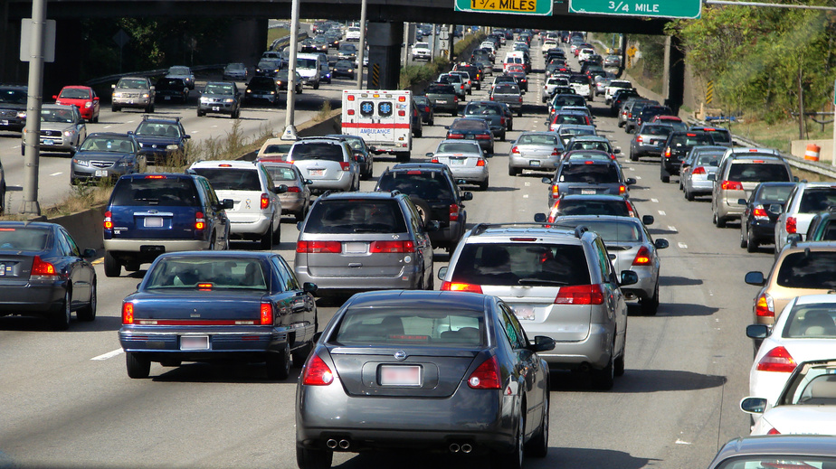
Commuter Benefits Program
All benefits-eligible employees may enroll in the Commuter Benefits Program.
For more information, visit: Commuter Benefits Program

Slide 37
Indemnity Plans
All benefits-eligible employees may enroll in the AFLAC Indemnity Plans. The plans pay benefits for covered health events. There are five plans available to employees:
Cancer Insurance
Hospital Confinement
Personal Sickness
Personal Accident
Specified Health Event
For more information, visit: AFLAC Indemnity Plans

Slide 38
DC 401(a) Retirement Plan
The District government's primary retirement plan for eligible employees first hired on or after October 1, 1987, is a "defined contribution" plan, with benefits based on 100% employer-provided contributions plus earnings over the course of the participant's working years.
The District funds this plan; there is no employee contribution. The current employer-paid contribution is 5% of the base salary. Employees must have one year of continuous service to participate, and they are fully vested in the Defined Contribution Pension Plan after five years of continuous service.
The schedule provides graded vesting in plan benefits after two years of service.
Years of Creditable Service | Percentage of Your Account that is Vested
Less than 2 | 0%
2 | 20%
3 | 40%
4 | 60%
5 or more | 100%

Slide 39

Tax-Deferred
Compensation Plan
All District government employees are eligible to participate in the Deferred Compensation Program (457B), an optional savings program that allows employees to tax-defer income and invest for the future.
The portion of salary an employee contributes reduces the amount of taxable income in each paycheck.
The 457 Deferred Compensation Program is available through ING Financial Advisors and is open to employees who can contribute the minimum of $20 per pay period.
Notes:
Are temporary employees eligible? Yes!

Slide 40
Retirement Plans
DC 401(a)- CitiStreet
  Automatically enrolled after 1 year and 1 day
  Representative for DDS: Michelle Reynolds @ 202-442-9640
ING- Deferred Compensation Program
  Optional
  Representative for DDS: Richard O’Neill @ 301-758-9398

Slide 41
Washington Sports Club
DDS has established a preferred corporate membership rate for its employees through the Sports Clubs Network of health clubs.
This benefit is only available to current employees of DC Government and only through this online enrollment service.
Click here for more information:
  Washington Sports Club

Slide 42
Employee Assistance Program
The District of Columbia Government offers all employees a work and family Employee Assistance Program through COPE, Incorporated.
COPE, Inc offers:
  Experienced, licensed, and credentialed mental health workers;
  One-on-One consultations to be held at your office or COPE offices;
  Assistance with short-term problem solving;
  Referral services when a longer-term solution is needed; and
  Consultations free of charge to you, as well as your spouse/significant other and dependent children 18 years of age and younger.
For more information or immediate assistance please call 202-628-5240 or e-mail at eap@cope-inc.com.

Slide 43

Safety at Work

Slide 44
Facility Service Calls
Contact Bill Davidson at
  202-730-1684 or
  william.davidson2@dc.gov
Emergency Calls
Emergencies are defined as problems that render the office unworkable.
All emergency calls are responded to as soon as possible, with a maximum response time of no more than 24 hours.

Slide 45

DDS Emergency Evacuation Plan
(2010)

Slide 46

Who is BERT?
The Building Emergency Response Team is responsible for the coordination of the evacuation operation in an emergency situation.
There are BERT members on each floor.
Those that may need assistance evacuating should inform the BERT member(s) assigned to their floor.

Slide 47
Steps to follow during a Fire Emergency, remember to RACE
Rescue - remove persons to “area of rescue”
Alarm – Notify 911 and/or set off fire alarm
Confine – Confine the fire to one area by closing doors or windows
Extinguish – If fire is small enough, use a fire extinguisher to put fire out OR Evacuate the building

Slide 48
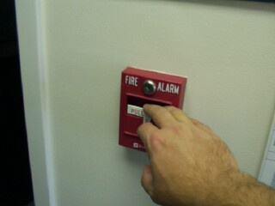
Activate the fire alarm
If you recognize a fire, pull the nearest Fire Alarm Pull station to start the evacuation of the building.

Slide 49
Evacuating the building
Use the nearest stairwells to exit the building
Congregate in Thomas Circle with your supervisor and unit (colleagues)
Departure can only be approved by the Director, Laura Nuss, the Facilities Manager, Bill Davidson, or their Delegation of Authority

Slide 50
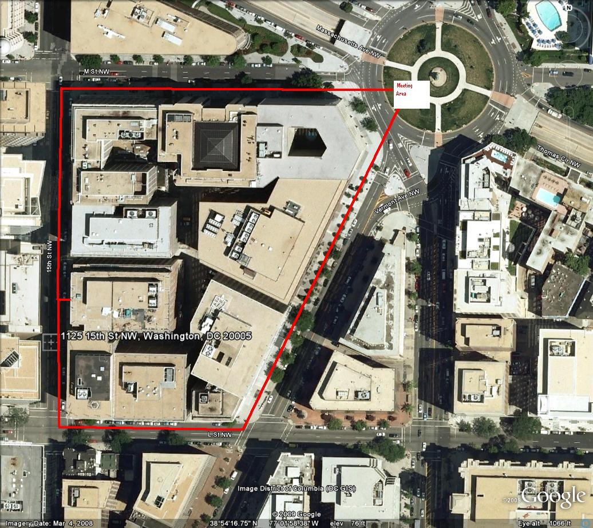
Thomas Circle

Slide 51
Fire Drills and Fines
Drills are held twice a year
Drills will include the use of the alarm system, shelter-in-place and evacuation of the building
During the drill, the fire department will do a walk-through, ensuring all staff have exited the building
If DDS staff have not evacuated during the drill, monetary fines will be given

Slide 52
Designated Shelter-in-Place Locations
All of the agency’s conference rooms
  First Floor- Training Rm and Conference Rms B, C, D, E, F
  Second Floor- Training Rm and Conference Rm B
  Third Floor- Conference Rms B, C
  Fourth Floor- Conference Rms A, B, C, D
  Eighth Floor- Conference Rms A, B, C, D
  Ninth Floor- Conference Rms A, B, C, D, E, F, G, H, J, K, L, M

Slide 53
Area of Rescue Locations
First Floor – Intake Area Room
Second Floor – West Lobby Area
Third Floor – 1st Conference Room South Corridor
Fourth Floor – West Lobby Area
Eighth Floor – West Lobby Area
Ninth Floor – West Lobby Area

Slide 54
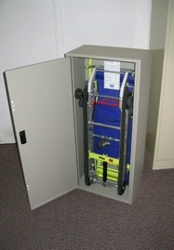
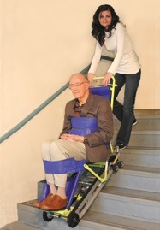
Evacu-Trac Chair
Play video: Emergency Evacuation Chair

Slide 55

For more information, please contact:
Bill Davidson
  202-730-1684
  William.davidson2@dc.gov

Slide 56
Collective Bargaining Unions
DDS has four separate labor unions representing employees.
The American Federation of Government Employees, Local 383 (AFGE 383)
The American Federation of State, County, and Municipal Employees (AFSCME 2401)
District of Columbia Nurses Association (DCNA)
Doctor’s Council

Slide 57
Questions?
Notes:
Dismiss or take break… FTE only

Slide 58
Welcome to the DDS Team

