Slide 1
No Wrong Door for LTSS
Extended Leadership Team: May 20, 2015

Slide 2
Planning Grant
One year planning grant (October 1, 2014 – September 30, 2015)
Funded by the Administration on Community Living (ACL), in partnership with the Centers for Medicare and Medicaid Services (CMS) and the Veteran’s Health Administration (VHA)
DC must work with stakeholders to develop a three-year plan to transform current Long-Term Supports and Services (LTSS) programs and processes in the District into a No Wrong Door system for all populations and all payers.

Slide 3
Federal Vision
Single statewide system that simplifies access to LTSS options for all populations and all payers.
All populations means all people regardless of age, income, or disability
All payers means any state administered program that delivers LTSS to all populations
Four key functions:
Public Outreach and Coordination with Key Referral Sources
Person Centered Counseling
Streamlined Access to Public LTSS Programs, and
State Governance and Administration of the NWD System.

Slide 4
Government Partners
DMHHS
DDS
DCOA
DBH
WIC
DHCF
OVA
DHS

Slide 5
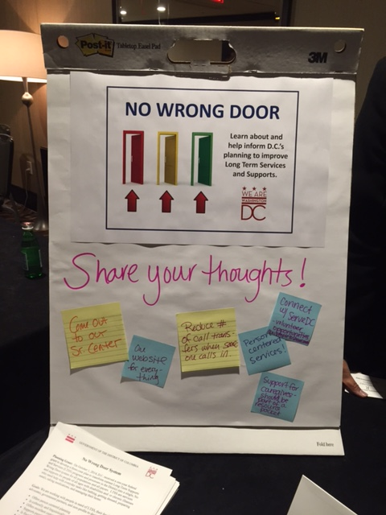
Stakeholder Input
People with disabilities and seniors have told us they want:
Help navigating the system
Single case management system for all services
Continuity of support throughout the lifespan
Better coordination between government agencies
Great customer service
Focus on what people can do
Support to live in the community as independently as possible
Person centered counseling, planning and service delivery
Support for family caregivers
Holistic approach that goes beyond just paid LTSS
Community-based (access and services)
On-line with one website for everything

Slide 6
Vision Statement
The District envisions implementing a user-friendly No Wrong Door (NWD) system that is highly visible and accessible for all people with disabilities, seniors, and their families to learn about and have easy access to a full range of integrated long term services and supports (LTSS) that assist them to live with dignity and as independently and as long as possible in their homes and fully included in their communities.

Slide 7
Mission Statement
The District will create a network of government and non-profit organizations that will engage in person and family-centered planning and provide responsive and comprehensive information about and referrals for LTSS. The information received will enable people with disabilities, seniors and their families to make informed choices regarding the LTSS they need to live with dignity in their homes and be fully included in their communities for as long as possible.

Slide 8
Goals & Objectives
To accomplish the vision and mission, D.C.’s No Wrong Door system will:
Be easy to understand and navigate
Offer person centered counseling and planning
Be culturally and linguistically competent
Offer excellent customer service
Support people to live with dignity in their homes
Be fiscally responsible and efficient
Link people to integrated/ blended community-based LTSS (natural supports and private options first, then public supports)

Slide 9
Work in Progress
Leadership Council
Governance and Administration
Information Technology
Resource Portal
Stakeholder Feedback
Person Centered Planning

Slide 10
Your Questions and Ideas
What do you think about the NWD planning so far?
Mission and Vision?
Goals and Objectives?
What qualities would you like to see in DC’s LTSS system?

