Slide 2
What is NCI?
The National Core Indicators™ (NCI™) program is a voluntary effort by state developmental disability agencies to track their performance using a standardized set of consumer and family/guardian surveys with nationally validated measures. The effort is coordinated by the National Association of State Directors of Developmental Disabilities Services (NASDDDS) and the Human Services Research Institute (HSRI).

Slide 3
Adult In-Person Survey 2017-2018
(2017-2018) An Adult In-Person Survey was conducted with various individuals that receive services from the state.
The information collected is used to gather data on approximately 60 consumer outcomes.
The information is then tested to ensure validity & reliability.
Each year the Performance Management Unit does a review of NCI data related to the HCBS Settings Rule compliance.

Slide 4
What Topics are Covered by the Survey?
The National Core Indicators are organized by “domains” or topics. These domains are further broken down into sub-domains, each of which has a statement that indicates the concerns being measured. Each sub-domain includes one or more “indicators” of how the state performs in this area. The following table lists the domains, sub-domains, and concern statements addressed by the NCI Adult In-Person Survey indicators.

Slide 5
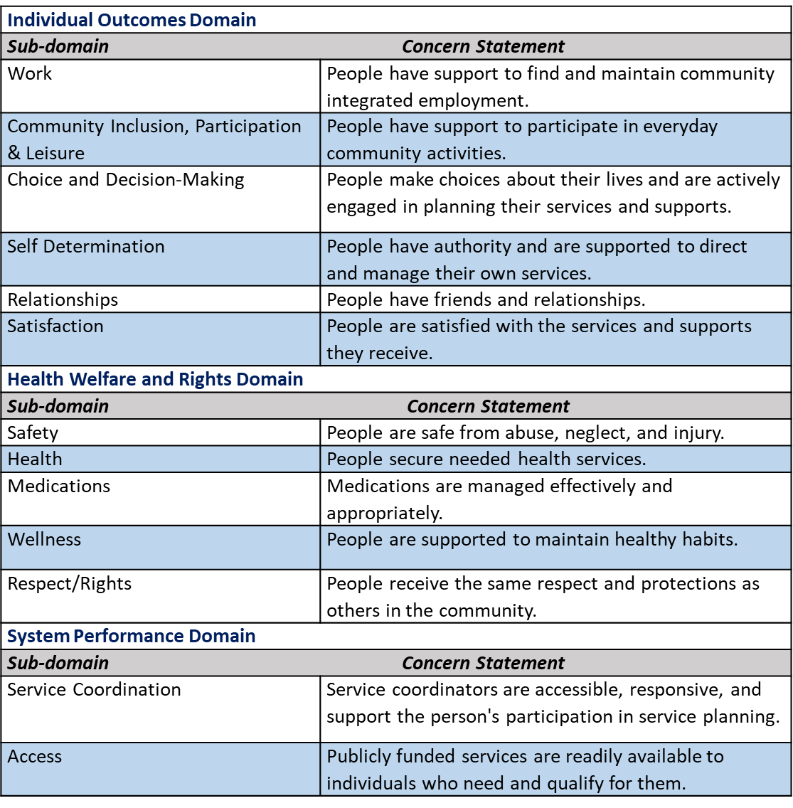
Topics Discussed
The National Core Indicators are organized by “domains” or topics. These domains are further broken down into sub-domains, each of which has a statement that indicates the concerns being measured. Each sub-domain includes one or more “indicators” of how the state performs in this area. The following table lists the domains, sub-domains, and concern statements addressed by the NCI Adult In-Person Survey indicators.

Slide 6
Service Coordination
Service Coordination | DC | NCI | -
Has met case manager | 95% | 94% | -1
Case manager asks person what s/he wants | 83% | 88% | -5
Able to contact case manager when s/he wants | 83% | 88% | -5
Staff come and leave when they are supposed to | 93% | 92% | -1
Took part in last service planning meeting, or had the opportunity but chose not to | 98% | 98% | *
Understood what was talked about at last service planning meeting | 89% | 84% | -5
Last service planning meeting included people respondent wanted to be there | 88% | 93% | -5
Person was able to choose services they get as part of service plan | 74% | 79% | -5
Average Total | 88% | 90% | -12

Slide 7
Choice & Decision Making
Choice and Decision-Making | DC | NCI | -
Chose or had some input in choosing where they live (if not living in the family home; proxy respondents were allowed for this question) | 44% | 57% | -13
Chose or had some input in choosing their housemates or chose to live alone (if not living in the family home; proxy respondents were allowed for this question) | 41% | 43% | -2
Chose or has input in choosing paid community job (proxy respondents were allowed for this question) | 93% | 87% | -6
Chose or had some input in choosing day program or workshop (proxy respondents were allowed for this question) | 41% | 56% | -15
Chose staff or were aware they could request to change staff (proxy respondents were allowed for this question) | 65% | 65% | *
Decides or has input in deciding their daily schedule (proxy respondents were allowed for this question) | 66% | 85% | -19
Decides or has input in deciding how to spend free time (proxy respondents were allowed for this question | 72% | 92% | -20
Chooses or has input in choosing what to buy, or has set limits on what to buy with their spending money (proxy respondents were allowed for this question) | 67% | 87% | -20
Can change case manager/service coordinator if wants to (proxy respondents were allowed for this question) | 68% | 89% | -21
Average | 61% | 73% | -12

Slide 8
Safety
Safety | DC | NCI | -
There is at least one place where the person feels afraid or scared (in home, day program, work, walking in the community, in transport, or other place) | 18% | 19% | -1
Has someone to go to for help if they ever feel scared | 90% | 94% | -4
Average Total | 54% | 57% | -3

Slide 9
Employment Goals & Daily Activities
Employment goals and other daily activities | DC | NCI | -
Does not have paid community job, and would like a job in the community | 64% | 45% | -25
Has community employment as a goal in their service plan (information may have been obtained through state records | 55% | 29% | -26
Has paid community job | 91% | 95% | -4
Attends a day program or workshop | 83% | 57% | -26
Volunteers | 34% | 31% | -3
Takes classes, training or does something to get a job or do better at current job | 54% | 20% | -34
Average Total | 60% | 46% | -26

Slide 10
Community Inclusion, Participation, & Leisure
Community Inclusion, Participation, and Leisure | DC | NCI | -
Went out shopping at least once in the past month (proxy respondents were allowed for this question) | 89% | 89% | *
Went out on errands at least once in the past month (proxy respondents were allowed for this question) | 91% | 86% | -5
Went out for entertainment at least once in the past month (proxy respondents were allowed for this question) | 94% | 74% | -20
Went out to eat at least once in the past month (proxy respondents were allowed for this question) | 87% | 86% | -1
Went out to religious service or spiritual practice at least once in the past month (proxy respondents were allowed for this question) | 66% | 41% | -25
Participated as a member in community group (proxy respondents were allowed for this question) | 25% | 32% | -7
Went on vacation in the past year (proxy respondents were allowed for this question) | 79% | 46% | -33
Able to go out and do the things s/he like to do in the community | 71% | 85% | -14
Able to go out and do the things s/he like to do in the community as often as s/he wants | 75% | 79% | -4
Has enough things to do when at home | 86% | 85% | -1
Average | 76% | 70% | -6

