Slide 1
Briefing on Medicaid Renewal: What Stakeholders Need to Know
Division of Eligibility Policy, Health Care Policy and Research Administration
Department of Health Care Finance
May 26, 2023
1

Slide 2
Medicaid Beneficiaries Will Have to Renew Their Coverage for the First Time in 3+ Years
In March 2020, CMS temporarily waived the need to renew Medicaid coverage and states received a 6.2% financial boost to accommodate the increased enrollment.
Medicaid enrollment has increased ~20% since the start of the public health emergency – just over 300,000 District residents are now enrolled in Medicaid.
​
At the end of 2022, Congress passed legislation ending the continuous eligibility requirement on March 31, 2023. ​
Therefore, the District was required to restart Medicaid eligibility renewals April 1, 2023. (Alliance and Immigrant Children’s Program renewals started in July 2022).
Government of the District of Columbia

Slide 3
Passive Renewals & Renewal Mailing Timelines
MAGI Medicaid Beneficiaries (adults 21-64), pregnant individuals, children/youth(0-20), parents/caretaker relatives)
Passive renewal – Occurs at the end of the month prior to mailing of renewal packets. If passively renewed, beneficiaries receive a notice their coverage is renewed and there is no further action required.
First renewal notice is sent at the end of the month 60 days prior to certification end date.
If renewal not received or there are outstanding verifications a second notice of pending termination is sent 30 days prior to certification end date with appeal rights information.
Non-MAGI Medicaid Beneficiaries (Age 65+, blind, or person with a disability, LTC/HCBS waiver participants, Qualified Medicare Beneficiaries)
First renewal notice is sent at the end of the month 90 days prior to certification end date.
If renewal not received or there are outstanding verifications a second notice of pending termination is sent 30 days prior to certification end date.
District Direct sample notices are available on the DHCF Website.
Medicaid renewal packages will have distinctive markings.

Slide 4
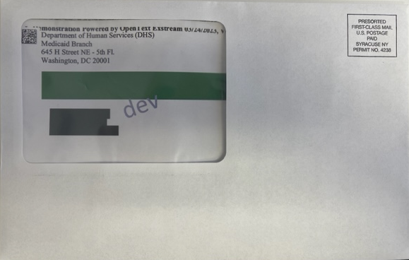
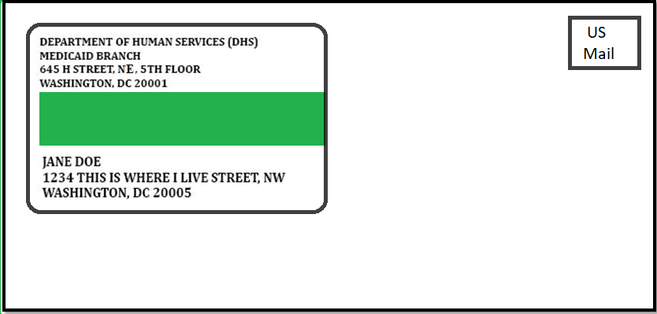
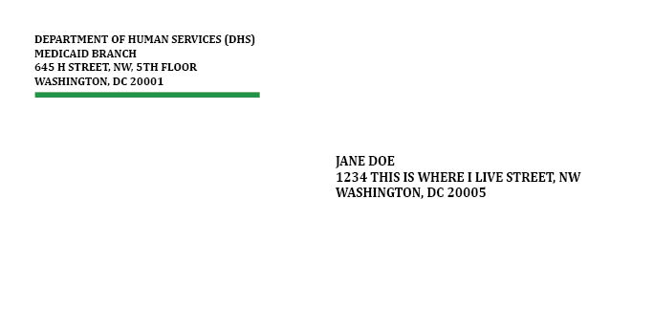
Look Out For An Envelope that Looks Like This!
Look for the green line here
Government of the District of Columbia

Slide 5
Look Out For These Renewal Documents in the Mail!
Government of the District of Columbia

Slide 6
Renewal Grace Period to Reinstate Benefits
Beneficiaries are given a 90-day grace period to renew Medicaid if they did not complete their renewal form prior to their certification end date.
Example: The grace period for the June renewal cohorts ends 9/30/2023.
The grace period allows additional time for individuals who fail to recertify timely to submit their renewal.
If the beneficiary is determined eligible for continued coverage, coverage will retroactively go back to the beginning of the certification period.
Example: Beneficiary certification ends June 30, 2023. they turn in their renewal packet on August 3, 2023. If still eligible, benefits will be reinstated back to July 1, 2023.
Individuals attempting to recertify their coverage after 90 days following their certification end date will be required to submit a new application.
The grace period for the June cohort ends 9/30/2023. From 10/1/2023 and forward this cohort will be required to submit a new application to re-activate their benefits.

Slide 7
Completed Renewal Form Packet: Information Needed
The completed renewal contains:​
Carefully reviewed answers to all questions on the renewal form. (Conversion renewal form, LTC supplemental, updated LOC) ​
A signature (wet, electronic, or telephonic signature) ​
A submission of current documentation of income and D.C. residency along with renewal form. ​
Government of the District of Columbia

Slide 8
Current income must be verified at renewal: Types of documents that are acceptable verifications of income
The following types of documents can be used to verify income:​
Recent pay stubs(four weekly, two bi-weekly, or one monthly);​
Completed employer verification form;​
Statement showing retirement income, disability income, workers compensation income or pension statement, social security benefits;
Paper, electronic, or telephonic documentation;​
A written statement which explains the discrepancy if other documentation is not available.​
Government of the District of Columbia

Slide 9
Renewal must verify DC residency:
Acceptable Verifications (Residency)
The following types of documents can be used to verify residency:
An active lease agreement, certified deed, or mortgage statement with a District and their name;
Phone or Utility bill within the past 2 months;
D.C. Voter Registration Card;
Non-expired D.C. motor vehicle registration or D.C. DMV identification card;
Cancelled check or receipt of mortgage or rental payments within the past 2 months;
Utility bills and payment receipts with a D.C. address within the past 2 months;
Non-expired automobile insurance statement with a D.C. residency address;
D.C. One Card; or
Completed and signed proof of D.C. Residency Form
Government of the District of Columbia

Slide 10
DHCF Website Contains Useful Information to Renew Coverage and Share With Beneficiaries
The DHCF Website now includes key information and messaging on Medicaid Renewals:
Encourages beneficiaries to update their contact information;
Educates beneficiaries on how to use District Direct to update contact information;
Shows sample Renewal Forms and commonly issued notices;
Provides a Stakeholder Communications Toolkit.
Find it at all at: https://dhcf.dc.gov/medicaid-renewal
Government of the District of Columbia

Slide 11
Outreach to Beneficiaries Is More Than A Letter in the Mail…
District Direct: Beneficiaries may log into District Direct to see notices, upcoming renewals, and can take action.
Text Messaging: All beneficiaries will be texted about updating their address and contact information next month; along with their renewal is due.
Robocalls:
Citywide Advertising and Outreach: Advertisements have already started on bus, radio, and through key partnerships.
Beware of Scams: In other states, Medicaid programs have noted instances of some fraud through emails and texts. The District will never charge money for Medicaid Renewal or ask beneficiaries to visit a website that is not a dc.gov account!

Slide 12
Dedicated Outreach to Special Populations in the District
Senior Beneficiaries
DHCF is partnering with DACL to training their staff and senior service network in early April on the renewal process.
Seniors will then be able to access in-person assistance at Senior Wellness Centers and 40+ Community Dining Sites across the District.
The Deaf and Hard of Hearing Senior Center and Senior Center for the Blind have also committed to assisting seniors with applications.
Beneficiaries Living with Disabilities
DHCF training employees at DDS and their providers to help beneficiaries.
Beneficiaries Experiencing Homelessness
DHCF is meeting with outreach staff, shelter case workers, and adult day centers that work with beneficiaries experiencing homelessness to ensure they are prepared to spread the word and assist beneficiaries with completing their renewals.
Government of the District of Columbia

Slide 13
Communication on Medicaid Renewal– Outreach to Beneficiaries
DHCF will send Renewal Packets to beneficiaries who cannot passively renew coverage.
The District will text the cell numbers of beneficiaries to ask beneficiaries to update their address and/or complete their renewal packet.
The District will conduct automated phone calls to ask beneficiaries to update their contact information and/or complete their renewal packet.
DHCF increased staffing at the Public Benefits Call Center to be able to field questions and concerns. The center can also update addresses for beneficiaries.
DHCF and DHS are increasing staffing at DHS Service Centers to be able to process more applications.
DHCF is training groups such as this one on how to update contact information and renew Medicaid.
Government of the District of Columbia

Slide 14
What Can Stakeholders Say to Beneficiaries? Don't Wait to Update! Then Check Mail for Important Information!
What Beneficiaries Can Do Right Now
Don't Wait to Update!: Update your contact information by logging into District Direct. If DHCF does not have the proper contact information, you will not receive notice of the need to renew your coverage through the mail or other means!
Check Your Mail: DHCF will mail you a letter about your Medicaid, Alliance, or ICP coverage. This letter will also let you know when it's time to complete your renewal.
What To Do After Receiving Your Renewal Notice
Complete your renewal by using districtdirect.dc.gov or fill out the form and mail/fax/drop at Service Center immediately to help avoid a gap in your coverage.
Government of the District of Columbia

Slide 15
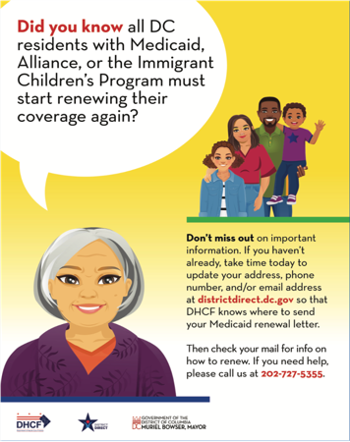
Visual Advertisements – Don’t Wait to Update!
Government of the District of Columbia

Slide 16
Beneficiaries Can Use a Variety of Mediums to Renew Coverage
Medicaid beneficiaries may submit their completed renewals:
Online: District Direct allows beneficiaries to complete their renewal, report changes, submit verifications, and view notices online or through the mobile app. Beneficiaries may visit https://districtdirect.dc.gov/ or download the mobile app through the Apple App Store or Google Play. Please encourage beneficiaries to complete their renewal online!
By Phone: Call Center (202) 727-5355; Language & Translation Line 1-855-532-5465
Mail
Department of Human Services | Economic Security Administration
Case Record Management Unit
P.O. Box 91560 Washington, DC 20090
Drop-off at a Service Center
Fax at (202) 671-4400

Slide 17
: DHCF Publishes Training Videos and Recording to Assist with Helping Beneficiaries in District Direct
Frequently Asked Questions: The District drafted Frequently Asked Questions – derived from input received from stakeholder meetings.
Training Videos: The District published short training videos on District Direct account creation and connection, change of address, and renewing coverage online.
Training: Bi-Weekly Community meetings.
Consumer Alert: The District issued a consumer alert on Medicaid Fraud related to Medicaid Renewal.

Slide 18
Questions and Feedback
Government of the District of Columbia

