Slide 1
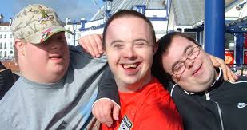
Making Friends and Building Relationships
“Community Connections”

Slide 2
Training Objectives
Understand the movement from institutions toward community inclusion.
Understanding how to support people to develop soft skills that help them make friends and navigate their community.
Understand your role as a DSP in promoting community exposure.
Understand how to support people with disabilities in advocating for themselves.
Notes:
Define soft skills: (personal attributes that enable someone to interact effectively and harmoniously with other people) These are the skills we use to socialize with people at school, work, play and in the community. Some skills include: Communication, Teamwork, Problem Solving, Flexibility, Observation and conflict resolution

Slide 3
Historical Context for people with ID and DD
Through most of the 20th century people with ID/DD did not grow up with their families, but were placed in institutions at the urging of the medical community.
Notes:
Tell the participants that they will be watching a short film that will provide the history of institutional care in DC, i.e., Forest Haven. You may be supporting some of these people who are still alive. So, it is important that you have an understanding of this history in the context of disability services. Please be advised that you may find some these images disturbing and they do not reflect current services delivery.

Slide 4
Beyond Forest Haven
Notes:
You will need quicktime to view this video, or you can view it online at https://www.youtube.com/watch?v=lAGmZcuCYQA
At the conclusion of the film, please give time for people to express their thoughts, concerns, comments, etc.

Slide 5
Where are we today?
People live, work, and play within their own communities.
People have friends.
People have hobbies.
People belong to churches, clubs, fitness centers, teams, neighborhoods.
Notes:
Service delivery has changed, laws have changed, families have advocated for inclusion and community services. Trainer can give as much or little context as they feel comfortable.

Slide 6
What is your role?
To make these things happen for the person you support.
You are the bridge to connect people to the community!
You help people navigate their current neighborhood, have new experiences, and develop new relationships.
Notes:
W

Slide 7
One way to support people is to help them develop “soft skill”
This is a catch all term referring to various actions that help people work and socialize well with others. In short they are good manners, cultural norms, and personality traits needed to get along with others and build positive relationships.

Slide 8
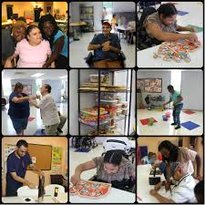
Soft Skills Help Support Meaningful Relationships!
Success in life is greatly determined by how we interact socially. We often take these skills for granted. It is hard to define these skills. It is easier to spot the absence of these skills than to detect the presence of them. These skills are usually learned by exposure and observation. Many people have social skills that need continued improvement. Providing opportunities to have meaningful relationships and modeling appropriate behavior is the key to this development.
Notes:
Examples of Basic Soft Skills:
When someone walks into a room what is the proper approach?
When some burps, belches, or sneezes what is the proper approach?
When someone interrupts two people engaged in a conversation to ask a question what is the proper approach?

Slide 9
Some Examples
Understanding and honoring the standards of dress and decorum at different social occasions;
The acceptable forms of social interaction for different social occasions;
Knowing when to make eye contact and when to avert the eyes;
Determining when physical contact is acceptable and what type (e.g. a handshake versus a hug);
Being able to politely start and stop conversations;
Being able to make small talk;
Understanding how to notice and respond to non-verbal body language;
Appreciating social nuance such as sarcasm and humor;
Understanding the differences between literal and figurative speech;
Being able to express feelings and respond to the feelings of others
Notes:
Give examples and ask the trainees if they have other examples:
Cutoffs are okay for a picnic, but not for work
People may talk loudly at a picnic, but whisper in the movies
We do not hug strangers, but may offer them a hand to shake.

Slide 10
Supporting/Teaching Soft Skills For Making Friends
Staff should demonstrate:
How to be a good listener
How to initiate small talk
How to start conversations
How to maintain eye contact
Notes:
Ask the participants how they might about teaching one of these skills.
Emphasize that people with ID/DD learn by doing!

Slide 11
Tips for Meeting People and Making Friends
Join organizations with people who share common interest
Join sports team
Take a class
Volunteer
Talk to your neighbors
Notes:
People meet other people that are compatible while participating in advocacy organizations, sport teams, volunteer activities etc.

Slide 12
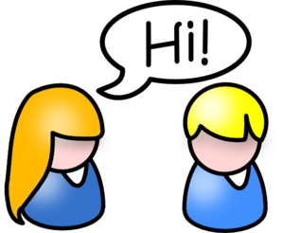
How do I support someone to learn these skills?
People learn by doing. Here are some tips for you to use.
Modeling the correct skill provides a roadmap.
Repetition supports learning.
Consistency is important for some people.
Schedules and routines work well for some people.
Notes:
Skill building should be repetitive and consistent. Schedules and routines work well for some people.

Slide 13
Where are these skills best taught?
Skills should be taught in the environment in which they typically occur.
Since we are supporting people to be part of their community, practicing soft skills should be done in the appropriate community setting.
For Example: If you are teaching “waiting your turn”; you might want to practice this when waiting in line at the movie theatre to purchase a ticket.

Slide 14
Teaching Strategies
Break down each learning task into small steps
Once the first step is reasonably mastered, the next step is ready to be introduced.
Most people are kinesthetic learners. This means they learn best by doing a task "hands-on."
Offer immediate positive feedback, even if they have not mastered the skill at a 100%.
Notes:
Lengthy verbal directions and abstract language is not very effective when teaching new skills.
Ask staff to take one of the following task and follow step 1. Break down the larger task into small steps.
Completing Laundry
Making a Sandwich
Filing out a job application
Going to the doctor

Slide 15
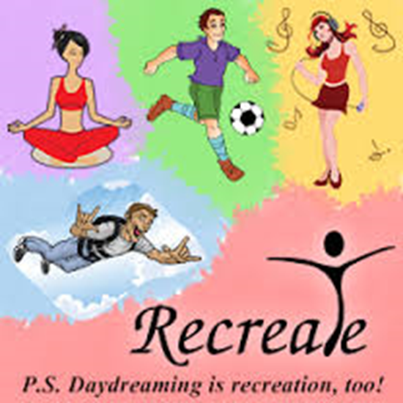
Community Activities Promote Opportunities for Practicing These Skills!
Expose people to a variety of new community experiences.
Perhaps nothing reveals so much about a person as how they choose to play - how they invest their time and energy for leisure time.
Notes:
It is important to remember what is important to a person!!! For the older population, due to lack of exposure you may want to slowly introduce them to new things because they may not even know what a big world it is out there! Young adults may have had more of an opportunity to explore various activities either in school or with their families and can readily identify those things they like and are important to them. Take the time to ask the person being supported for their opinion, ideas, thoughts. Make no assumptions on the persons behalf!!

Slide 16
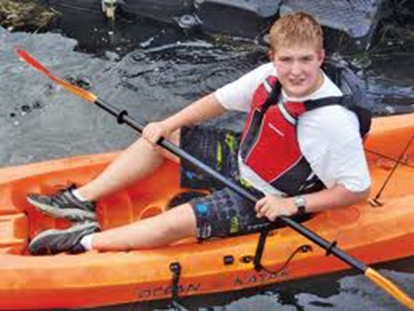
Be Creative! Exposure to New Opportunities is up to you !
Everyone needs regular recreation that promotes good health, relieves stress, facilitates social interactions, and provides a general joy for living.
Notes:
Game of Twenty:
In 20 seconds write down as many recreational activities that you can think of.
Facilitator: Get a big chart paper and write down learners list as they share what they have written. The person who has the most activities on their list, wins. (Give a small gift, candy, applause, a gold star etc.)

Slide 17
Pay Attention to a Person’s Preferences!
What activities are important to them?
Good readers read – Join a book club.
Athletes seek sports' activities – Join a team
Musicians lose themselves in music – Attend a concert
Visual artists paint or draw – Take an art class.
Craftspeople create – Find others with shared interest.
Social people like to engage in group activities.
Notes:
The Positive Personal Profile (PPP) will guide you to developing an understanding of the person’s preferences, strengths, and interests. When setting and implementing goals, they should reflect the PPP. For example, if a person does not like books, does it make sense to have a goal to go to the library to look through books?

Slide 18
Benefit of people being in the community and having friends
People have friends that are not paid staff
People discover new interests
People are happy
People learn new skills
People develop an understanding of how things are related or connected in the world
People develop an understanding of self and develop self confidence
People have more control of their life
People are valued

Slide 19
Who Can Help Me Find Activities Where My Winning Personality Can Shine?
Relationship Map
However, those who are in the person’s circle of support can play a more active role in promotion.
ANYONE!!
Family
Paid support at work/school
Paid support at home and community
Friends
Notes:
People who know the person best can assist in identifying activities and interest.

Slide 20
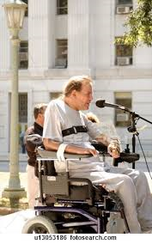
Developing Self Advocacy is one key to Community Connections
Advocacy is the act of speaking on behalf of or arguing in favor of something that is important to you.
When a person feels empowered and is part of their community they are their own best advocate!
Notes:
Being part of advocacy groups is an excellent way to meet others who share your same vision, passion and outlook on life.

Slide 21
How to Support Advocacy
Encourage people to speak up.
Encourage people to exercise choices.
Use language that can easily be understood.
Educate people of things they are interested in.
Encourage people to be civic minded.
Support finding like minded people.
Notes:
Staff can support people to become self advocates by helping them to gain some key skills that promotes their understanding, growth and development.

Slide 22
Advocacy Groups & Organizations
The following District agencies support or provide advocacy services for people with developmental disabilities:
DC Advocacy Partners
Project ACTION!
TASH
Quality Trust for Individuals with Disabilities
ULS (Universal Legal Services)
Notes:
Facilitator please give out website information for each group. (See attachment)
Please visit their website. Many of their group meetings and activities are listed on their website.

Slide 23
What we learned today
How services moved from the institution to the community
The skills people to need to be successful in the community.
The role the DSP plays to support community inclusion.
How to encourage self advocacy.

