Slide 1



DC Supporting Families
Community of Practice
July 11, 2016

Slide 2

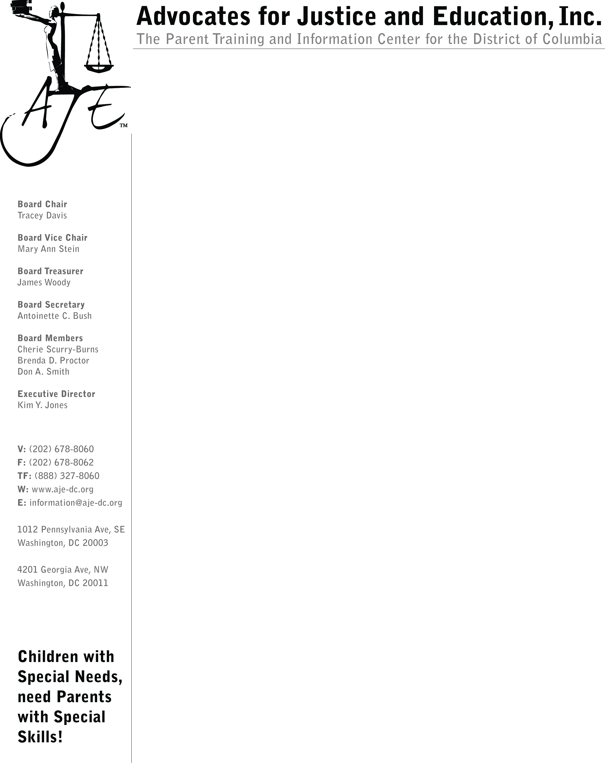




DC Supporting Families CoP
Core Team Members

Slide 3

Agenda
Welcome
Lunch and Discussion with DDS Interim Director Andy Reese
Updates: PCT &
Family Support Council
Announcements
Reflections & Projections
Needs Assessment

Slide 4
Comprehensive Supports for People with I/DD
9,632 individuals estimated to have Developmental Disabilities*
77%
(7,367)
23%
(2,265)
Receiving DDS Services
Not Receiving
DDS Services
*Based on 1.49% prevalence, S. Larson, University of Minnesota (2013)
Notes:
Partnering on a Needs Assessment
Advocacy

Slide 5
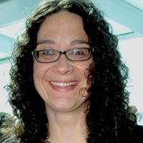
For More Information
Thank you for attending!
DC Supporting Families Community of Practice
http://dds.dc.gov/page/dc-supporting-families-community-practice
Erin Leveton
DC Department on Disability Services
Program Manager, State Office of Disability Administration
Project Director for the DC Supporting Families CoP
erin.leveton@dc.gov
(202) 730-1754

