Slide 2
Job Corps Mission
To attract young adults, teach
them relevant skills needed to become employable and independent, and help prepare them for success in life by securing meaningful jobs or opportunities for further education.

Slide 3
Job Corps
Funded by the US Department of Labor
More than 2.7 million young people trained and educated
More than 60,000 students enroll each year
More than 100,000 young Americans receive training and job placement annually
Program averaging between 6-14 months

Slide 4
Job Corps Eligibility

Slide 5
Age Breakdown
March, 2014

Slide 6
Gender Breakdown
PY 2010

Slide 7
Ethnic Breakdown
March, 2014

Slide 8
Philadelphia Region
Potomac Job Corps Woodland Job Corps
Flatwoods Job Corps Keystone Job Corps
Harpers Ferry Job Corps Old Dominion Job Corps
Charleston Job Corps Woodstock Job Corps

Slide 9
How Job Corps Works
Career Development Services System
Designed to help students achieve their career objectives
Four stages of CDSS build on one another:
Outreach and Admissions (OA)
MyPace Period (MPP)
Career Development Period (CDP)
Career Transition Period (CTP)

Slide 10
How Job Corps Works Outreach and Admissions (OA)
Applicants are introduced to:
Academic training
Career technical training (training programs)
Life on center
Responsibilities
Zero Tolerance Policy
Personal Career Development Plan
Post-center transition services

Slide 11
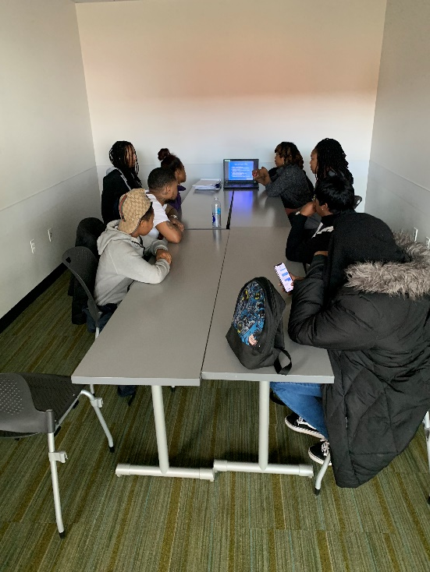
Information Sessions
Admission Counselors conduct information sessions throughout DC;
We can schedule special sessions at your organization for 10 or more youth;
Sessions focus on benefits and opportunities of Job Corps and typically last 1 hour.

Slide 12
Center Tours
We encourage applicants to tour a Job Corps Center via Virtual
Tours for groups can be schedule by contact an admissions counselor.
https://potomac.jobcorps.gov/
https://recruiting.jobcorps.gov/

Slide 13
Typical Admissions Process
Attend Information Session
Gather required documents
Tour a center
Individual interview with Admission Counselor
Complete Application

Slide 14
Required Documents
Birth Certificate
State ID Card
Social Security Card
Proof of family income
High School Transcripts/GED
Individual Education Plan (IEP)
Immunization Records
Wellness Records (As Applicable)
4 most important Documents

Slide 15
How Job Corps Works MyPace Period (MPP)
An 8 week period (Virtual or on Center)
Introduction to center rules and safety
Aptitude tests and shadowing to determine academic and career technical training
Introduction to health and wellness
Employability and job search skills
Update Personal Career Development Plan

Slide 16
Training For Success
Career Success Standards
Workplace Relationships and Ethics
Communication
Personal Growth and Development
Interpersonal Skills
Information Management
Multicultural Awareness
Career and Personal Planning
Independent Living

Slide 17
How Job Corps Works Career Development Period (CDP)
Career technical training
Academics
Work-based learning
Employability and social skills
Independent-living skills
Job search skills
Community service activities
Leadership opportunities
Update Personal Career Development Plan
Career Transition Readiness

Slide 18
Training For Success
Academics
High school diploma (partnerships with local school districts)
GED
ESL/ELL Program
Qualified instructors
Technology-focused
Higher education opportunities with technical and community colleges

Slide 19
Training For Success
Career Technical Training
Advance Career Training opportunities
Advanced training in specific areas
State-of-the-art tools and technology
Select career areas offer training in “green” practices

Slide 20
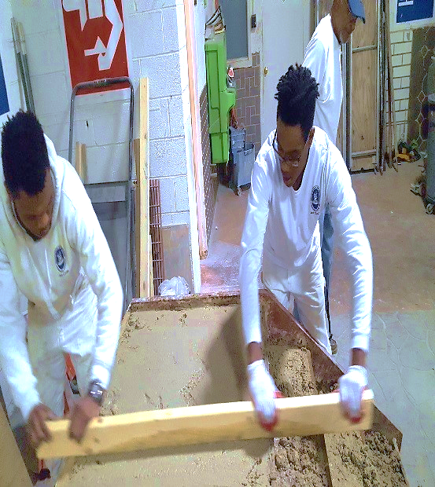
Academic and CTT Schedule
Weekly
Rotating Schedule
Academic
Learn more about your trade in a classroom setting
Academic Uniform is required
Career Technical Training
Hands on training on your trade
CTT Uniform is required

Slide 21
Career Pathways
Advanced Manufacturing
Automotive and Machine Repair
Construction
Finance and Business
Health Care
Homeland Security
Hospitality
Information Technology
Renewable Resources and Energy
Retail Sales and Services
Transportation

Slide 22
Typical Day on Center
Monday – Friday
6:00 am Wake up-Dorm Duties
7:00 am Breakfast
8:00 – 11:20 am Training
11:21 – 12:15 pm Lunch
12:16 – 3:30 pm Training
3:45 – 4:15 pm Student Dorm Meeting
5:00 – 6:00 pm Dinner is Served
6:00 – 9:00 pm Recreation/Leisure Time
9:00 pm Curfew (Depending on the days)
10:00 pm Lights Out

Slide 23
Life On Center
Job Corps provides students with:
Housing and dining services
Counseling services
Health and Wellness services
Transition services, including
job placement assistance
Recreational activities

Slide 24
Life On Center
Job Corps provides students with:
Drug- and violence-free environment (zero tolerance)
Biweekly living allowance
Uniform
Child care allotment
Transitional Allotment

Slide 25
Life On Center
Each center offers recreational and leisure-time opportunities for students, such as:
Student Government Association
Student Ambassador program
Career area leadership opportunities
Community service opportunities
Local cultural outings
Clubs
Sports
Movies
First Recreational Activity is a REQUIREMENT!!

Slide 26
Benefits of joining Job Corps!
Learn and train for the Job you would want to pursue!
Many trades to choose from!
Great support system!
Enjoy some recreational activities free of charge
Free housing and meals!
Bi-Weekly Stipend!

Slide 27
How Job Corps Works Career Transition Period (CTP)
Eligible students may receive up to 12 months of placement services after they leave center
Assigned CTS Specialist assist student in obtaining placement
CTS provides referrals to address students transition barriers
CTS verify placement

Slide 28
For More Information
Khalil Muhammad
202-868-7515
Muhammad.Khalil@jobcorps.org
www.jobcorps.gov
www.recruiting.jobcorps.gov
www.mifuturo.jobcorps.gov

