Slide 1
Introduction to Human Rights
Individual Rights & Responsibility and Recognizing Abuse, Neglect, Exploitation

Slide 2
Learning Objectives
Identify the rights of people with intellectual and developmental disabilities
Staff’s role in supporting rights (What does that look like?)
Identify the person’s responsibility related to rights
Common rights violations to avoid
Recognizing abuse, neglect, mistreatment
Incident versus Grievance

Slide 3
People with disabilities have been denied access to:

Slide 4
Human Rights - Important Terms
RESPECT for the person
LIBERTY- right to do as one pleases
SELF DETERMINATION- the process by which people control their life
INCLUSION- right to be part of a community
PRIVACY – away from observation or company
EQUALITY – treatment of all people in the same way

Slide 5
Rights and Responsibility
Rights
Responsibilities
Fundamental Rights are specifically guaranteed by our Constitution, federal and state laws.
However, people with disabilities have been historically denied rights.
Since the 1970’s federal laws have been passed specifically to protect this population’s rights.
It is the responsibility of staff to help people understand their rights and support them in exercising these rights.
It is the responsibility of the person to exercise rights and understand responsibilities related to each right.

Slide 6
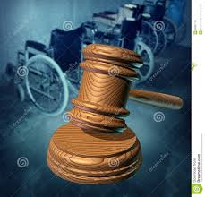
Rights - Respect for the Person
Right to be treated with dignity, courtesy, and respect.
Right to live in a safe environment and be free from abuse, neglect, and exploitation.
Right to have one’s religion, culture, ethnicity, and identity respected.
Remember your values may conflict with the person’s values. How would you deal with that?
Notes:
Do not let your personal biases, stereotypes, or prejudices interfere with your support of the person. Please leave them at the door.
People have different values. People have different beliefs. People have different religions.
It is your job to be respectful of the person and support them in their religion, culture, ethnicity and identity…..not to impose ours.
Note: We will discuss abuse, neglect and exploitation is greater detail, later in the presentation.

Slide 7
What might Respect look like?
People live in homes that reflect their values.
People are spoken to in a respectful manner and called by their name of choice.
People have access to clothing that is age appropriate. People are supported to participate in the religion of their choice…or not participate in religion.
People are described in terms of their abilities, not their disabilities.
People celebrate their cultural holidays and eat their cultural food.
Notes:
Make sure to have your sound on for this training. There is an audio clip!
Some people like to live in homes that are clean and tidy, others…..not so much. Their home should reflect their values.
However, we must ensure that homes are safe and well maintained.
People may want to express themselves in the way they dress. This should be supported. Maybe they like to always wear the color blue or dress in the clothing of the opposite sex.
Not everyone celebrates Christmas.
Not everyone eats pork or meat or shell fish.

Slide 8
Right & Responsibility-Respect
Right of the Person
Responsibility of the Person
Right to be treated with dignity, courtesy, and respect.
--------------------------------
Right to have one’s religion, culture, ethnicity, and identity respected.
Be courteous to others and treat them with respect.
Respect the rights and choices of others.
-----------------------------
What might the responsibility of one’s religion look like?
Notes:
An example of responsible behavior: When attending a church or a temple or a mosque, one must not disrupt the people around them and be respectful of the rituals of the service and the religion.
Group Discussion:
What would you do if you were supporting someone who was not upholding their responsibility to be kind and courteous to others?
What would you do if you were supporting someone who spent more money than they had in their account and then expected their provider to pay their overdraft fee?

Slide 9
Right - Liberty
Right to make informed choices.
Right to freedom of movement.
Right to have relationships with, live with, and have association with people of one’s own choice.
Right to take responsible risks.
Notes:
How many people in this room have done the following:
Had an irresponsible friend?
Had a boyfriend or girlfriend of whom your parents or family did not approve?
Went somewhere that was not a safe place?
Did something risky that may have caused you harm…..physically or emotionally?
Well, guess what, the people that we support have the same freedom to do these things…to make these choices, to take some risks. Your job is to support them in the negotiation of these decisions, relationships, and risks.

Slide 10
What might Liberty look like?
People decide when to go to bed and to get up.
People decide how and when to complete chores for which they are responsible.
People select their own friends and partners.
People select their own clothing.
People have access to all areas of their home with the exception of a roommate’ bedroom.
People choose which staff works with them.
People can choose to try new things!
People have the right to make a mistake!
Notes:
People are allowed to select their own friends, their own boyfriend or girlfriend.
All areas of a person’s home are accessible to them. There should be no offices in the homes. There should be no locked closets or cabinets in a home that are inaccessible to the person who lives there, unless there is a major health or safety reason, the Human Rights Committee has approved, and the person or legal guardian has give consent.

Slide 11
Right & Responsibility- Liberty
Right of the Person
Responsibility of the Person
Right to have relationships with, live with, and have association with people of one’s own choice.
--------------------------------
Right to take responsible risks.
Visit in private with your guest, if you want to be intimate.
Do not exploit other people or allow yourself to be exploited.
--------------------------------
What might the responsibility of taking a risk look like?
Notes:
A person may want to learn to ride the bus to visit his friend on the weekend. He has a right to take this risk; however, he also has the responsibility to learn which bus to take, to ensure that he has identification with him, and to know what to do in case of an emergency.
People are allowed to have sexual relationships or marry the person of their choice……whether of the opposite sex or the same sex. What should be the responsibility of the person?
Answer: practice safe sex, do not exploit others and do not allow yourself to be exploited, certain activities are to occur in private
Can you think of other risks a person may want to take?
What would the responsibilities of the person look like.

Slide 12
Right - Self Determination
Right to participate in the planning of one’s services and supports.
Right to exert control over one’s life.
Right to advocate for one’s own behalf.
Right to voice a complaint.
Right to refuse services.
Notes:
It is very important that we support and encourage people to participate in the planning and selection of services. Their voice must be heard!
Who do they want as a housemate?
Where would they like to work?
What staff would they prefer working with them?

Slide 13
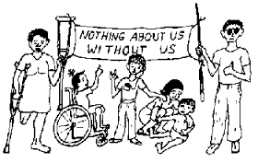
What might Self Determination look like?
People select who they want to attend their planning meetings.
People participate in self advocacy and learn to speak up.
A person has the right to refuse treatment or services.
If a person does not like something, he or she can request a change and be supported in making that change.
People select their providers and staff.
Notes:
Refusal of treatment or services:
Raise your hand if you do everything that your doctor recommends that you do?
Did you lose that 20 pounds?
Do you stay away from sugar and carbs?
However, when you make these decisions, you understand the risk attached to it. You could put yourself at risk for diabetes or heart disease.
Discuss your agency’s grievance process. How do they address requests for change?

Slide 14
Right & Responsibility-Self Determination
Right of the Person
Responsibility of the Person
Right to refuse services.
-----------------------------------
Right to voice a complaint.
Understand why the treatment is needed, know the benefits of receiving the treatment, and be able to identify the risks of not getting the treatment.
--------------------------------
What might the responsibility of voicing complaints look like?
Notes:
It is imperative that every person you support can identify one person that they trust and can go to if they have a concern or a complaint. That staff or person must take the complaint or grievance forward for the person.
The responsibility is reporting the complaint clearly and honestly.
Scenario for discussion:
You support a man who comes to work with hot pink lipstick on every day. You see that the people around this person talking about him and laughing about the fact that he wears lipstick. What is our role to support him?

Slide 15
Right - Inclusion
Right to be educated, live, play, and work in the least restrictive environment.
Right to have accessible transportation
Right to be part of one’s own community
Right to have competent personnel who can communicate with the person.
Notes:
Living in the community does not automatically mean one is included in the community.
Staff must support the person to explore the community, find and use resources in the community, and form community relationships.
Think of your own life. What do you belong to? Where do you hang out?

Slide 16
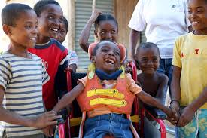
What might Inclusion look like?
People go to the local barber or hairdresser.
People are informed about activities in their community.
People live as independently as possible.
People shop for their own food.
People have access to public transportation.
People belong to clubs and civic organizations.
People have staff who they can understand and who understand them.
People know where the ATM is located
People build relationships.
Notes:
What is “important to” the person? What does he or she like to do?
This should guide you in helping people make community connections.
If someone likes to bowl, they should join a bowling league.
If getting a manicure is important to the person, go to the same salon and use the same manicurist. This is how connections are made.

Slide 17
Right & Responsibility- Inclusion
Right of the Person
Responsibility of the Person
Right to live and work in the least restrictive environment.
--------------------------------
Right to be part of one’s own community.
Learn new things and strive to be as independent and safe in the community, as possible.
-----------------------------
What might the responsibility of being part of the community look like?
Notes:
In the community, it is “important for” the person to behave in a safe and healthy way. For example, not taking things that do not belong to them, crossing the street with the light, demonstrating the proper boundaries when riding the train or the bus (don’t sit too close)

Slide 18
Right - Privacy
Right to dignity/control of one’s body
Right to receive/entertain visitors in private
Right to private communication on the phone and when sending/receiving mail, e-mail
Right to have confidential information kept private
Notes:
Staff must support the privacy of the person supported.
It is their home and people can lock their doors.
It is their phone.
It is their mail or e-mail.
Visitors can be entertained privately; however, that is arranged.

Slide 19
What might Privacy look like?
Others enter a bedroom only with permission of the person and people can lock their bedroom if they want.
People have privacy in the bathroom and are reminded to close the door.
People are given medication privately.
People visit with their friends in private.
Information is shared only with designated staff or those legally authorized. This includes pictures, records, face book, social media, and conversations.
Notes:
It is imperative that we respect the confidentiality of the person you support’s personal information…..whether verbal or written.
Do not discuss this person’s private information with the people who are not members of the team unless you have the consent/permission of the person.
Do not share written information unless you have the written consent of the person or guardian.

Slide 20
Right & Responsibility- Privacy
Right of the Person
Responsibility of the Person
Right to dignity/control of one’s body.
-----------------------------------
Right to have confidential information kept private.
Close the door when you are in the bathroom.
Dress and undress in the privacy of your bedroom.
--------------------------------
What might the responsibility of keeping information confidential look like?
Notes:
Do not share other people’s private information.
If your roommate is on a special diet, do not embarrass her if she eats to much of something or eats the wrong food.

Slide 21
Equality
Right to vote
Right to free, appropriate secondary education
Right to equal employment opportunities and fair compensation for work
Right to purchase, own, and dispose of property
Right to legal representation and due process
Notes:
Staff must support people in understanding their civic and legal rights and responsibilities.
For example:
What resources are available for the person to learn about the politicians running for election?
Where do I find a attorney or health care decisions maker?
What if I want or need to purchase something? How do I go about it?

Slide 22
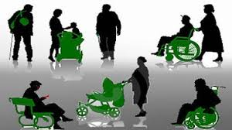
What might Equality look like?
People are offered the opportunity to vote.
Everyone is entitled to a free, appropriate secondary education, in the least restrictive environment possible.
People have their own possessions.
People are assisted in developing work skills and seeking work that maps to their interest and ability.
People own their own clothes and others are not allowed to take or borrow them unless permission is given by the person (excluding staff).
Notes:
What is least restrictive?
Students have the right to be educated with non-disabled peers
People work in all types of work environments with people who are intellectually or developmentally delayed
People live in neighborhoods

Slide 23
Right & Responsibility- Equality
Right of the Person
Responsibility of the Person
Right to equal employment opportunities and fair compensation for work
-----------------------------------
Right to vote
Arrive at work on time.
Dress appropriately for the work environment.
Listen to your boss.
-----------------------------
What might the responsibility to vote look like?
Notes:
If you are going to vote, understand the issues, know where you are supposed to vote, and who you want to vote for.

Slide 24
Common Rights Violations
Confidentiality
Privacy
Lack of access to community (people, places, things)
Discrimination
Over-medication
Mistreatment, abuse, neglect

Slide 25
Activity
Describe and discuss one example of rights violation from each item listed on the previous slide
How would you avoid or respond to the violation?
Notes:
Break the staff into small groups. Assign each group one of the “Common Rights Violation” areas.
Ask the group to identify what a violation may look like, e.g. “what might a confidentiality violation look like?”
Secondly, how would they respond to this violation or take steps to avoid it?

Slide 26
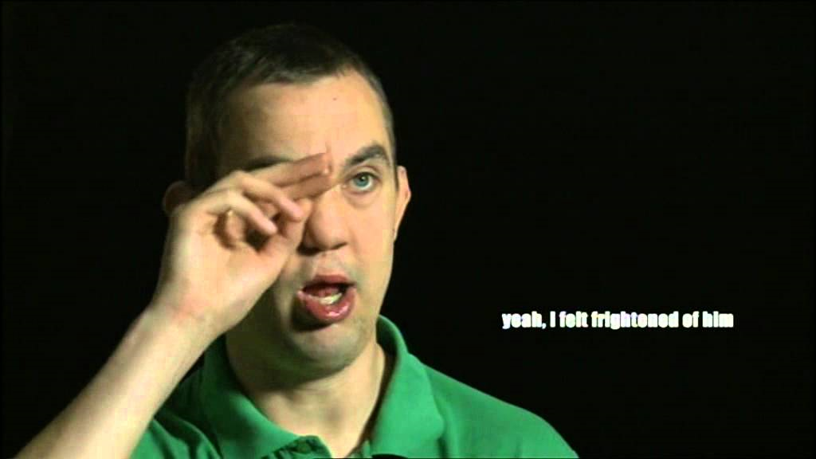
Recognizing Abuse, Neglect, Exploitation
People have the right to live in a safe environment and be free from abuse, neglect, and exploitation.

Slide 27
What is Abuse?
The wrongful treatment of a person that endangers wellbeing through the action or inaction of anyone, whether or not the person appears to be injured or harmed. This includes:
physical abuse
verbal/psychological abuse
sexual abuse
mistreatment

Slide 28
Physical Abuse
What is physical abuse?
Signs of possible physical abuse
Using more force than is necessary for the safety of the person. Examples include hitting, slapping, kicking, biting, shoving, strangling, grabbing, yanking, pinching, strangling, punching, dragging, shaking.
Bruises in the shape of fingers or an object
Untreated/Unexplained injuries
Rope or strap marks on limbs
Broken bones, sprains, fractures
Numerous hospitalizations for injuries
Missing hair or teeth

Slide 29
Verbal Abuse
What is verbal/ psychological abuse?
Signs of possible verbal/ psychological abuse
The use of verbal or nonverbal expressions or actions that subjects the person to:
Intimidation
Ridicule
Humiliation
Harassment
Wrongful manipulation
Cowers in the presence of the abuser
Emotionally upset, agitated, withdrawn
Stress related conditions:
Sleep problems
Unexplained weight loss or gain
Upset, agitation, withdrawal

Slide 30
Sexual Abuse
What is sexual abuse?
Signs of possible sexual abuse
Touching/fondling the genitals or intimate parts of a person
Sexual assault, battery, rape, or coerced nudity
Forcing a person to perform sexually explicit acts
Taking sexually explicit photos of a person
Sexual activity for a person receiving services who has not given consent
Person reports having been sexually assaulted or raped
Sexually transmitted disease
Infection/unusual discharge or smell
Trauma to the genital area
Bruises around the breasts
Soreness around the genital area, breasts or anal area
Difficulty walking or sitting
Clothes with blood stains or tears

Slide 31
Mistreatment
What is mistreatment?
Signs of possible mistreatment
Practices which:
Are contraindicated in a person’s plan of service
Are used for the convenience of staff or a substitute for treatment or care
Do not follow accepted treatment practices or standards in the ID field
Are not allowed as described by law
Observed or informed of “creativity” in managing challenging behaviors, i.e. standing someone in the corner, having a person run laps for behavior, or anything that looks like bribery or punishment.
Placement of a person in a locked room or area
Over medication/over sedated
Notes:
Explain what contraindication means related to a service plan. For example, a person has a behavior support plan that gives specific guidelines for supporting behaviors and rather than following that, a staff person gets “creative” with their own interventions.

Slide 32
Neglect
What is neglect?
Signs of Neglect
The failure to report or act on health problems of the person or changes in health condition
The failure to provide sufficient, consistent or appropriate services, treatment or care that harms or jeopardizes the person’s health or safety
A toothache, illness, or condition that is not treated
Dirty clothing/living conditions
Person is malnourished, dehydrated or begs for food
Pressure (bed) sores
Person appears dirty, unkempt
Person has an odor
Person has chronic health problems
Clothing improper for weather
Notes:
Scenario for discussion:
You support someone who comes to their Individualized Day Services Program without a jacket and it is 40 degrees outside. How would you approach this situation?

Slide 33
Exploitation
What is exploitation?
Signs of exploitation
The illegal or improper use of a persons funds, property, or assets for the personal gain or benefit of staff, volunteers, contractors, guardians, family.
Staff receiving gifts or property from the person served
Person asked to do tasks or chores for the benefit of staff without compensation.
Evidence of a forged signature
Person’s funds or money not accounted for, i.e. no receipts
Person spending money they do not want to spend
Cashing person’s check w/o permission
Notes:
An example: staff says to a person supported, “Oh, Betty, I love your bracelet.” Betty offers to give the bracelet to staff. Do not take that bracelet!

Slide 34
Staff Responsibility for Abuse, Neglect, Exploitation
This is a Serious Reportable Incident
Staff must do the following:
Provide immediate protection
Notify your supervisor
Notify the nurse
Complete an incident report and assure this is reported to the Incident Management Coordinator

Slide 35
Staff Responsibility for Rights Violations
The violation of a right may not rise to the level of an Serious Reportable Incident or a Reportable Incident, but must still be reported.
Your agency must have a “Grievance Procedure” for reporting rights violations and/or complaints, including reporting anonymously.
The rights violation must be reported to your supervisor and the Incident Management Coordinator.

Slide 36
Rights Violations that may be Grievances
Person is not allowed to have his/ her significant other visit in private.
Person complains her phone calls are always monitored by staff.
Medications are given in front of other people and not in the privacy of the person’s room or some other private location.
A person’s medical record is not kept in a secure location and is accessible to anyone who wanders by.

Slide 37
SUMMARY
Be familiar with the rights of the people you support
Know your responsibility in protecting those rights and supporting the person in understanding rights
Support the person in showing responsibility for the right
Recognize abuse, neglect and exploitation
Report abuse, neglect and exploitation as Serious Reportable Incidents
Recognize rights violations
Report rights violations as grievances/complaints

