Slide 1
Introduction to Developmental Disabilities
“I am a Person with Abilities”

Slide 2
Learning Objectives
Participants will understand the definition and criteria for intellectual disabilities
Participants will understand the definition and criteria for developmental disabilities
Participants will learn communication strategies and ethical work standards for DSPs.
Participants will learn about the life cycle

Slide 3
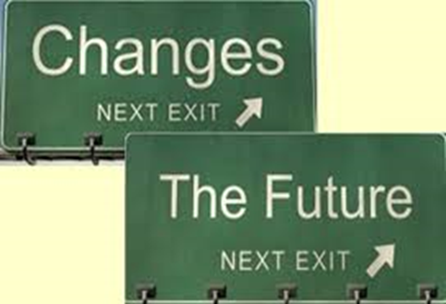
Welcome to the Field of Developmental Disabilities
This field is not a static field it is ever-changing and requires the following competencies:
Willingness to change
Willingness to try and experience new things
Patience
Willingness to listen and advocate for others.
Notes:
Define:
Willingness-
Change-
Try-
Experiences-
Patience-
Advocate-
Talk about what good listening looks like.
Talk about what advocacy looks like. (Scenario-

Slide 4
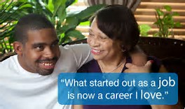
Welcome to the Field of Developmental Disabilities
As a Direct Support Professional (DSP), you are the major advocate for the people you are supporting. Words that are synonyms or mean the same as advocate include: supporter, backer, promoter, proponent and campaigner.

Slide 5
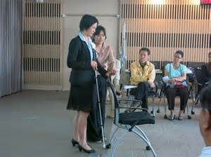
Welcome to the Field of Developmental Disabilities
A DSP should always set the standard, leading by example.
The community takes it’s cue from you! Your language, your tone, your dress, your interaction…..All eyes are on you!

Slide 6
DSPs: Set a Good Example!
Be respectful to all people.
Remember you are working with adults.
The person is first. The disability is secondary.
Call people by their preferred name
Notes:
Discuss what it means to work with adults – emphasize that it means you are not making decisions for someone, do not treat people how you might treat your children, we aren’t “caring for” we are “caring with.”

Slide 7
What is the Difference between Intellectual Disabilities and Developmental Disabilities
Developmental Disabilities
Diagnosed before age 22 and results in significant functional limitations in three or more major life activities
Intellectual Disabilities
Must be diagnosed before age 18 and an IQ score of less than 70.
Notes:
Lets think about how intellectual disabilities an developmental disabilities intersect or share similarities based on the diagram.
1. Both can occur within any ethnic group
2. Both can occur within any Socio-Economic grouping
3. Both can occur within any political affiliation
4. Both can occur within any religious group.
Disability does not discriminate.

Slide 8
FACTS: About Intellectual Disabilities (ID)
Intellectual disability (ID) means that a person mentally develops at a different rate. People with ID can have learning difficulties and trouble socially adjusting.
Intellectual disability (sometimes called cognitive disability) is not a disease or a contagious condition
People diagnosed with intellectual disabilities may develop slower than others in terms of speaking, walking, and taking care of themselves (showering, eating, dressing).

Slide 9
FACTS: About Intellectual Disabilities (ID)
10 percent of Americans have a family member with some sort of intellectual disability
People with intellectual disabilities create one of America's largest disability groups
Every year, 125,000 children are born with an intellectual disability
In the U.S., roughly 6.5 million people are identified as having an intellectual disability.
Notes:
Despite these facts it is important to realize that people can live full, independent, and rewarding lives.

Slide 10
Causes of Intellectual Disabilities (ID)
There are many causes of intellectual disability. A specific cause can be identified in approximately two thirds of cases. Known causes include:
Brain injury or infection before, during or after birth
Growth or nutrition problems
Chromosomal and genetic disorders
Babies born long before the expected birth date – also called extreme prematurity
Health problems during childhood
Drug use during pregnancy, including excessive alcohol intake and smoking
Environmental deprivation
Exposure to toxins
Unknown
Notes:
Also add that sometimes a cause is totally unknown and also, not all of these causes will result in ID.

Slide 11
Effective Communication
Tips that may help when talking with someone who has an intellectual disability include:
Make sure you have the person’s attention. Use their name, gain eye contact or respectful tone and language.
Start by assuming a person can understand you, then adjust your level of communication according to their response.
Ask the person how they would like to communicate.
Notes:
This could include using communication aids or devices, answering with a way of saying ‘yes’ or ‘no’ to questions (for example, using eye gaze, or head or hand movements), sign language, gestures or facial expressions. If you are not able to understand the person, you may need to ask persons in their circle of support for assistance or guidance.

Slide 12
Effective Communication
Tips that may help when talking with someone who has an intellectual disability include:
Use appropriate language for the person and the situation – for example, simple, clear words and short, uncomplicated sentences. If the person is an adult, do not speak as though they are a child.
Use visual information such as pictures, diagrams, signs, objects, or gestures to improve understanding.
Notes:
Use a respectful tone and volume. If the person does not understand you, try a different way of providing the information or asking the question – don’t assume that raising the volume of your voice will help.

Slide 13
Effective Communication
Tips that may help when talking with someone who has an intellectual disability include:
Don’t rush.
Check if they have been able to understand what you have said by asking them to rephrase in their own words. Do not simply ask, ‘Do you understand?’ because people will often say ‘yes’ to avoid embarrassment or because it is the answer they think you want to hear.
Notes:
Allow the person the time to listen, process your words and respond. Waiting patiently conveys interest in and respect for what they will say. If you think you have not been understood, try repeating your message more slowly or using different words. It is your responsibility to make sure your message is understood accurately.

Slide 14
Effective Communication
Tips that may help when talking with someone who has an intellectual disability include:
If you don’t understand the other person, do not pretend to understand. Be honest and take responsibility for any communication breakdowns. For example, say: ‘I’m sorry, I don’t understand what you’re telling me. Would you please tell me again?’
If you cannot understand or be understood, try another approach. Is there another way you can communicate what you want to say? Ask if it’s okay to involve someone who is familiar to the person (a family member or support worker).
Notes:
At this point, you may have a discussion about how behavior is a form of communication as well. If a person is exhibiting some sort of behavior that is undesirable, first think about what they are trying to communicate.

Slide 15
Don’t be awkward!
Notes:
You will need QuickTime for this video, or you can access it online here: https://www.youtube.com/watch?v=Gv1aDEFlXq8

Slide 16
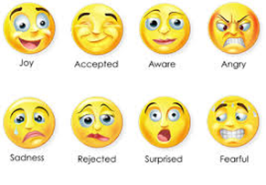
REMEMBER
People diagnosed with an intellectual disability, experience and feel things like joy, anger, pride, hurt, jealousy and other emotions just like you and me.
People diagnosed with an intellectual disability, want the opportunity to have a range of life experiences.
People diagnosed with an intellectual disability, can learn to adapt to new situations and enjoy life independently.

Slide 17
FACTS: About Developmental Disabilities
Developmental disabilities is an umbrella term that includes intellectual disabilities (ID) but also includes other disabilities that have effects on a person’s ability to independently complete major life activities in three or more areas. These conditions begin during the developmental period, but before age 22 and last throughout a person’s lifetime.

Slide 18
FACTS: About Developmental Disabilities
Developmental disabilities occur among all racial, ethnic, and socioeconomic groups. Recent estimates in the United States show that about one in six, or about 15%, of children aged 3 through 21 years carry a diagnosis of developmental disability.
ADHD
autism spectrum disorders,
cerebral palsy,
hearing loss,
intellectual disability
learning disability,
vision impairment
other developmental delays.
Notes:
Example: To be diagnosed as Developmentally disabled , a person would have a condition that impacts three or more of their daily functioning needs. So for example: A young man who has cerebral palsy and hearing loss= The condition of cerebral palsy effects ones motor skills and ability to be mobile as well as spastic movements may effect the persons ability to be steady when dressing or cooking and hearing loss requires one to have a communication device or learn sign language in order to communicate with others. Hence, mobility, cooking, dressing and communication are functioning areas needed in everyday living. In order to achieve independence person may need to utilize assistive/adaptive devices or an aid to complete these tasks daily.

Slide 19
FACTS: About Developmental Disabilities
SOME MAJOR LIFE ACTIVITIES INCLUDE:
Self Care
Learning
Receptive and Expressive Communication
Mobility
Self-Direction
Capacity for Independent Living
Economic Self Sufficiency
Notes:
Stress that a DSP should support people to do these things as independently as possible.
Activity: Ask DSP to describe what each of the above areas may look like
Example:
Self-Care (brushing teeth, showering, dressing, toileting etc.)
Learning- (Reading, Writing, etc.)
Receptive and Expressive Communication- (to understand/comprehend what is being communicated and to be understood by others) (through language, gestures, writing etc.)
Mobility-( Walking, use of a wheelchair, walker, cane, orthopedic shoe or brace etc.)
Self Direction- (

Slide 20
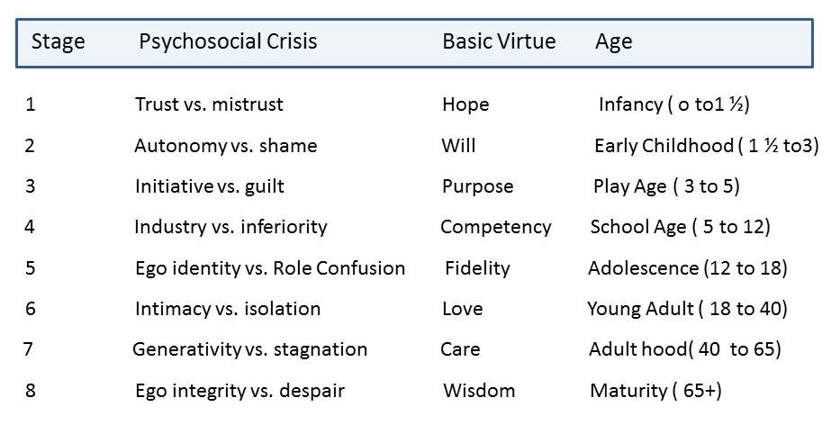
Growth and Development
LIFE CYCLE STAGES
According to Erik Erikson

Slide 21
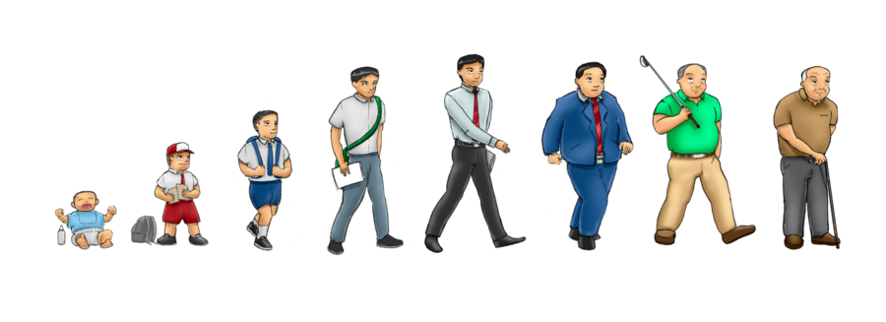
Growth and Development
LIFE CYCLE
Notes:
The life cycle is a continuum. Often we may revisit key components of each stage several times in our lives.
For Example: As a child you learn trust and how to trust people. As and adult you may have an experience that may cause you to loose trust and this has to be relearned.

Slide 22
Growth and Development
People go through a continuum of change during their lifetime
As people grow older, these are basic human needs that must be met through the developmental stages:
Trust –which builds hope
Autonomy – which builds will
Initiative – which builds purpose
Industry – which builds competency
Identity – which builds fidelity
Intimacy – which builds love
Generativity – which builds care
Ego – which builds wisdom
Notes:
Discuss that these are some key areas of development that affect how people interact with the world. When basic human needs are not met in the various developmental stages, it can affect people negatively through the subsequent developmental stages.

Slide 23
Growth and Development
People go through a continuum of change during their lifetime
Riddle Me This??
What creature walks on four legs in the morning, two legs at noon and three legs in the afternoon?
Notes:
If you answered a Human you are correct!!
This riddle is used to describe life stages when you are a child you crawl on al fours, when you are older you walk on two and as you grow old and age you use a cane which represents the third leg.
Life is a cycle often people revisit stages as they experience events in life. For example when trust is broken we often have to learn to trust ourselves and others again. This is even more true for persons with disabilities as every interaction becomes very critical to supporting positive or negative experiences.
In life’s cycle some of the very needs that we have as child are some of the same needs as an elderly person.
In life’s cycle some of the very fears that we have as a child are some of the same fears that we have as we age.
Life is a cycle and a continuum of change!

Slide 24
How Can I Effectively Support a Person with a Disability?
DSP Code of Ethics
As a DSP I will promote:
Person Centered Supports
Physical and Emotional Well-Being
Integrity and Responsibility
Confidentiality
Justice, Fairness and Equity
Respect
Relationships
Self –Determination
Advocacy
Notes:
Please National Alliance for Direct Support Professionals Code of Ethics Agreement. Review with staff and have all staff sign.
(link attached below)
https://www.nadsp.org/library/code-of-ethics/10-library/72-code-of-ethics-full-text.html

