Slide 1
Health and Wellness
Signs & Symptoms
HCMP & Health Passport
Medication Administration
Side Effects of Medications
Psychotropic Medications
BSP
Oral Health
Protocols

Slide 2
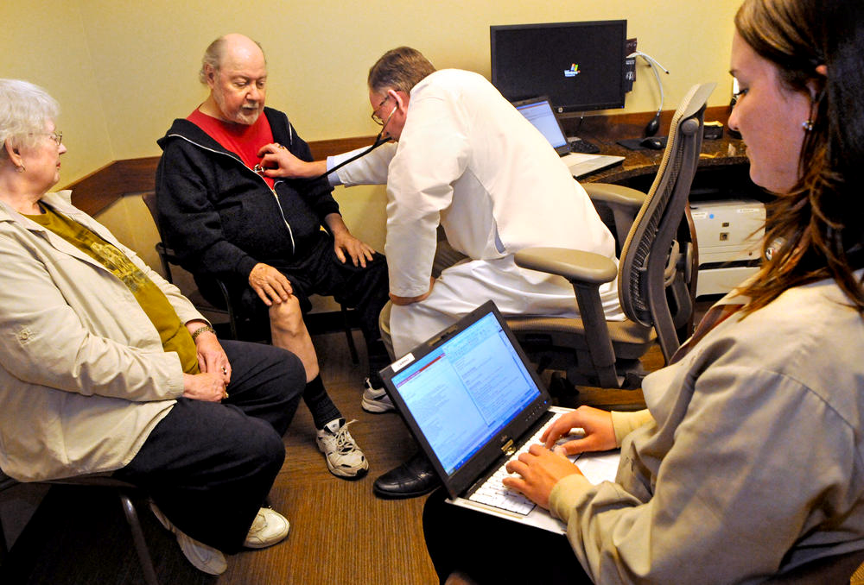
As a DSP
You are responsible for making sure the people you serve receive the best health care possible and that all health care issues are addressed.
You are the person’s strongest advocate, particularly if he or she has difficulty communicating or understanding health care issues.
The DSP should be knowledgeable on important information regarding the health and safety of the person they support.

Slide 3
DDS Health and Wellness Standards
Developed to provide information and tools to obtain the best health outcomes for the people we serve.
Priorities:
Preventive health care
Continual assessment for health changes
Care coordination

Slide 4
What might negatively impact access to quality health care for persons with DD or ID?
Health Disparities: Differences in health conditions between people with and without disabilities
Incomplete medical history
Person’s difficulty communicating symptoms/needs
Lack of consistent routine/ preventive health care
DSP’s lack of experience in performing health advocacy
Poorly communicated information from health care provider that impacts care
Notes:
Emphasize that sometimes DSPs are uncomfortable communicating with health care professionals and knowing that it is okay to ask questions and make sure they fully understand the information.

Slide 5
Understanding Signs and Symptoms
Signs are objective: like a rash, fever, vomiting, person holding neck stiffly, or limping
Signs are what you see, smell, feel, hear
Signs possibly indicate a disease or illness
Symptoms are often subjective, what the person feels that you can’t see or measure – e.g. headache, stomach ache, chest pain
Symptoms are very important, because illness is not always visible!
Symptoms are warning signs – pay attention!

Slide 6
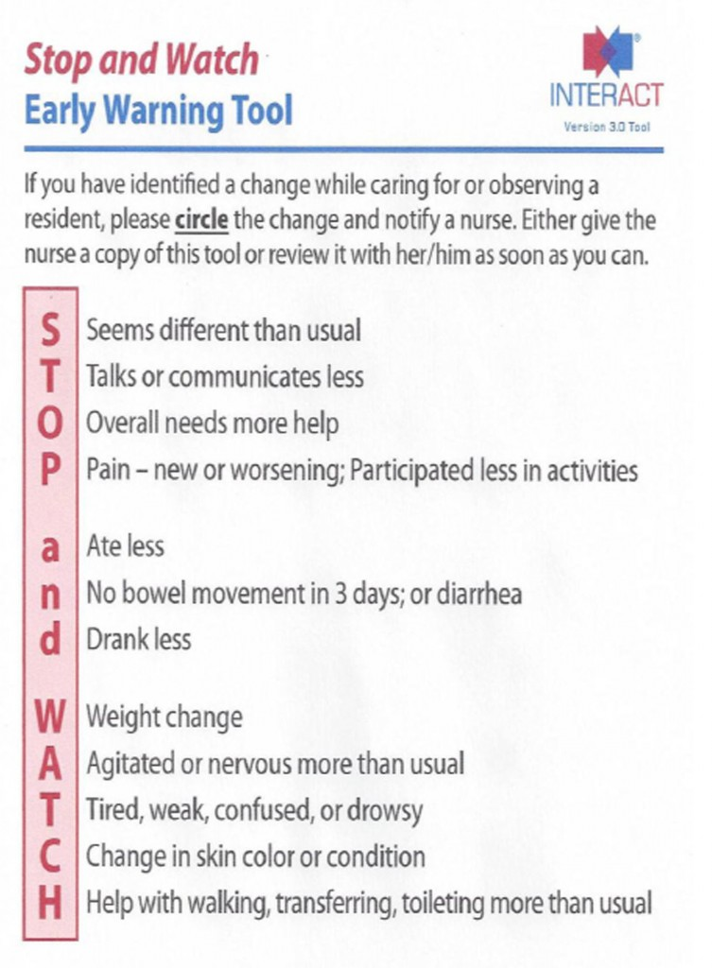
STOP AND WATCH
Notes:
This is called a mnemonic. Use the first letters in STOP AND WATCH to help you remember important things to observe in the people you support. Contact a supervisor if you notice a change in any of these areas from the way the person usually behaves.
If you are not sure about the person’s usual behavior, but you see something that you think is different – ASK.
You can use the STOP AND WATCH when preparing your progress notes. These are all areas that are important to document.

Slide 7
How do you respond to any changes? Be a detective!
ASK the 5 W’s and 1 H
What, Where, When, Why, Who, and How
This information will be important when
documenting and speaking to professionals
The Nurse
Physician
Emergency Personnel
Notes:
Remind audience that “Why” is a question you DO NOT ask when investigating an incident.
But when responding to health changes, this is a good question, because it may lead you to an answer for why something is happening.

Slide 8
Asking Questions????
Remember, the person you support may not be able to accurately answer your questions.
Be sure to ALSO ask: family members, other team members, day program, nurse, etc. Together, you may piece the puzzle together.
Notes:
Everyone communicates differently.
The better you know the people you support, the better you will be able to understand how to ask questions to get the best answer.
Does the answer come in the form of a gesture? A vocalization? A facial expression?

Slide 9
What can cause changes in a person’s health status?
Falls
Dehydration
Seizures/Epilepsy
Allergies
Diarrhea
Constipation
Abdominal Pains/Belly Ache
Trouble swallowing (Dysphagia)
Inhaling food or liquid into the lungs (Aspiration)
Notes:
Be aware that some of these may also require an incident report. Always ask your supervisor.

Slide 10
Falls
Some people may be at higher risk for falling than others.
What do you think might make someone at a higher risk for falls?

Slide 11
Causes of Falls
Poor vision and hearing
Unsteady gait and balance
Neurological disorders
Medication side effects
Dizziness
Being upset
Seizures
Cardiac or heart abnormalities
Muscle Weakness
Arthritis
Foot Problems
Low blood pressure or dizziness
Cognitive or mental impairment
Thyroid abnormalities
Pain or Fatigue
Urinary frequency or incontinence

Slide 12
Environmental Causes for Falls
Floor spills & clutter
Slippery floor surfaces
Wet outdoor walking surfaces
Poor/dim lighting
Unstable or low chairs or beds
Lack of secure bathroom bars
Low toilet seats
Faulty stairs/steps
Improper footwear
Improper use or poor repair of equipment
(e.g. wheelchairs, walkers, canes)

Slide 13
Some people are at high risk for falls.
A Falls Risk Assessment can tell you what the risks are and how to decrease the chances of a fall.
It gives you strategies and procedures to keep the person safe in his or her environment.
Know these procedures!
Know the people you support!
Pay attention to the environment!

Slide 14
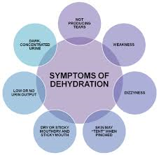
Dehydration
Occurs when more water and fluid leaves the body than enters the body.
Following are some common causes,
their signs and symptoms
and how to prevent.
Notes:
Some dehydration (1) may be due to illness; (2)some may be due to neglect.
The person has a fever and is vomiting – this will cause dehydration and he/she may need to go to the hospital.
The person is unable to get fluid independently and staff do not offer fluids.
In the case of (2), this may be an incident - neglect

Slide 15
Dehydration from – Not drinking enough fluids
You may see:
Dry mouth, irritability, confusion, lightheadedness and dizziness, decreased urine output, trying to take someone else’s drink or drinking from inappropriate source
You should:
Offer fluids with and between meals, especially on warm days. Take fluids when out and about.

Slide 16
Dehydration from Sweating
You may see:
Profuse sweating, person is warm to the touch, low energy
You should:
Wear clothing appropriate for weather, layer when possible, plan activities to not be outdoors for extended time on hot days, offer lots of fluids (and be sure they are consumed!) on hot days.

Slide 17
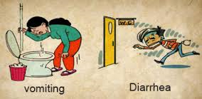
Dehydration from Diarrhea or Vomiting
You may see:
Frequent episodes of vomiting, diarrhea
You should:
Report the consistency and frequency of episodes to nurse or PCP
Provide fluids if directed to do so
Call 911 if unresponsive
Be especially cautious if person is diabetic

Slide 18
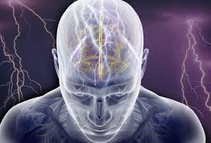
Seizures – What is a seizure?
The brain is full of electrical activity. It is how the brain ‘talks’ to the rest of the body.
If there is abnormal or extra electrical activity in part of the brain, it can cause a ‘misfire’ and result in a seizure
People who have recurring seizures are said to have a seizure disorder or epilepsy.
Notes:
Show a video of what various kinds of seizures look like.

Slide 19
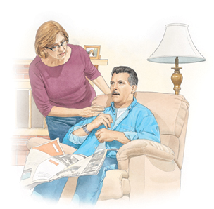
Seizure Without Change In Awareness:
A Simple Partial or Myoclonic Seizure
Person is fully awake and alert
You usually don’t need to do anything
Stay calm and reassure person they are safe
If person is frightened, encourage slow deep breaths
Stay with the person until seizure is over
Know and Follow agency protocol

Slide 20
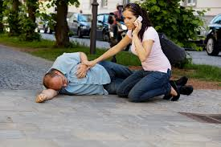
Seizure with Altered Awareness
Complex Partial or Cluster of Absence Seizures
Help person to a safe place; don’t let them wander
Keep person away from sharp objects or dangerous places
Call for help if person is headed for danger
Don’t assume they can talk or follow your instructions. Remind them they are safe
Time the seizure if possible.
Know and Follow agency protocol

Slide 21
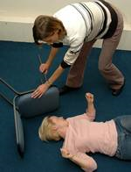
Seizure with Loss of Consciousness
Tonic-Clonic Seizure
Person is totally unaware – their safety is your responsibility
Keep area where they are free from danger or objects that can hurt them
Time the seizure. Call 911 if seizure last more than 5 minutes
Don’t restrain movements; don’t put anything in their mouth
Know and Follow agency protocol
Stay with the person until they are aware & safe

Slide 22
Seizures: Who, What and How?
Under your care….
Know who has a seizure disorder
Know what a typical seizure looks like
(each person is different!)
Know how to respond
Notes:
Give examples of the different people you serve and how their seizures differ from each other. Each person is different
When would a seizure be an incident? (Refer to Incident Management Training). E.g., when 911 is called.
What first aid response should you make?

Slide 23
Seizure Protocol
Protocol Should Tell:
About the specific person and his/her seizures
What type of seizures the person usually has
What the seizures look like
What to do and what not to do
Remember, even if someone takes seizure meds, they may still have seizures.
The person’s safety depends on you knowing and using this information!!

Slide 24
What does a seizure look like?
Notes:
If you do not have Quicktime, click on this link:
https://www.youtube.com/watch?v=hLeSlQS9g2c

Slide 25
Allergies
An allergy is an exaggerated immune response or reaction to substances that are generally not harmful.
Signs of allergy may include: Breathing problems (coughing, shortness of breath); burning, tearing, or itchy eyes
Common Allergens
Pollen
Nuts
Fruit
Animals (Cats, Dogs)
Dust
Shellfish

Slide 26
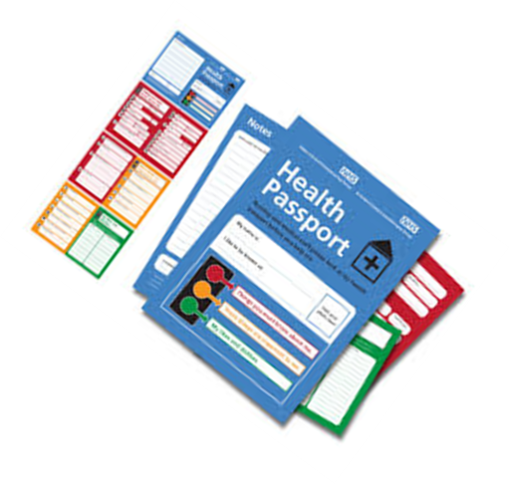
Life Threatening Allergies
The health passport for the people you serve lists all the allergies.
This is IMPORTANT to know.
Some allergies to medications or food may be life threatening to some people (e.g. shellfish, bee stings, certain drugs).
Notes:
Refer to Incident Management Training. An example of an incident may be if the person needs medical attention.

Slide 27
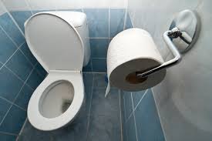
BOWELS!!
This is a very private, personal area of care.
As DSPs, you may be providing the most intimate of care to the people you serve.
Remember to respect each person’s dignity in offering support, privacy and gentle care.

Slide 28
Diarrhea
Is the condition of having three or more loose or liquid bowel movements per day (or as defined by the health care professional)
Everyday things such as food, medication, or stress can cause diarrhea. However, diarrhea sometimes may signal an underlying medical condition.

Slide 29
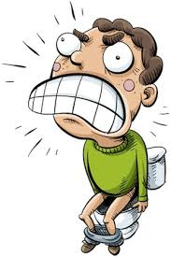
Constipation
Refers to bowel movements that are infrequent or hard to pass.
Remember, everyone is different. Not everyone has a bowel movement every day, but not having bowel movements CAN be life-threatening.
Some possible signs of constipation:
Straining
Hard stools
Abdominal pain
Two or fewer bowel movements in a week
Incomplete evacuation
Or – a protocol specific to the person you support

Slide 30
Bowel Protocols
The people we support are at higher risk for diarrhea or constipation because of medications, decreased mobility and exercise, and physical disabilities.
Bowel protocols provide guidance on responding to diarrhea or constipation. The people you serve may have protocols.
Learn them!!!
You are responsible for following these protocols!
These protocols will also tell you if you need to be present in the bathroom or if the person you support can self-report.
Notes:
If diarrhea or constipation leads to the need for medical intervention, this IS an incident. And, it could possibly be considered neglect, if it is felt that staff did not follow a protocol or provide necessary care.

Slide 31
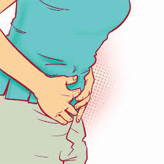
Abdominal Pain/ Belly Ache
Whether it is a mild stomachache, sharp pain, or stomach cramps, abdominal pain has numerous possible causes.
Some are serious – some are not.

Slide 32
How to tell???
With so many causes of abdominal pain, how can you find out the cause?
Go back to “who, what, where,
when, why, how”
Ask team members, the person you support and others. Gather all the information you can and provide it to the nurse.

Slide 33
Some questions the DSP might ask a person complaining of belly pain:
When was the person’s last bowel movement?
(i.e., is the person constipated?)
When did this pain start? (i.e., is it menstrual cramps?
(Is the flu going around?)
Has the person eaten anything unusual?
Is urine cloudy, dark, smelly?
Report the information to the nurse.
Remember, YOU have the most direct contact with the person. Your accurate information is vital for the nurse.

Slide 34
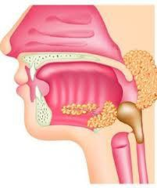
Dysphagia and Aspiration
Dysphagia is the medical term for difficulty in swallowing
Aspiration is the entry of secretions or foreign material (e.g. food/fluid) into the trachea and lungs
Persons with some developmental disabilities (e.g. cerebral palsy) or the elderly may be at risk for developing dysphagia, which may lead to aspiration.
Notes:
If this problem requires medical attention, it is an incident.
Dysphagia and aspiration occur more frequently in individuals with some developmental disabilities and as people age.

Slide 35
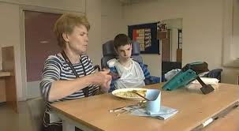
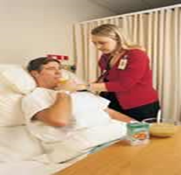
Let’s pay attention to our language and manners
When you support someone at mealtime:
You Are:
Sitting with the person you support
Paying attention to the person you support
Sharing mealtime
You Are NOT:
Standing over the person.
Multitasking – talking with others and doing other things
“Feeding” the person
Notes:
Do not give commands.
Don’t rush the person.
Make mealtime an enjoyable experience!

Slide 36
To assess nutritional and eating challenges:
Your input, as a DSP is essential to the team
Observe, document and communicate issues so that the team can develop an effective plan.
The Nutritionist may develop a therapeutic diet and advise on texture changes. Follow this!
The OT may advise on the use of adaptive equipment to support successful eating. Follow this!
The Speech Pathologist may recommend positioning guidelines to support successful eating. Follow this!

Slide 37
Mealtime or Eating Protocols
For someone who has dysphagia or is at risk for aspiration, there may be
mealtime protocols.
These may tell you:
How to prepare the food (e.g. texture change – pureed, chopped, ground)
How to present the food (e.g. small amounts)
What adaptive equipment to use
Positioning (How the person should be sitting)
How to assist with eating

Slide 38
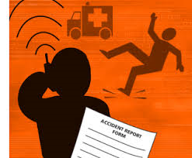
A Note about Incidents
A change in a person’s health status – as shown in many of these slides, MAY be an incident.
Always discuss these changes with your nurse and/or supervisor to ensure correct and appropriate reporting of incidents.
Notes:
If you a see a change in health status, make sure to contact the nurse or supervisor. Don’t allow people to experience pain or discomfort without telling someone about it. How would you feel?

Slide 39
Other Protocols – guidance for DSPs
As part of a person’s care, there may be other protocols that DSPs must follow to provide the best care (aside from those already listed)
For example: blood pressure protocols, positioning protocols.
It is important that you know and understand these protocols.
The person’s safety depends on you knowing and using this information!
Notes:
Emphasize that if there are any protocols of any sort in place, and an incident occurs in which a protocol was not followed, this may result in a charge of neglect. And, more importantly, it may negatively impact the health of the person you support.

Slide 40
Oral Care
Good oral care means:
Brushing after every meal
Using equipment and products recommended by dentist
Developing a protocol if tooth brushing is challenging
Flossing daily
Having regular checkups
This is essential to help prevent disease,
including pneumonia.

Slide 41
Oral Care
To help support good oral hygiene,
DSPs should:
Support people with brushing after every meal & flossing to prevent plaque
Report any dental concerns (pain, bleeding, broken or missing teeth) to nurse immediately
Follow specific oral care protocols.
Obtain dental checkups as ordered or usually every 6 months.

Slide 42
Dual Diagnosis
A person has a developmental disability and a co-occurring mental health condition.
The full range of mental health diagnoses is believed to be present in persons with ID.
Frequently diagnosed mental health conditions:
Depression
Post-Traumatic Stress Disorder
Schizophrenia
Schizoaffective Disorder
Obsessive Compulsive Disorder
Anxiety Disorders
Bipolar Disorder

Slide 43
Maladaptive behaviors are not always a sign of a mental health condition!
Example: Possible reasons for aggression:
Means of expressing frustration, fear, injustice, or anger
Means of communication (displeasure, discomfort, desire for assistance)
Learned problem behavior
Relief from boredom
Modulation of stimulating environments
Expression of physical pain or acute medical condition
Signal of acute psychiatric problem
Grief and loss issues
Escape or avoidance of unwanted demands or situations
Attention seeking

Slide 44
Behavior is a form of Communication!
What would you do if you couldn’t tell someone to stop bothering you?
What would you do if you couldn’t tell someone that you hurt somewhere?
What would you do if you couldn’t tell someone that you hate what you are being asked to do?
How would you communicate?????
Notes:
Ask the participants to give some examples of how they would communicate in these situations.
Talk about the alternative communication methods of the people we serve. Ask the participants to name some of these that they have seen (e.g. gestures, smiles, facial expressions, communication devices, physical movement, vocalizations, etc.)

Slide 45
Behavior is Natural
We all “behave” and we all have “behaviors”
You are “behaving” by sitting in this class.
You are “behaving” when you kiss your child good night.
You are “behaving” when you have an argument with your friend.
If you are human, you “behave.”

Slide 46
5 ways to support people with dual diagnosis
Environmental interventions- to reduce stress for the person
Positive programming/skills training- to teach and support effective skills for handling challenges
Positive behavior support and positive reinforcement-to increase the frequency of effective behaviors and reduce ineffective behaviors
Reactive or Emergency strategies- techniques to keep the person, and other people, safe
Medication- supporting the person with lowest number of medications and the lowest dosages necessary for stabilization

Slide 47
Behavior Support Plans (BSP)
A plan to support positive behaviors may be developed when a person:
Exhibits behaviors that pose a threat to self or others;
Exhibits behaviors that interfere with learning goals or personal outcomes;
Takes psychotropic medications meant for behavior support;
Has been subject to emergency restrictive controls or restraint due to a behavioral crisis and/or;
Needs support from staff on learning different communication strategies.
You must receive training on the current BSP of the persons you support.
Know the documentation and monitoring requirements.

Slide 48
BEFORE Developing a BSP!!!
It is VERY IMPORTANT to rule out medical or health issues or environmental issues that may be causing the behaviors before developing a BSP.
Notes:
You need to rule out any medical conditions which may be causing behavioral changes. E.g. someone is angry and yelling – it turns out they have serious back pain.
Or, someone gets angry (shouts, throws things) every time his/her favorite show is turned off. You don’t need a BSP for this. Figure out a way to let the person watch what he/she wants and still complete necessary care.

Slide 49
Behavior challenges can originate from a medical problem
In people with ID, mental health symptoms such as anxiety, depression, aggression, and drastic mood changes are often caused by medical problems.
Common medical problems that can lead to mental health symptoms:
seizures, otitis, gastrointestinal disorders, sinusitis, dental problems, sleep disorders, pain (e.g. menstrual, gout, headaches)

Slide 50
The Importance of the BSP
A BSP is NOT a plan that is used when a person exhibits challenging behavior.
It is a plan to SUPPORT the person in using positive behaviors to get what they want and need in life.
A BSP is really a plan for DSPs. You cannot change anyone’s behavior. You can only change your own!
Notes:
Tell the participants that these plans used to be called “behavior management plans” (BMPs) but we realize that we are not “managing behaviors” we are supporting positive behaviors by the actions we take (BSP)

Slide 51
Did anyone say, “Person-Centered?”
Remember, above all, the person you support is the focus of your attention.
AND EACH person is different!
Not every person requires special protocols or special equipment.
Know the people you support.

Slide 52
The Health Care Management Plan
This document is created by the nurse and carried out by the DSP and the nurse.
Identifies all current conditions and what the DSP and the RN/LPN interventions are.
The HCMP also gives staff preventive strategies to be able to provide the best care for the individual.
Know where the HCMP is kept in your agency.
Notes:
Go over the parts of a HCMP.
Remind the learners that they need to know their responsibilities with the HCMP, they need to understand the document and ask questions if they do not understand.
They need to provide feedback to the nurse and supervisor if there are any changes to the HCMP that need to be recorded.

Slide 53
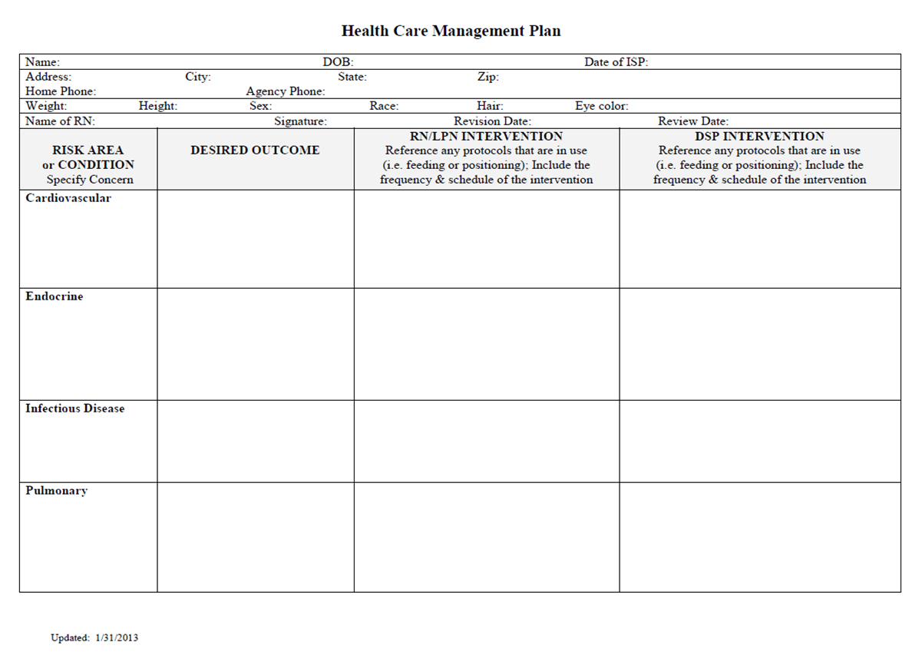
Health Care Management Plan (HCMP)

Slide 54
The Health Passport
A portable functional document that has all of the key information about a person including:
Identifying Information (contact #s, PCP, etc.)
Next of Kin/Substituted Decision-Maker Information
Physician Information
Diet and Adaptive Equipment Needs
Consent(s)
Allergies
Diagnoses
Medications
Vaccinations
Know where the Health Passport is kept.
Notes:
Refer to HIPAA – which will also be covered under Incident Management. It is important with all these documents to protect the privacy of the people we support.

Slide 55
The Health Passport
A copy should be kept
and used:
In Residential medical record
At Day Program
At ER/Hospital
At doctor’s
Appointment – make sure you take it with you!

Slide 56
Health Passport and Medications
Perhaps one of the most important sections of the Health Passport is the Medications!
This section gives the following:
Name of Medication/Generic Name
Dosage
Time
Route
Reason for Taking
Start date and Discontinue date

Slide 57
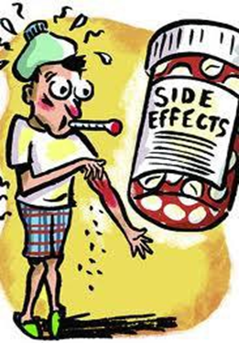
What DSPs need to know about Medications
What time a person usually takes their medication
How do they take it – do they take it themselves or do they have help?
Remember STOP and WATCH – could there be any side effects of the medications?

Slide 58
Common Side Effects of Medications
Nausea, constipation and/or diarrhea
Drowsiness
Dizziness
Pain (headaches, stomachaches, joint and muscle pain)
Tremors
Anxiety or Nervousness
Irregular Heartbeat
Headache
Restlessness
Diarrhea
Dry Mouth
Insomnia
High Blood Pressure

Slide 59
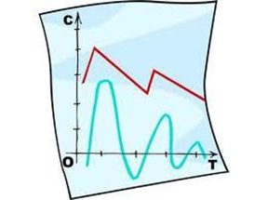
Keeping Accurate Data
Helps the person and their support team know if interventions are working.
Is important to show that protocols are being followed.
Helps the psychologist/psychiatrist evaluate events that may affect a person’s behavior, if applicable.

Slide 60
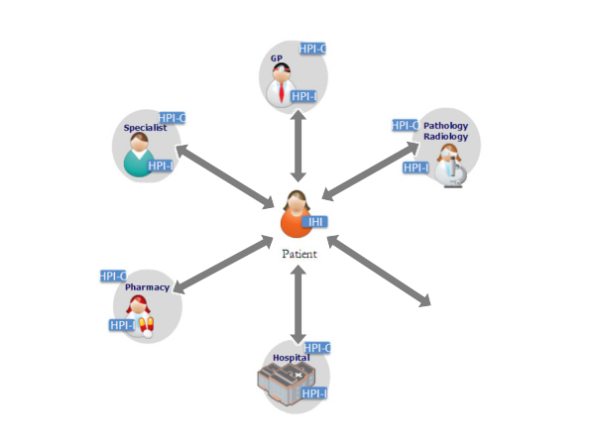
Supporting Good Medical Care
When going to any medical appointment including emergency visits you MUST take the person’s current Health Passport and a consultation sheet that (1) lists purpose of the appointment and (2) gives any related consults or lab studies and their results.
The HCMP and Health Passport should be updated by the nurse whenever there is a change in the person’s health status or at minimum reviewed every 3 months.

Slide 61
Providing support at health care appointments
What is your role?
Know the details of why the person is seeking care and what you need to do/to ask.
Talk to the person you are accompanying about the visit so they can participate as much as possible.
Take any objective data you need that pertains to that visit: e.g. records of seizures, episodes of incontinence, behavioral data, history of current complaint.
Take health passport, which includes listing of current medications, medical conditions, allergies, etc.
Advocate for the person you support. Make sure the provider talks TO THE PERSON and not just TO YOU.

Slide 62
And More……
ASK QUESTIONS!!! If you do not understand what the provider is saying, no one else will either!!
Ask the person you are supporting, “do you understand what the doctor said?”
Do not sign any consent forms – ever. Know ahead of time who is able to give consent.
Read all the information written by the provider BEFORE YOU LEAVE! If you can’t read it, no one else can either.

Slide 63
What do you do when you return from a medical appointment?
Know and follow your agency policies about recording, reporting, and securing information; ordering new medications; obtaining referrals; and filing information. Each provider is different.
Notes:
Discuss your agency’s policy on medical appointments.

Slide 64
Health and Wellness
Recognizing Signs and Symptoms of Illness
Knowing What to do
Taking Preventive Measures
Knowing where to find important medical information
Giving Medical Professionals good information and feedback
Supporting the WHOLE person MIND, BODY & SPIRIT!

