Slide 1
Department on Disability Services
Budget Presentation
Fiscal Year 2024
Andrew P. Reese, DDS Director
Public Forum – March 24, 2023

Slide 2
DDS BUDGET HISTORY
2

Slide 3
PROPOSED BUDGET BY PROGRAM
Program | FY 2023 Approved | FY2024 Proposed | Change FY23 to FY24
Developmental Disabilities Administration | $147,846 | $152,244* | $4,398*
Rehabilitation Services Administration | $20,616 | $21,643* | $1,027
Disability Determination Division | $11,687 | $12,024 | $337
Agency Management | $14,894 | $14,857 | ($36)
Financial Operations | $1,933 | $1,958 | $24
Total | $197,976 | $203,726 | $5,751
3
Notes:
*You will notice that the numbers I shared today are a little lower than what you see in the budget books: that is because $1,000,000 in local funds supporting CSG 50, “Subsidies and Transfers,” was erroneously allocated to DDA’s budget, rather than to RSA’s budget, where it should have gone. This is attributable to the agency’s conversion to the District Integrated Financial System, and we will be correcting the misallocation through the errata process. The same error appeared in last year’s proposed and approved budgets, and we will be correcting the problem from last year through a mid-year reprogramming. For this year, once the error is corrected, the net effect of our clean-up will be the same increase in spending power you see in the budget books: $27,000 more for RSA than last year and $5.3 million more for DDA than last year, which will go to Waiver costs.

Slide 4
WHERE THE MONEY COMES FROM
Fund | FY 2023 Approved | FY2024 Proposed | Change FY23 to FY24
Local Funds | $136,407 | $142,848 | $6,440
Special Purpose Revenue Funds | $12,715 | $10,082 | ($2,633)
Federal Grant Funds | $34,326 | $34,362 | $36
Federal Medicaid Payments | $14,429 | $16,336 | $1,908
Federal Payments /American Rescue Plan Act (ARPA) | $99 | $99 | $0
Total | $197,976 | $203,726 | $5,751
4

Slide 5
DDS STAFFING
Program | FY 2022 FTEs | FY2023 FTEs | Change FY22 to FY23
Developmental Disabilities Administration | 185 | 185 | 0
Rehabilitation Services Administration | 105.5 | 106.5 | 1
Disability Determination Division | 63 | 62 | -1
Agency Management | 62.5 | 62.5 | 0
Financial Operations | 12 | 12 | 0
Total | 428 | 428 | 0
5

Slide 6
DEVELOPMENTAL DISABILITIES ADMINISTRATION
Supports more than 2,300 adults with intellectual and developmental disabilities.
Two HCBS Waivers serving more than 1,800 people in integrated, community-based settings.
FY 2024 Total Budget - $152,244,402
FY 2024 Local Funding - $132,130,623
Includes a $744,600 enhancement to increase PNA
6

Slide 7
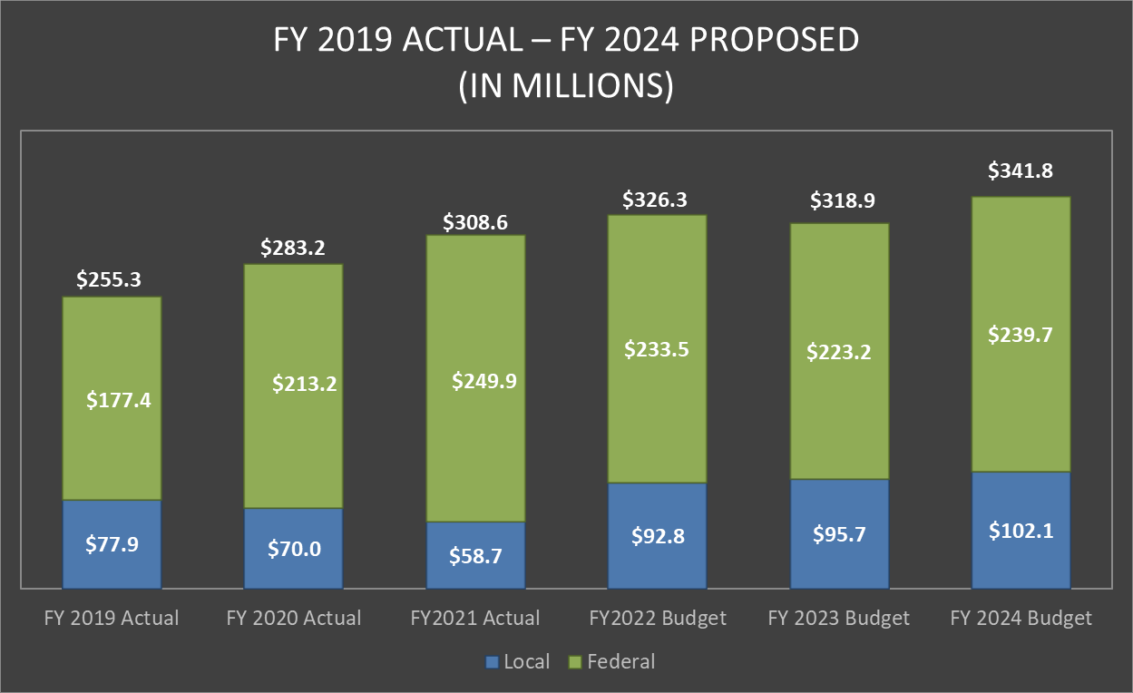
DDS HCBS WAIVERS
7

Slide 8
DDA WAIVER & RESIDENTIAL COSTS
HCBS Waiver Slots | IDD | IFS
Available | 116 | 78
Utilized | 1,826 | 12
Planned net increase of 50 waiver slots per year
Residential Costs
Budgeted residential costs for FY 2024 - $27.5 million
Budgeted residential costs for FY 2023 - $26.7 million
Actual residential expenditures FY 2022 - $24.6 million
8

Slide 9
REHABILITATION SERVICES ADMINISTRATION
RSA helps people prepare for work and to get and keep better jobs.
RSA FY 2024 Budget - $21,642,607
78.7% federally-funded, with a 21.3% local share and required maintenance of effort.
9

Slide 10
RSA MATCH AND MAINTENANCE OF EFFORT
Fiscal Year | Match | Maintenance of Effort | Approved Budget | Expenditures
FY 2020 | $4,157,617 | $8,209,038 | $7,369,966 | $8,593,447
FY 2021 | $4,225,263 | $8,813,367 | $5,142,610 | $8,824,120
FY 2022 | $4,287,286 | $8,593,448 | $5,142,610 | $8,739,063
FY 2023 | $4,287,286 (est.) | $8,824,121 | $4,828,344
FY 2024 | $4,287,286 (est.) | $8,739,064 | $4,743,191
10

Slide 11
DISABILITY DETERMINATION DIVISION
DDD is the District office for the Social Security Administration’s review and determination of disability claims.
100 percent federally funded, with a proposed FY 24 budget of $13,023,885.
Four positions are in recruitment.
Awaiting SSA approval to fill nine open positions.
11

