Slide 1
Positive Practices in Behavioral Support
© 2016 Institute for Applied Behavior Analysis,
Los Angeles, California. All rights reserved.
2016 D1-G
1

Slide 2
Basic Principles
Presented by:
Institute for Applied Behavior Analysis

Slide 3
Introduction
Notes:
Use this slide to introduce the co-presenters and the background leading up to this program.

Slide 4
ABA in Support of Values
  Social role valorization: The enablement, establishment, enhancement, maintenance, and/or defense of valued social roles for people--by using, as much as possible, culturally valued means (Wolfensberger, 1983)
Notes:
While we are talking about people who have challenging behavior, our focus in working with such individuals isn’t primarily their behavior but rather their quality of life. This is measured by certain valued outcomes, as influenced by the work of Wolfensberger and John O’Brien…

Slide 5
ABA in Support of Values
  Community presence and participation, in ways that are age appropriate and valued by society
  Autonomy and self determination, through the exercise of increasingly informed choice
  Continuous involvement in the ongoing process of becoming
  Increasing independence and productivity, to the point of economic self sufficiency
  The opportunity to develop a full range of social relationships and friendships
Notes:
Each of these is reviewed, with a particular emphasis on the qualifying clauses of each statement.
We use behavioral technology in support of and subordinate to these outcomes and use it to address the barriers to these outcomes that may be represented by challenging behavior.
It is only when that behavior is a barrier to these outcomes that we address those needs.
The option isn’t either a behavioral approach or a values based approach, but rather to use the principles of Applied Behavior Analysis in the pursuit of these valued outcomes.
Values are needed to guide the technology. Technology is needed to achieve our valued outcomes.

Slide 6
Punishment
The contingent presentation of a stimulus or event, resulting in a future decrease in response strength.
The contingent withdrawal of a stimulus or event, resulting in a future decrease in response strength.
Notes:
Since we explicitly use the principles of ABA, we should define some basic terms.
There are two types of Punishment as defined here…
(Ask the audience to identify examples of each.

Slide 7
Aversive
A stimulus or event one would ordinarily act to avoid.
Notes:
Define an aversive event and compare and contrast it to Punishment.
This week, we will be talking about alternatives to punishment and to the use of non-aversive events.

Slide 8
A Non-linear Model for Positive Behavioral Support
Notes:
Let us now introduce the model that will organize our work together this week.

Slide 9
Why People Use Punishment
Response Alternatives
Child Rearing Practices
Modeling Effect
Literature
Expert Consultation
Myth of Effectiveness
Reinforcement Histories
Notes:
Let’s begin with a recognition that there are a lot of reasons why people use punishment.
Response Alternatives - It’s what we know how to do. Asked to list how they would solve a particular problem behavior, the list of punitive and aversive techniques would be 5 or 6 times longer than their list of positive techniques. If we want people to reduce their use of punishment, we need to introduce them to the alternatives. That’s what we intend to do this week.
Child Rearing Practices- Spare the rod, spoil the child.
Modeling Effect - People around us use punishment
Literature - Until recently, the published research was dominated by punishment studies.
Expert Consultation - Based their advice on single element interpretations of the literature.
Myth of Effectiveness -
Reinforcement Histories - we’ve used it before and it has “worked.”
You really may want to skip most of this and just explain the first reason and it implications.

Slide 10
Responses to Problem Behavior
Treatment
Protection
Emotional Expression
Notes:
We have different needs when faced with problem behavior.
We should understand these different needs and consider why we sometimes use punishment to meet them.
Treatment-Reducing behavior overtime; Punishment is not necessary for treatment. This will become even more clear as the week goes on.
Protection-Introduce the concept of episodic severity. When a behavior puts people at risk, we must do something to bring about fast/safe resolution. We sometimes use a punitive procedure as a reactive strategy because we need to respond. This week we will introduce you to a whole range of non-aversive reactive strategies that are amazingly effective in bringing about rapid, safe resolution of a behavioral episode.
Emotional Expression - Punishment also helps us deal with our emotional needs. In fact, our use of punishment is often emotionally driven. Provide example, e.g., our emotional response to being spat at and how that drives our use of punishing consequences.
The emotional drive to punish is natural and may even have survival value, as is our drive to reproduce. Compare and contrast mating urges and urges to punish. However, we, as humans, can base our behavior on values and desired future outcomes while suppressing the urges of the moment. However, if we are going to effectively address the needs for treatment and protection with alternatives to aversive procedures, we will have to address our emotional needs in some other way. This may be the biggest challenge to our approach.

Slide 11
If we wish to change the basic strategies that we use, a longitudinal program of behavior change, with us as the learner, is necessary.
04/03 D1-G
© 2003 IABA
11
Notes:
We have different needs when faced with problem behavior.
We should understand these different needs and consider why we sometimes use punishment to meet them.
Treatment-Reducing behavior overtime; Punishment is not necessary for treatment. This will become even more clear as the week goes on.
Protection-Introduce the concept of episodic severity. When a behavior puts people at risk, we must do something to bring about fast/safe resolution. We sometimes use a punitive procedure as a reactive strategy because we need to respond. This week we will introduce you to a whole range of non-aversive reactive strategies that are amazingly effective in bringing about rapid, safe resolution of a behavioral episode.
Emotional Expression - Punishment also helps us deal with our emotional needs. In fact, our use of punishment is often emotionally driven. Provide example, e.g., our emotional response to being spat at and how that drives our use of punishing consequences.
The emotional drive to punish is natural and may even have survival value, as is our drive to reproduce. Compare and contrast mating urges and urges to punish. However, we, as humans, can base our behavior on values and desired future outcomes while suppressing the urges of the moment. However, if we are going to effectively address the needs for treatment and protection with alternatives to aversive procedures, we will have to address our emotional needs in some other way. This may be the biggest challenge to our approach.

Slide 12
Ethical Considerations
Conditions
Functionality
Notes:
While there are many ethical considerations that would lead us to the adoption of a positive approach, we want to address the one that has most influence our approach, which, in fact, forms a basic premise underlying our approach, i.e., that what we refer to as challenging behavior invariable serves a legitimate function for the person.
This is to such an extent that if we understand why a person doing what they are doing, from their point of view, we wouldn’t feel ethically comfortable in and wouldn’t even think of using a punitive approach.
Use some dramatic actual examples and audience participation to support this point…
If behavior serves legitimate functions for the person, what are the ethics of using punishment without even going through a process of understanding the meaning of the behavior from that person’s point of view.

Slide 13
Administrative & Legal Considerations
Legislation
Court findings
Agency rules & regulations
Notes:
While there are ethical reasons for adopting a positive approach to challenging behavior, there are increasing administrative and legal ones as well.
Confirm that people are aware of the administrative, regulatory and legal trends that increasingly limit what procedures we are allowed to use in our services.
This is occurring because as a field we may have overused, misused and in some cases abused the punishment technology that is available to us.
We should adopt a positive approach because it may be the only approach we are allowed to use in the future…
…and to the extent we adopt a positive approach, we may remove the impetus for external control of the field.

Slide 14
Empirical & Clinical Considerations

Slide 15
Empirical Considerations
Notes:
Let’s discuss the empirical considerations first and review the evidence base in support of positive behavioral supports.

Slide 16
Are Positive Practices Effective with Severe and Challenging Behavior?
Foxx, 2005; Johnston, Foxx, Jacobson, Green & Mulick, 2006
_________________________________
Severe vs. not severe
Institutions vs. community
High rate vs. Low rate Behavior
Specialists needed
5. High cost vs. low cost
Notes:
Concerns have been raised regarding the efficacy of PBS…

Slide 17
Literature Review of Type 3
Case Studies (Kazdin, 1981):
Valid inferences:
  Objective data for multiple Behaviors.
  Continuous assessment.
  Problems of long standing/stable histories and of the type that would not ordinarily improve without effective intervention.
  Applied across various ages, diagnoses, and personal backgrounds.
Notes:
Some of the evidence in support of PBS is based on Type 3 case study reports. If certain criteria are met, valid inferences can be drawn from case studies…

Slide 18
Are Positive Practices Effective with Really Severe and Challenging Behavior?
Donnellan, A. M., LaVigna, G. W., Zambito, J., and Thvedt, J. (1985). A time limited intensive intervention program model to support community placement for persons with severe behavior problems. The Journal of the Association for Persons with Severe Handicaps,
LaVigna, G. W., Willis, T. J., and Donnellan, A. M. (1989). The role of positive programming in non-aversive behavior management. In E. Cipani (Ed.) Behavioral Approaches to the Treatment of Aberrant Behavior. AAMD Monograph Series, American Association on Mental Retardation.
LaVigna, G. W., and Willis, T. J. (1992). A Model for multielement treatment planning and outcome measurement. In D.E. Berkell (Ed.), Autism: Identification, Education, and Treatment. Lawrence Erlbaum Associates, Hillsdale, New Jersey.
Willis, T. J., & LaVigna, G. W. (2003). The safe management of physical aggression using multi-element positive practices in community settings. The Journal of Head Trauma Rehabilitation.
Notes:
Here are some of the type 3 case studies reported in the literature.

Slide 19
Donnellan, A. M., LaVigna, G. W., Zambito, J., and Thvedt, J. (1985). The Journal of the Association
for Persons with Severe Handicaps
  All 16 were at imminent risk of institutionalization.
  Five involved serious self-injury or physical aggression.
  Others involved property destruction, extreme tantrums, inappropriate sexual Behavior, etc.
Notes:
These cases studies all addressed very serious behavior challenges…

Slide 20
Excerpts from case files:
…he became so assaultive and unmanageable that he had to be placed in a psychiatric hospital for two weeks.
…deep concern over the effects of their son’s (assaultive) Behavior on his younger sister’s physical safety.
…head butting.
…this client spent 90% of her waking hours at home in a straight jacket and/or locked in a wheelchair.
…the mother had to lock herself in the garage or bathroom to prevent herself from incurring severe bodily harm.
Notes:
… these were clearly severe behaviors!

Slide 21
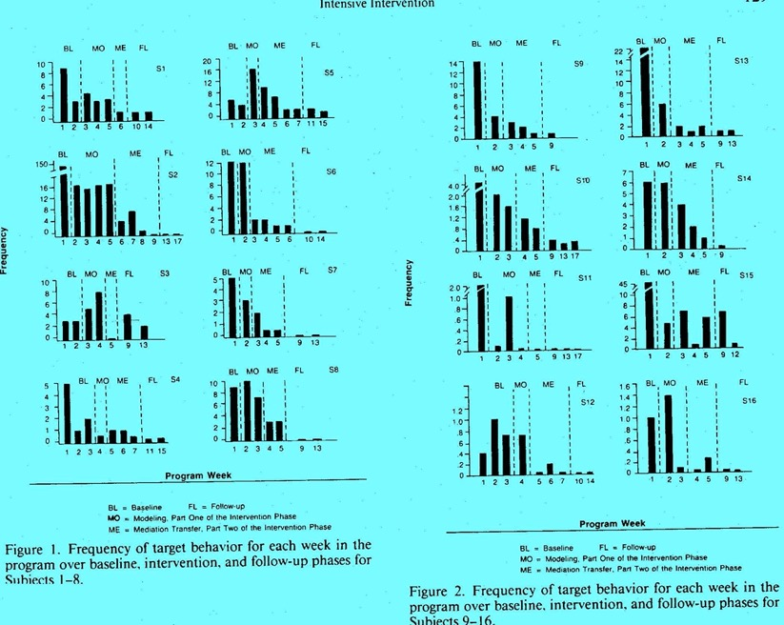
Notes:
All 16 cases benefited from PBS, comparing baseline rates of problem behavior through intensive intervention, primary mediator intervention and follow-up phases.

Slide 22
Prior use of punishment
Even though the ethical practice of ABA requires the least restrictive method, our referrals often involve people whose problems are serious and for whom a punitive approach has failed.
The next case involved a person for whom a wide range of aversive procedures were used unsuccessfully.
Notes:
See slide…

Slide 23
Case Details
LaVigna, G.W., and Willis, T.J. (1992)
17-year-old boy with autism and hearing loss.
Target Behavior: SIB - striking his head or nose with his fist or against another object…
Previous treatment: the behaviors were initially controlled by aversive consequences, including bare-bottomed smacks, water squirts, pinches, and the like. Eventually, the consequences only escalated the problem, e.g., after more than a year, he received 177 bare-bottomed smacks in just one day.
Notes:
See slide…

Slide 24
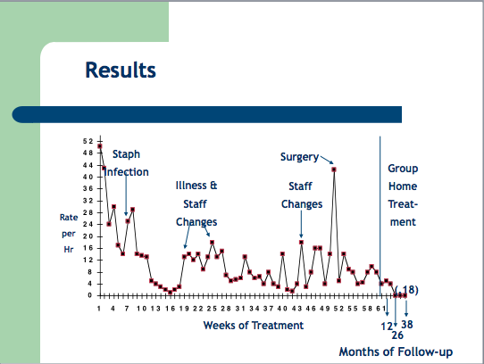
Notes:
Again, PBS solved the problem of serious self injury.

Slide 25
Prior use of punishment
The 1989 study involved a person for whom a systematic, consistently applied Overcorrection procedure was ultimately unsuccessful.
___________________________________________
LaVigna, G. W., Willis, T. J., and Donnellan, A. M. (1989) The role of positive programming in non-aversive Behavior management. In E. Cipani (Ed.) Behavioral Approaches to the Treatment of Aberrant Behavior. AAMD Monograph Series, American Association on Mental Retardation.
Notes:
See slide…

Slide 26
Long Lasting Results
The problem of physical aggression was resolved.
If Overcorrection could not produce durable results, the question remained as to whether or not the outcomes achieved through the positive plan were durable.
A 20-year follow-up was planned: 2004
Notes:
See slide…

Slide 27
Notes:
Explain how to read a cummulative graph and what this one shows, emphasizing the result of the 20-year follow-up revealing no occurrences of aggressive behavior for the entire year – 2004.

Slide 28
Are Positive Practices Effective with Really Severe and Challenging Behavior?
Hudson, A., Wilken, P., Jauernig, R, & Radler, G., (1995). Regionally based teams for the treatment of challenging Behavior: a three-year outcome study. Behavior Change.
Hudson, A., Jauernig, R., Wilken, P., & Radler, G., (1995). Behavioral treatment of challenging Behavior: a cost benefit analysis of a service delivery model. Behavior Change.
McClean, B., Grey, I. M., & McCracken (2005). An evaluation of positive Behavioral support for people with very severe challenging Behaviors in community-based settings. British Journal of Learning Disabilities.
McClean, B., Dench, C., Grey, I., Shanahan, S., Fitzsimons, E., Hendler, J., & Corrigan (2005). Person Focused Training: a model for delivering positive Behavioral supports to people with challenging Behaviors. Journal of Intellectual Disability Research.
Notes:
Others have reported similar findings.

Slide 29
Can Positive Practices be Implemented by Front Line Staff?
McClean, Dench, et al. (2005):
Details: 138 individuals
67 physical aggression
31 self-injurious Behavior
10 property destruction
30 other
Notes:
This study was particularly important because of its size…

Slide 30
Results
77 % Reduction in Target Behavior*
22 Months of Follow-up Data
Conclusion: With training/coaching, positive practices, including functional assessment, can be successfully implemented by direct care staff.
*large institutions
Notes:
…and because it was DIRECT SERVICE staff who were trained and COACHED to carry out the assessments and to develop and then implement the PBS plans. Effective PBS is easily taught and is accessible.

Slide 31
Control Group Study
Grey, I. & McClean, B. (2007) Service user outcomes of staff training in positive Behavior support using person-focused training: A control group study. Journal of Applied Research in Intellectual Disabilities.
Notes:
Here’s a control group comparison study that demonstrates the effectiveness of PBS.

Slide 32
Train the Trainers
LaVigna, G. W., Christian, L., and Willis, T.W. (2005). Developing Behavioral Services to Meet Defined Standards within a National System of Specialist Education Services. Pediatric Rehabilitation.
Notes:
Here’s a study that demonstrates IABA staff can train others to train others as well as IABA can train others. Again, this is a disseminable and accessible technology.

Slide 33
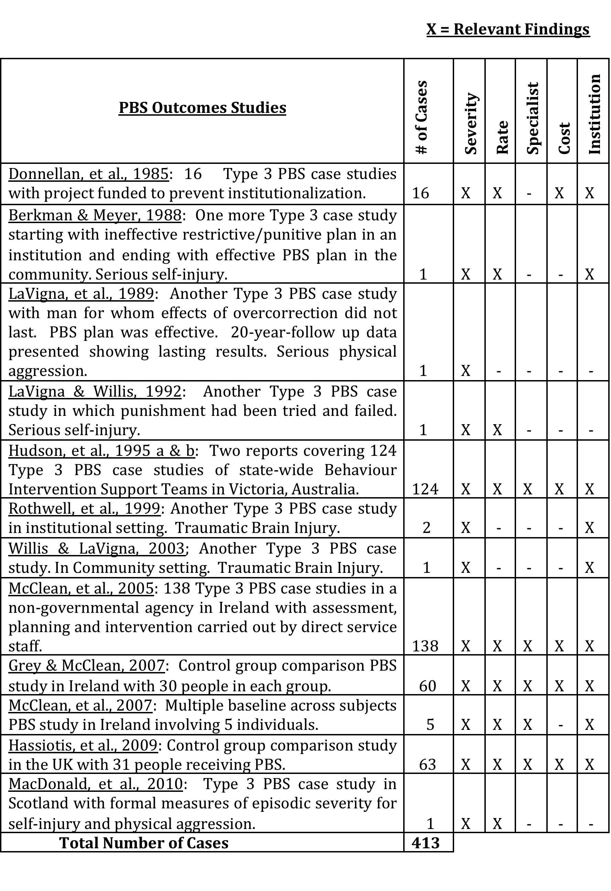
Summary of Studies
Included
LaVigna, G. W. & Willis, T. J. (2012). The efficacy of positive behavioural support with the most challenging behaviour: The evidence and its implications. Journal of Intellectual and Developmental Disability
Notes:
A series of articles in the JIDD reported the empirical support for PBS. This series included a literature review…

Slide 34
PBS Special Issue Web Access
http://informahealthcare.com/toc/jid/37/3
Notes:
… if you want, here is where you can access it.

Slide 35
Additional Articles
Nicola Crates, Matthew Spicer
Developing behavioural training services to meet defined standards within an Australian statewide disability service system and the associated client outcomes (31 +)
Brian McClean, Ian Grey
An evaluation of an intervention sequence outline in positive behaviour support for people with autism and severe escape-motivated challenging behaviour (4)
A component analysis of positive behaviour support plans (61)
Notes:
Additional research was also published as part of the special series.

Slide 36
Positive ABA practices can be
effective with severe target Behavior
513 Type 3 Case Studies, single subject design & control group comparison studies …and wide ranging clinical practice
Practice Based Evidence
Notes:
See slide…

Slide 37
Conclusions:
A positive approach can be effective, even with the most challenging and high rate behavior.
This is empirically supported in the published literature.
This has implications for the ethical practice of ABA, given the principle of the “least restrictive procedure.”
Notes:
See slide…

Slide 38
Ethics
Behavior Analyst Certification Board Guidelines for Responsible Conduct For Behavior Analysts© (August 2004)
4.07
Least Restrictive Procedures.
The behavior analyst reviews and appraises the restrictiveness of alternative interventions and always recommends the least restrictive procedures likely to be effective in dealing with a behavior problem.
Notes:
Given the evidence that PBS is accessible and effective, we are ethically required to use it.

Slide 39
Clinical Considerations
Notes:
Now let’s look at the clinical considerations.

Slide 40
Is Punishment Necessary for Effectiveness?
Speed and Degree: over time and within an episode
Durability
Generalization
Side Effects
Social Validity
Clinical/Educational Validity
Notes:
In additional to the empirical evidence, we also want to consider the clinical rationale for adopting a positive approach. The question, of course, isn’t “is punishment effective,” the question is “is punishment necessary for effectiveness.
Briefly explain the different criteria that need to be met to call an approach effective, illustrating the latter two with brief examples, as these may be new terms.
It is generally recognized that punishment isn’t necessary and in fact does not contribute the the latter five criteria.
Punishment is justified b y the need for speed and degree of effects.
“is punishment necessary for rapid and significant effects?”
Traditional meaning of rapid effects is rapid effects over time.
In addition we need rapid, control over an episode…define episodic severity.
Give examples of antecedent control and stimulus satiation, before the fact strategies, as superior to punishment, an after the fact strategy, for purposes of rapid treatment effects.
Explain that punishment is not only not necessary for rapid, safe resolution but is know to escalate a behavioral episode. Help audience relate this to their personal experience.

Slide 41
Outcomes
Speed &
Degree
of Effects
Durability
of
Effects
Generalization
of
Effects
Side
Effects
Social
Validity
Educational/
Clinical
Validity
Over
Time
Episodic
Severity
04/08 D1-G
© 2008 IABA
41
Notes:
In the multi-element approach we will be discussing this week, we will stay focused on the entire range of outcomes we are trying to produce, not just rapid control (both meanings).
First and foremost, improvements in the person’s quality of life.
Rapid control (both meanings), when the behavior represents a barrier to those desired quality of life outcomes.
Durability and generalization of both the improvements in quality of life and removal of behavioral barriers, while minimizing negative side-effects, using strategies that are acceptable to consumers, their families, staff and the wider community.

Slide 42
Support Plans
Proactive Strategies |  |  | Reactive Strategies
Ecological Strategies | Positive Programming | Focused Support
Settings Interactions Instructional Methods Environmental Pollutants (e.g., noise, crowding…) Number & Characteristics of other people | General Skills Development Functionally Equivalent Functionally Related Coping/Tolerance | Differential Schedules of Reinforcement Antecedent Control Instructional Control Stimulus Satiation Etc. | Active Listing Stimulus Change Crisis Resolution
Notes:
No one strategy can accomplish this wide range of outcomes. What is needed is multi-element support plan, where one or more of the elements address one or more of the desired outcomes and where together, all are therefore addressed.
These include proactive strategies aimed at future effects, including:
Ecological strategies to smooth the fit in the mismatches that are identified between the person’s needs and characteristics and the characteristics of their physical, interpersonal, and/or service environments.
Positive programming aimed at teaching the person additional skills and competencies to more effectively deal with their environments.
Focused support strategies to reduce and if possible eliminate the occurrence of the target behavior and the need for reactive strategies.
And reactive strategies aimed at situational effects for purposes of rapid, safe resolution to reduce the severity of a behavioral episode, I.e., episodic severity.

Slide 43
Assessment
Process | Content | Materials
Observation Data Collection Interview Records Review Interaction Test Situations Analysis Report Writing | Referral Information Background Information Functional Analysis Mediator Analysis Motivational Analysis | Assessment Guide and User’s Manual Reinforcement Surveys Communication Functions Instrument Report Format
Notes:
To develop multi-element support plans such as these requires a comprehensive approach to functional assessment in order to understand the behavior from the person’s point of view. This involves important attention to the:
The processes of assessment that are required;
The questions that need to be answered through the assessment process;
And full utilization of the materials that can be of assistance in carrying out a comprehensive functional assessment.
When you are ready to transition to the next slide, ask the question:
“How many of you have every said something like - we know what we need to do to solve the problem, we just can’t get people to do it consistently?”
No approach to challenging behavior is complete unless to issue of consistency is addressed.

Slide 44
Mediation
04/08 D1-G
© 2008 IABA
44
Notes:
In our multi-element approach, the issue of consistency is addressed under “Mediation,” meaning the mediation, I.e., the implementation of the plan.
We will talk about the social change agents that may be responsible for implementing the plan, including natural, professional and specialized change agents. (Define what we mean by each.)
We will also talk about the training we will arrange for each, to establish both the general skills and specific skills they will need (define each), and the quality management systems we will need to assure quality and consistency, once staff know how to do what they need to do.

Slide 45
Breaking the Barriers to Social & Community Integration:
A Non-linear ABA Framework for Research, Support and Training
ASSESSMENT
PROCESS
CONTENT
MATERIALS
SUPPORT PLAN
PROACTIVE STRATEGIES
REACTIVE
ECOLOGICAL STRATEGIES
POSITIVE PROGRAMMING
FOCUSED SUPPORT
SITUATIONAL MANAGEMENT
INDEPENDENT VARIABLES
SERVICE DESIGN
MEDIATION
TRAINING
GENERAL
SPECIFIC
COMPLIANCE
NATURAL
SOCIAL
CHANGE
AGENTS
SPECIALIZED
PROFESSIONAL
DEPENDENT VARIABLES
SPEED &
DEGREE OF
EFFECTS
SIDE EFFECTS
SOCIAL
VALIDITY
DURABILITY OF EFFECTS
CLINICAL/
EDUCATIONAL
VALIDITY
GENERALIZATION OF EFFECTS
OVER
TIME
EPISODIC
SEVERITY
04/08 D3-G
© 2008 IABA
45
Notes:
All of this gets integrated into our multi-element framework for breaking the barriers to social and community integration…based on the outcomes we are trying to produce, through the consistent implementation of a multi-element support plan that has been based on a comprehensive functional assessment aimed at understanding the behavior from the person’s point of view.
Point out and emphasize the solid line between proactive and reactive strategies and what this means. Illustrate the principle with the case of the self-injurious lip puller.
Give the audience an overview as to when each of the elements in the framework will be discussed in detail.
Stop to see what questions they may have at this point.
After questions and answers, say…

Slide 46
Support Strategies
Presented by:
Institute for Applied Behavior Analysis
Notes:
“…we will now discuss each of these in turn, beginning with a discussion of ecological strategies as the first element making up our proactive plan.

Slide 47
Ecological Strategies
Changes in physical, interpersonal, and programmatic environments that better fit the person's characteristics & needs
Notes:
Ecological strategies are defined as…
Re-iterate transitional point, i.e., Ecological Strategies attempt to smooth the fit, i.e., eliminate the mismatches found between the person’s needs and characteristics and their environment.
Explain that these strategies are necessary because we typically find through our assessment that there are mismatches between the person’s needs and characteristics and the environments they are in.
These mismatches can contribute to the occurrence or episodic severity and/or detract directly from the person’s quality of life.

Slide 48
Ecological Strategies
Physical Factors
  Examples
    Setting
    Light
    Noise
    Crowding
  Implications
Notes:
In discussing the physical environment as the first example, I usually ask the audience to confirm their common experience that they have worked with people with whom changes in the physical environment having to do with such things as noise, crowding, etc., led to dramatic behavioral changes.
I use this as a set up to discuss two major implications associated with ecological strategies:
Ecological strategies can represent two-way changes or a one-way change:
Provide at least one example of each.
Point out that to be unclear about which you are recommending can affect the social validity of the plan.
Ecological strategies be recommended for the rapid effects they are expected to have on target behavior or because it positions you to teach the skills you need to teach to produce long-term quality of life outcomes:
When the reason is for the later, in fact, the ecological changes can have an unwanted effect on target behavior.
Hence, the potential counter-therapeutic effects of the necessary ecological strategy may need to be balanced with some additional focused support and reactive strategies, similar to what we discussed in introducing the multi-element role of a reactive strategy.
Provide hypothetical or real examples.

Slide 49
Ecological Strategies
Interpersonal Factors
  Examples
    Peer respect
    Communication / culture
    Social interactions
    Expectations
  Implications
Notes:
Then move on to the interpersonal environment as an area that may need some changes.
a.I ask if anyone has worked with a person whose target behavior occurs when they with staff who don’t treat them in a respectful way but who target behavior rarely, if ever, occurs when they are with staff who treat them in a respectful, age appropriate manner. This usually gets an affirmative response from the majority of the audience.
i. I ask if they have ever left a job not because of the nature of the work but rather because of how they were being treated. This is also a common experience.
ii. I also point out to them (although I don’t ask for a show of hands) that many of them have probably left their marriages or partnerships…they may have tried to fix the relationship, but if they couldn’t fix it they left it.
iii. Similarly, when we see a relationship conflict exists for one of our clients, we try to fix it. If we can’t, we may need to make a recommendation for a change in placement, not because of the nature of the physical environment but because of the interpersonal environment.
Ecological changes can and may need to be major undertakings.
b. The presentation then move to Jeff’s case study as an example of a non-negotiable need for him to be with people who are fluent in sign language given his hearing impairment and the focus, with him, to teach him sign language as his major system of communicating with those he lives with.
i. This is a rare opportunity for you to show the audience the outline of entire plan, since most of our examples are isolated examples. (We also do this on the 4th (PSR) day.)
ii. The main point is that the entire plan, implemented by IABA staff, was only partially effective, until he moved into a group home that had the (interpersonal) ecology that provided right match for him.

Slide 50
Jeff's Multi-Element Support Plan
Ecological Strategies
Positive Programming
Focused Support
Strategies
Reactive Strategies
04/08 D1-G
© 2008 IABA
50
Notes:
Talk them through the case study…see video tapes, remind me to send reprint of this publication.

Slide 51
Jeff's Multi-Element Support Plan
Ecological Strategies
Community based group home
Peer & staff sign language for primary communication
Interim increased intensive support - 30 hours/ week
Token reinforcement program
Positive Programming
Focused Support
Strategies
Reactive Strategies
04/08 D1-G
© 2008 IABA
51
Notes:
Talk them through the case study…see video tapes, remind me to send reprint of this publication.

Slide 52
Jeff's Multi-Element Support Plan
Ecological Strategies
Chronological age-appropriate & functional skill development
Discrete trial, differential reinforcement for compliance
General sign communication training
Signed request for self restraint
Positive Programming
Focused Support
Strategies
Reactive Strategies
04/08 D1-G
© 2008 IABA
52
Notes:
Talk them through the case study…see video tapes, remind me to send reprint of this publication.

Slide 53
Jeff's Multi-Element Support Plan
Ecological Strategies
Positive Programming
Antecedent control gradually faded
DRO schedules
Focused Support
Strategies
Reactive Strategies
04/08 D1-G
© 2008 IABA
53
Notes:
Talk them through the case study…see video tapes, remind me to send reprint of this publication.

Slide 54
Jeff's Multi-Element Support Plan
Ecological Strategies
Positive Programming
Focused Support
Strategies
No physical intervention was necessary
Signed "No - Wrong!"
Back up self-restraints
Reactive Strategies
04/08 D1-G
© 2008 IABA
54
Notes:
Talk them through the case study…see video tapes, remind me to send reprint of this publication.

Slide 55
Results
Staph
Infection
Surgery
Group
Home
Staff
Changes
Illness &
Staff
Changes
Rate
Per
hour
(.18)
Weeks of Treatment
Months of Follow-up
12
38
26
Notes:
Talk them through the case study…see video tapes, remind me to send reprint of this publication.

Slide 56
Ecological Strategies
Programmatic Factors
  Examples
    Choice, predictability & control
    Motivational systems
    Curriculum
    Task difficulty
    Instructional methods
  Implications
Notes:
The service (or programmatic) environment is addressed next.
Use hypothetical or actual example to illustrate ways in which the changes in the service environment can lead to rapid improvements in behavior or to improvements in the person’s quality of life (our most important goal).
Examples might include using discrete trial vs. hierarchy of prompt teaching methods when working with people challenged with autism or the use of concrete visual systems with the same population.

Slide 57
Breaking the Barriers to Social & Community Integration:
A Non-linear ABA Framework for Research, Support and Training
ASSESSMENT
PROCESS
CONTENT
MATERIALS
SUPPORT PLAN
PROACTIVE STRATEGIES
REACTIVE
ECOLOGICAL STRATEGIES
POSITIVE PROGRAMMING
FOCUSED SUPPORT
SITUATIONAL MANAGEMENT
INDEPENDENT VARIABLES
SERVICE DESIGN
MEDIATION
TRAINING
GENERAL
SPECIFIC
COMPLIANCE
NATURAL
SOCIAL
CHANGE
AGENTS
SPECIALIZED
PROFESSIONAL
DEPENDENT VARIABLES
SPEED &
DEGREE OF
EFFECTS
SIDE EFFECTS
SOCIAL
VALIDITY
DURABILITY OF EFFECTS
CLINICAL/
EDUCATIONAL
VALIDITY
GENERALIZATION OF EFFECTS
OVER
TIME
EPISODIC
SEVERITY
04/08 D3-G
© 2008 IABA
57
Notes:
We’ve discussed Ecological strategies. We now turn to Positive Programming strategies.

Slide 58
Positive Programming
Longitudinal instruction designed to teach skills & competencies that facilitate behavioral change for the purpose of social integration.
Notes:
Transitional Logic: “While ecological strategies are aimed at smoothing the fit in the mismatches we find in the person’s environment and his or her characteristics, in contrast, Positive Programming is aimed at teaching the person additional skills to more effectively deal with their (inevitably) imperfect environments.
Positive programming is defined as…
There are four separate categories of skills we include under the heading of positive programming.
These include general, functionally equivalent, functionally related and coping and tolerance skills.
Let’s first talk about general skills…

Slide 59
Positive Programming
Variations
  General Instructive Programming
    Functional
    Chronologically age-appropriate
    Low inference
Notes:
General skills are what we might typically think of when we talk about skill development.
They include domestic, self care, recreational, community, vocational and even academic skills.
In the context of a plan which addresses challenging behavior, for behavioral rather than educational reasons, it is important that the skills we teach be functional, chronologically age-appropriate and taught using low inference strategies. This is because, to the extent that what we teach is not functional, is age-inappropriate and is being taught in artificial, segregated settings, we increase the likelihood of problem behavior.
Further, we would recommend putting the word “fun” back in functional. I.e., we should be emphasizing teaching the person what they want or would like to learn, rather than things that are “useful” for them to learn.
Give examples.

Slide 60
Positive Programming
  Teaching Functionally Equivalent Skills
    Communications
      Examples
      Choosing augmentative systems
      Instructional strategies
    Independence
Notes:
This is based on our premise that what we call challenging behavior serves a legitimate need for the person. The strategy here is to teach a skill that gets that need met in a more acceptable way.
One typical way to do this is to teach the person a more acceptable way of communicating the message underlying the behavior (citee Durand, Mirenda, Carr.)
Provide examples (see video’s) from different levels of functioning…making the point that this strategy is still applicable to those who can speak.
Emphasize and illustrate the teaching methods, not just the skill that is being taught. Positive programming involves systematic instruction.
Also make the point that we can teach a functionally equivalent skill separate from a communication skill, e.g., independence. Use video and positive programming chapter for example of this involving a 6-year-old boy who engaged in PICA behavior. Specifically, having determined through CFA that he engaged in PICA behavior to ingest, we taught him to access food independently by going to the fridge and pantry and helping himself to food.
In addition to functionally equivalent skills, it may also be necessary to teach certain (functionally) related skills…

Slide 61
Positive Programming
  Teaching Functionally Related Skills
    Discrimination
    Choice
    Predictability & control
    Rules
    Stimulus control
Notes:
Continue with PICA example to illustrate how teaching him to discriminate between edible and inedible items was a skill he need to learn that was related to the function of the PICA behavior.
Provide further case vignettes to illustrate how the above may represent further examples of functionally related skills that may need to be taught.
Emphasize that these are only meant to be examples.
This is a good opportunity to compare and contrast ecological and positive programming strategies. Give the person more choice and control would be an example of an ecological strategy. To teach how to make choices and how to exert control, would be examples of postive programming.
Take this opportunity to explain the difference between rule governed versus contingency governed behavior. Use my “going home nude” example if you want. Illustrate through example the use of rule governed behavior to teach a functionally related skill, i.e., the rule. Examples should cover variations such as teaching through the written rule, role playing and Imagery Based Role Play Practice (social stories).
Use examples from video’s and chapter or use your own. In fact, if you have your own examples for any of the points I am emphasizing in the notes, by all means use them. Just make sure they are on point.

Slide 62
Positive Programming
  Teaching Coping Skills
    Desensitization
    Shaping
    Relaxation training
Notes:
Regardless of well you are able to smooth the fit with Ecol Strat and the general, functionally equivalent and functionally related skills you are able to teach, there is one more set of skills that are perhaps the most important if you are serious about producing good quality of life outcomes and lasting results.
That is, ultimately it is likely to be necessary to teach people how to cope with and tolerate naturally occurring aversive events, triggers to problems behavior that are unavoidable, such as delay in gratification, denial, frustration, failure…and the need to perform non-preferred activities and tasks.
Provide some case examples of this, relying on the positive programming chapter, the videos and/or you own experiences.

Slide 63
Long Lasting Results
The problem of physical aggression was resolved.
If Overcorrection could not produce durable results, the question remained as to whether or not the outcomes achieved through the positive plan were durable.
A 20-year follow-up was planned: 2004
Notes:
See slide…

Slide 64
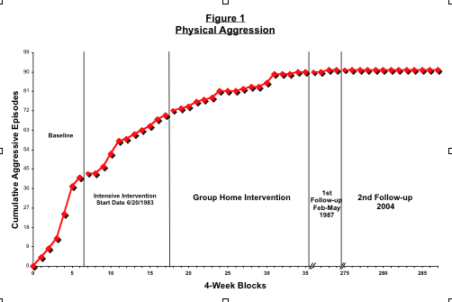
Notes:
This is a reminder of the earlier slides…

Slide 65
Breaking the Barriers to Social & Community Integration:
A Non-linear ABA Framework for Research, Support and Training
ASSESSMENT
PROCESS
CONTENT
MATERIALS
SUPPORT PLAN
PROACTIVE STRATEGIES
REACTIVE
ECOLOGICAL STRATEGIES
POSITIVE PROGRAMMING
FOCUSED SUPPORT
SITUATIONAL MANAGEMENT
INDEPENDENT VARIABLES
SERVICE DESIGN
MEDIATION
TRAINING
GENERAL
SPECIFIC
COMPLIANCE
NATURAL
SOCIAL
CHANGE
AGENTS
SPECIALIZED
PROFESSIONAL
DEPENDENT VARIABLES
SPEED &
DEGREE OF
EFFECTS
SIDE EFFECTS
SOCIAL
VALIDITY
DURABILITY OF EFFECTS
CLINICAL/
EDUCATIONAL
VALIDITY
GENERALIZATION OF EFFECTS
OVER
TIME
EPISODIC
SEVERITY
04/08 D3-G
© 2008 IABA
65
Notes:
We’ve looked at Positive Programming. Now we turn to Focused Support.

Slide 66
Focused Support Strategies
Notes:
While it may be obvious that lasting, quality of life outcomes can be obtained through ecological and positive programming strategies, they are not likely to contribute to a quick change in the challenging behavior itself.
It may take awhile to make the desired ecological changes and it will certainly take awhile to teach the skills we want to teach.
Hence the need for focused support strategies in our plans.

Slide 67
Focused Support Strategies
To reduce, and if possible, eliminate, the need for a reactive strategy.
Notes:
The role of a focused support strategy is…
While there are other very effective focused support strategies we will talk about later this week, today we are going to talk about the use of preferred events.

Slide 68
Time-Based Schedules
Increase the density of time-based delivery of preferred events.
Notes:
The first use of preferred events that would almost always be a part of our plans would be to increase the density of time-based preferred events in the person’s life.
Explain what this means.
Give examples.
Compare and contrast the density of preferred events in the lives of our clients and in the lives of a matched group of typical people.
Point out that a high density of preferred events is a setting event for the lower likelihood of challenging behavior and a low density of preferred events is a setting event for the higher likelihood of challenging behavior.
If we want to dramatically reduce the occurrence of challenging behavior, we may need to do nothing more than increase the density of time-based preferred events in a person’s life.

Slide 69
Differential Schedules
Notes:
This is in contrast with the contingent presentation of preferred events through differential schedules of reinforcement.
Such schedules may also, on occasion, make an important contribution to our support plans.
They should be acknowledged and considered as artificial support for the person, prosthetic that may attract negative attention, but that may be necessary in the short run for the person to be successful.
Today we’ll discuss three different formats for providing differential reinforcement and their relative strengths and weakness as focused support strategies.
These are:
The differential reinforcement of other behavior (DRO).
The differential reinforcement of low rates of responding (DRL).
The differential reinforcement of alternative responses (Alt-R).
We’ll discuss each in turn.

Slide 70
DRO - Differential Reinforcement of Other Behavior
Reinforcement after a specified period of no undesired responding
Notes:
DRO is defined as…
Provide some example.

Slide 71
DRO
Target
No
Behavior
Target
Behavior
Notes:
Explain the powerful dynamic that underlies DRO’s effectiveness as a focused support strategy…
i.e., the universe is divided into two mutually exclusive possibilities, intervals of time that either have that don’t have the problem behavior.
We reinforce and therefore increase one part of the university, the proportion of intervals that don’t have the problem behavior and thereby reduce (reciprocally) the proportion of intervals that have the problem behavior.
Use the video’s and alternatives to punishment as background material to prepare for this slide and the slides that follow.

Slide 72
DRO - Variations
DRO - Reset Schedules
DRO - Fixed Interval Schedules
DRO - Progressive Schedules
Notes:
Point out that there are different variation of DRO, each with its own characteristics.
Define and provide an example of the reset variation and point out that it very often produces an undesirable behavioral pattern, I.e., reinforcement sets the occasion for the problem behavior…we tend not to use this variation.
Define and provide an example of the fixed interval variation and point out that it is more often used that the reset variation and does not have that problem. If people are concerned that the person will exhibit high rate behavior after they have “blown” the interval, indicate that as common as this concern is, it very rarely happens and if it does the reset method can be used.
Set up definition of DROP and click to next slide.

Slide 73
DRO - Variations
A DROP schedule of reinforcement involves the progressive increase of reinforcement available for each consecutive interval during which target behavior does not occur up to a specified maximum
Notes:
A DROP schedule of reinforcement involves…
Use example of 18-year-old or other client of ours or yours to illustrate this technique.
The example(s) should be dramatic.
This is a very powerful focused support strategy, especially for low rate but very serious behavior, for which the literature provides very little advice.

Slide 74
DRO Variations
Momentary DRO Schedules
Trial by Trail -Omission Training
DRO Escalating (Increasing Interval) Schedules
Notes:
Define and provide examples from videos, alternatives to punishment and progress without punishment to illustrate these techniques.

Slide 75
DRO-Implementation
Selection of target behavior
Selection of DRO variation
Selection of time interval
  Goldilocks Rule
  Fixed interval: 50% of the average time between responses before intervention
Notes:
Define and talk about the Goldilocks rule.
Provide examples.
The point is that certain technical requirements need to be met if these techniques are going to be successful.

Slide 76
DRO-Implementation
Selection of reinforcers
  The Free Access Rule: The maximum amount of positive reinforcement available during intervention must be less than the person would seek given free access
  General considerations
Notes:
Define and provide examples of the free access rule, again emphasizing the importance of meeting the key technical requirement for such techniques.
Talk about ethical considerations of (deprivation) limiting access to the preferred events to be use in a DRO, or any other schedule of reinforcement.

Slide 77
DRO-Implementation
Fading of reinforcers
Positive programming
Notes:
The time to fade out a DRO schedule of reinforcement is not when the behavior has been reduced or eliminated (the very purpose of a focused support strategy) but rather after the critical skills under positive programming have been mastered and after the key ecological changes have been made.
Until this is achieved, it may be necessary to continue with prosthetic support.
Positive programming is necessary. DRO doesn’t teach anything except what not to do.

Slide 78
DRL - Differential Reinforcement of Low Rates of Responding
The reinforcement of the undesired response, if more than a specified period of time has elapsed since the last response, or if fewer than a specified number of responses occurred during a preceding interval of time.
Notes:
Having talked about DRO, we now turn to DRL as a focused support strategy.
Define and provide examples.

Slide 79
DRL - Variations
IRT Method
Low Rates Method
Notes:
Define and provide examples of each.

Slide 80
DRL
High Rate
Behavior
Low
Rate
Behavior
Notes:
This schedule of reinforcement also provides a powerful dynamic that serves the role of a focused support strategy.
A universe is defined with two mutually exclusive possibility…high rate and low rate behavior…through the mechanism of reinforcement, one goes up and the goes down…reciprocally.
Provide example.

Slide 81
DRL-Implementation
Response rate
Learner ability
Interval size & reinforcement criteria
Changing criteria
Reinforcement magnitude
Notes:
Briefly discuss each of these. See DVD.

Slide 82
DRL Advantages
Success with high rate behaviors
Flexible interval size
Ease of implementation
Reinforcement frequency
Tangible feedback
Speed of effects
Potential for group contingencies
Potential for completely eliminating behaviors
Notes:
Discuss each.
Read alternatives to punishment and view video tapes to prepare.

Slide 83
Potential for Group Contingencies & Systems
04/03 D1-G
© 2003 IABA
83
Notes:
Use classroom example to show how a DRL schedule can be applied to a group.
Student with emotional disturbance.
57 average number of problem behaviors per day.
Plexiglass bowl at front of room with 57 ping pong ball
Each time a student exhibits his/her behavior, a ball comes out and passed to them to keep, with a verbal reminder to remember what they are working on.
If at the end of the day, there is a least one ball left, a wet sponge raid on the principals office is held, led by the teacher.
The criterion is gradually reduced.
Teacher has control!!!!! She can determine the #of behaviors each day.

Slide 84
DRL - Cautions
Non-constructive
Concerns regarding social validity
Minimize potential for aversive component
  Student controlled
  Matter-of-fact
  Non-exchangeable
  Non-interruptive
  Link failure with opportunity
Notes:
Read about cautions in Alternative to Punishment in case questions come up.
If you have time, review # 3.

Slide 85
ALT-R Differential Reinforcement of Alternative Responses
The reinforcement of specified behaviors that are topographically different from the undesired response.
Notes:
This is the last schedule to be discussed today.
Define and provide hypothetical example.
Explain that although this is a typically used schedule, it is not usually effective as a focused support strategy for reasons you will now be explaining.

Slide 86
ALT-R Variations
DRA
DRI
100%
Notes:
Define and provide example of DRA to demonstrate that the behavior chosen for reinforcement may even be a functionally equivalent skill(FES) but still not lead to desired reduction in problem behavior because it is not incompatible with the problem behavior.*
*Further, If you reinforce a FES you not strengthen it but all other member of the functional response class, including the target behavior.
What’s needed to a strategy to break the functional response class. Choices:
Alt-R (DRA)/punishment, or
Alt-R (DRA)/DRO
*Further, it wouldn’t work to reinforce an incompatible behavior unless it satisfied the 100% rule…
* Videos, Alt to Punish, & progress w/o punish.

Slide 87
THE 100% RULE
The target behavior and the alternative response, taken together, must represent the universe of possibilities.
Notes:
Define and provide examples…
Of Alt-R that satisfies 100% Rule and that doesn’t.
Use the Yeltsin principle to help the audience understand this important rule.
Consider the room, building, city, country, continent, hemisphere, etc.
Everybody needs to be doing either the the alternative response or the target behavior to conclude that the 100% rule has been met.

Slide 88
ALT-R Variations
The 100% Rule: The target behavior and the alternate response, taken together, must represent the universe of possibilities.
Notes:
DRO satisfies the 100% rule…As does DRL…
Alt-R may or may not…provide examples of each.
If not, don’t rely on it as a focused support strategy, but do include it as part of your positive programming strategies.

Slide 89
ALT-R Implementation
1. Meet 100% rule or approximate
2. Specify reinforcement schedule
  a. Free access rule
  b. Mediating systems
3. Natural contingencies
Notes:
See slide… explain.

Slide 90
ALT-R Advantages
1. Lasting effects
2. Constructive
3. Social validity
Notes:
See slide…

Slide 91
ALT-R Concerns
Delayed effect
Complexity and mixed evidence
Recovery and rebound
Notes:
See slide…
…say goodnight Gracey.

