Slide 1
Racial Equity Initiative
DDS Pilot Cohort Overview
October 2022

Slide 2
Racial Equity Initiative
Session Goals
Discuss Background and Context for the District-Wide Racial Equity Initiative
Provide update on current Racial Equity Efforts at DDS
Discuss Four Key Goal and Outcome Areas
Collect Feedback via virtual Whiteboard (during and after meeting)

Slide 3
Racial Equity Initiative
Data Informed Discussion
Racial-Ethnic Disparities in Educational Attainment Among Adults with Intellectual Disability¹
Educational attainment among all adults with intellectual disability (ID) has increased but increases have varied by racial-ethnic group.
Across all birth cohorts, Black adults with ID had the lowest probability of attaining a high school degree or more.
The Intersectionality of Ethnicity/race and Intellectual and Developmental Disabilities: Impact on Health Profiles, Service Access and Mortality²
People from Black Asian and Minority Ethnic (BAME) groups are experiencing more severe forms of COVID-19 and dying at higher rates than their white counterparts.
One critical actionable item was described as “tackling lack of cultural relevance in services and institutionalized racism” as this is “long overdue and the international scientific and professional community in intellectual disabilities must redress those obstacles”
NASDDDS hosted a series of sessions as part of the Equity, Diversity and Inclusion: State Round Table Series ³

Slide 4
Racial Equity Initiative
Background and Context
The Office of Racial Equity (ORE) within the Office of the City Administrator (OCA) was established by Mayor Bowser in 2021
The Office carries forward the implementation of the Racial Equity Achieves Results “REACH Act”⁴
The Office is charged with developing an infrastructure to ensure policy decisions and District programs are evaluated through a racial equity lens
The Act also requires the Mayor (via agencies) to include racial equity- related performance measures in the development of agency annual performance plans and an evaluation of the use of racial equity tools in annual performance accountability reports

Slide 5
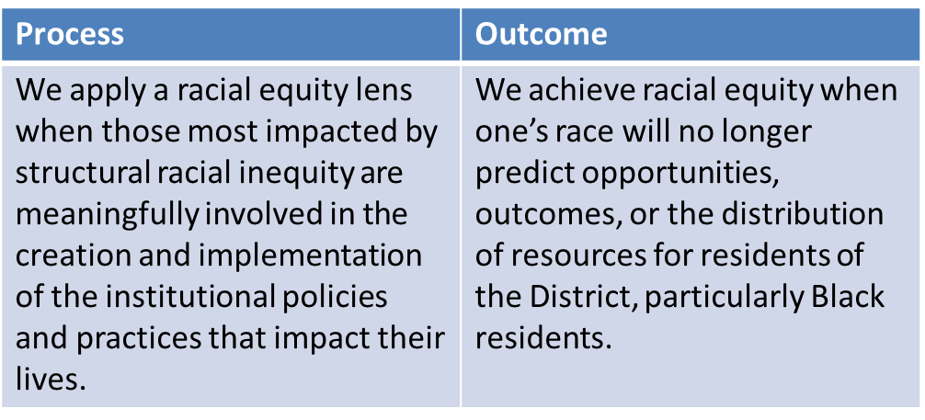
Racial Equity Initiative
Office of Racial Equity (ORE) Mission Statement:
The Mayor’s Office of Racial Equity (ORE) works in collaboration with District leadership and agencies to apply a racial equity lens across government operations. The office also works to:
Provide leadership, guidance, and technical assistance to District agencies on racial equity to improve the quality of life for Washingtonians.
Promote strategic alignment and coordinate the District’s efforts toward achieving racial equity.
Strengthen external partnerships with local racial and social justice organizations through meaningful community engagement.
Defining Racial Equity⁵

Slide 6
Racial Equity Initiative: Federal Level Action
Background and Context
Executive Order 13985 of January 20, 2021: Advancing Racial Equity and Support for Underserved Communities Through the Federal Government⁶
CMS Developed a Framework for Health Equity where it defines health equity as: “…the attainment of the highest level of health for all people, where everyone has a fair and just opportunity to attain their optimal health regardless of race, ethnicity, disability, sexual orientation, gender identity, socioeconomic status, geography, preferred language, or other factors that affect access to care and health outcomes…”

Slide 7
Racial Equity Initiative: Federal Level Action
Background and Context
HCBS Quality Measure Set was informed by the CMS Framework for Health Equity as it aligns within the 5 key priority areas:
Priority 1: Expand the Collection, Reporting, and Analysis of Standardized Data
Priority 2: Assess Causes of Disparities Within CMS Programs, and Address Inequities in Policies and Operations to Close Gaps
Priority 3: Build Capacity of Health Care Organizations and the Workforce to Reduce Health and Health Care Disparities
Priority 4: Advance Language Access, Health Literacy, and the Provision of Culturally Tailored Services
Priority 5: Increase All Forms of Accessibility to Health Care Services and Coverage

Slide 8
Racial Equity Initiative
Vision Statement:
The Department on Disability Services believes in the power of Inclusion for All. Through person-centered practices and a race and racial inequity perspective aimed at developing programs, initiatives and provider networks that meet all service and cultural needs of a person, strides are consistently made allowing for equal access that leads to equal progress for .
DDS Racial Equity Strategic Initiative:
With a focus on the equity in service availability and outcomes made available to D.C. Residents through the passing of the Racial Equity Achieves Results Act, DDS will continue to ensure that all aspects of the service delivery system are designed and implemented in ways that allow for equality amongst all those seeking services. In FY23, DDS will develop the agency-specific Racial Equity Action Plan (REAP) which will identify specific goals with target outcomes relating to this initiative.

Slide 9
Racial Equity Initiative
Inaugural Racial Equity Pilot Cohort
The Office of Racial Equity (ORE) identified DDS as one of the
agencies that will consistently engage with ORE while:
Piloting racial equity tools;
Completing a departmental assessment of racial equity; and
Developing a Racial Equity Action Plan (operationalizing
change).
The goal of having all agencies implementing best practices to create racially equitable DC, will be addressed using a phased approach.
Racial Equity Action Team
Action teams are responsible for providing leadership, assessing agency policies, procedures, and practices through a racial equity lens, and lead the facilitation of the racial equity action plans.

Slide 10
Racial Equity Action Plan: Goals and Outcomes
Goal 2
Goal
4
Goal 1
Goal 3
Potential Outcomes: Streamlined focus on equity through Person- Centered Practices and expansion of services and program supports
Potential Outcomes: Centered on increasing awareness through training and sharing information
Potential Outcomes: Partnering with DCHR to establish routine data collection and sharing practices
Potential Outcomes: Increasing opportunities for sharing and accessing information

Slide 11
Racial Equity Action Plan: Goals and Outcomes
Goal 1: DDS staff understand and are committed to achieving racial equity.
Desired outcomes: Centered on increasing awareness through training and sharing information |  | Indicator(s) of desired outcomes: Recognition and inclusion of cultural identities
Supporting Action 1: Develop a new PCO Tool/Survey centered on aspects of racial identity and social experiences
Performance Measure Number of planning meetings held (involving community engagement) aimed at tool development | Timeline | Timeline: Target Completion – September 2023 | Timeline: | Required Resources
Supporting Action 2: Provide opportunities for training
Performance Measure Percentage of staff attending agency trainings | Timeline | Timeline: Target Completion – September 2023 | Timeline: | Required Resources

Slide 12
Racial Equity Action Plan: Goals and Outcomes
Goal 2: DDS is committed to eliminating racial and ethnic inequities.
Desired outcomes: Streamlined focus on equity through Person- Centered Practices and expansion of services and program supports |  | Indicator(s) of desired outcomes: Racial Equity considerations occurring at program/procedure develop
Supporting Action 1: Utilize Racial Equity Budget Tool during fiscal budget meetings
Performance Measure Document responses to tool questions and submit with budget package | Timeline | Timeline: Target Completion – September 2023 | Timeline: | Required Resources
Supporting Action 2: Strategic Initiative Implementation
Performance Measure Provide quarterly/annual progress on agency SI Review existing data to identify underserved and unserved communities | Timeline | Timeline: Target Completion – September 2023 | Timeline: | Required Resources

Slide 13
Racial Equity Action Plan: Goals and Outcomes
Goal 3: DDS is committed to meaningfully involving community and strengthening community partnerships.
Desired outcomes: Increased opportunities for sharing and accessing information |  | Indicator(s) of desired outcomes: Documented feedback from stakeholders
Supporting Action 1: Targeted approach to Outreach and Community Engagement
Performance Measure Sponsor educational, informational, cultural, and social event in underserved and unserved communities | Timeline | Timeline: Target Completion – September 2023 | Timeline: | Required Resources
Supporting Action 2: Utilize existing partners’ communications strategies to disseminate information through in-language or ethnic outlets
Performance Measure Develop and maintain flyers, brochures, and other printed materials in diverse languages | Timeline | Timeline: Target Completion – September 2023 | Timeline: | Required Resources

Slide 14
Racial Equity Action Plan: Goals and Outcomes
Goal 4: DDS is an equitable employer and engages in racially equitable hiring practices.
Desired outcomes: Partnering with DCHR to ensure equity in hiring practices includes perspective of disability and racial equity |  | Indicator(s) of desired outcomes: Development of Best Practices Documentation and supported through data analysis
Supporting Action 1: Targeted approach to training
Performance Measure Host quarterly/annual trainings with HR teams from cluster agencies | Timeline | Timeline: Target Completion – September 2023 | Timeline: | Required Resources
Supporting Action 2: Data Sharing
Performance Measure Analyze DCHR data on points relating to staff composition and/or advancement | Timeline | Timeline: Target Completion – September 2023 | Timeline: | Required Resources

Slide 15
Racial Equity Initiative
Opportunities for Feedback
IdeaBoardz - Racial Equity Action Plan (REAP) Discussion
Access this link to provide comments and suggestions for the DDS Action Team

Slide 16
Questions or Comments?
8
For more information, please contact:
Mark Agosto
mark.agosto@dc.gov
Fikicia Guy fikicia.guy@dc.gov
Kwame King kwame.king@dc.gov
Charlotte Roberts Charlotte.Roberts@dc.gov
Winslow Woodland winslow.woodland@dc.gov
Thank you Action Team Members!

Slide 17
Resources
8
"Racial-Ethnic Disparities in Educational Attainment Among Adults with " by Erin Bisesti (syr.edu)
The Intersectionality of Ethnicity/race and Intellectual and Developmental Disabilities: Impact on H (tandfonline.com)
NASDDDS Equity, Diversity, and Inclusion: State Round Table Series – Nasddds
https://code.dccouncil.us/us/dc/council/acts/23-521#%C2%A7103
What is Racial Equity? | Race Forward
Federal Register :: Advancing Racial Equity and Support for Underserved Communities Through the Federal Government

