Slide 1
Service Coordination & Waiver
Public Health Emergency Unwinding Activities
Community and Provider Forum
October 27, 2023

Slide 2
WHY ARE WE HERE?
DDS Mission Statement
The mission of the Department on Disability Services (DDS) is to provide innovative high-quality services that enable people with disabilities to lead meaningful and productive lives as vital members of their families, schools, workplaces and communities in every neighborhood in the District of Columbia.

Slide 3
Federal Public Health Emergency
Ended May 11, 2023
Flexibility of Companion remains in effect Until November 11, 2023

Slide 4
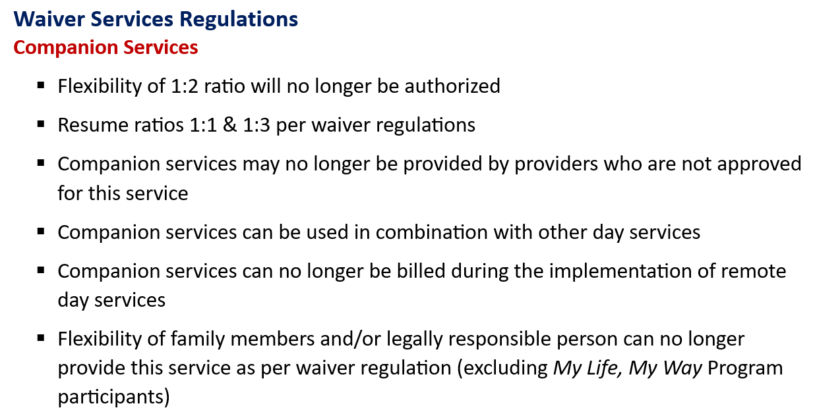
Flexibilities Cease 6 Months Post End Date of PHE

Slide 5
Notification to Stakeholders
Multiple Presentations at Community and Provider Forums on the Unwinding Plan since 2022
Presentation at the DDS Provider Fair
Transmittals to DDS Providers
Letters to Families, Advocates, and Guardians of persons supported
Presentation by QAPMA at the Provider Coalition and Leadership Meeting
Presentation to Project Action

Slide 6
As we approach the end of the PHE, DDS wants people supported to:
Reconnect with their communities either in person or virtual consistent with their identified preferences, choices and assessed needs
Have a smooth transition to day programs, including Individualized Day or Employment services
Utilize technology to promote inclusion and self determination

Slide 7
Prior to the Federal Public Health Emergency (PHE)
Companion Services were only included in the ISP after considering appropriateness of other waiver services such as
Day Habilitation
Employment Readiness
Individualized Day
Supported Employment

Slide 8
IDT Review of Companion
Effective November 1, 2023, the IDT Review of companion services will be required for ALL people who are currently receiving companion services to ensure people have access to meaningful day options.
IDT Review of Companion will be documented in MCIS:
Outcome of IDT Meeting:
Person has a documented health or medical condition that is a barrier to employment or day services (Next steps: Upload medical documentation)
Person is 65 and older and prefers to explore retirement options (Next steps: None)
Person received 3 or more days a week of companion prior to the PHE and wishes to continue to receive 3 or more days a week of companion (Next steps: None)
Person will decrease or cancel companion services and explore the following day supports: (check all that apply): ER, SE, IDS, DH, Other (specify) (Amend ISP to request the needed services & submit referral, if applicable)
The person’s services are under $75,000 and they have decided to enroll in PDS (Next steps: complete Pathway to PDS and update POC to reflect self directed services)
The person is receiving companion services for three or more days and opting not to explore alternative day supports. (Next Step Complete MAP Tool)

Slide 9
Persons with 8 Providers not authorized to provide companion pre-PHE
Providers – please support timely meetings as services are being canceled effective November 12
To confirm whether your agency is on the list, please contact your QRS or CA
If you believe there is an error, please speak with your CA
SCs are unable to reschedule or cancel meetings without confirmation by the CA or Waiver

Slide 10
Meaningful Day Assessment & Planning Tool (MAP)
The Meaningful Day Assessment and Plan (MAP) is to be completed by the Interdisciplinary team for all persons receiving Companion Services who are (1) not retired (2)>65 years old and not interested in other day supports or employment (3) were not receiving companion prior to the PHE and (4) do not have a documented health or medical condition that is a barrier to participation in community-based day supports.
MAP will assist interdisciplinary teams with determining the need for amendments to current day authorizations and/or return to community based, in-person or virtual day supports, consistent with their identified preferences and needs.
The person’s companion provider shall ensure the companion schedule is available for team review during the MAP meeting.

Slide 11
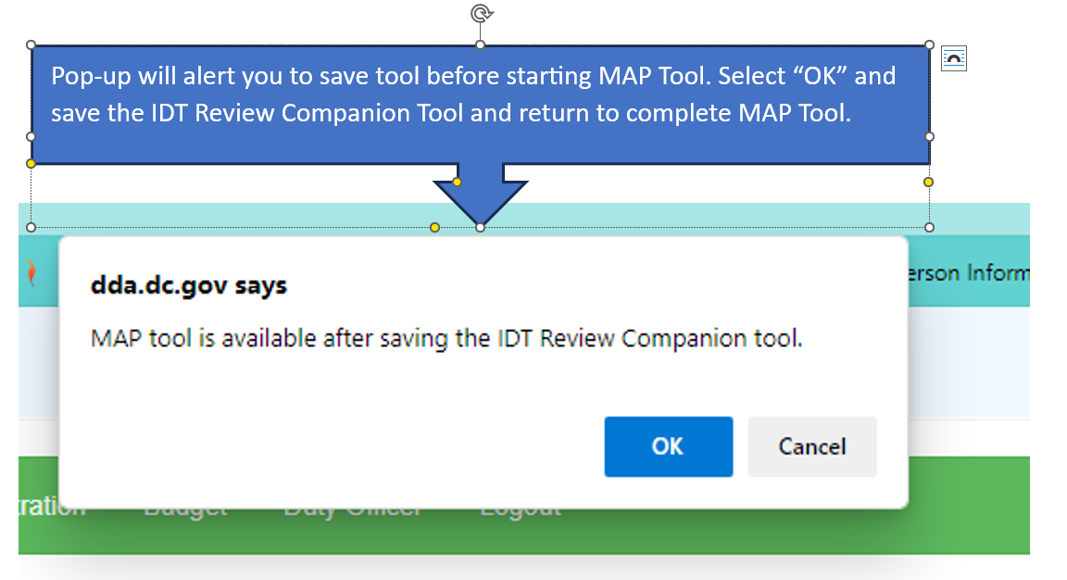
IDT Review of Companion

Slide 12
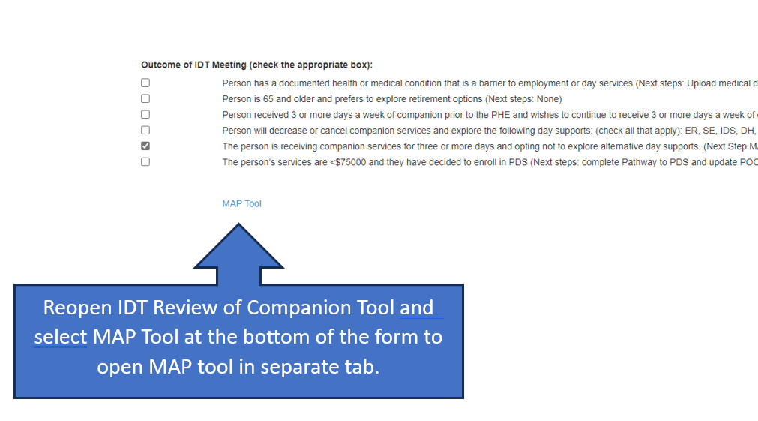
MAP Tool Continued….
Opening MAP Tool

Slide 13
MAP Tool Continued…
Section I: Specify the current companion DSP's relationship to the person. Starting from 11/11/2023, Medicaid reimbursable companion services cannot be provided by family members

Slide 14
Map Tool Continued….
Section II: Specify the person's preferences for a meaningful day.

Slide 15
Map Tool Continued….
Section III: Document barrier to community participation, select all that apply.

Slide 16
Map Tool Continued….
Section IV & Section V

Slide 17
Map Tool Continued….
Section IV & Section V Continued….

Slide 18
Map Tool Continued….
Attendance Sheet: Who participated in the meeting?

Slide 19
Questions?
If you have case specific questions regarding unwinding from the Public Health Emergency (PHE), please contact your assigned Service Coordinator, Supervisory Service Coordinator or Program Manager
If you are a provider and have questions about whether you are approved for companion, please contact your assigned CA
SCs will need authorization from the CA to reschedule or cancel any meetings scheduled because a provider is not approved for companion services

Slide 20
