Slide 1



DC State as a Model Employer Initiative
Notes:
Should we add DC Gov general logo to this since it is not a DDS only project?

Slide 2
DC’s State as a Model Employer Initiative
(SAME)
  The District of Columbia was selected to receive support from U.S. Department of Labor’s Office of Disability Employment Policy (ODEP)’s competitive solicitation process for state government agencies, as part of their National Expansion of Employment Opportunities Network (NEON) initiative to improve employment outcomes within statewide systems that serve individuals with disabilities.
  DC received support from two nationally recognized subject matter experts who have worked on SAME initiatives in other states.

Slide 3













Agency Partners
Notes:
DCHR has been an incredible partner in the work (as well as our other partners).
-Highlight new partners

Slide 4
Importance of SAME
DC Government
should lead by example
as an employer of people with
disabilities
DC Government employees
should reflect the diversity of
the District.
Retaining employees with
disabilities ensures continuity of services and saves
taxpayer dollars
Employees with disabilities are
underrepresented in both public and and private sectors
Making workplaces more inclusive benefits everyone
Creating a talent pipeline for DC residents to address workforce shortages
Notes:
DC Government should reflect the diversity of the district
-Priority of the Mayor
-Part of bringing economic equity to marginalized community
-Retaining employees with disabilities saves tax payers
-We had a World Cafe and one of the recommendations key recommendations was that DC Gov should be a model employer. Community feedback from that event was a catalyst to our first NEON proposal.

Slide 5
What have we done so far?
Landscape Assessment
Work Plan
Moving Forward
Subject Matter Experts Assessed:
  Implement work plan
  Communicate with
the community
  Plan application for
the next NEON grant to
support priorities
  Current policies
and practices
  Talent development
  Hiring practices
  Available Supports
  Work in partnership
across agencies
  Integration of SAME strategies across agencies
Notes:
Subject matter experts worked with state agencies to collect information to be included in the landscape assessment
-Looked at current internship and apprenticeships available under different agencies
-SMEs looked at the hiring portal and created a mock application

Slide 6

Fiscal Year 2024 Priorities
Develop and
Distribute a
Baseline
Data Survey
Assess the Careers
DC Platform
for Accessibility
Integrate SAME
into the WIOA State Plan
Notes:
-Our workgroup through it was important to focus on training on rights and accommodations and workplace culture in during the first fiscal year.
Baseline survey
-Appreciate DDS Staff who participated in a pilot and highlighted the need for more training on accommodations
-Need data to track progress (both participation and estimate number of employees with disabilities)
Careers Platform
-Look at access to the platform
-Look at content barriers that would discourage applicants with disabilities
WIOA
-Workforce Innovations and Opportunities Act
-Developing a 4 year comprehensive state plan, lead by our partners at the Workforce Investment Council
- WIOA State Plans outline what your State or Territory is doing to help Americans, including youth and those with significant barriers to employment, into high-quality jobs and careers and help employers hire and retain skilled workers.
-We will be looking at opportunities to align SAME and the WIOA state plan.

Slide 7
Fiscal Year 2024 Priorities
Support
Continued
collaboration in
the Employment
First Leadership
Workgroup
Train Managers on
ADA and Inclusive
Workplace Practices
Assess current workplace
flexibilities
Notes:
We want to keep up the momentum and engagement that we have with our agency partners.
Training Managers
-Training planned for Manager week on ADA/Accommodations
-Workshop to dig in deeper on attitudes and bias related to disability
-Use info and feedback from these trainings to inform future employee and manger training topics.
Flexibility
-Assess current workplace flexibilities
-Leading to development of a clearing house of resources that may include customized job descriptions, flexible work hours, part-time and shared positions, and remote work.

Slide 8
Work Plan Updates
  Baseline Survey/ Data Collection
  Application Accessibility Workgroup
  Manager Training-Manager Week
  NEON proposal 2023-2024
Notes:
We have been looking at ways that we can combine same priorities with other initiatives in the District
-We know that there will be a disability question included in an all
-Sub-group has identified priorities for measurement and drafted questions
Application
-DCHR and Mayor's office on innovation are revamping DC Careers website
-Home page is updated
-Subgroup including multiple people with disabilities will be part of the design and testing of the platform redesign
Manager Training
-First part of this strategy is to host two session during manager week (date tbd)
-Overview of ADA and Reasonable Accommodations
-Workshop that will go more in depth into attitudes and lingering questions for managers
-We will use the feedback from these trainings to look at what is needed for both managers and staff
NEON Proposal
-EF partners are enthusiastic about continuing the work
-Adding partners

Slide 9
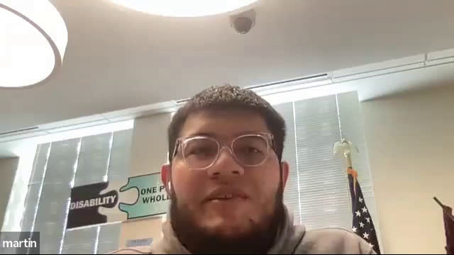
Notes:
We are committed to hiring people with disabilities and using they their talents and skills to help further the mission of DDS
Here is our colleague Martin who has participated in our NEON work talking about his experience as an employee.

Slide 10
NEON 2023-2024 Proposal
  Align SAME Workplan with WIOA State Plan: Working with the cross-agency Employment First Leadership Workgroup, the cross-agency WIC workgroup of WIOA partners developing the 2024 WIOA State Plan, and NEON SMEs, include activities and initiatives in DC’s WIOA State Plan to support the implementation of SAME in DC.
  Develop and Iimplement training for managers, including hiring managers and ADA coordinators, primarily through DC Human Resources (DCHR) and the Office of Disability Rights (ODR) to improve outreach, recruitment, application, interviewing and retention processes, with a special focus on underserved underrepresented people with disabilities. This focus can be informed by DC’s cross-agency Cultural and Linguistic Competence Community of Practice.

Slide 11
NEON 2023-2024 Proposal
  Develop a District-wide clearinghouse/webpage of flexible employment strategies (including customized employment) and support services (including assistive and enabling technologies) to improve employment outcomes for people with disabilities within DC government, which can be updated as new practices are identified.
  Develop and provide training and technical assistance support to ADA coordinators in each District government agency to support them to become resources within their agencies to better ensure the retention and success of people with disabilities in their DC government positions and as part of teams.

Slide 12
Questions?
Notes:
Do not direct questions to Martin

