Slide 1
DDS Community & Provider Forum:
Budget Update
Director Andrew Reese ~ September 23, 2022

Slide 2
Presentation Outline
Budget Process
Overview of FY23 Approved DDS Budget
DDS Budget "Big Picture"
Questions/Priorities?

Slide 3
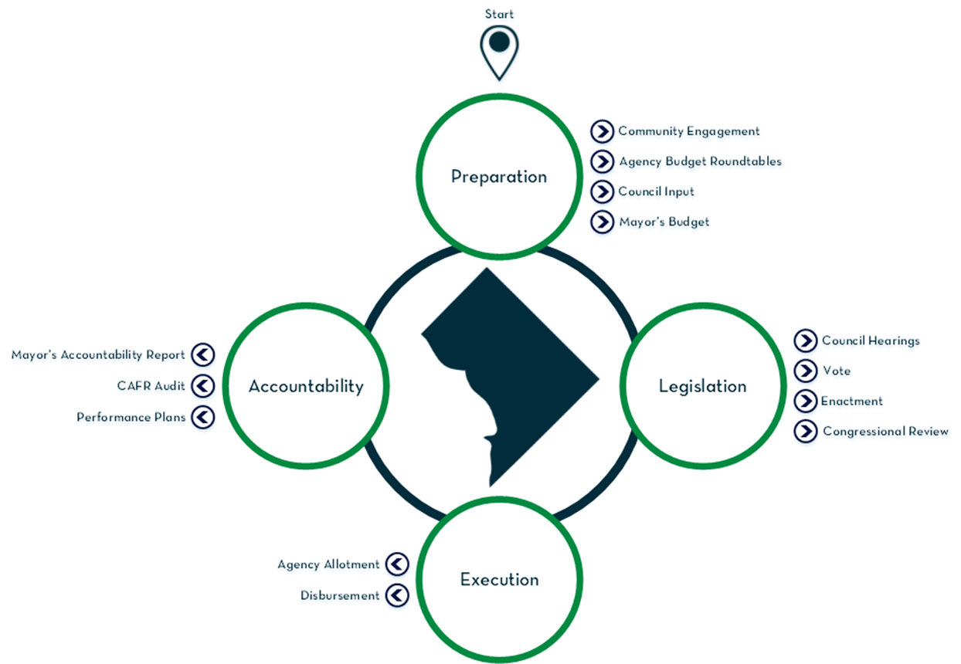
Budget Process

Slide 4
DDS Budget Process
Mid-October
Mid-November
December
February
Receive MARC from Mayor’s Office of Budget & Planning (OBP)
Preliminary Budget due to OBPM
Budget Roundtables -> Agency ~ DM ~ OBPM
Mayor receives community input
3rd Week of March
April
June
October 1st
Budget Hearing
Council Votes/ Mayor Enacts and transmits to Congress
Fiscal year begins -> Process starts over
Mayor finalizes budget & transmits to Council

Slide 5
DDS Budget By Program
Program | FY 2022 Approved | FY2023 Approved | Change FY22 to FY23
Developmental Disabilities Administration | $147,771 | $147,846 | $75
Rehabilitation Services Administration | $21,691 | $20,616 | ($1,075)
Disability Determination Division | $11,540 | $12,687 | $1,147
Agency Management | $13,935 | $14,796 | $861
Financial Operations | $1,856 | $1,933 | $77
American Rescue Plan Act (ARPA) | $0 | $98 | $98
Total (in thousands) | $196,793 | $197,976 | $1,183

Slide 6
Where the Money Comes From
Fund | FY 2022 Approved | FY2023 Approved | Change FY22 to FY23
Local Funds | $134,064 | $136,407 | $2,343
Special Purpose Revenue Funds | $14,755 | $12,715 | ($2,040)
Federal Grant Funds | $32,928 | $34,326 | $1,398
Federal Medicaid Payments | $14,195 | $14,429 | $234
Intra-District Funds | $246 | $0 | ($246)
American Rescue Plan Act (ARPA) | $605 | $98 | ($507)
Total (in thousands) | $196,793 | $197,976 | $1,183

Slide 7
Developmental Disabilities Administration (DDA)
Supports more than 2,300 adults with intellectual disabilities
FY 2023 Total Budget - $147,856,055
FY 2023 Local Funding - $125,392,000
Two HCBS waivers serving more than 1,800 people in integrated, community-based settings

Slide 8
DDA Local Funds Budget

Slide 9
DDA Direct Services Budget $125.9 million

Slide 10
DDA Waiver & Residential Costs
HCBS Waiver Slots | IDD | IFS
Available | 1,943 | 90
Utilized | 1,844 | 10
Planned net increase of 50 waiver slots per year
Residential Costs
Budgeted residential costs for FY 2023 - $27.6 million

Slide 12
American Rescue Plan Act (ARPA)
Enhanced funding from ARPA provides D.C. the ability to strengthen HCBS waiver services by:
•Implementing the Direct Support Professionals Payment Rate Act
•Providing a second round of DSP bonus payments, hiring and retention bonuses, and reimbursing providers for vaccine incentives and PPE
•Strengthening DDS’s capacity to carry out DD Expansion
•Hiring a housing coordinator to maximize opportunities for people supported by DDA
•Strengthening supports for people with I/DD and behavioral health needs
•Reducing utilization of ER and incidence of EIH through the DDS Telehealth Initiative
•Delivering assistive and enabling technology and remote supports
•Conducting a Rate Study on adequacy of reimbursement in IFS and IDD Waivers
•Conducting a study of effects of pandemic on people supported by DDA
•Implementing self-direction in the IFS Waiver

Slide 13
Rehabilitation Services Administration (RSA)
RSA helps people prepare for work and find, keep and get better jobs.
RSA FY 2023 Budget - $20,615,796
78.7% federally-funded with a 21.3% local share and required maintenance of effort

Slide 14
RSA Match & Maintenance of Effort
Fiscal Year | Match | Maintenance of Effort | Budget | Expenditures
FY 2020 | $4,157,617 | $8,209,038 | $7,369,966 | $8,593,447
FY 2021 | $4,225,263 | $8,813,367 | $5,142,610 | $8,824,120
FY2022 | $4,287,285 | $8,593,448 | $7,369,966
FY2023 | $4,287,285 (est.) | $8,824,121 | $7,369,966

