Slide 1
CHANGING THINKING
TAKING ACTION
Michael Smull & Laura Buckner
Support Development Associates
Notes:
Purpose: This slide is here to flag people that we are moving from describing what
one page introductions do to looking at some samples of one page
introductions.
Script:
There are a number of one page introductions on your tables. These are real one page introductions and we do have permission to share them with you today.
Help people see if there is an example that works for them – usually because it
reminds them of the issues that they deal with.
Comment on a couple of samples that you think help to demonstrate; positive
introductions, helping people maintain positive control, and leads for community
connecting.
When commenting on the samples, mention the “purpose” of a couple of them.
Example: Anne’s was made to share with co-workers, Kristin Kiner’s was made to
support during illness, others were for school, etc.
Then tell the group that it’s important to think about the purpose of the one page
as they develop them. Let them know that we will talk about that later in the day.
Tips:
Have a few samples of one page introductions on the table. Choose ones that
show different age groups and purposes.
Time: 10 Minutes

Slide 2
Levels of Change
Any change that results in a positive difference in the lives of people who use services or in your own work life.
Level 1
Any changes an organization makes to it’s practices, structure or rules that result in positive differences in the lives of people.
Level 2
Any change in practice, structure and rules made at the system level. These changes have an effect on many organizations, and therefore many peoples’ lives.
Level 3
Notes:
PURPOSE:
To help the participants understand how change happens at different levels and how it trickles down.
SCRIPT
Discontent leads to change and it is helpful to think about change as happening at several levels.
Level one, you don’t need any permission to implement. Changes in such things as routines, rituals, approach. These are changes that can be made immediately.
Level two changes require approval from management. It is a change in practice, policy, or structure.
The need for Level two changes is best identified by having a structured way for the shared learning of direct support level go to the organizations leadership.
Level three changes can be thought of as “systemic” changes. A change in state law or regulation is an example of a level three change.
TIPS:
If you have primarily direct support staff in your training, you do not need to spend a lot of time on level three changes. Simply refer to them as state or federal rules.
TIME: 3 minutes
NOTES:

Slide 3
Levels of Change
Changed Thinking:
Took Action:
Level 1
Action Needed:
Action Taken:
Level 2
Action Needed:
Action Taken:
Level 3
Notes:
PURPOSE:
To help the participants understand how change happens at different levels and how it trickles down.
SCRIPT
Discontent leads to change and it is helpful to think about change as happening at several levels.
Level one, you don’t need any permission to implement. Changes in such things as routines, rituals, approach. These are changes that can be made immediately.
Level two changes require approval from management. It is a change in practice, policy, or structure.
The need for Level two changes is best identified by having a structured way for the shared learning of direct support level go to the organizations leadership.
Level three changes can be thought of as “systemic” changes. A change in state law or regulation is an example of a level three change.
TIPS:
If you have primarily direct support staff in your training, you do not need to spend a lot of time on level three changes. Simply refer to them as state or federal rules.
TIME: 3 minutes
NOTES:

Slide 4
Levels of Change
Changed Thinking:
Took Action:
Level 1
Action Needed:
Action Taken:
Level 2
Action Needed:
Action Taken:
Level 3
Notes:
PURPOSE:
To help the participants understand how change happens at different levels and how it trickles down.
SCRIPT
Discontent leads to change and it is helpful to think about change as happening at several levels.
Level one, you don’t need any permission to implement. Changes in such things as routines, rituals, approach. These are changes that can be made immediately.
Level two changes require approval from management. It is a change in practice, policy, or structure.
The need for Level two changes is best identified by having a structured way for the shared learning of direct support level go to the organizations leadership.
Level three changes can be thought of as “systemic” changes. A change in state law or regulation is an example of a level three change.
TIPS:
If you have primarily direct support staff in your training, you do not need to spend a lot of time on level three changes. Simply refer to them as state or federal rules.
TIME: 3 minutes
NOTES:

Slide 5
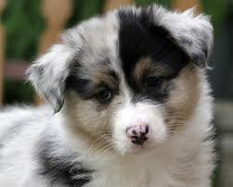
5
Notes:
PURPOSE:
To set the tone for the puppy exercise
SCRIPT
Just use this slide to introduce the puppy exercise.
TIPS:
This is purely a segue slide that sets a tone. Only have it up while you are telling people what you are doing next. Then go to the next slide. (You can use your own puppy pictures if you like – but just one slide’s worth.)
TIME: 30 Seconds
NOTES:

Slide 6
Someone brings home a new puppy. Given your own experiences and those that you have heard from others, what does and does not make sense about having a new puppy in the house.
What works/makes sense
What doesn’t work/Doesn’t make sense
Perspective of new puppy’s owner
Notes:
PURPOSE:
To give people practice in sorting issues and see how people weight pros and cons differently.
SCRIPT
To help the participants learn how to do this analysis, ask them to begin with what works and doesn’t work about having a new puppy in the house.
Ask for 1 or 2 examples for each side and then have people work in their groups. Keep it light hearted and keep people moving. Watch out for groups that are sharing stories without writing anything down. They should be able to generate a decent list in 5 minutes.*
Ask each group to share 1 item on each list. After you have asked each group to share, ask how many people would like a new puppy and how many people are saying something on the order of “Hell will freeze over”? Point out that there seemed to be a lot of agreement about what items should be written down.
What they should see is that no situation is all good or all bad. What determines what people do is the “weight” that people give to the items. For one person, the “weight” of some of the items in the ‘makes sense’ column, creates a balance that tips toward having a puppy. For others, the items in the ‘doesn’t make sense’ column cause them to decide that having a new puppy is not worth it.
TIPS:
This can also be done with the larger group instead of breaking up into smaller groups – this changes the pace.
TIME: 10 Minutes

Slide 7
Working/Not Working
Focus in on a specific issue or area of life
Helps you dig deeper
Negotiation Skill
All must feel listened to – accurately reflect perspectives
Start with common ground
Remain unconditionally constructive
Done in partnership
Bridge to action planning
What needs to be maintained/enhanced?
What needs to change?
Notes:
PURPOSE:
To emphasize the key elements of the working/not working analysis
SCRIPT
Go over all points listed.
Have a detailed example of your own for peeling the ‘onion’. After telling your story, ask if anyone has ideas about actions that could be taken to help the person get more of what is important to them.
TIPS:
Slide is animated to help trainer emphasize each set of points.
TIME: 10 Minutes
NOTES:

Slide 8
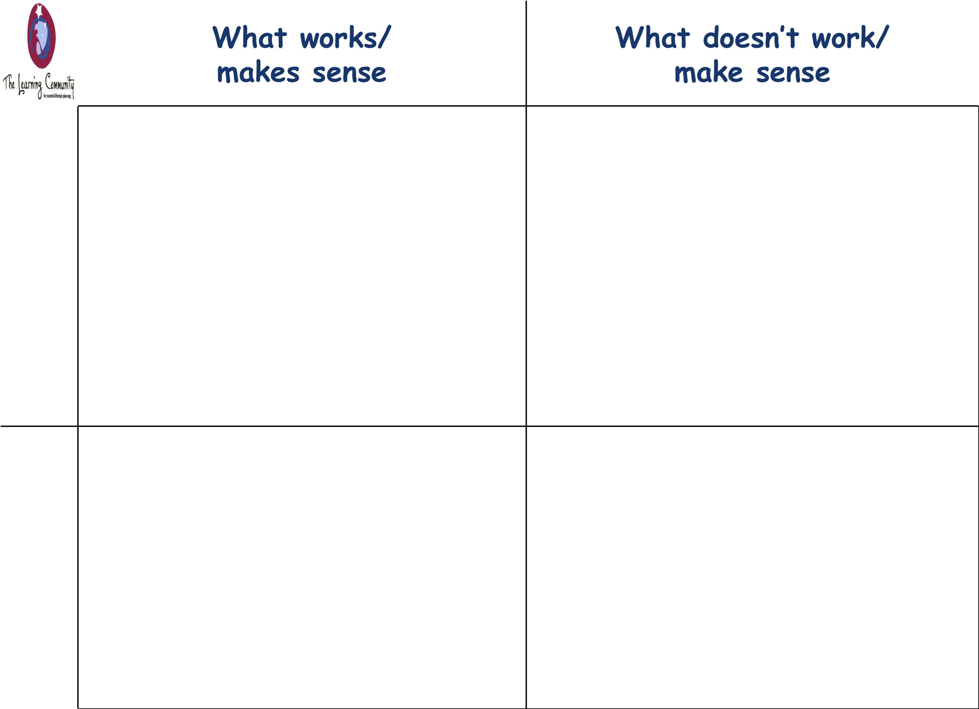
Person’s
perspective
USE THIS INFORMATION TO BUILD THE
A G E N D A
FOR THINGS THAT NEED TO CHANGE
USE THIS INFORMATION TO BUILD THE
A G E N D A
FOR THINGS THAT ARE TO STAY THE SAME
Disagreements
Staff’s
perspective
Notes:
PURPOSE:
To illustrate how the working/not working analysis can be used
SCRIPT
Use this slide to illustrate how this can be used to develop goals and objectives that help people move toward the lives that they want and to assist with negotiation where there are disagreements
To help with action/goal planning -
The left hand column helps with identifying those things that you wish to maintain or enhance.
The right hand column shows things that need to change.
A way to help people create meaningful goals or plans and not “stupid goals” – can give an example.
Point out that disagreements often turn up on the diagonals.
Let people know that this has 2 of the core principles of negotiation built into it –
If you have carefully written down everyone’s perspective they feel listened to.
If you point out where the same items appear in the same column but different perspectives you have started with common ground.
TIPS:
A recent article reported a study that claimed accurately reflecting perspectives in mediation was more important than empathy.
Apr 22, 2008 ... Perspective-takers created more value and earned significantly more points for themselves than those from the empathy group or the control ... www.sciencedaily.com/releases/2008/04/080422115014.htm
TIME: 5 Minutes

Slide 9
The issue or area of focus (current reality) is:
___________________________________________________________
What works/makes sense
What doesn’t work/Doesn’t make sense
My perspective
Notes:
PURPOSE:
To give people practice in sorting issues and see how people weight pros and cons differently.
SCRIPT
To help the participants learn how to do this analysis, ask them to begin with what works and doesn’t work about having a new puppy in the house.
Ask for 1 or 2 examples for each side and then have people work in their groups. Keep it light hearted and keep people moving. Watch out for groups that are sharing stories without writing anything down. They should be able to generate a decent list in 5 minutes.*
Ask each group to share 1 item on each list. After you have asked each group to share, ask how many people would like a new puppy and how many people are saying something on the order of “Hell will freeze over”? Point out that there seemed to be a lot of agreement about what items should be written down.
What they should see is that no situation is all good or all bad. What determines what people do is the “weight” that people give to the items. For one person, the “weight” of some of the items in the ‘makes sense’ column, creates a balance that tips toward having a puppy. For others, the items in the ‘doesn’t make sense’ column cause them to decide that having a new puppy is not worth it.
TIPS:
This can also be done with the larger group instead of breaking up into smaller groups – this changes the pace.
TIME: 10 Minutes

Slide 10
The issue or area of focus (current reality) is:
___________________________________________________________
What works/makes sense
What doesn’t work/Doesn’t make sense
My perspective
Notes:
PURPOSE:
To give people practice in sorting issues and see how people weight pros and cons differently.
SCRIPT
To help the participants learn how to do this analysis, ask them to begin with what works and doesn’t work about having a new puppy in the house.
Ask for 1 or 2 examples for each side and then have people work in their groups. Keep it light hearted and keep people moving. Watch out for groups that are sharing stories without writing anything down. They should be able to generate a decent list in 5 minutes.*
Ask each group to share 1 item on each list. After you have asked each group to share, ask how many people would like a new puppy and how many people are saying something on the order of “Hell will freeze over”? Point out that there seemed to be a lot of agreement about what items should be written down.
What they should see is that no situation is all good or all bad. What determines what people do is the “weight” that people give to the items. For one person, the “weight” of some of the items in the ‘makes sense’ column, creates a balance that tips toward having a puppy. For others, the items in the ‘doesn’t make sense’ column cause them to decide that having a new puppy is not worth it.
TIPS:
This can also be done with the larger group instead of breaking up into smaller groups – this changes the pace.
TIME: 10 Minutes

Slide 11
 | What works/ Makes sense | What doesn’t work/ Doesn’t make sense
_______’s
perspective
_______’s
perspective
_______’s
perspective
Notes:
PURPOSE:
Overview – a visual introduction to Working/Not Working
SCRIPT:
Working/Not Working is a problem solving and a negotiation SKILL. It analyzes an issue/situation across multiple perspectives. Provides a picture of how things are right now. Helps those involved find common ground.
TIPS:
Time: no more than 15 minutes for the entire overview (slides 21- 35) – 30 seconds per slide
NOTES:

Slide 12
 | What works/ Makes sense | What doesn’t work/ Doesn’t make sense
_______’s
perspective
_______’s
perspective
_______’s
perspective
Notes:
PURPOSE:
Overview – a visual introduction to Working/Not Working
SCRIPT:
Working/Not Working is a problem solving and a negotiation SKILL. It analyzes an issue/situation across multiple perspectives. Provides a picture of how things are right now. Helps those involved find common ground.
TIPS:
Time: no more than 15 minutes for the entire overview (slides 21- 35) – 30 seconds per slide
NOTES:

Slide 13
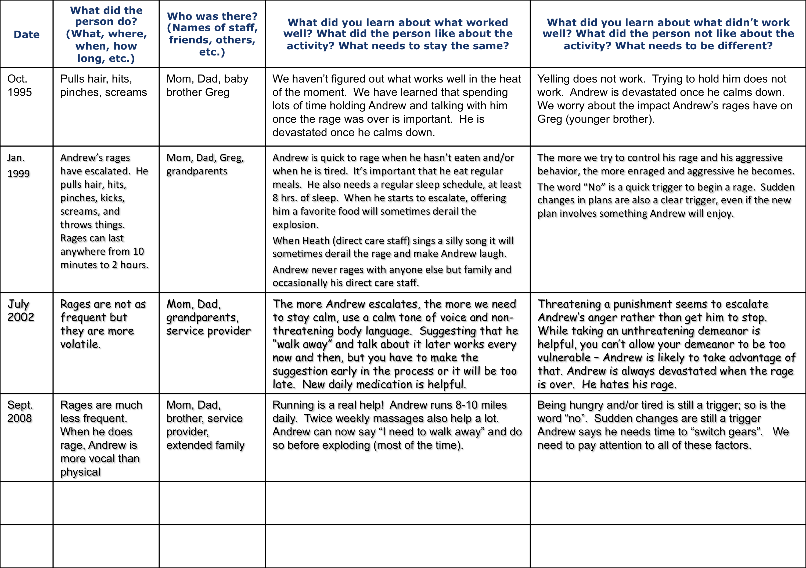
Learning Log for Andrew (page 1)
Using the learning log to show a family’s learning over time
Notes:
PURPOSE:
Demonstrate the use of (and importance of) learning over time.
SCRIPT
For participants:
Read the log
Discuss at your tables (or with your partner – depending on size of group):
What have you learned?
How does this help you support this family today?
What would you do for Andrew?
What supports do you think this family would appreciate?
What does this save you from doing/trying?
How could this help you in your work?
TIPS:
For the Trainer:
Possible things that may come up:
The importance of understanding the family’s journey
Why families are content experts
Points to make:
Developing trust – this usually takes time!
Respecting family as experts
How does this help you support an individual/family today?
For large groups, make this a table discussion and have tables report out
TIME: 8 Minutes (2 slides)
NOTES:
Andrew’s learning log is 2 pages (2 slides)

Slide 14
Learning Log for Andrew (page 2)
Using the learning log to show a family’s learning over time
Notes:
PURPOSE:
Page 2, Andrew’s Learning Log
SCRIPT
TIPS:
TIME:
NOTES:

Slide 15
Learning Log
Using the learning log to replace typical progress notes
Date | What did you/the person do? (What, where, when, how long, etc.) | Who was there? (Names of staff, friends, others, etc.) | What did you learn about what worked well? What did the person like about the activity? What needs to stay the same? | What did you learn about what didn’t work well? What did the person not like about the activity? What needs to be different?
Notes:
PURPOSE:
Overview – a visual introduction to the Learning Log
SCRIPT
This is a way to record learning as it is happening, a way to journal learning. For example to take the place of typical progress notes-or when to capture learning outside of typical notes-
TIPS:
Guiding question for participants: How many of you write progress notes that you know will never be used for anything?
Time: no more than 15 minutes for the entire overview (slides 21- 35) – 30 seconds per slide
NOTES:

Slide 16
Learning Log
Using the learning log to replace typical progress notes
Date | What did you/the person do? (What, where, when, how long, etc.) | Who was there? (Names of staff, friends, others, etc.) | What did you learn about what worked well? What did the person like about the activity? What needs to stay the same? | What did you learn about what didn’t work well? What did the person not like about the activity? What needs to be different?
Notes:
PURPOSE:
Overview – a visual introduction to the Learning Log
SCRIPT
This is a way to record learning as it is happening, a way to journal learning. For example to take the place of typical progress notes-or when to capture learning outside of typical notes-
TIPS:
Guiding question for participants: How many of you write progress notes that you know will never be used for anything?
Time: no more than 15 minutes for the entire overview (slides 21- 35) – 30 seconds per slide
NOTES:

Slide 17
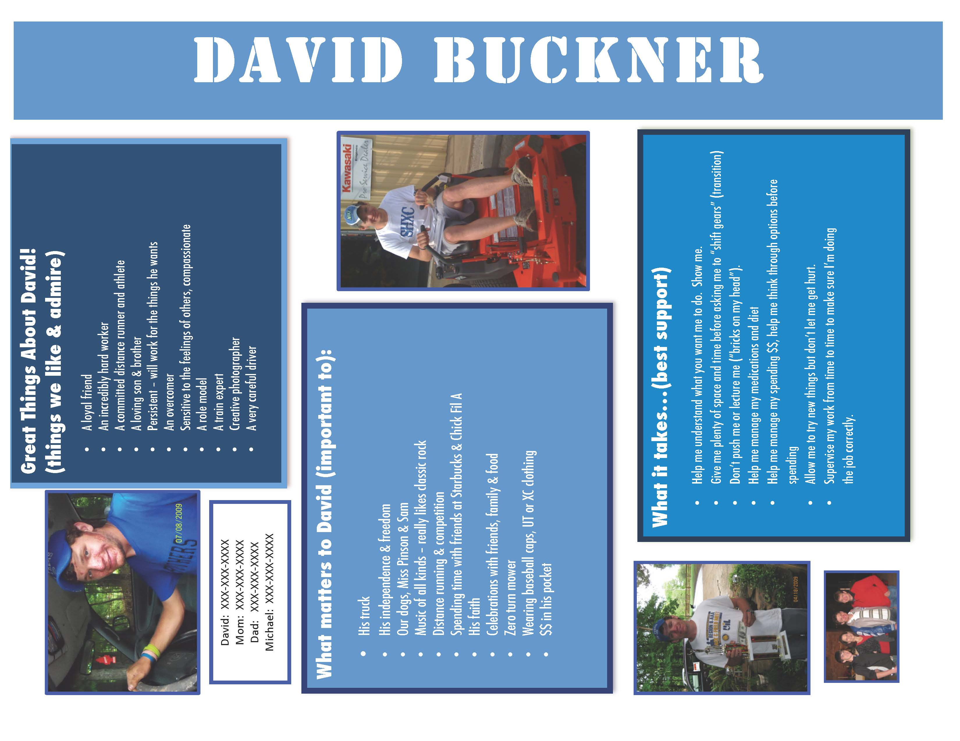

Slide 18
The Hidden Outcome of One Page Profiles
So…as we consider the ways One Page Profiles can be helpful and not just “garnish” or more meaningless
paperwork…I have to share this perspective. I shared it with Michael Smull recently and he did what you know he always does…he said “you need to write
that and share it.” Here’s my perspective on the one-page profile...
Through the years I’ve been to lots of conferences and seminars and seen lots of ways to help others know my child. Many of them, while great ideas, were overwhelming to me. I was already an exhausted Mom and caregiver, and now you want me to do WHAT??? I rarely followed through. The One Page Profile provides families a way to introduce their loved one in a simple and straightforward way, without having to invest hours and hours of time they don’t have. The fact that they can attend a one-day training and walk out with a good start on a profile is bonus!
But there’s a bigger outcome of one page profiles that we can’t overlook and it’s an outcome you may never see.
My son David is now 24 years old, and he is one of the Loves of My Life. But I have to be honest and say that I didn’t always feel that way. David was diagnosed at the age of 3 months with a rare disease I’d never heard of. We were given a very grim prognosis which included intractable seizures, intellectual disability, gross and fine motor delay…scary stuff for a brand-new, first-time Mom.
What the grim prognoses never mentioned were the behavioral and psychological issues that typically go hand-in- hand with the disease. I’ll spare you the awful details, but just know that life as I knew it changed. There is much I hate about this disease, but the behavior and psychological stuff was SO INCREDIBLY DIFFICULT - I hate it the most. Somehow, in those early years, I lost sight of my son in light of the hatred I felt for his disease and what it was taking from him, from me, from our family.
When David was about 5 years old, I met a now-dear friend named Kathie Snow (disabilityisnatural.com). Kathie asked me about my son, and like so many other parents like me, I flew into my detailed description of everything that was wrong with David, using the best medical, educational, and therapeutic jargon I could muster. You know…it was all about his "functioning levels", and his “behaviors”, and his medical issues and therapeutic programs. Kathie stopped me mid-sentence and gently challenged me by asking “Yes, but tell me about your son. Tell me about David. Who is he? What does he love? What is he good at? What’s your favorite thing about him?”
I was speechless. Really. I mean speechless. I couldn’t answer her.
Kathie then challenged me to go home and begin re-defining who David was in my own mind. I remember it so clearly…sitting at the keyboard with my hands poised to start typing and not knowing where to start. I’m ashamed to admit it. I honestly could not think of a positive thing to say. It was a watershed moment for me; one that forever changed me. I finally managed to type these words:
David loves to laugh. He can tell you everything you ever wanted to know about trains…and bulldozers and backhoes…and angels. He gives the best hugs in the world. He loves life and the outdoors. He’s a terrific big brother.
So…Perhaps the most important outcome of a One Page Profile has nothing to do with introducing the loved one or helping that person get the supports they need. Perhaps The Most Important Outcome of a one page profile happens inside the person(s) writing it. Writing a one page profile gives parents, family members the opportunity to consider their loved one in a whole new light - the light of “like and admire”; of "Important To" and “Best Support”. Changed Thinking.
And THAT - to me - is a pretty powerful outcome, whether anyone ever reads the One Page Profile or not.
Laura Buckner – December 2013

