Slide 1
DISTRICT OF COLUMBIA NO WRONG DOOR
Supporting Families Community of Practice Meeting
December 14, 2015

Slide 2
NWD Grants
One-year planning grant, started October 1, 2014 and 3-year implementation grant started on October 1, 2015
Funded by the Administration on Community Living (ACL), in partnership with the Centers for Medicare and Medicaid Services (CMS) and the Veterans Health Administration (VHA)
Requires that District government work with stakeholders to finalize and implement a three-year plan to transform current Long-Term Supports and Services (LTSS) programs and processes in the District into a No Wrong Door system for all populations and all payers.

Slide 3
Federal Vision
Four key functions:
Public Outreach and Coordination with Key Referral Sources – How will the NWD System have formal linkages with Information and Referral Entities, Nursing Homes and other Institutions, Acute Care Systems, and VA Medical Centers?
Person Centered Counseling- And planning by private community partners and public. Competencies, training and credentialing, performance.
Streamlined Access to Public LTSS Programs – All processes and requirements to determine eligibility that are required by any of the state administered programs that provide LTSS to any NWD System population, and how PCC interfaces with streamlined access? Preliminary and final, financial and program.
State Governance and Administration of the NWD System.

Slide 4
Definition of LTSS
Assistance with activities of daily living (ADLs) and instrumental activities of daily living (IADLs) provided to individuals who cannot perform these activities on their own due to a physical, cognitive, or chronic health condition that is expected to continue for an extended period of time, typically 90 days or more
Definition from AARP
Notes:
Definition from AARP

Slide 5
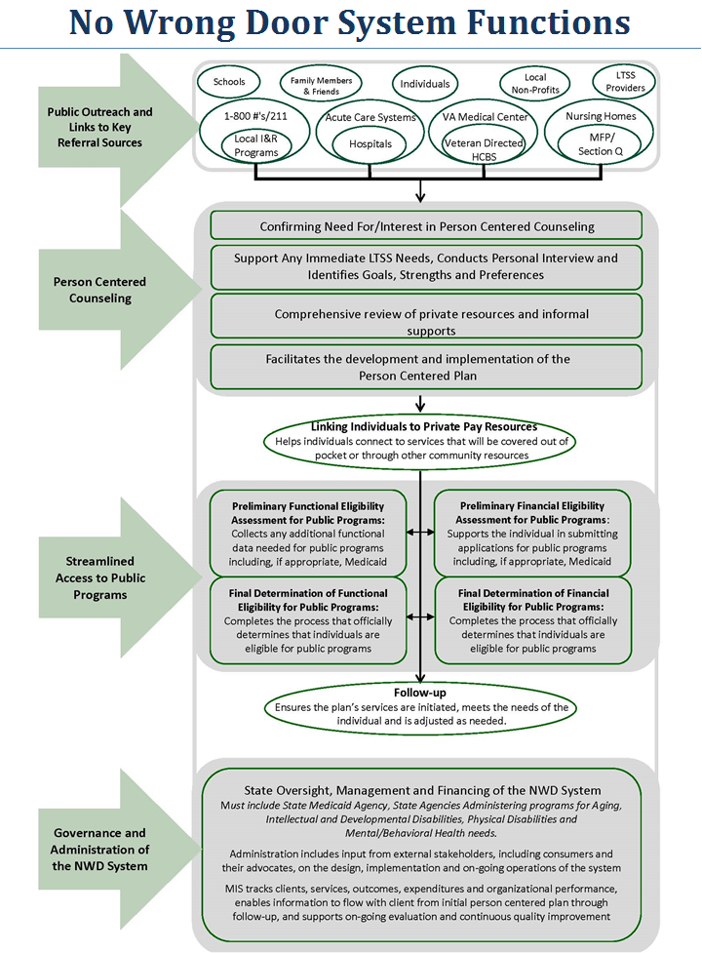

Slide 6
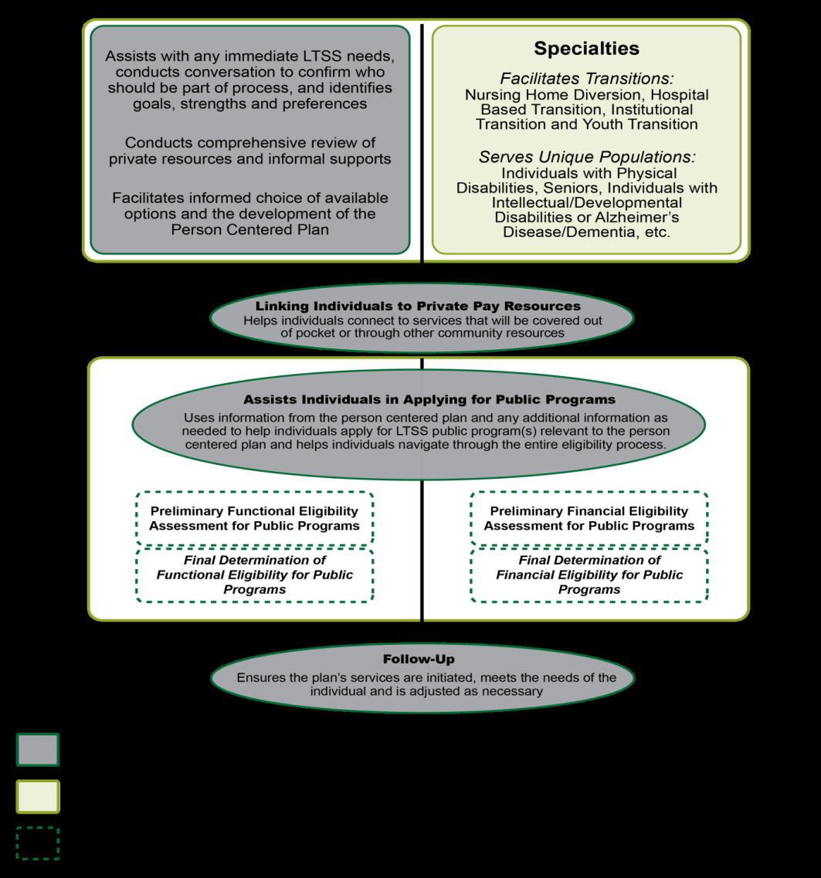
No Wrong Door Person Centered Counseling Functions
Shaded=> Core competencies required for all staff performing Person-Centered Counseling
Unshaded => Specialties
Broken lines => Streamlined access

Slide 7
No Wrong Door System Characteristics
One-Stop Coordinated System w/ Consistency
Visible and trusted
Not just one entity or network
Built upon existing access functions and places known to individuals and eligibility determination
Single standard process
Common protocols & information exchange
Objective/Neutral/Person-Centered
Seamless & Person Friendly
Tell your story only once
Streamlined access to LTSS
Both use of private resources and public programs
Notes:
Why is No Wrong Door important to sponsors?
Front door to services
Maximize use of all resources
Key to diversion
The vision is that each state would have 1 NWD system. Not separate NWD access systems for different populations. No organization/network, has the capacity, expertise or authority to carry this out on their own. Multiple agencies and organizations at the state and local level will need to be formally involved in the operations of a state's NWD System

Slide 8
Why Do We Need a Coordinated Effort?
No one agency or network has the capacity, expertise or authority to effectively carry out all the NWD System functions for all the different populations that will be served by the NWD System so there is a NWD Leadership Council to engage agencies that serve youth, adults and elders with disabilities.

Slide 9
Major State LTSS Components/Policy Issues
of a No Wrong Door System
Access to public and private LTSS services, paid and unpaid
Consumer-directed services
Focus on workforce development
Support for family caregivers
Options for transition & diversion from institutional settings
Intersection of health/medical and community living support
All payers, all ages and all populations with braided resources
Quality & outcome measurement with stakeholder input
Inclusion of Youth Transitions
Notes:
This slide lists the major LTSS components or policy issues within a state.
NWD is one component of a state’s LTSS system.

Slide 10
ACL’s Evolving Vision of the Structure and Role of Community Services in Providing LTSS
Charting the Life Course
The Role of the Community, Community Services and Natural Supports
Need to Build the Capacity of Community System to Support NWD & Person-Centered Practices
The Importance of Supporting Families
Integrated Supports Across the Lifespan

Slide 11
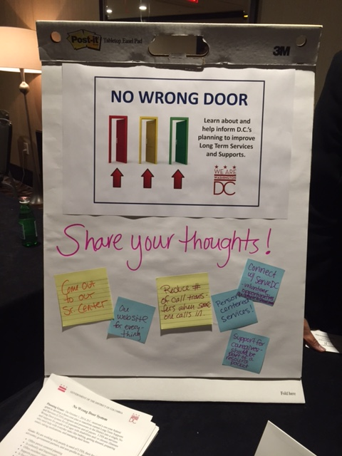
Stakeholder Input
People with disabilities and seniors have told us they want:
Help navigating the system
Single case management/service coordination system for all services
Continuity of support throughout the lifespan
Better coordination between government agencies
Great customer service
Focus on what people can do
Support to live in the community as independently as possible
Person centered counseling, planning and service delivery
Support for family caregivers
Holistic approach to support that goes beyond just paid LTSS
Community-based (access and services)
On-line access with one website for everything

Slide 12
ADDITIONAL INPUT
Your ideas for engaging stakeholders so that they are involved in all aspects of planning, implementation and evaluation of the District’s No Wrong Door system?
Other input regarding what you’d like to see in the District’s No Wrong Door system?

