Slide 1
DC Supporting Families of People with I/DD Throughout the Lifespan Community of Practice
March 13, 2015

Slide 2

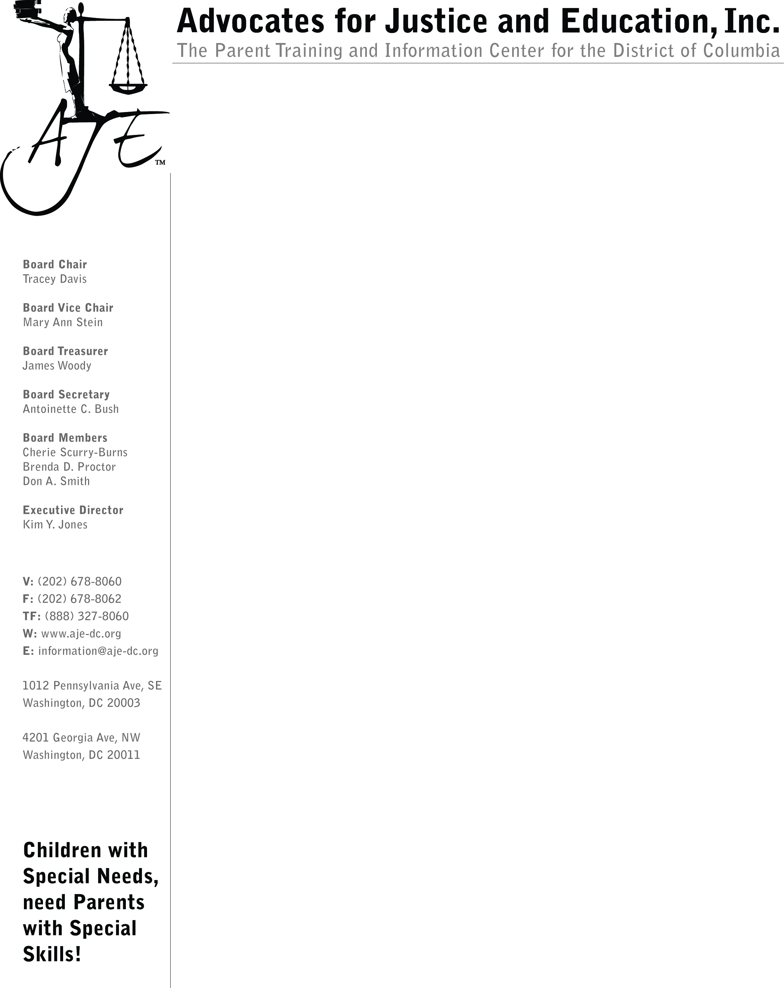




Our Core Team Members

Slide 3
Person Centered Thinking
Drives Systems Change
One Page Profile Template and Sample
[INSERT NAME]’s One-Page Profile
What People Like and Admire about me:
Insert
Photo
Here
What is Important to me:
Supports I Need To Stay Happy, Healthy & Safe:
For a good match: characteristics needed to be present or absent

Slide 4
Levels of Change

Slide 5
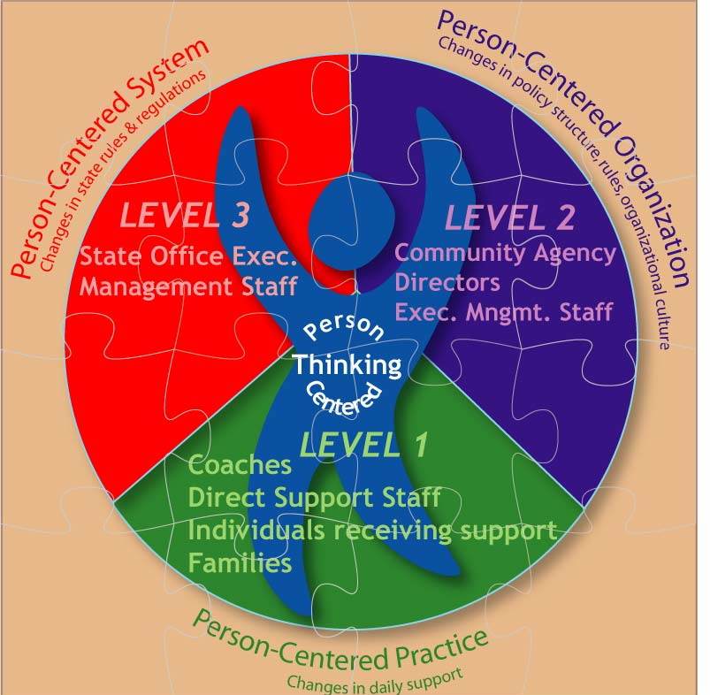
Levels of Change

Slide 6
Level 3 Changes
Needed in DC
Peer support throughout the lifespan
Coordinated services and supports
Supports for self-determination
Person and family centered supports
Comprehensive supports for people with DD throughout the lifespan

Slide 7
No Wrong Door
Our vision for Long Term Services & Supports:
Person and family-centered
Culturally and linguistically competent
Excellent customer service
Inclusive and integrated
Community-based

Slide 8
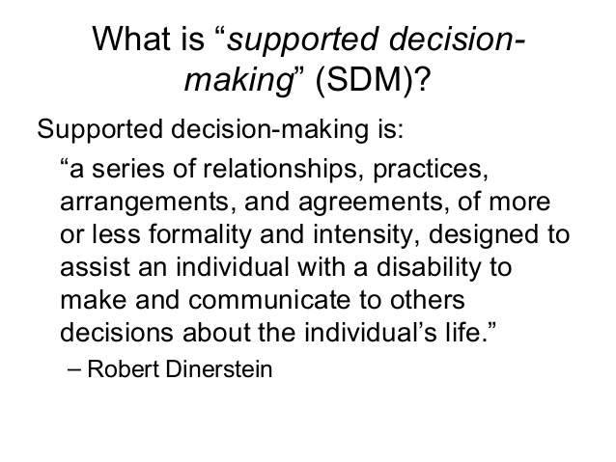
Supported Decision-Making

Slide 9
Work in Progress on
Level 3 Changes in DC
DC Advocacy Across the Lifespan Guide
DC Parent-to-Parent Chapter
No Wrong Door to LTSS
Outreach to Families
Lifespan Respite Coalition
And more!!!

Slide 10
Family Support Council
The FSC is established to provide recommendations, assist and advise DDS and sister agencies on developing person and family-centered systems of support for families throughout the life course of their family members with intellectual and developmental disabilities.

Slide 11

Support for Decision-Making
Work Group
Review DC laws and advise on changes needed to keep decision-making in the hands of people with disabilities and their families.

Slide 12
Ending Commitment in DC
Is your family member with an intellectual disability going to turn 18?
Do you want to make sure that you and your family member will have a say in his or her life as an adult?
Do you want to help restore the civil rights of other people with intellectual disabilities in DC?
If so, your voice is needed!

