Slide 1

Washington DC Community of Practice
Mary Lee Fay, National CoP, NASDDDS
December 17, 2014
Notes:
What are We Learning from the Community of Practice with Six States on Supporting Families
Across the Life Course
John Agosta, Human Services Research Institute; Yoshi Kardell, Human Services Research Institute; Mary Lee Fay, National Association of
State Directors of Developmental Disabilities Services; Sheli Reynolds, University of Missouri-Kansas City
P
articipants will learn about the National Community of Practice on Supporting Families, which is focused on building capacity to create
policies, practices, and systems to better assist and support families that include a member with intellectual disability across the life
course. This session will provide an overview of the national framework and lessons learned from the six states that are participating in the
National Community of Practice.

Slide 2
Project Goal
To build capacity through a community of practice across and within States to create policies, practices and systems to better assist and support families than include a member with I/DD across the lifespan.
Project Outcome
State and national consensus on a national framework and agenda for improving support for families with members with I/DD.
Enhanced national and state policies, practices, and sustainable systems that result in improved supports to families.
Enhanced capacity of states to replicate and sustain exemplary practices to support families and systems.

Slide 3
Key Recommendations
Focus on systems change within Medicaid and developmental disability services
Develop a national Community of Practice to further define supports to families
Expand or create national longitudinal data sets to include supports to families
Create a national research focus on supports to families
Elevate the presences of ADD within federal structure

Slide 4









Funded by
National Partners

Slide 5






CT
DC
MO
OK
TN
WA

Slide 6
89% of People I/DD are Supported by Family

Slide 7
Family Caregivers Have Always Been the Backbone of the
Nation's Long-Term Care System
39% of all adult Americans (2 of every 5) care for a loved one who is sick or disabled, an increase from 30 % in 2010.
It is not just women doing the caregiving.
Men are almost as likely to be caregivers as women (37% m; 40% w)
36% of Americans between ages 18-29 are caregivers
Almost half of family caregivers perform complex medical/nursing tasks for their loved ones — such as managing multiple medications, providing wound care, and operating specialized medical equipment.

Slide 8
Moving to Supporting Families
Family Support | Supporting Families
Defined by eligibility, services or programs available, or funding | Not a program or based on eligibility, it is needs defined by the families across the lifespan regardless of service provision
Caregiver or parent | Family is defined functionally; inclusive of siblings, parents with disabilities, grandparents
Tension between self-advocacy and family support | Enhances opportunities for self-advocacy and self-determination
Crisis, immediate response | Preventative, long-term planning
Supporting caregiver in order to decrease demand on long-term services | Creates a quality of life for person with DD and their family by supporting their many roles
Notes:
Defined by professionals or service system
As a program or specific services
Tension between self-determination/self-advocacy and family support
Goal of supporting caregiver in order to decrease demand on long-term services

Slide 9
Guiding principles and LifeCourse framework
Reframing the Conversation at All Levels

Slide 10

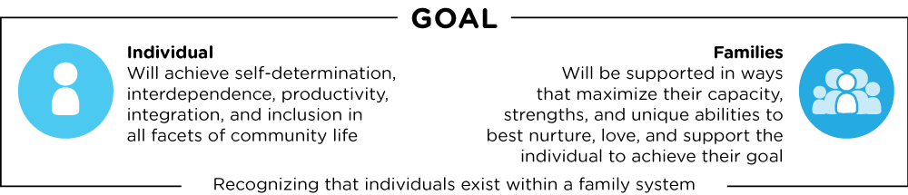
Defining Supports to Families
DISCOVERY AND NAVIGATION Knowledge & Skills | CONNECTING & NETWEORKING Mental Health & Self-Efficacy | GOODS & SERVICES Day-to-Day & Caregiving/Supports

Slide 11
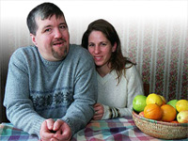
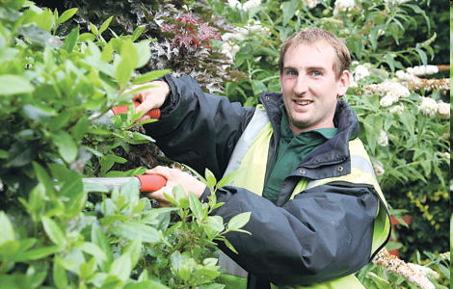

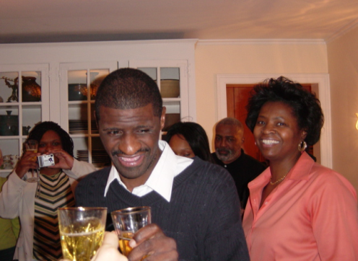
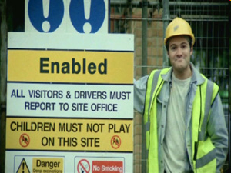
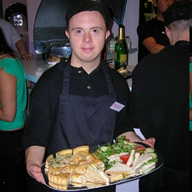
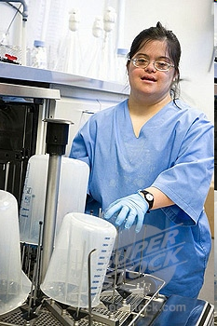
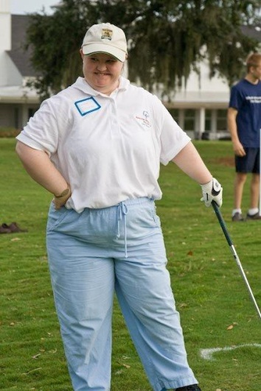
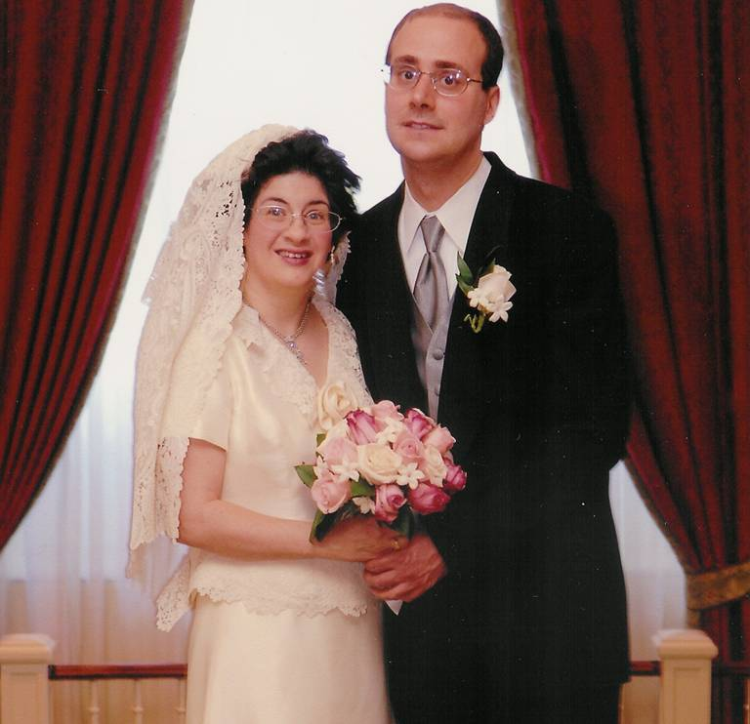
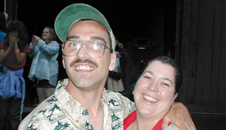
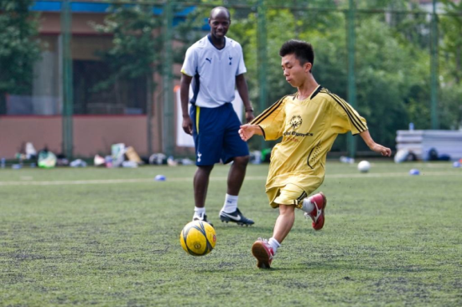
People with disabilities and their families have the right to live, love, work, play
and pursue their life aspirations just as others do in their community.
Notes:
It’s as simple as that. No more and no less.
And if you believe that, as I do, then you might be the type of person who believes that in this future individuals with disabilities and their families:
Ought to be Are in charge of the supports they receive to the extent they can be.
Ought to Have opportunities across their life course and the many facets of their life to use resources flexibly and in ways that enhance their lives and help them to participate in their communities.
May Offer support to each other and others in their community to enhance the well-being of all.
Have a shared responsibility with policy makers for the wise use of public dollars to assure that the diverse needs of all families and individuals can be met now and in the future.

Slide 12

Focus on “ALL”
100%
ALL individuals with
disabilities and families
are considered in our
values and vision.
(Family is defined by Individual)

Slide 13
Focusing on ALL
All 4.9 Million people with developmental disabilities
25%
75%
National % Receiving State DD Services
Based on national definition of developmental disability with a prevalence rate of 1.49%

Slide 14
Oklahomans with I/DD
60,277 estimated Oklahomans with Developmental Disabilities
15%
73%
(44,002)
12%
Enrolled State DD Services
Waiting for State DD Services
Based on 1.58% prevalence of 3.815 million citizens, US Census

Slide 15
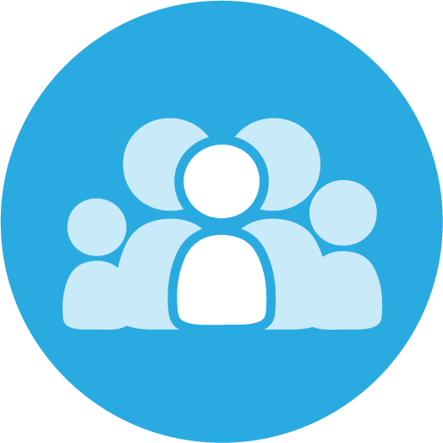
Lifelong Impact of Family on Individual
Biologically: Likes, dislikes, skills, abilities
Socially: Family and friend network, connection with community members
Environmentally: Neighborhood, socio-economic, education
Policy:
Dreams, Aspirations,
House rules, cultural rules, expectations

Slide 16
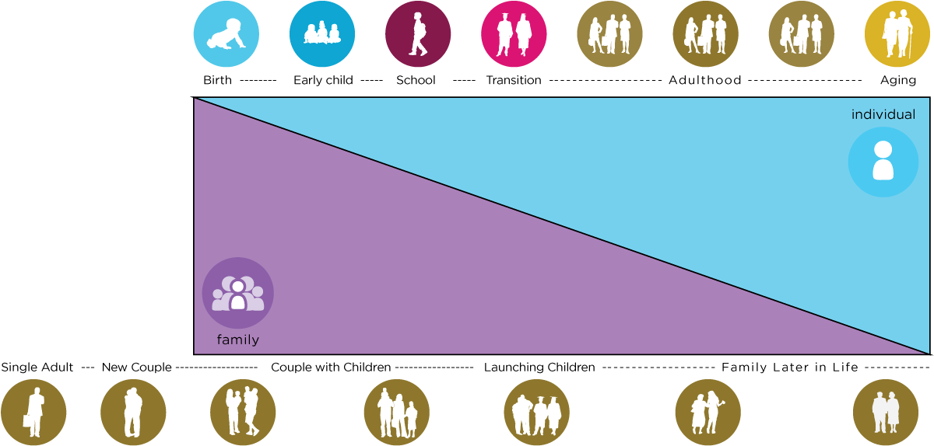
Family Life Cycle
Evolving Family Systems
Individual Life Cycle

Slide 17


Reciprocal Roles of ALL Family Members
Caring About | Affection & Self-Esteem
 | Repository of knowledge
 | Lifetime commitment
Caring For | Provider of day-to-day care
 | Material/Financial
 | Facilitator of inclusion and membership
 | Advocate for support
*Adapted from Bigby & Fyffe (2012), Dally (1988), Turnbull et all (2011)

Slide 18
Life Outcomes
Vision of a “Good Life”
Individuals and families have a vision for a good life that focuses on positive on life experiences that foster self-determination, community living, social capital and economic sufficiency for all.

Slide 19
Trajectory towards Life Outcomes
Friends, family, self-determination, community living, social capital and economic
sufficiency
Trajectory towards Outcomes
Vision of What I Don’t Want
Trajectory towards things unwanted
Both in practice with individuals and
in policy changes for systems

Slide 20

How do policies and practices facilitate fostering and including self-advocates and family to be engaged in, lead and drive
Policy and Systems Change?

Slide 21
Areas of Focus in 6 States
Supporting Families Across the LifeCourse

Slide 22

Activities Organized in 3 Buckets
Discover & Navigation
Goods &
Services
Connecting & Networking

Slide 23

Practices for Discovery
Education, information and navigation strategies for the person with a disability and their family across the lifespan

Slide 24


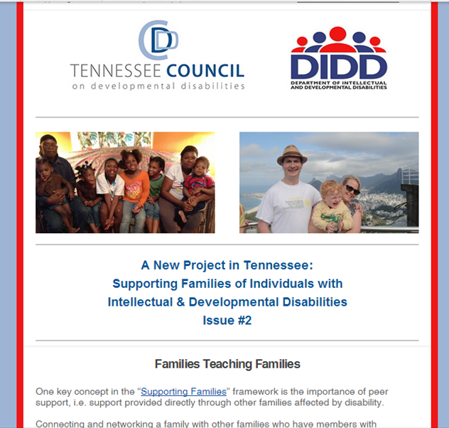
Tennessee
Communication Tools for Reframing
(e-newsletter, magazine, folder, website, social media)

Slide 25

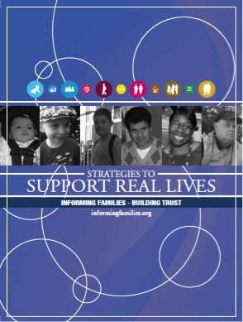

Washington
Infused the lifecourse framework into existing “Informing Families, Building Trust” messaging efforts
Building virtual planning tool based on LifeCourse booklet

Slide 26

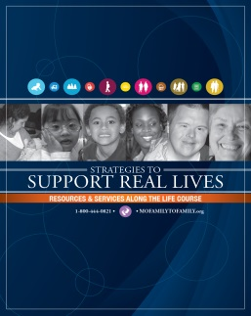
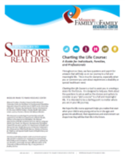
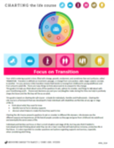
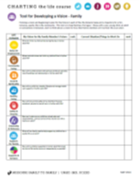
Missouri
Consistent Message Across the LifeSpan
Family to Family at Missouri UCEDD
Early Childhood, Part C
School Districts, Special Education
PNS Show Me Career Grant Pilot Sites
State Division of Developmental Disability
Special Health Care Needs

Slide 27
Peer Support Practices
Tennessee: Created sub-committee enhancing, connecting and sustaining
District of Columbia: State has contracted with P2P USA to assist in starting chapter
Washington: Adult Sibling Focus group
Connecticut: Participated in Parents with Disabilities conference
Missouri: State agency contracted with F2F HIC for seamless front door

Slide 28
Leadership Development Practices
Missouri: Partners in Policymaking and Alumna Weekend
Oklahoma: Statewide Joining Forces Family Leadership Conference and Rural Leadership Institutes
District of Columbia: Family Stipends, Advocacy Training with Georgetown
Connecticut: Facilitating bringing together Family Networks to work together on advocacy and information dissemination

Slide 29
Practices Focused on Those Served by the State Service System

Slide 30

Connecticut
Full time staff in Central office to focus on systems change to support families
Cross department life span team
Community Teams
  Information Dissemination
  Family Mentoring and Leadership
  Training and Education
  Self-Directed Services and In-Home Supports
  Social Supports and Respite
  Positive Behavior Supports
  Person Centered Housing
  Employment
  Healthy Living
  Technology

Slide 31
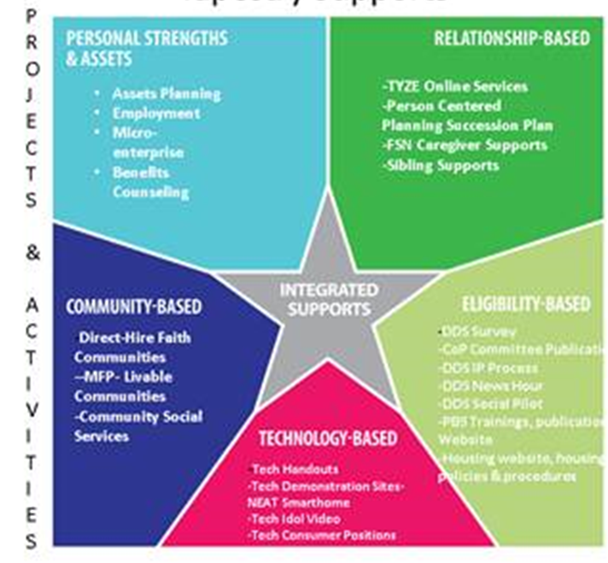
Connecticut

Slide 32


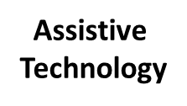
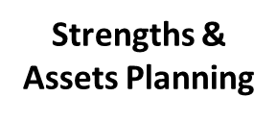
Connecticut
Eligibility
Services
DDS Services
Person Centered Planning

Slide 33
Washington
Strong leadership and partnership of state DD Council with State DD system
Recommendations made for integrating “supporting families” framework and specific services into the new states K Plan
Exploring “a family component” into already strong use of NCI data to drive systems change

Slide 34

District of Columbia
Currently Legacy System
  Adults with Intellectual Disabilities only
  Commitment to community based supports
  Stalled at reforming the law
Developing new Legislation for DD Services
Budget Line Item for Supports to Families
Initiated Supporting Families Advisory Council
Connecting System Reform Initiatives Together (Employment First, Person Centered Thinking: Trained Family Facilitators, Supporting Families CoP)

Slide 35

Oklahoma
State DD System
  Existing initiatives focused on person centered planning
  Enhance role of case managers and intake workers to focus on support to families
Governors Blue Ribbon Task Force using LifeCourse framework to guide conversations and plan development

Slide 36
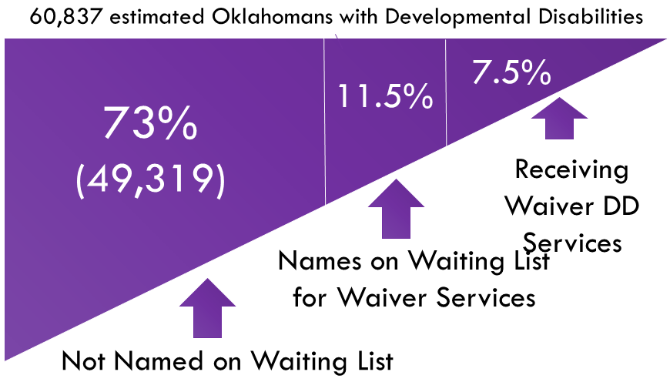
Reframing Wait List Discussion
Information about Oklahomans with DD on Waiting List
0-5 | 6-18 | 19-64 | 65+ | Total | Details
624 | 2579 | 3714 | 59 | 6,976 | Names on Waiting List
114 | 620 | 850 | 11 | 1,695 | On list, No known public benefits
510 | 1959 | 2864 | 48 | 5281 | On list, Getting Some Public benefits

Slide 37
What are we learning?
Overall Themes
Balancing Focus on Person with Disability as we try to increase supports to families
Concept of “all” has made a major impact
Family support vs. supporting families
Aging families or “traditional mindset” families comfortable with the current system

Slide 38
What are we learning?
Overall Themes
Thinking about integrated supports: Technology is really exciting people and Increased focused on what are “natural or informal supports”
People are “ready” and excited for the message and concrete, practical tools
The skill of “partnering” with other entities and with self-advocates and families is hard

Slide 39
    Integrated and Comprehensive Systems: Connecting the Dots
Employment First
Alternatives to Guardianship/Supported Decision Making
No Wrong Door Initiatives
Aging and Disability Resource Center
CMS Balanced Incentive Program
CMS Community Settings and Person Centered Rule
Family Information Systems Project
NIDRR newly funded RRTC on Family support
IDEA Performance Outcomes
HRSA Home Visiting

Slide 40
Future Supporting Families Practice Areas
Providers Partnering with Families
Self-Directed Supports and Families
Goods and Services Specific to Family or Caregiver
Building Capacity of Community to Support Families

Slide 41
Difficulties in Capturing Learning
  Constant priorities and changes in state systems (policy, CMS, leadership, staffing, funding)
  No operational definition of family support
  Lack of defined evidence based practices
  Data on “family” and “family support services” difficult to capture
  Different Starting Points for Systems Change
  Supporting Families is a cultural change, it is bigger than one system

