Slide 1



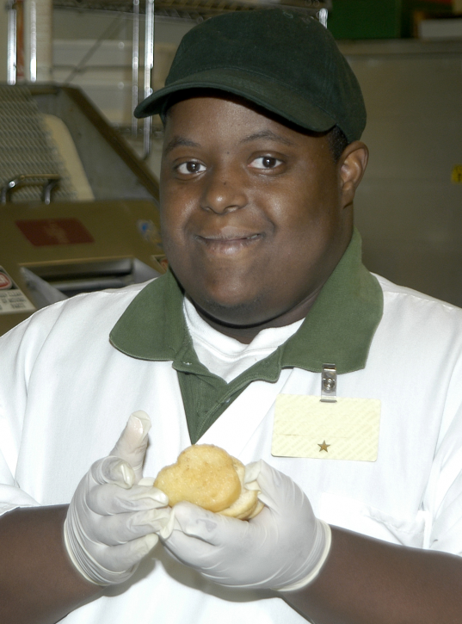
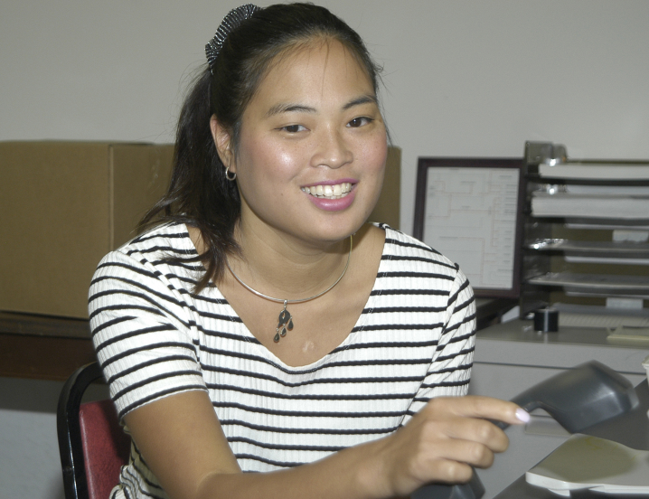
DC Learners & Earners

Slide 2
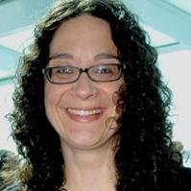
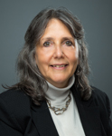

About Us
Erin Leveton
DC Department on Disability Services
State Office of Disability Administration
erin.leveton@dc.gov
Rebecca Salon
DC Department on Disability Services
State Office of Disability Administration
rebecca.salon@dc.gov
Notes:
Everyone

Slide 3

District of Columbia
Person-Centered Thinking
Supporting Families Community of Practice
Employment First: EFSLMP, SELN, Partners in Employment
HCBS Transition Plan
WIOA Implementation
No Wrong Door LTSS Implementation Grant
Notes:
In the midst of a multi-year effort to infuse and immerse the system with value based principles and practices to move systems change to the next level. (Year 5 for PCT and SF CoP.)

Slide 4
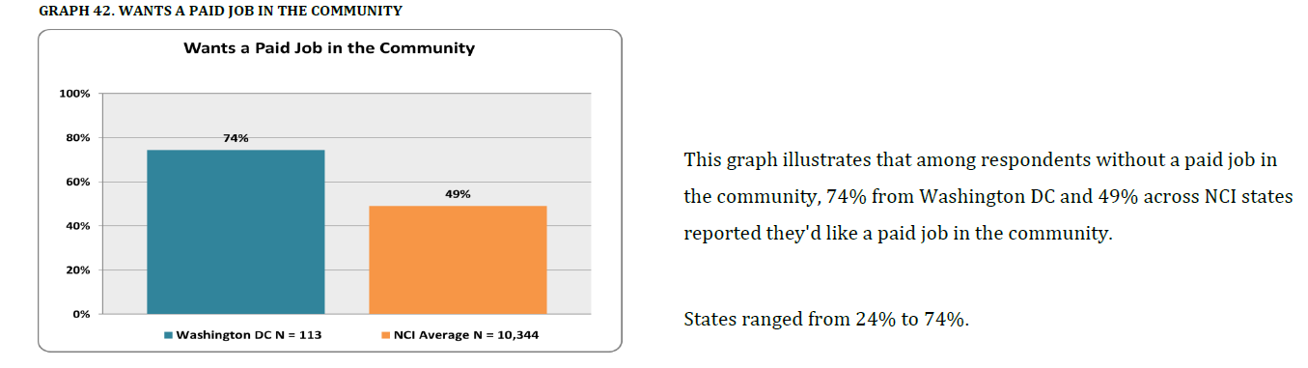
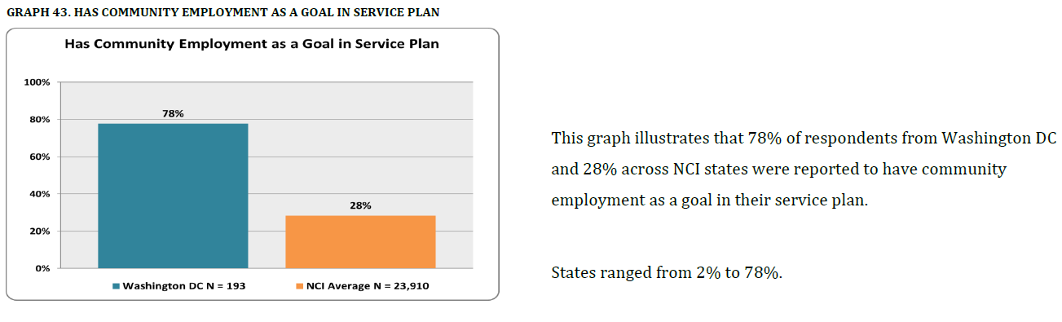
NCI – Employment Data
DC has Strong Early Outcomes – We are #1 in:
Up from 37% last year!
Up from 58% last year!

Slide 5
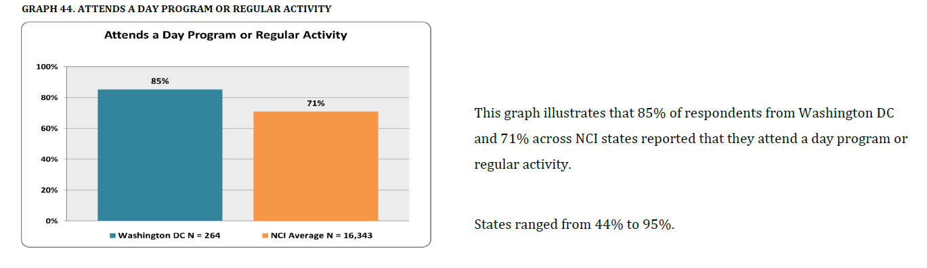
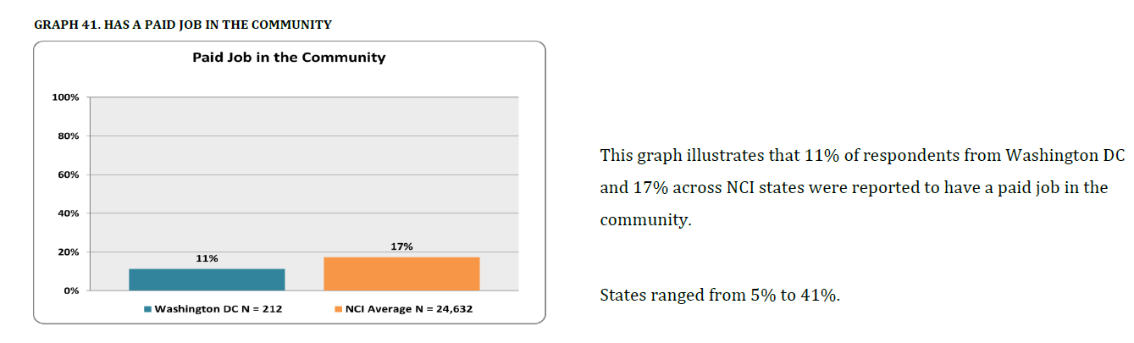
NCI – Employment Data
But. . . There is lots of room to improve
Notes:
And that’s why we applied for the PIE grant – we need to take our systems change to the next level in DC

Slide 6
DC Learners & Earners
Level 1:Build high expectations for employment
Level 2: Create community-based networks of support
Level 3: Change government policies and practices
Credit: The Learning Community for Person Centered Practices
Notes:
DC Learners and Earners initiative is aimed at improving employment outcomes for young people with intellectual disabilities. Recognizing that to be successful this will require change at every level, DC is working with people with disabilities and families to build high expectations for employment and share tips for success; with neighborhoods throughout the District of Columbia to build community-based networks of support for young people; and examining where our government policies and practices must change.

Slide 7
Foundations of Systems Change for Employment First in DC
Person Centered Thinking
LifeCourse
Framework
Discovery
Pathways to Employment
Notes:
Our project is guided by person-centered thinking and the LifeCourse principles. We will partner with people with intellectual disabilities, including self-advocacy leaders in the District, and their families so that they inform and influence the planning, policy, implementation, evaluation and any revisions of this project.

Slide 8
It Takes a Village
People with I/DD
Families
Gov’t Agencies
Private Partners
DDS Staff
Notes:
Multi-layer approach
Person centered
Engage families
Involved changing culture and practices with DDA/ RSA, sister agencies, partners

Slide 9
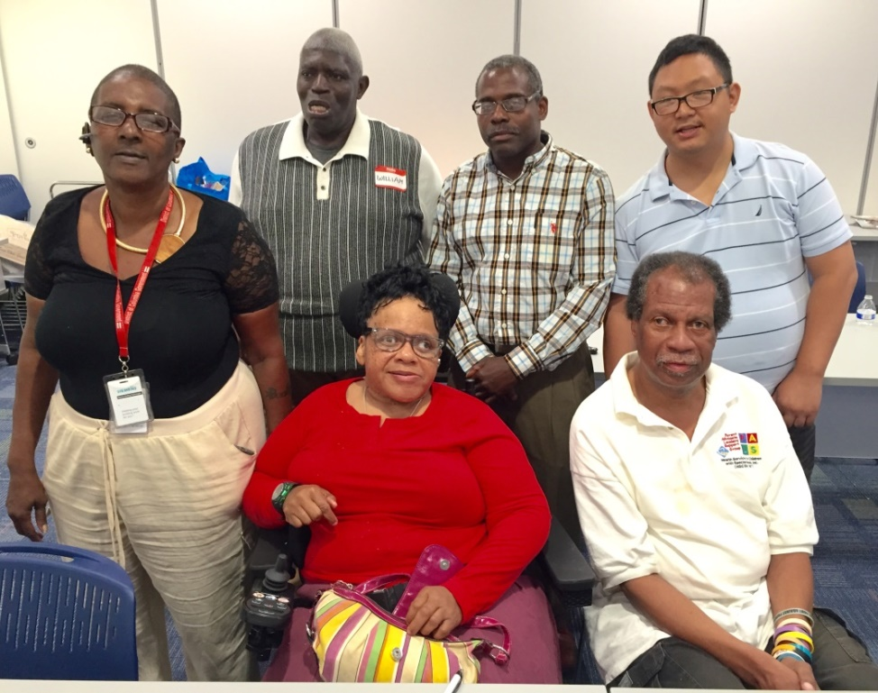
Discovery Led by People with IDD
We are Peer Trainers for
People Planning Together
We live in DC. We helped to update this training and will continue to train people in DC.
Notes:
One of our level 1 changes will be to work with DC’s existing PPT trainers and subject matter experts at the Learning Community for PCP to create a new curriculum that really focuses on employment discovery. Our trainers will all be people with employment experience, who can help facilitate a conversation around people’s skills, preferences, and support needs. The trainers will also be models who will visually demonstrate that people with IDD can work and can be leaders.

Slide 10
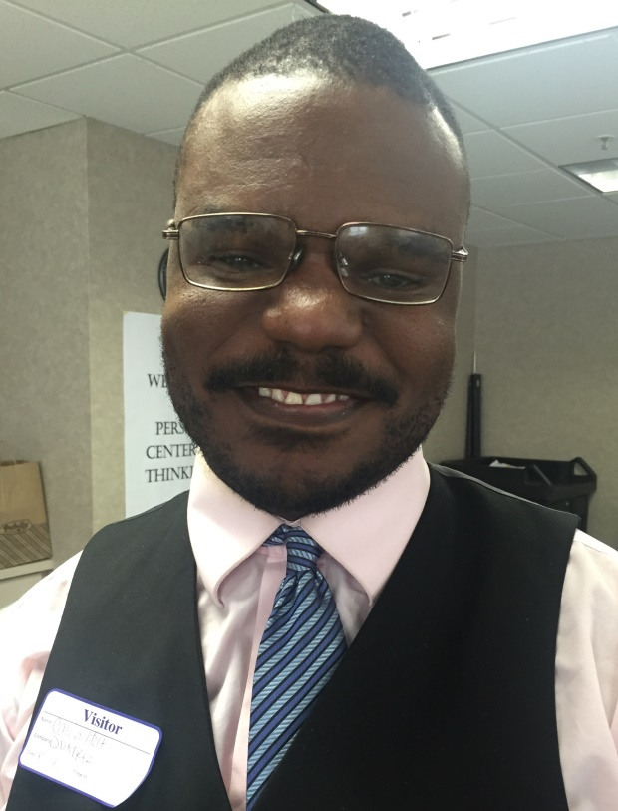
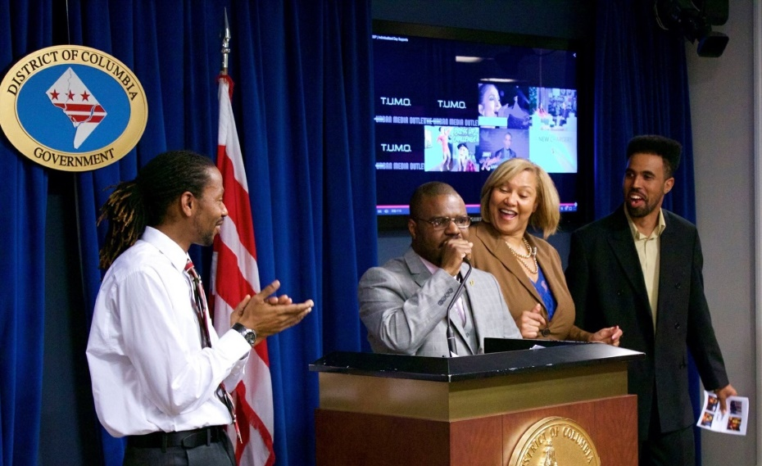
PPT Success Story
“My support staff, Kirk, helped me to write, star, perform, and promote my own video.”
This is Calvin. He loves Christian music and especially loves Rap. He wanted to star in his own Rap video.
Notes:
We were inspired to do this by some of the early successes of our PPT training. (Calvin’s story)

Slide 11
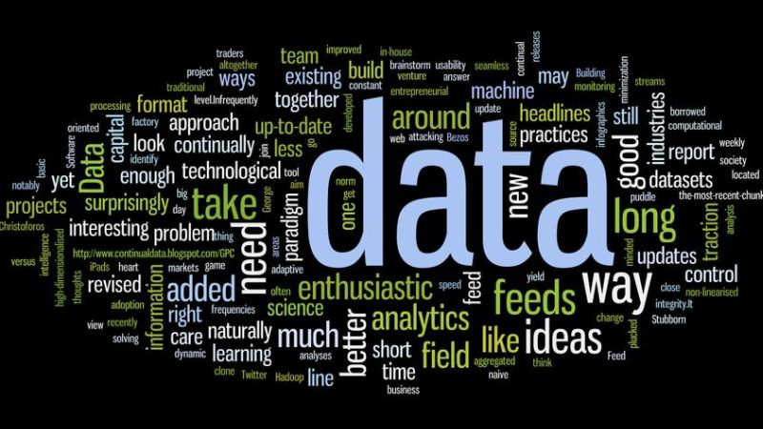
Using Data to Drive Decisions
Looked at characteristics of people 18 - 30 who receive DDA supports
What services do they use?
Which providers?
Provider quality?
Acuity level?
Selected 1 or 2 Pre-Vocational Settings to Pilot new PPT Training
Notes:
When we thought about how to expand our PPT program and introduce the new employment curriculum, we looked to our data. DC doesn’t have sheltered workshops, but we do have a number of day settings. We looked to which programs people who are under 30 years old and who have indicated an interest in employment are attending. Then we looked at quality data for those providers and selected up to 2 sites to begin a pilot.

Slide 12
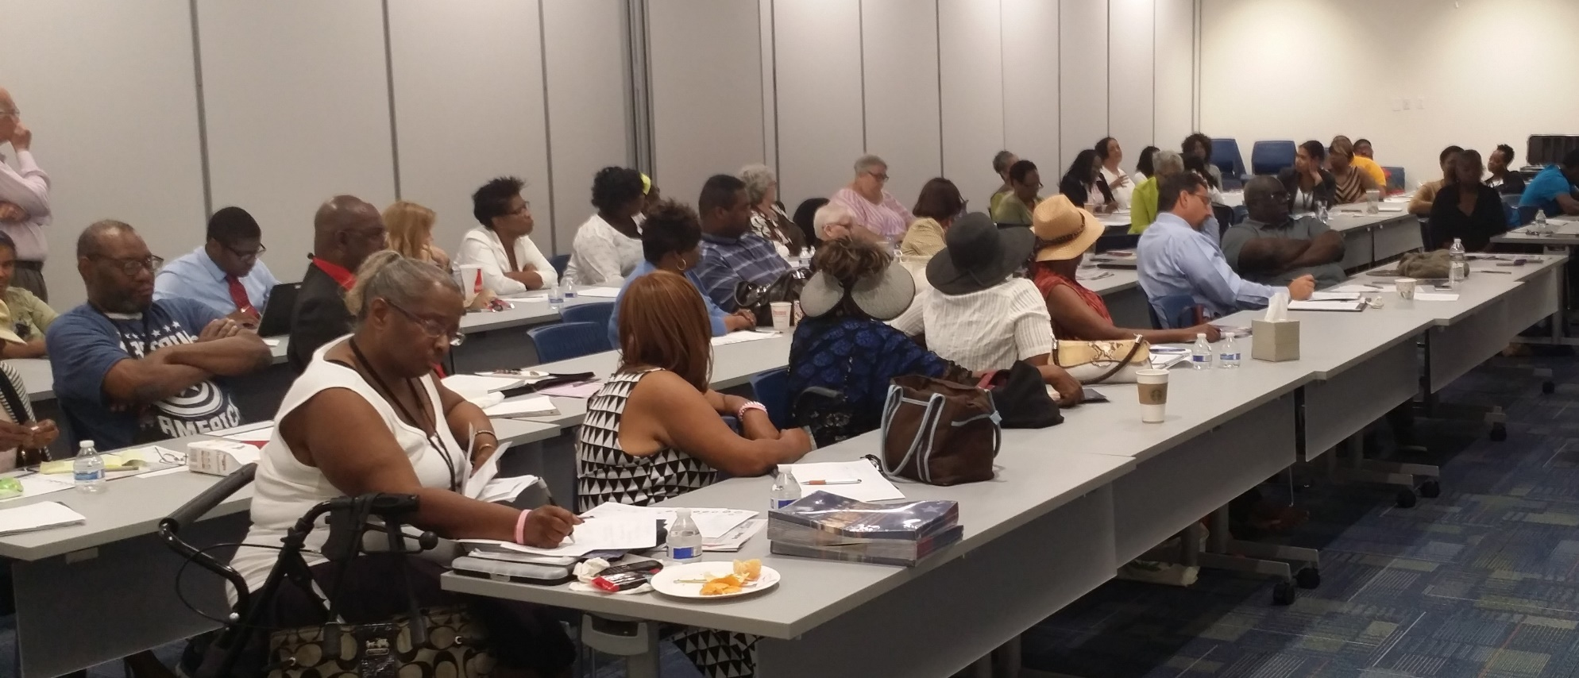
Engaging Families
Notes:
Families can be our greatest cheerleaders for person-centered and employment first systems change and our strongest advocates, or they can be barriers to systems change. We wanted to make sure that as we reformed our DD system, we were working closely with the people we support and their families and were guided by their experiences. At the beginning of systems change we knew we had a major responsibility to change mindset.
We were really pleased to be able to launch the Supporting Families CoP at the same time that we were doing a deep dive into PCT. Because change must starts with the family.
We used the LifeCourse & PCT to reframe vision of what success looks like at the individual and systems level – and build a shared responsibility for systems change. To start, we trained family members in person-centered thinking using the Family Planning Together and Supporting Families Lifecourse Framework curriculums. We also trained several family leaders to become trainers themselves.
Intentionally embedded leadership in CoP meetings. Exec team leadership at all SF CoP meetings. Change has continued through change in Director – embedded in culture now.
Taking the same approach now, as we begin the work on the DC Learners and Earners project. We are including people with IDD, their families, stakeholders, providers, and, of course, representatives from key government agencies.

Slide 13

Three Types of Supports
Goods &
Services
(Day to Day, Medical, Financial Supports)
Discovery & Navigation
(Info and Training)
Connecting & Networking
(Talking to someone that has been there)
Notes:
Through the SF CoP we learned that to be successful, families need a combination of supports – government services alone are not sufficient. Families also need help with information, training and navigation – and you cannot discount the benefit of peer to peer supports.

Slide 14
Talking to Families About Employment
Notes:
In this first year, we are working with DC families to learn how they are getting these supports now – for information; how they are connecting with other families; and around goods and services. This information will help us both have good resources to share and identify potential gaps.
We created this assessment tool using the integrated support star principle out of the National Supporting Families CoP, that recognizes that all people need support to lead good lives. Using a combination of many different kinds of support helps to plot a trajectory toward an inclusive, quality, community life.

Slide 15
Talking to Families About Employment
Notes:
We also thought it was important that in the first year of the project, just as we are creating a platform for people with IDD to lead through PPT Discovery training, we recognize the expertise families bring to the table. We worked with our SF CoP to talk about what their vision is for employment for their family members and asked them what they were doing to help support them. We collected their ideas and share them with others. We typically distribute this with a blank trajectory form so that families can develop their own vision and chart their own paths to employment success.

Slide 16
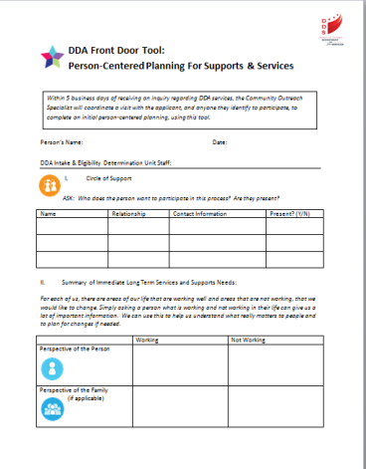
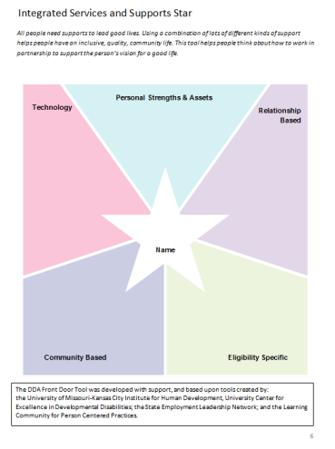
Redesigning the Front Door
Person-Centered Planning & Discovery starting at DDA intake
  Like and Admire to determine strengths
  Trajectory to identify goals
  Guided conversation on Employment
Working towards joint application with Vocational Rehabilitation
Will pilot with transition age students at a school
Notes:
We wanted to reframe the front door to DDA supports to make them person-centered and strength based, with a goal to connect people to community-based supports as quickly as possible. We started by looking at all of our requirements for application packets and were able to remove many of the clinical assessments we were requiring. We realized that they harkened back and were carryovers from the time when most people in supports went into ICFs.
Instead, we created a new guided conversation at DDA that starts by talking with people and their families about their strengths, using the PCT Like and Admire Tool. Next, we will talk to people about what’s Working and Not Working in terms of the person being supported to identify gaps and needs for LTSS. We have a guided conversation on ther person’s interest in employment. Based on that information, we will problem solve with the person and his or her family and immediately offer referrals to community based supports, including VR services. The information we gathered at intake will flow into the DDA ISP and, if the person is being referred to another agency and consents, be shared with that agency for service planning. We are working now on making this a joint application between DDA and RSA.

Slide 17
Thank you!!!
https://dds.dc.gov/page/dc-learners-and-earners
Notes:
Erin

