Slide 1

Ranked choice voting
2026 implementation information
Notes:
Please replace this logo with higher quality version. White would look nice here.

Slide 2

Ranked choice voting (rcv) in the district of columbia
RCV is Here!
In the November 2024 General Election, voters overwhelmingly voted for Initiative Measure No. 83 (I83), a voter initiative that established RCV as a voting method in DC
The DC Council funded RCV in the FY 2026 budget
DC Board of Elections (DCBOE) will implement RCV in all elections that we administer beginning with the June 16, 2026 Primary and Special Elections
Notes:
Explain why RCV will be used, when, what offices and needing three or more candidates. Please replace logo with higher quality version.

Slide 3
Ranked choice voting (rcv) in the district of columbia
PRIMARY, GENERAL ELECTIONS, & SPECIAL ELECTIONS
President and Vice President of the United States;
Mayor of the District of Columbia;
Attorney General;
Chairman of the Council of the District of Columbia;
Delegate to the United States House of Representatives;
Members of the Council of the District of Columbia;
Members of the State Board of Education;
United States Senator;
United States Representative; and
Advisory Neighborhood Commissioner.
Notes:
Explain why RCV will be used, when, what offices and needing three or more candidates. Please replace logo with higher quality version.

Slide 4
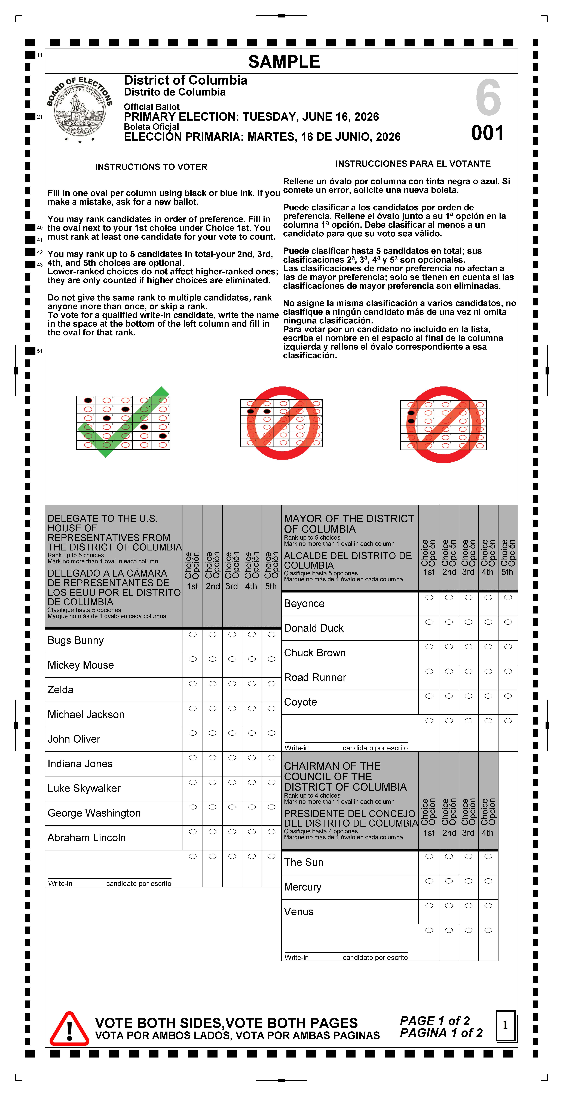
What is rcv AND HOW DOES IT WORK?
Please note that there are many RCV models. The model of RCV that is being implemented in DC was determined by the text of I83, not by DCBOE.
DCBOE is responsible for drafting regulations that align with the legislation.
RCV will apply to each contest that contains at least three qualified ballot access candidates.
In RCV contests, voters may rank candidates in order of preference instead of choosing only one.
Ballots are counted in rounds until a candidate receives a majority of votes (at least 50%).

Slide 5
Please Note
If no candidate receives over 50% of the votes in a contest, we will begin the RCV tabulation process.
During each tabulation round, the candidate with the fewest votes is removed from the ballot.
Even though you are ranking up to five (5) candidates in a contest, only one vote is valid at a time.
Once you select your first candidate, your vote stays with your top-ranked candidate as long as that candidate remains active.

Slide 6

How to mark your ballot
Fill in only one oval per column
Rank up to five candidates
Ranking additional candidates does not harm your 1st choice
Voters are not required to rank candidates. Voters may select one candidate if they choose to do so.
Notes:
You can talk about ranking only one, what happens if you do, and the advantages of ranking more than one candidate.

Slide 7
Mistakes to avoid
Notes:
Columns are highlighted on clicks to show which votes would not count.

Slide 8
Mistakes to avoid

Slide 9
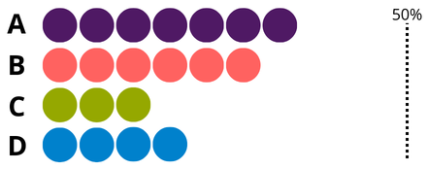
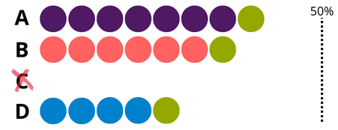

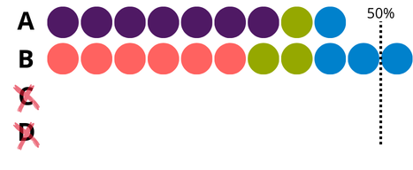
Round 1
TABULATION PROCESS
First choices are counted.
Round 2
The candidate with the fewest votes is eliminated. Those ballots are transferred to the voter’s next choice.
B
Round 3
This process continues until a candidate reaches a majority.
WINS
Notes:
These are place holder graphics. Text not finalized yet. Text and graphic positions not finalized yet. Each round will appear on a click.

Slide 10

What should you expect?
Voting
Results
It may take longer to mark your ballot
Guidance on RCV will be available at Vote Centers
Mail Ballot packets will include guidance on RCV
Results reports will look different from reports in previous elections
  Getting best practices from other jurisdictions
  Transparency is key
Results will still be available on DCBOE website
The results reporting schedule will be different from previous elections
  Schedule is being determined
  Preliminary results will still be posted on Election Night

Slide 11
Education & outreach
Available Resources
Coming Soon
RCV page on DCBOE website
Resource Lab at DCBOE
FAQs
Palm cards
In-person and virtual speaking engagements
Election tabulation simulator tool
Explanation Video
Voter Guide
Mailers

Slide 12
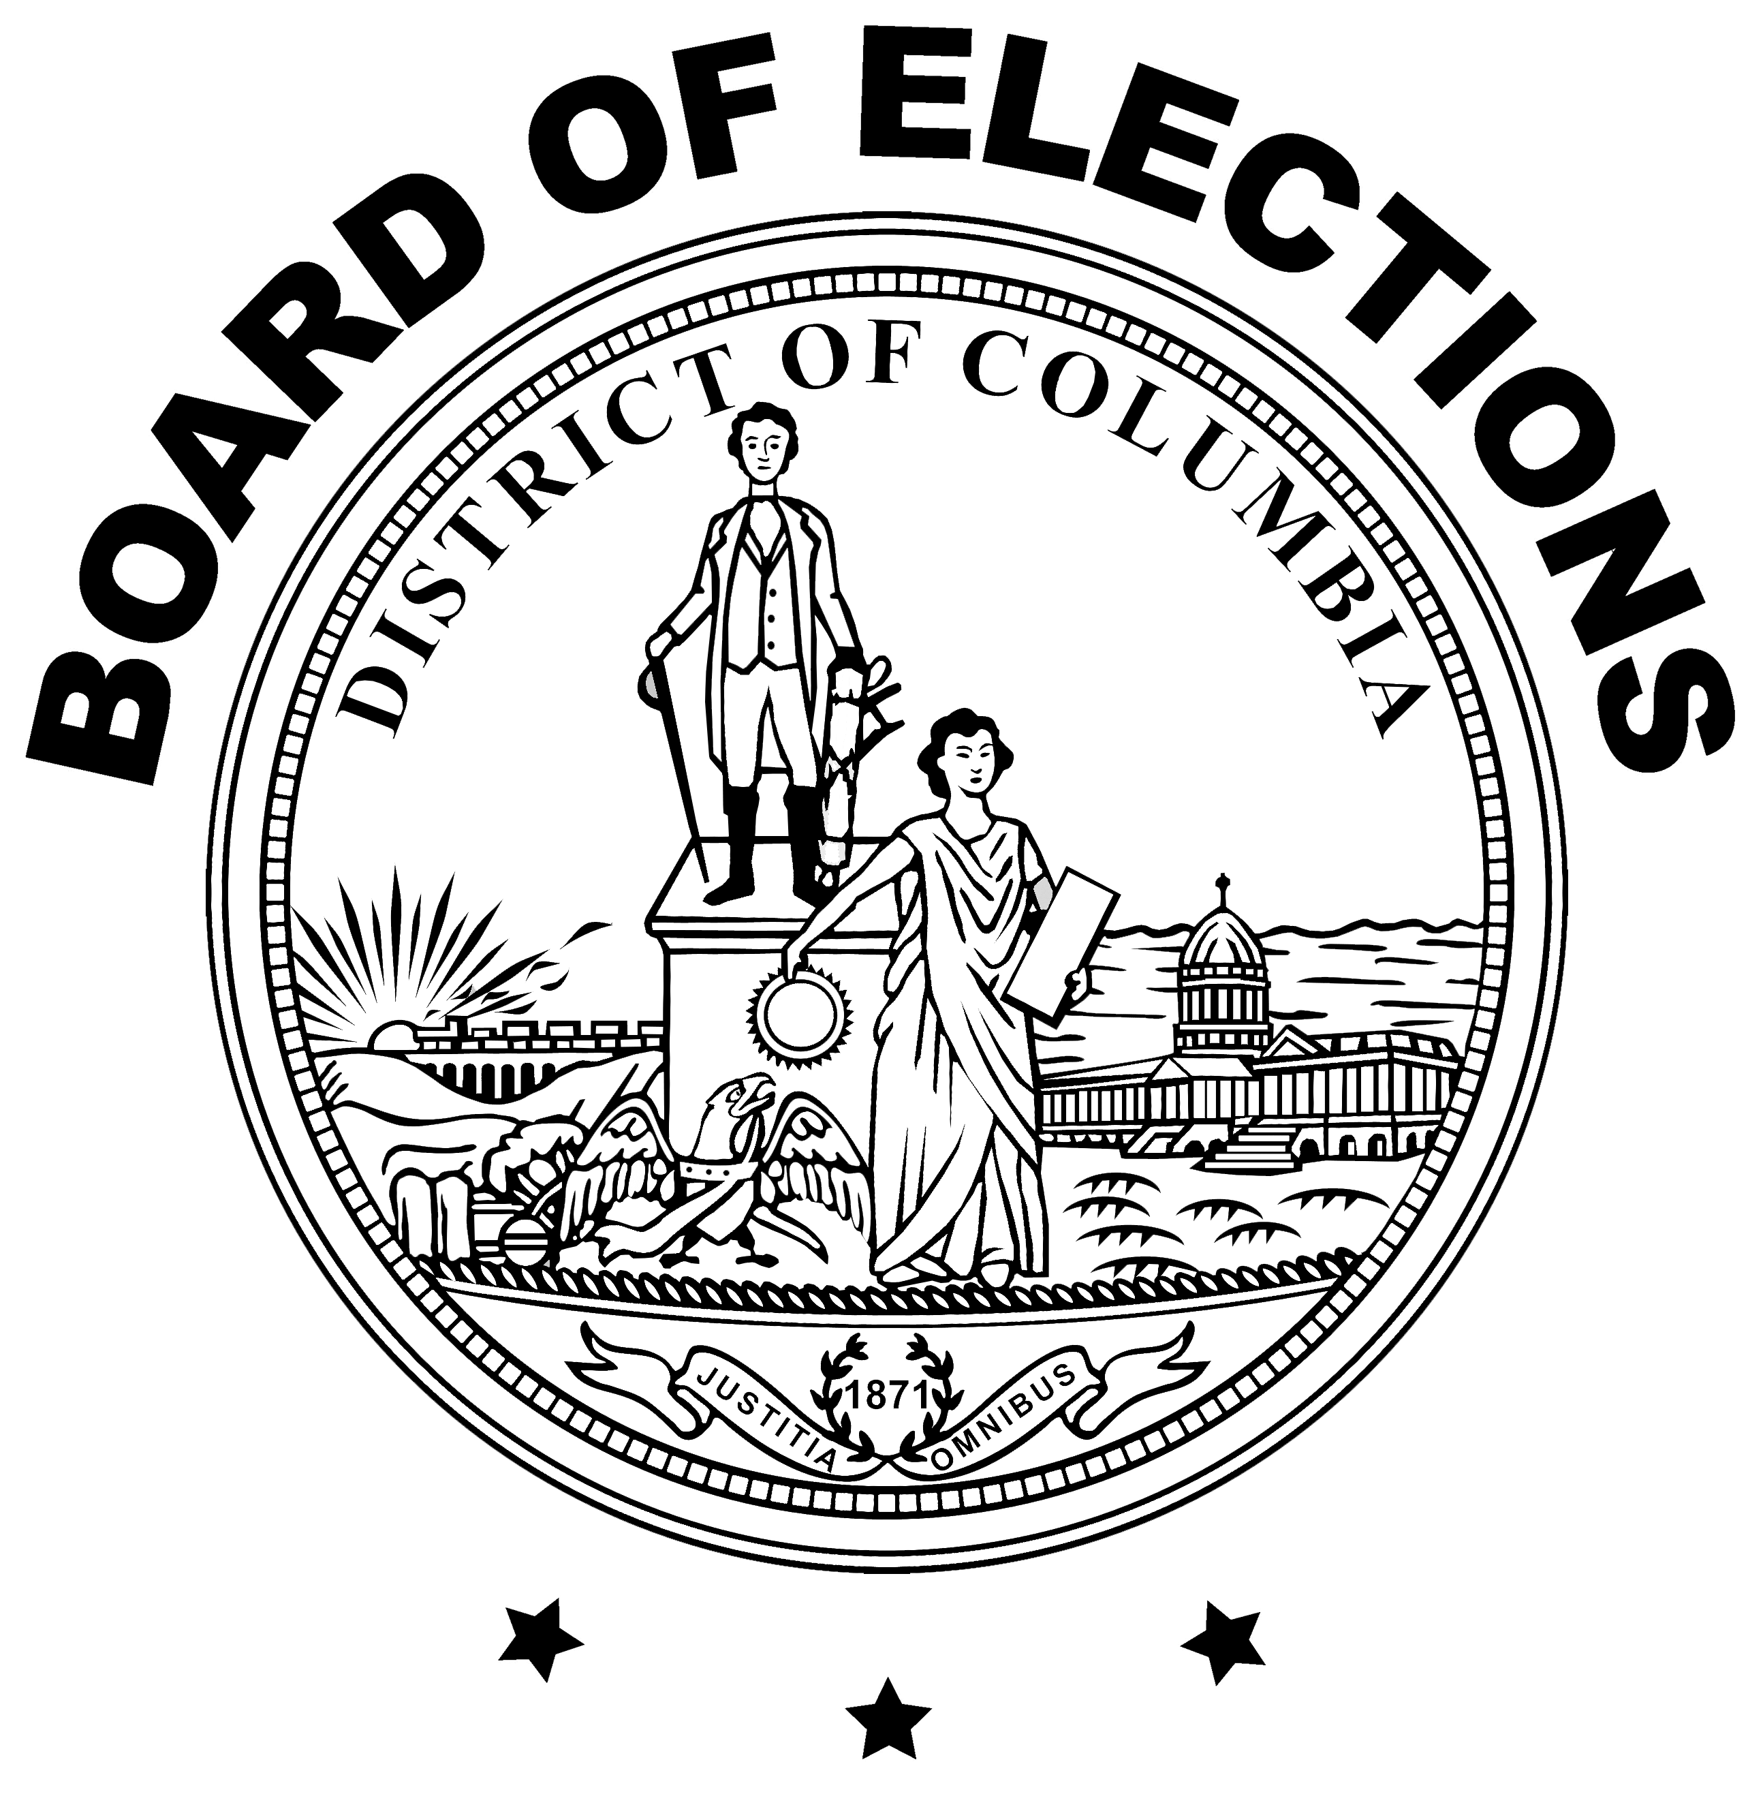
www.dcboe.org
For questions regarding Ranked Choice Voting, contact: rcv@dcboe.org
For more information about speaking engagements, contact:
Outreach@dcboe.org
Notes:
Please replace logo with higher quality version. Add contact info.

