Slide 1
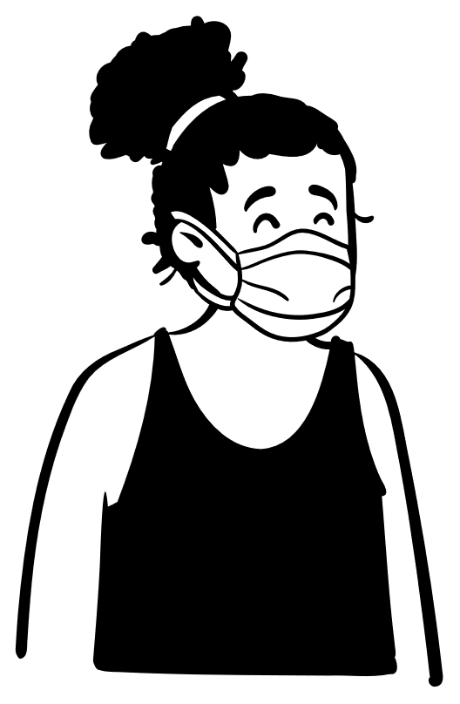
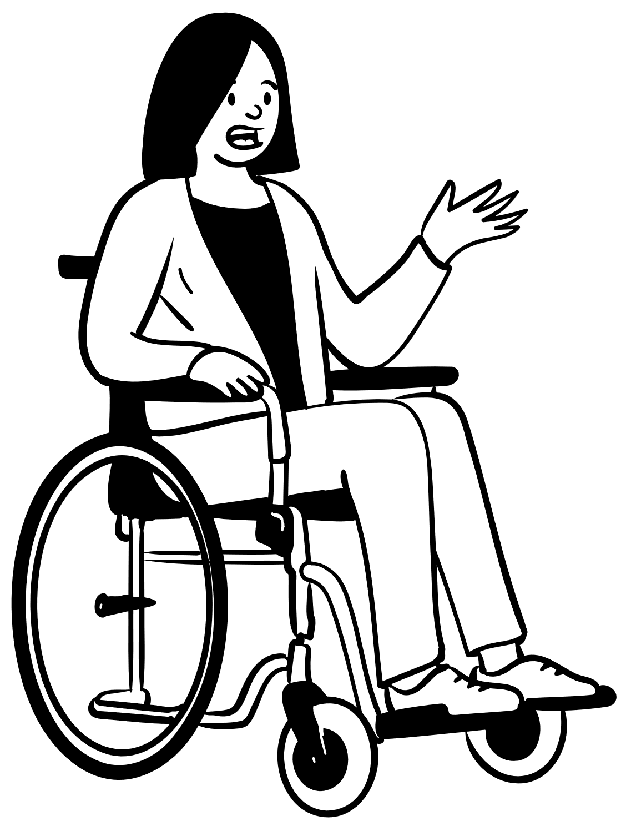
Benefits Counseling Overview Dr. Marquita Siler Tyler Certified benefits specialist

Slide 2
What are benefits?
Social Security benefits are payments made to qualified retired adults and people with disabilities, and to their spouses, children, and survivors.

Slide 3
What’s the difference?
Supplemental Security Income (SSI) is needs based; and you may not have resources over $2,000 for individuals and $3,000 for couples. You must be an individual with a disability or an elderly person to access this money.
Social Security Disability Insurance (SSDI) is based on work credits an individual earned while they were working and paying into the system (or in some cases when their parents were working and paying into the system). You must be a person with a disability to access this money.
Social Security announced a 5.9% Cost-of-Living adjustment for 2022. This raises the Maximum Federal Benefit rate for Supplemental Security Income (SSI) from $794 to $841 for individuals and From $1191 to $1261 for couples.

Slide 4
What is Benefits Counseling?
Benefits Counseling is a process during which a certified benefits specialist will:
analyze a person’s benefits such as SSI, SSDI, etc.
give beneficiaries (person receiving benefits) insight on how these benefits may be impacted by employment.
provide information on work incentives and other programs that may assist beneficiaries with retaining most or in some cases all of their benefits when they return to work.
Assist beneficiaries in making informed decisions about what employment goal works best for their individual circumstances.

Slide 5
Why is Benefits Counseling Important?
It provides beneficiaries with the information they need to make informed decisions about employment.
It gives them options, by informing them about work incentives that may help them go back to work and safeguard some if not all their benefits.
It helps them understand the impact of employment on benefits, so they can avoid pitfalls such as overpayments.

Slide 6
What are some examples?
If you are receiving SSI and you go back to work, you may be able to continue to receive payments until the earned income counted exceeds the SSI limits. The maximum Federal Benefit Rate for SSI is $841 for individuals and $1,261 for couples.
Your Medicaid may continue even if you earn over the SSI limits if you cannot afford similar medical care and depend on Medicaid in order to work.
The 2022 District of Columbia threshold amount (amount used to decide if earnings are high enough to replace SSI and Medicaid benefits) is $54,771.

Slide 7
What is a PASS PLAN?
The Plan to Achieve Self Support or the PASS Plan, is a work incentive that allows SSI recipients to save money towards their vocational goals without penalty.
The money cannot be SSI funds and the vocational goal must lead the beneficiary becoming self-sufficient.

Slide 8
What are ABLE Accounts?
ABLE Accounts allow eligible people with disabilities to save money to pay for qualified disability expenses related to the designated beneficiary’s disability.
These funds can also be used for the beneficiary to maintain or improve his or her health, independence or quality of life.

Slide 9
What about students?
Most scholarships or grants used to pay for tuition, books and other expenses directly related to getting an education, don’t count as income if you go to school or are in a training program.
There is also a Student Earned Income Exclusion (SEIE) where $2,040 of your monthly earnings (up to a maximum of $8,230 a year) can be excluded when calculating your SSI cash payment.

Slide 10
What happens if I go to work on SSDI?
If you need supports to work, there are special rules that allow some of your earnings to be excluded when figuring your SSDI cash payment.
And if your SSI or SSDI benefits have end because of earnings from work, and you again become unable to work due to your disability; you have 60 months during which you may request reinstatement of benefits without filing a new application

Slide 11
What is Ticket to Work?
Social Security's Ticket to Work Program is a free and voluntary program available to people ages 18 through 64, who are blind or have a disability; and who receive Social Security Disability Insurance (SSDI) or Supplemental Security Income (SSI) benefits.
Ticket to Work is Social Security's program to encourage disability recipients to return to work. Ticket to Work expands the vocational services available to people on SSDI and SSI and provides additional protections to people's disability benefits as incentives for them to attempt to return to work.
Basically, when someone is being retrained or is working under the Ticket to Work program it means that social security won't do a medical review.

Slide 12
What is a Trial Work Period?
When you return to work for nine months (not necessarily consecutive), your earnings will not affect your SSDI cash benefit.
If the nine months of trial work do not fall within a 60-month period, you may have even longer to test your ability to work.
Earnings of $970/month or more equals one TWP service month.

Slide 13
What happens next?
At the end of the trial work period your cash benefits will stop.
However, for at least 36 months after a successful trial work period, if you continue to work while disabled, you may receive a cash payment for any month your earnings fall below the “substantial gainful activity” (SGA) level of $1,350/month for individuals with disabilities or $2,260/month for individuals with statutory blindness.

Slide 14
How many hours can I work on disability benefits?
You can work while you apply for disability benefits (and while you receive benefits), if your earnings do not exceed a certain amount set by the SSA each year, called the SGA limit. SGA stands for "substantial gainful activity.“
In other words, if you earn more than SGA (which is currently $1,350 per month; or $2,260 for blind applicants), you won't get disability benefits for that month. Unless you are in the Trial Work Period.

Slide 15
What about my Medicare?
If you have Medicare and you start working, you may have at least 93 months of extended coverage (including the nine-month TWP).
After this, you may buy Medicare coverage by paying a monthly premium if no other insurance is available to you.

Slide 16
What if I don’t agree with a SSA decision?
As a Social Security applicant or beneficiary, you have the right to appeal any decision made about your benefits. Most requests must be made within 60 days of the date you received the letter, or notice, of the decision. Beneficiaries are assumed to have received the letter within 5 days of the date SSA sent it.
Appeals consist of several levels of administrative review:
Reconsideration;
Administrative law Judge Hearing; and
Appeals Council Review.
Each must be requested within certain time periods.

Slide 17
Who should attend benefits counseling?
Anyone who is Receiving Benefits and thinking of going back to work.
Any high school aged youth receiving benefits who is transitioning to adulthood.

Slide 18
What is the Role of the Internal Benefits Specialist?
To offer guidance to Social Security beneficiaries.
To provide them with detailed and accurate information on the impact of employment on their benefits
To support beneficiaries’ self determination and economic self sufficiency
To make them aware of programs and services available that may reduce or eliminate their dependency on benefits

Slide 19
How is this accomplished?
An information session is conducted each week to explain the effects of employment and self-employment income on SSI, Social Security Disability benefits, Medicaid, Medicare and all other public assistance programs.
Each counselor has been provided with a referral form for these weekly sessions, which they complete for their client/beneficiary and return to the benefits specialist along with the required paperwork for the session. A list of registered attendees are compiled for each session.

Slide 20
Prior to the session, beneficiaries complete the appropriate paperwork necessary to help evaluate how their individual situation will impact their benefits. This includes consent forms to request their information from social security; and to share their information with the DC Benefits Team. The DC Benefits Team is a team of certified benefits specialists working both independently and with other agencies.
Beneficiaries are shown a power point presentation on the possible impacts of employment on benefits; and the various protections in place that may help safeguard their benefits while they try to work. Attendees receive a hard copy of the presentation to take with them.

Slide 21
What happens next?
The beneficiary’s completed paperwork is faxed over to Social Security.
Social Security sends the benefits specialist a report that provides information on the beneficiary’s lifetime of earnings, eligibility, classification (disabled worker, disabled child, etc), and other pertinent information; and they are the key piece in the benefits counseling process.
The beneficiary’s voc rehab counselor is informed of any situations that would require immediate assistance not provided by the benefits specialist inside the agency; such as overpayments, need for a language interpreter, employment, or any other reason that would require follow along services.

Slide 22
The extent of this agency’s benefits specialist’s duties is to provide beneficiaries with information so that they can understand the impact of employment on benefits, so they can avoid pitfalls such as overpayments.
For beneficiaries requiring a greater or more immediate need for assistance, external benefits specialists are utilized.

Slide 23
How does it all come together?
For those who are referred to the external benefits counseling providers, the external benefits specialist will begin to research the beneficiary's situation, desired goal, and salary ranges for employment goal selected. This information will be combined with information provided by Social Security and by the beneficiary’s self reporting.
Based on that information, the appropriate calculation sheet is completed to give a numerical break down of how their cash benefits may be impacted.
This information along with any other factors that may impact their benefits is compiled in an individualized report.

Slide 24
The external benefits specialist will review the report with the beneficiary, the counselor and/or any relevant party, such as a spouse or representative payee (employment status changes can impact the spouse or children receiving benefits as well, so it is important that those impacted are aware.)
Once all parties are clear on the impact employment may have, they are able to make an “informed choice” about their employment journey.

Slide 25
2022-2023 benefits counseling schedule
October 2022 November 2022 December 2022 January 2023
10/3 – 11:00pm-12:30pm (virtual) 11/7 – 11:00pm-12:30pm (Virtual) 12/5 – 11:00am-12:30pm (virtual) 01/2 – Holiday
10/13 – 11:00am-12:30pm (Virtual) 11/17 – 11:00am-12:30pm (Virtual) 12/15 – 11:00am-12:30pm (Virtual) 01/12 – 11:00am-12:30pm (virtual)
10/17 - 11:00am – 12:30pm (Virtual) 11/21 – 11:00am-12:30pm (Virtual) 12/19 – 11:00am – 12:30pm (Virtual) 01/16 – Holiday
10/27 – 11:00am-12:30pm (Virtual)
February 2023 March 2023 April 2023 May 2023
02/6 – 11:00am-12:30pm (virtual) 03/6 – 11:00am-12:30pm (Virtual) 04/3 – 11:00am-12:30pm (virtual) 05/1 – 11:00am-12:30pm (virtual)
02/16 – 11:00am-12:30pm (Virtual) 03/16 – 11:00am-12:30pm (Live) 04/13 – 11:00am-12:30pm (Live) 05/11 – 11:00am-12:30pm (Live)
02/20 – Holiday 03/20 – 11:00am-12:30pm (Virtual) 04/17 – Holiday 05/15 – 11:00am – 12:30pm (Virtual)
03/30 – 11:00am-12:30pm (Live) 04/27 – 11:00am-12:30pm (Live) 05/25 – 11:00am-12:30pm ( Live)
June 2023 July 2023 August 2023 September 2023
06/5 – 11:30am-12:30pm (virtual) 07/3 – 11:00am-12:30pm (Virtual) 08/7 – 11:00am-7:00pm (virtual) 09/4 – HOLIDAY
06/15 – 11:00am-12:30pm (Live) 07/13 – 11:00am-12:30pm (Live) 08/17 –11:00am-12:30pm (Live) 09/14 – 11:00am-12:30pm (Live)
06/19 –11:00am-12:30pm (Virtual) 07/17 – 11:00am-12:30pm (Virtual) 08/21 – 11:00am – 12:30pm (Virtual) 09/18 – 11:00am – 12:30pm Virtual
06/29 –11:00am-12:30pm (Live) 07/27 – 11:00am-12:30pm (Live) 08/31 – 11:00am-12:30pm (Live) 09/28 – 11:00am-12:30pm (Live)

Slide 26
Helpful Benefits Definitions
SSA – The Social Security Administration
SSI (Supplemental Security Income) – a federal income supplement program funded by general tax revenues (not social security taxes): it is designated to help aged, blind, and disabled people who have little or no income; and it provides cash to meet basic needs for food and shelter.
SSDI (Social Security Disability Insurance) – provides benefits to disabled or blind individuals who are “insured” by workers’ contributions to the Social Security trust fund. These contributions are the Federal Insurance Contributions Act (FICA) social security tax paid on their earnings or those of their spouses or parents.
BPQY (Benefits Planning Query) – Report from SSA that lists the what benefit the client is getting and how much; who else is receiving benefits on that client’s record (such as a spouse or child); client’s reported history of earnings; and if they have used certain work incentives.
Work Incentives – Special Rules that make it possible for people with disabilities receiving Social Security or Supplemental Security Income (SSI) to work and still receive monthly payments and Medicare or Medicaid.

Slide 27
IRWE (Impairment Related Work Expense) - SSA deducts the cost of certain impairment-related expenses that beneficiaries receiving SSI or SSDI need in order to work from their earnings when they decide if the beneficiary are performing substantial work. Examples of impairment-related expenses are things such as a wheelchairs, certain transportation costs and specialized work-related equipment.
"Subsidies" and "Special Conditions“- refers to support SSI and SSDI beneficiaries receive on the job that could result in them receiving more pay than the actual value of the services they performed. SSA deducts the value of subsidies and special conditions from earnings when they decide whether the beneficiary is working at the SGA level. (example more supervision than others, fewer or simpler tasks than others doing the same job, having a job coach or mentor who helps them perform some of their work)
Trial work period - allows SSDI beneficiaries to test their ability to work for at least 9 months. During their trial work period, they will receive their full disability benefit regardless of how much they earn as long as their work activity has been reported and they continue to have a disabling impairment. The 9 months does not need to be consecutive, and their trial work period will last until they accumulate 9 months within a rolling 60-month period. Certain other rules apply.

Slide 28
Earned Income Exclusion SSI- SSA does not count the first $65 of the earnings beneficiaries receive in a month, plus one-half of the remaining earnings. This means that SSA counts less than one-half of beneficiary's earnings when they figure their SSI payment amount. SSA applies this exclusion in addition to the $20 general income exclusion. The $20 general income exclusion is first applied to any unearned income that beneficiaries may receive.
Student Earned Income Exclusion SSI- If a beneficiary is under age 22 and regularly attending school, SSA does not count up to $1,700 of earned income per month when they figure their SSI payment amount. The maximum yearly exclusion is $6,840. These amounts are for the year 2012; they may be adjusted each year based on the cost-of-living.
Blind Work Expenses SSI -- Earned income that a blind individual uses to meet the expenses of working does not count when we determine SSI eligibility and payment amount. The expenses do not need to be related to blindness and include earned income used to pay income taxes, meals consumed during work hours, transportation costs or guide dog expenses.

Slide 29
Feel Free to Contact Me
Dr. Marquita D. Siler, PsyD
Certified Benefits Specialist, RSA Division
Vocational Rehabilitation Unit
250 E street, SW, 1st Floor
Washington, DC 20024
Cell: 202-590-7533
Fax: 202-442-8713
Email: marquita.siler@dc.gov

