Slide 1
Celebrating LGBTQIA+ Pride Month, 2023
Thomas Mangrum, Project ACTION!
Erica Thomas, RCM of Washington

Slide 2
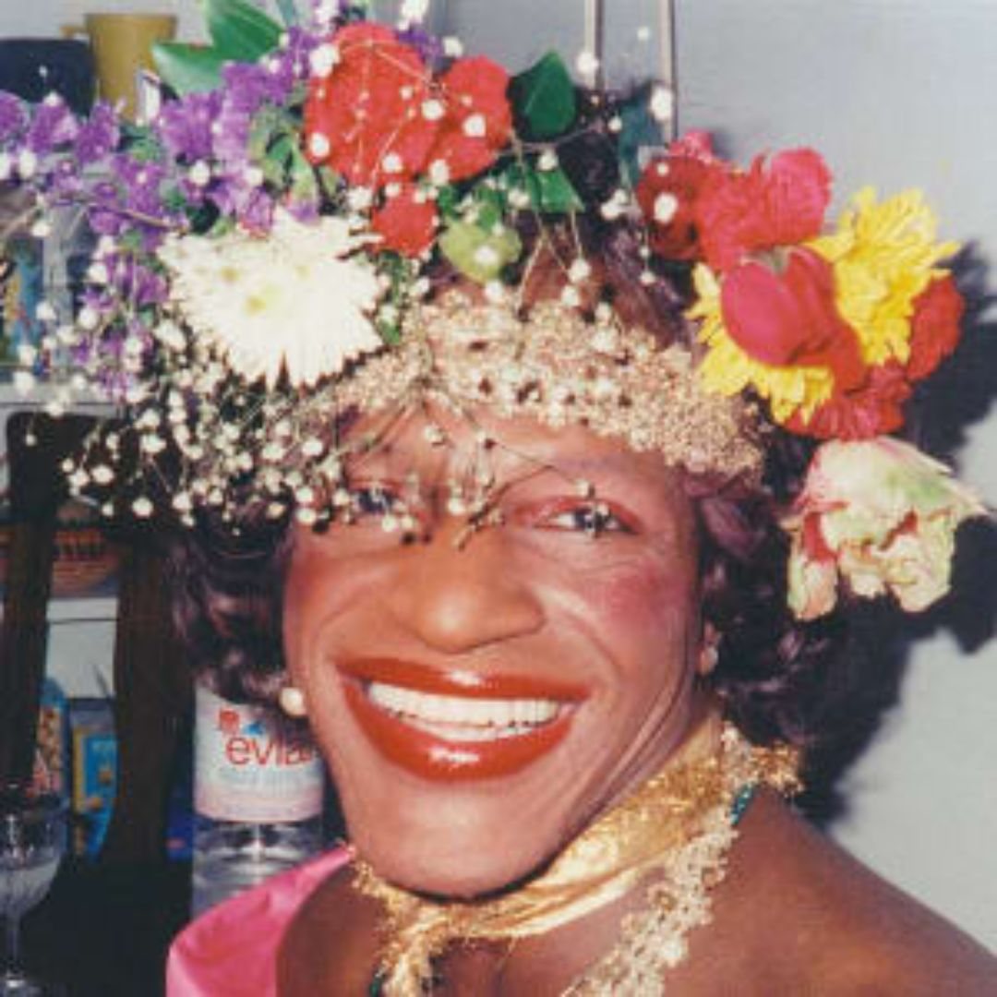
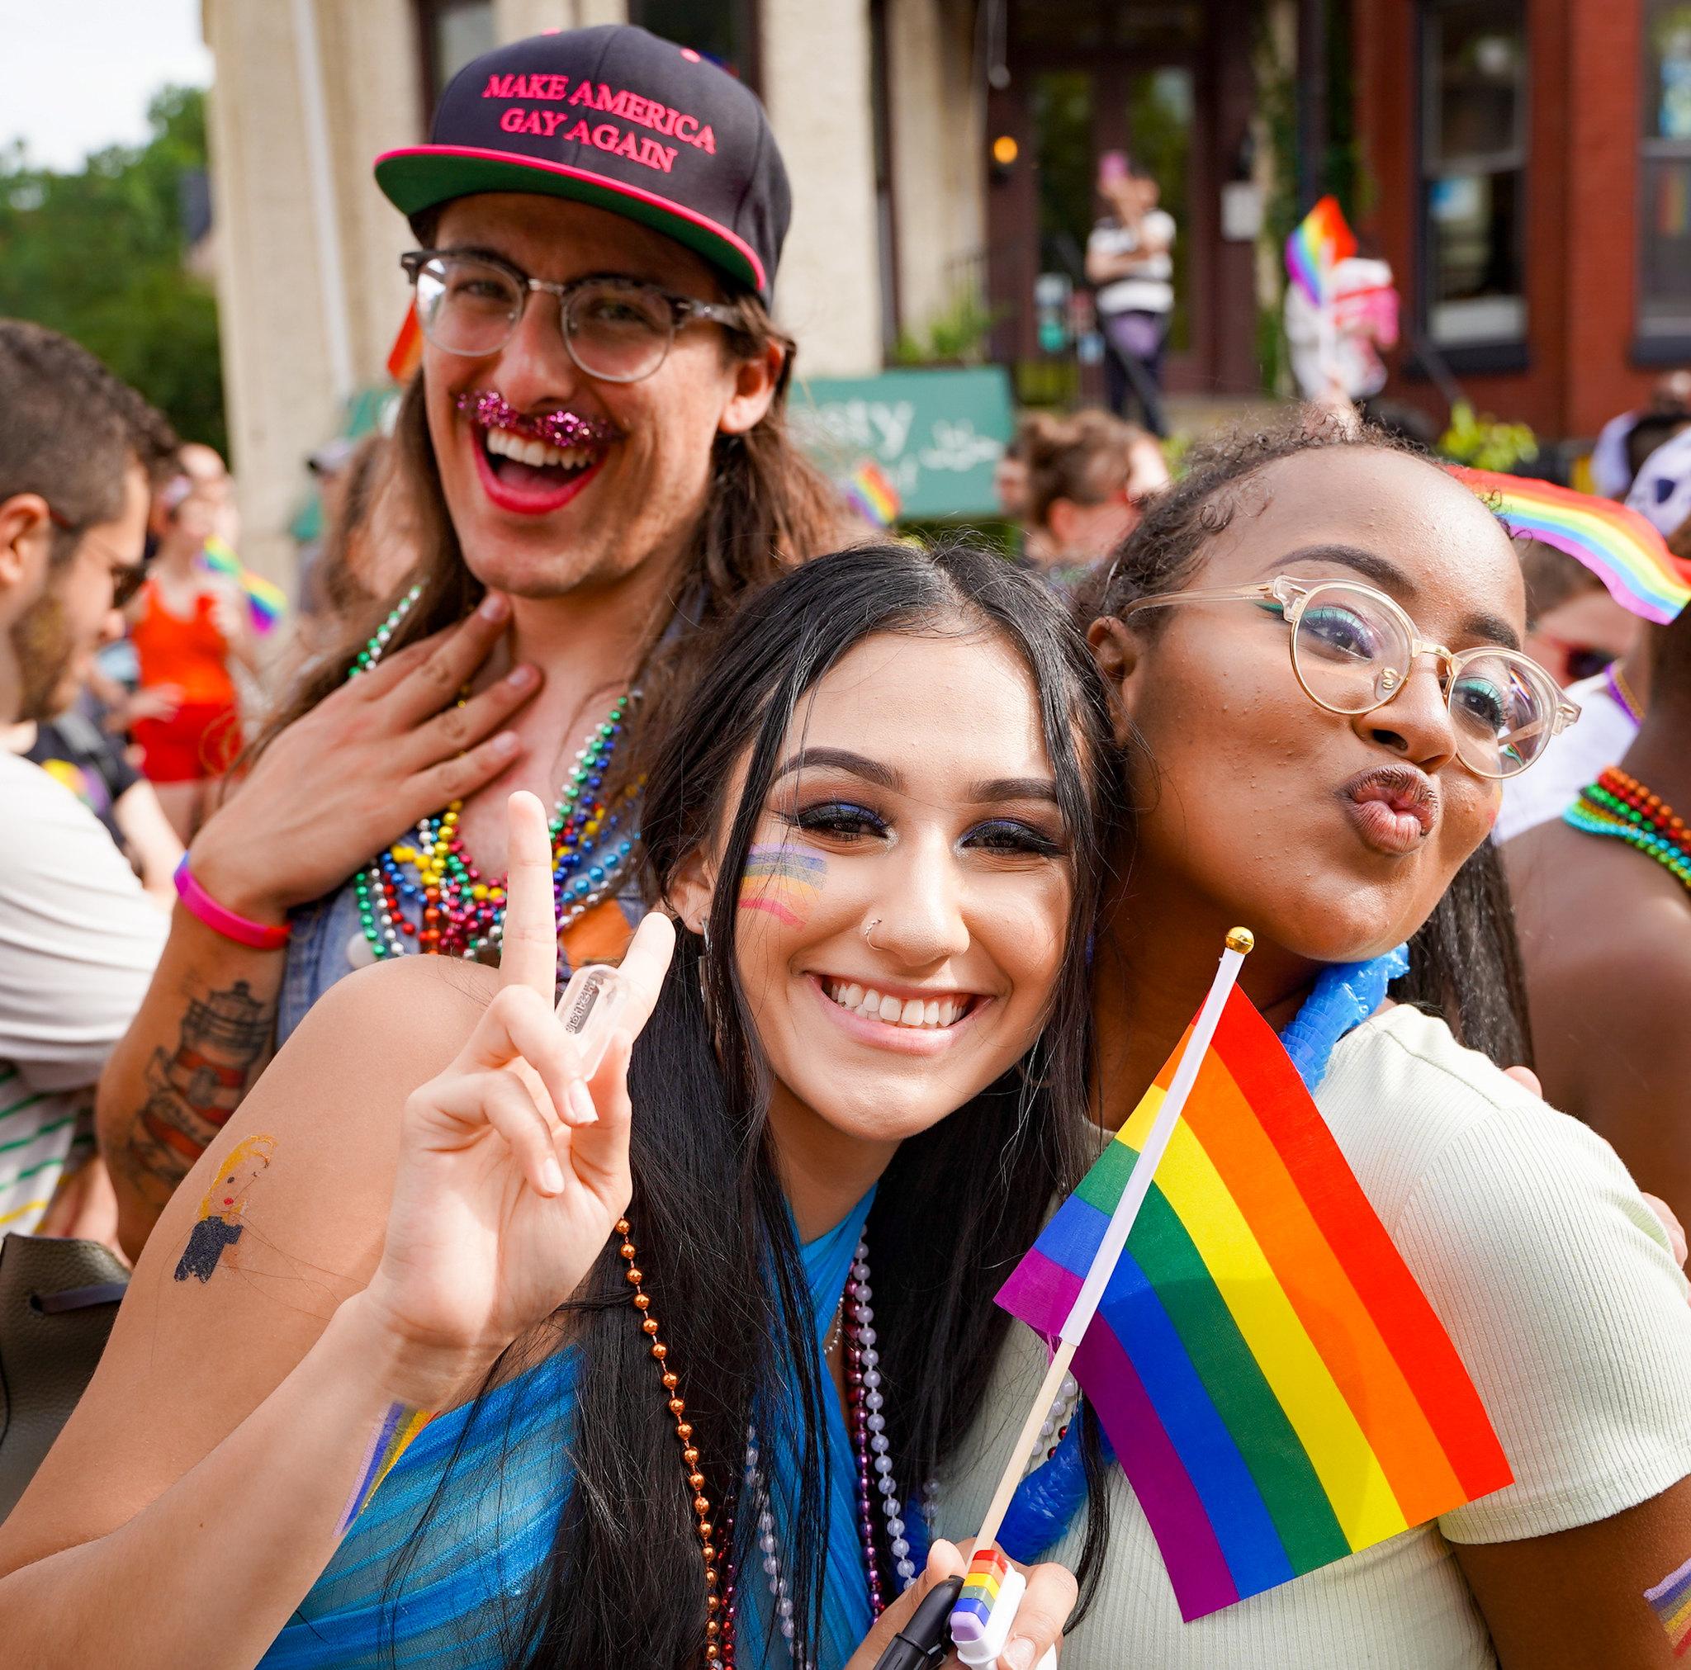
Introduction
LGBTQIA+ Pride Month
What is LGBTQIA+ Pride Month?
Why does the United States celebrate it?
How can you celebrate LGBTQIA+ Pride Month in DC?
Notes:
What is LGBTQIA+ Pride Month?
Lesbian, Gay, Bisexual, Transgender and Queer (LGBTQ) Pride Month is currently celebrated each year in the month of June to honor the 1969 Stonewall Uprising in Manhattan. The Stonewall Uprising was a tipping point for the Gay Liberation Movement in the United States. In the United States the last Sunday in June was initially celebrated as "Gay Pride Day," but the actual day was flexible. In major cities across the nation the "day" soon grew to encompass a month-long series of events. Today, celebrations include pride parades, picnics, parties, workshops, symposia and concerts, and LGBTQ Pride Month events attract millions of participants around the world. (Library of Congress)
Why does the United States celebrate it?
Lesbian, Gay, Bisexual and Transgender Pride Month (LGBT Pride Month) is celebrated annually in June to honor the 1969 Stonewall riots, a series of riots for gay liberation that took place over several days beginning on June 28, 1969. The riots began after a police raid at the Stonewall Inn, a gay bar located within Lower Manhattan in New York City. Celebrating Pride Month works to achieve equal justice and equal opportunity for lesbian, gay, bisexual, transgender, and questioning (LGBTQ) Americans.
Thomas:
What does LGBTQIA+ Pride Month mean to you?
Why is it important to you?
Why should we support people with IDD in celebrating LGBTQIA+ Pride Month?

Slide 3
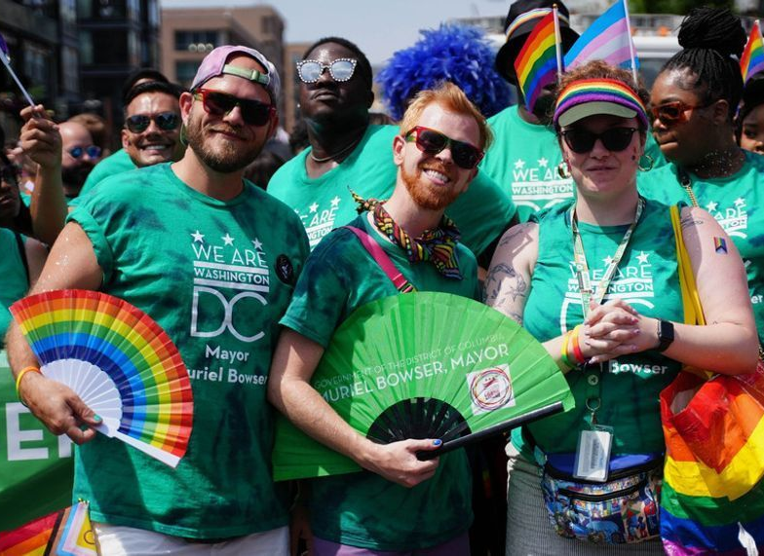
Sexual Orientation and Gender Identity
Sexual Orientation – Who you are attracted to and want to have relationships with. Who you feel drawn to romantically, emotionally and sexually.
Gender Identity – A person’s innermost concept of self as male, female, a blend of both or neither – how individuals perceive themselves and what they call themselves. One's gender identity can be the same or different from their sex assigned at birth. “Who do you think you are?”
Gender Expression - External appearance of one's gender identity, usually expressed through behavior, clothing, body characteristics or voice, and which may or may not conform to socially defined behaviors and characteristics typically associated with being either masculine or feminine.
Human Rights Campaign - https://www.hrc.org/resources/sexual-orientation-and-gender-identity-terminology-and-definitions

Slide 5
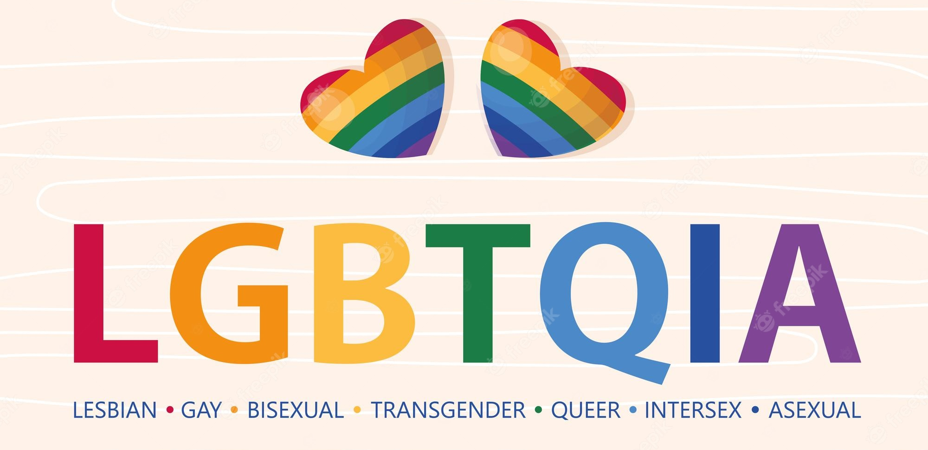
The Range of Sexuality and Gender
Notes:
Lesbian: Usually, a woman whose primary sexual and affectional orientation is toward people of the same gender.
Gay: A sexual and affectional orientation toward people of the same gender.
Bisexual: A person whose primary sexual and affectional orientation is toward people of the same and other genders, or towards people regardless of their gender.
Transgender: An adjective used most often as an umbrella term and frequently abbreviated to “trans.” Identifying as transgender, or trans, means that one’s internal knowledge of gender is different from conventional or cultural expectations based on the sex that person was assigned at birth. While transgender may refer to a woman who was assigned male at birth or a man who was assigned female at birth, transgender is an umbrella term that can also describe someone who identifies as a gender other than woman or man, such as non binary, genderqueer, genderfluid, no gender or multiple genders, or some other gender identity.
Queer: One definition of queer is abnormal or strange. Historically, queer has been used as an epithet/slur against people whose gender, gender expression and/or sexuality do not conform to dominant expectations. Some people have reclaimed the word queer and self identify in opposition to assimilation (adapted from “Queering the Field”). For some, this reclamation is a celebration of not fitting into social norms. Not all people who identify as LGBTQIA use “queer” to describe themselves. The term is often considered hateful when used by those who do not identify as LGBTQIA.
Questioning: The process of exploring one’s own gender identity, gender expression, and/or sexual orientation. Some people may also use this term to name their identity within the LGBTQIA community.
Intersex: An umbrella term to describe a wide range of natural body variations that do not fit neatly into conventional definitions of male or female. Intersex variations may include, but are not limited to, variations in chromosome compositions, hormone concentrations, and external and internal characteristics. Many visibly intersex people are mutilated in infancy and early childhood by doctors to make the individual’s sex characteristics conform to society’s idea of what normal bodies should look like. Intersex people are relatively common, although society's denial of their existence has allowed very little room for intersex issues to be discussed publicly. Hermaphrodite is an outdated and inaccurate term that has been used to describe intersex people in the past.
Asexual: A broad spectrum of sexual orientations generally characterized by feeling varying degrees of sexual attraction or a desires for partnered sexuality. Asexuality is distinct from celibacy, which is the deliberate abstention from sexual activity, despite sexual desire. Some asexual people do have sex and do experience varying levels of sexual attraction. There are many diverse ways of being asexual. A person who does not experience sexual attraction can experience other forms of attraction such as romantic attraction, as physical attraction and emotional attraction are separate aspects of a person’s identity. These may or may not correlate with each other - for instance, some people are physically and romantically attracted to women. However, others might be physically attracted to all genders and only emotionally attracted to men.
Allyship: The action of working to end oppression through support of, and as an advocate with and for, a group other than one’s own.
+ - All other non cisgender and non straight identities

Slide 6
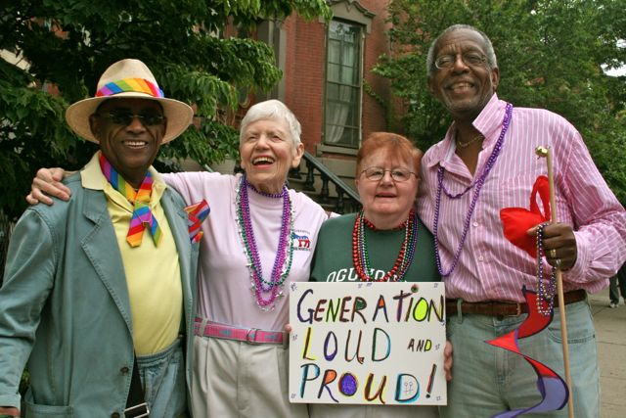
Guess What?
Some people with IDD identify as LGBTQIA+
Guess What?
You might be supporting someone who identifies as LGBTQIA+
Guess What?
We must recognize and respect the choices of people with IDD and support them to live their best lives!

Slide 7
How can DDS support people with IDD who identify as LGBTQIA+? How can you support people with IDD who identify as LGBTQIA+?
Notes:
Thomas: How can we support people with IDD who identify as LGBTQIA+?

Slide 8
A Quick Plug for Pronouns and Inclusive Language
Pronouns: words we use to refer to ourselves or others (they/them/theirs, she/her/hers, he/him/his)
It is important to respect a person’s pronouns
Do not assume someone’s pronouns by looking at them
What if you do not know a person’s pronouns or use incorrect pronouns? – Just Ask!
How do you ask?
“What pronouns do you use?” or “What pronouns would you like me to use?”
How do you make language more inclusive?
“Hey everyone!”, “How are y’all doing?”, “They are…” instead of, “Hey guys!”, “How’s it going ladies?”

Slide 9
Interesting Facts About LGBTQIA+ Pride
The LGBT rights movement in the US was kickstarted in 1969 with the Stonewall riots.
The rainbow flag was designed in 1978 by Gilbert Baker.
President Obama announced the designation of the first national monument to LGBTQIA+ rights in 2016.
Capital Pride was originally called, “Gay Pride Day” – a one day block party.
“DC Black Pride” is the first official black gay pride event in the US.
Notes:
Rainbow flag colors: pink to represent sexuality, red for healing, yellow for sun, green for serenity with nature, turquoise for art, indigo for harmony and violet for spirit

Slide 10
Celebrate Pride Month!
Local Activities
Arlington Pride Festival, June 24th
Rockville Pride, June 24th
Gay Men’s Chorus of Washington: Potomac Fever, June 25th
Pride in the Plaza (Veteran’s Plaza, Silver Spring, MD), June 25th
Elevate Drag Brunch: PRIDE EDITION (Officina at the Wharf), June 25th
Trivia Night: Celebrating Pride (National Portrait Gallery), June 27th
Wine Down Pride Month, June 28th

Slide 11
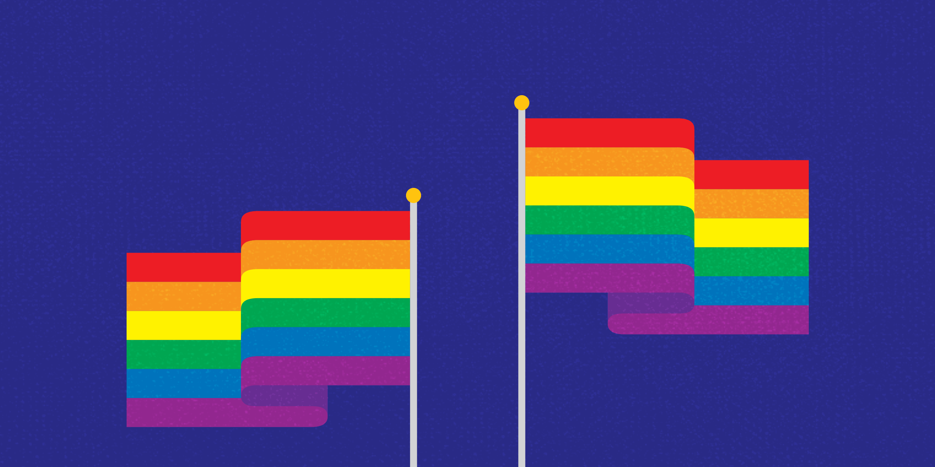
Any Questions?

