Slide 1
A Blueprint for Service Delivery
Your Introduction to Person Centered Supports
Notes:
What is a blueprint? It is a written framework or foundation for how services and supports will be delivered to a person.

Slide 2
Learning Objective
Participants will understand the importance of the Person Centered Individual Support Plan (ISP) as the blueprint for services delivery. They will identify the planning pieces of the ISP process, the people involved in the planning, and the role of the Direct Support Professional in the execution of the plan.

Slide 3
A Credo for Support
Notes:
You need quicktime to view this video. If it does not play in the presentation, you can view it online here - https://www.youtube.com/watch?v=wunHDfZFxXw

Slide 4
Person Centered Supports
The person is the center of the plan
The plan is formally updated annually
There are three major planning components
Person Centered Planning Meeting
Clinical Assessments (e.g., OT, PT, etc.)
Health Assessments (e.g., annual physical)
Information is integrated into the Individual Support Plan (ISP) to include goals
The team supports achieving outcomes
The plan is updated and revised, as needed
Notes:
This is what you are going to learn about today.

Slide 5
Planning begins with the Person
And the person’s team of choice which may include:
Family members
Close friends
Provider staff who know the person best
Service Coordinator
Qualified Intellectual Disability Professional (QIDP)
Clinical and/or Medical Personnel
Notes:
Emphasize that a person chooses the members of their support team and chooses who they want to attend their meetings.
- Every situation is different – have a discussion with the group about various scenarios: What do we do when a person doesn’t want their Service Coordinator at a case conference? What do we do when a person doesn’t want their parent at a meeting when they are talking about their sexual health?

Slide 6
Individual Support Plan (or blueprint for services)
Each person has an Individual Support Plan (ISP)
It is developed by the team through Person Centered Planning
The focus is on the person’s strengths, interests and preferences
The plan includes support for health and safety needs
It identifies person centered goals or outcomes
It identifies community supports and services to be delivered
Notes:
Some of the tools you may utilize to help you through this process include person centered thinking discovery toolkit.
Visit DDS Website under IDS section for the complete toolkit.
Speaker may want to share some of the components of the PCT toolkit with the group for hands on practice.

Slide 7
Relationship Map
Family
Paid support at work/school
Paid support at home and community
Friends
Person Centered Planning occurs prior to the ISP Meeting
Notes:
A person’s chosen circle of support is crucial to the person centered planning process. The person centered planning meeting (pre-ISP meeting) is a brainstorming sessions, led by the person to determine the person’s “blueprint” for the next year.
Many of the outcomes of this meeting is what is used to build the actual
Individualized Support Plan.

Slide 8
Person Centered Planning includes:
What is important to the person
What is important for the person
Interests & Hobbies
Hopes & Dreams
Aspirations (education or employment)
Choice & decision making
Relationships
Community Connections
Maintaining good health
Supporting health concerns
Ensuring Safety
Support for behaviors that significantly interfere with daily living
Being a valued member of the community.
Notes:
Speaker may want to emphasize the theme of “Important To” and “Important For” will be a common thread throughout all of the modules. It is the foundational principle.
Please note that Important To and Important For is a broad concept and might sometimes overlap and ultimately the person being supported determines the value of each.

Slide 9
The ISP includes:
Finding a balance between important to and for
Important To
Relationships
Things to do
Places to go
Rituals and routines
Pace of life
Status and control
Things to have
Important For
Prevention and treatment of illness
Promotion of wellness
Safe environments
Being free from fear
Being a valued and contributing member of the community
Notes:
The information that you get from getting to know and listening to the person, using discovery tools, and assessments all make up the components of the ISP.

Slide 10
Health Documentation in ISP
Everyone receiving residential supports has a Health Care Management Plan (HCMP). People who live with their families may not have a formal HCMP.
The HCMP is completed by a Registered Nurse (RN) & identifies any health needs to be monitored or supported & staff responsible.
Most people also have a Health Passport that is attached to the ISP. This document travels with the person.
Everyone is responsible for helping the person maintain good health.

Slide 11
Clinical or Medical Needs
A person MAY require a formal assessment prior to the ISP. These could include:
Speech and Language
Occupational Therapy
Behavior Support
Physical Therapy
Nutritional Support
People who receive residential services are required to have an annual physical, dental and nursing assessment.
Notes:
Emphasize that not all people have needs related to these areas. Assessments should be done only when the person or people who know them well believe there is a need for one.

Slide 12
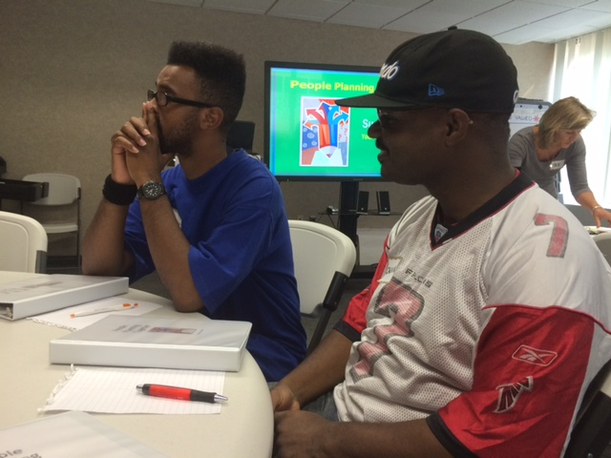
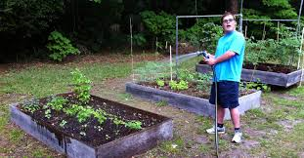
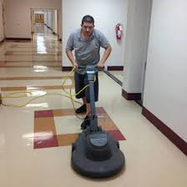
Meaningful Day Activities
Each ISP addresses what each person defines as meaningful day activities. This may include:
Employment,
Exploring and identifying interests
Other activities in the community.

Slide 13
Everyone has goals in their ISP
The information gathered for the ISP is translated into goals and objectives that the person and the team identify.
Most of the goals and objectives are implemented and supported by people who work most closely with someone.
Notes:
Have a conversation with the group:
How do you set your own goals?

Slide 14
Goals and Objectives
Goals may fall into six core values categories:
Choice and Decision Making
Rights and Dignity
Community Inclusion
Safety and Security
Health and Wellness
Relationships

Slide 15
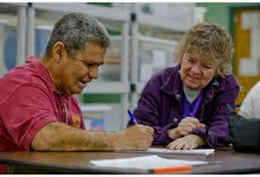
One of your many roles as a DSP is to document progress on these goals. This documentation helps teams evaluate and measure services and outcomes.
Notes:
DSPs have many responsibilities and this is not the ONLY role, but a very important one to support each person’s learning. Other roles will be discussed and emphasized throughout future trainings.

Slide 16
The ISP is an ever changing document
It should be modified as the needs of the person changes. For example:
A goal is achieved and a new one added
The person’s health condition changes
At a minimum a quarterly review is conducted to document progress towards the person’s outcomes and any changes in the person’s life.
Notes:
Have a conversation with the group:
Why do you think the ISP and documentation is important? How do you think this supports people to have good lives?

Slide 17
Individual Support Plan
Everyone plays a critical role in the development and implementation of the ISP that provides a Blueprint for service delivery.
You support the person to achieve their hopes, dreams, and aspirations.
You support the person to maintain optimal health.
You are the link to the community for the person you support.
You play an important role!

Slide 18
A Blueprint for Service Delivery
Like?
Learn?
Change?
Notes:
Ask participants to think of one thing they liked, one thing they learned and one thing they would change about this training. You can facilitate this in any way you want:
Have a discussion about it
Have people write it down on paper and give it to you
Give out three post-its to everyone and have them write “like” on one of them, “learn” on one of them and “change on one of them, then stick them to flip chart paper
- You decide!

