Slide 1


District of Columbia
Supporting Families Community of Practice
April 8, 2016

Slide 2








Project Goal
To build capacity through a community of practice across and within States to create policies, practices and systems to better assist and support families than include a member with intellectual and developmental disability across the lifespan.
CT
DC
MO
OK
TN
WA

Slide 3


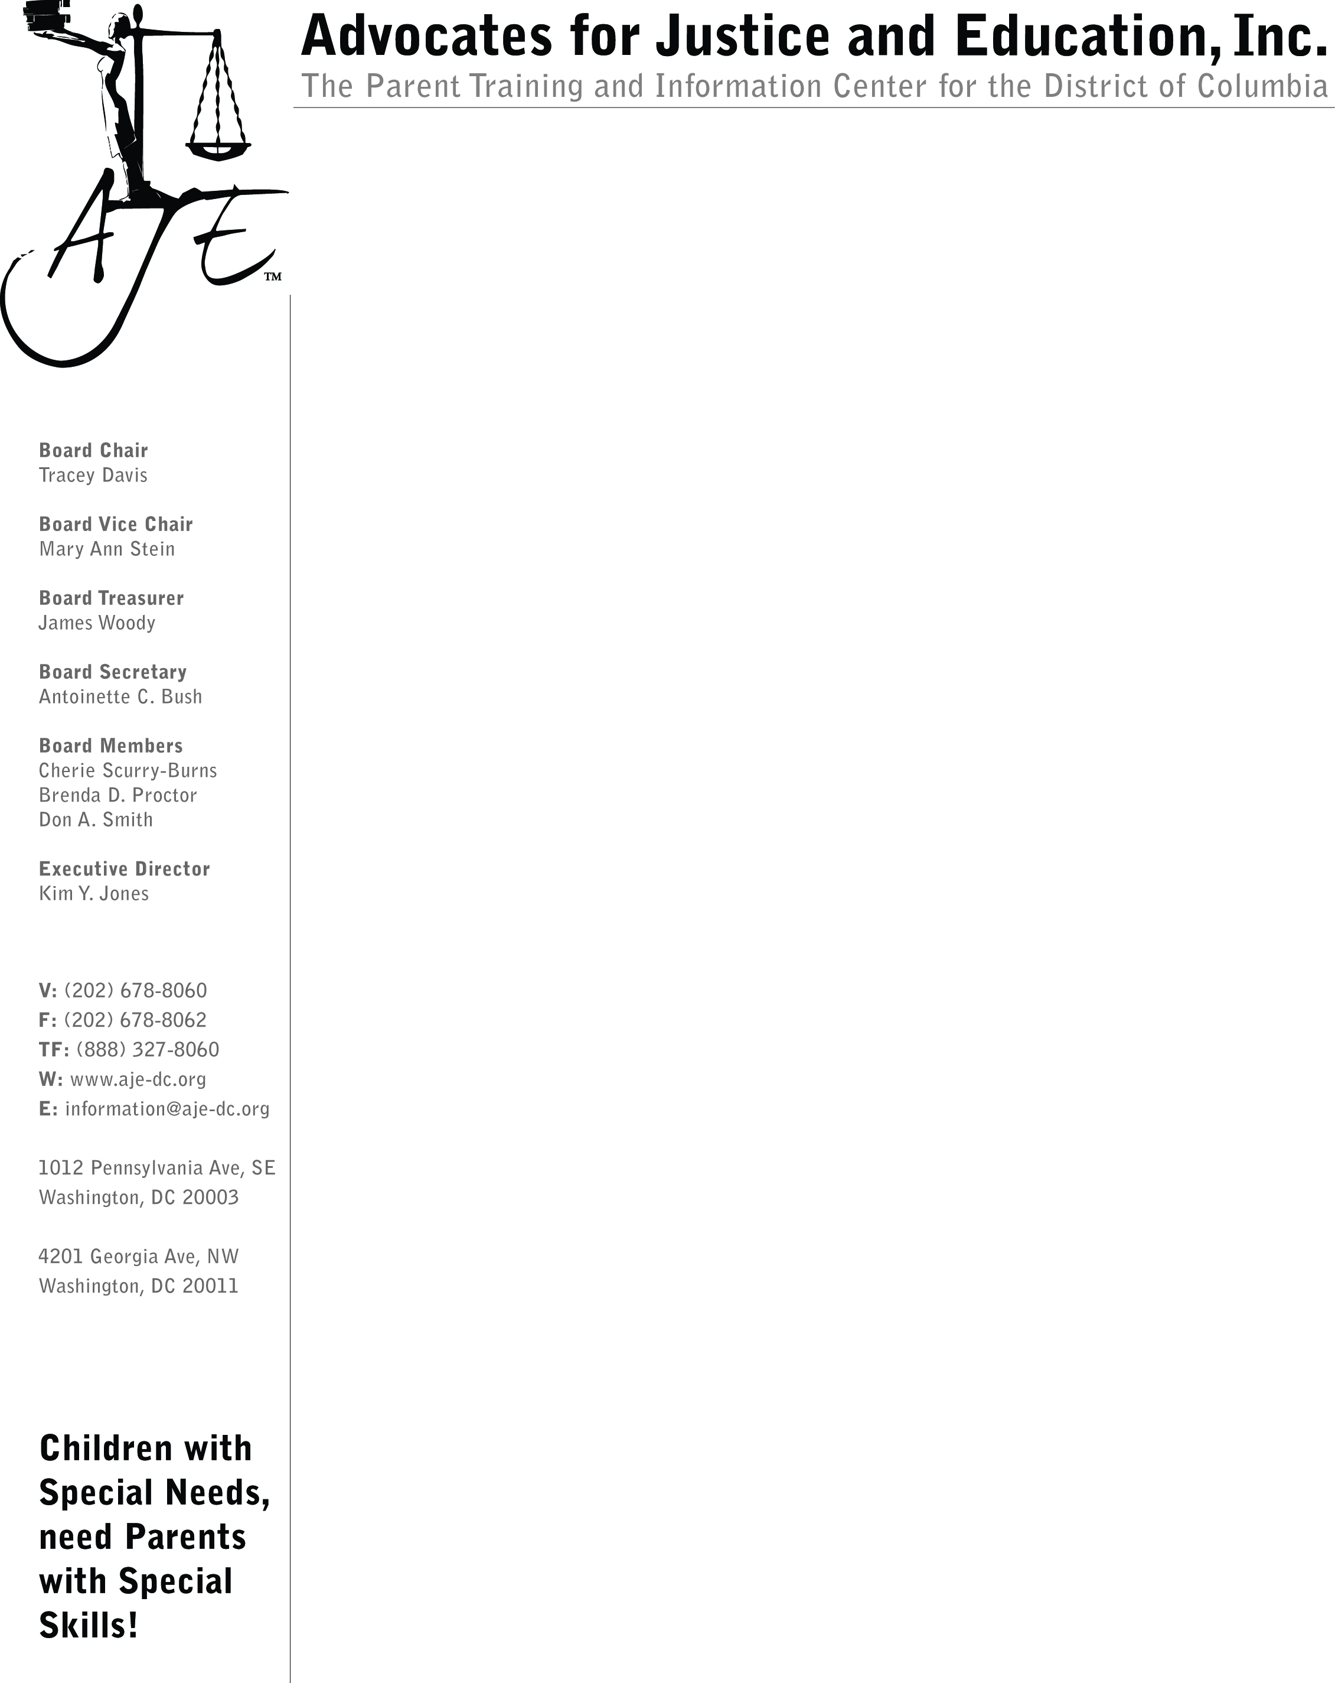




Our Core Team Members

Slide 4
DC Supporting Families
Community of Practice Grant
Year 1
Kick Off
Year 2
Priority Setting
Year 3
Building Blocks to Systems Change
Year 4
Making Systems Change
Year 5
Focus on Sustainability
Notes:
Year 1: Kick Off
Year 2: Using Person-Centered Thinking and LifeCourse Framework to establish priorities for systems change + early legislative changes
Year 3: Steps to sustainable systems change: Advocacy Guide; Family Support Council; No Wrong Door Planning Grant
Year 4: NOW – Strong focus on systems change in DC LTSS
Year 5: Work towards sustainability

Slide 5
DC Supporting Families
Community of Practice – Not Just a Grant!
Families & People with IDD
Private Partners
Gov’t
Dedicated group coming together to design a system that supports people with intellectual and developmental disabilities and their families across the lifespan
Notes:
DC CoP is not just a grant – it’s about families, private partners and government all coming together to design a system that supports the families of people with intellectual and developmental disabilities of all ages.
Sustainability – Rhonda and Joan will talk about their perspectives on how people with disabilities and families can help make sure this work continues. From the perspective of the government – it absolutely must! And to help ensure that we continue this work, we wrote a grant application to the federal government to reform our system of supports, using the learning from the CoP. We are 1 of 5 states to get a NWD grant – introduce staff. We will continue to talk and learn from each other as we design our coordinated system

Slide 6
Top 5 DC Supporting Families Priorities
Peer Support
Coordinated Lifespan Supports
Self-Determination
Person and Family Centered Supports
Comprehensive Supports for People with DD
Notes:
Family-to-family peer support
Coordinated services across the lifespan
Supports for self-determination, to keep decision-making in the hands of people with disabilities and their families
High quality, person and family centered supports for people with I/DD
Comprehensive supports for people with DD

Slide 7
Person & Family Centered Supports
PCT
DDA
ADRC
DHCF
DHS
DBH
City-wide commitment to person-centered counseling, planning, and thinking across government and provider agencies.
Over the next 6 months we will:
Train more than 200 staff, providers, families, and people with disabilities in person-centered practices; and
Double the number of government agencies with PCT trainers on staff.
Federal government says DC is a “Promising Practice” and will feature our work in an upcoming national report.
Notes:
One of the strongest messages from this CoP has been the need for person and family centered supports throughout government and provider agencies.
PCT is the foundation of systems change that is responsive to the needs of people with disabilities and their families – because it helps us think differently about supports and focus on what is important to and important for each individual person and their family.
Shared approach and commitment to PCT also demonstrates the government’s commitment to work together to build coordinated supports

Slide 8

DDS Budget Hearing
Budget Forum: Learn what’s in the budget for FY 2017
Wednesday, April 13 at 1 PM at DDS
Budget Hearing: Monday April 18 at 10 AM
Room 500, Wilson Building
Sign up to testify: Malcolm Cameron, 202-741-0909 mcameron@dccouncil.us
Let your voice be heard!

