Slide 1
“Informational Refresher on COVID Guidance when in the Community and for I/DD Providers””
Michael Sigelman, MSN, RN
January 27th, 2023
Edited and presented again on February 24th, 2023
Notes:
Introduction
Welcome

Slide 2
Guidance and Expectations
COVID Guidance
Visitors
Date, Time, Initials
Temperature
Questions regarding exposure, recent history of illness, current state of health
People Receiving Services
Restrictions (if any) based upon their health
Agreed upon or discussed activities
Notes:
How many
Prescribed and OTC or only prescribed
138 different definitions of polypharmacy (per one systematic review)

Slide 3
Guidance and Expectations
COVID Guidance
Increase in positive COVID-19 cases
Holidays? Relaxation of masking?
Requirement for employees to properly wear facemasks
Decrease the risk of potential serious illness/hospitalization
Notes:
How many
Prescribed and OTC or only prescribed
138 different definitions of polypharmacy (per one systematic review)

Slide 4
Guidance and Expectations
COVID Guidance
When a person supported is EXPOSED https://www.cdc.gov/coronavirus/2019-ncov/your-health/if-you-were-exposed.html
When a person supported tests POSITIVE https://www.cdc.gov/coronavirus/2019-ncov/your-health/isolation.html
Guidance for Staff https://coronavirus.dc.gov/sites/default/files/dc/sites/coronavirus/page_content/attachments/COVID-19_DC_Health_HCP_RTW_11.4.22.pdf
Notes:
How many
Prescribed and OTC or only prescribed
138 different definitions of polypharmacy (per one systematic review)

Slide 5
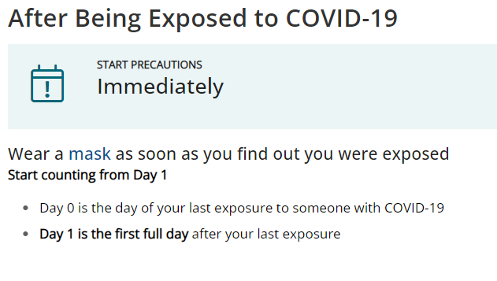
Guidance and Expectations
COVID Guidance – When a person supported is EXPOSED
Notes:
How many
Prescribed and OTC or only prescribed
138 different definitions of polypharmacy (per one systematic review)

Slide 6
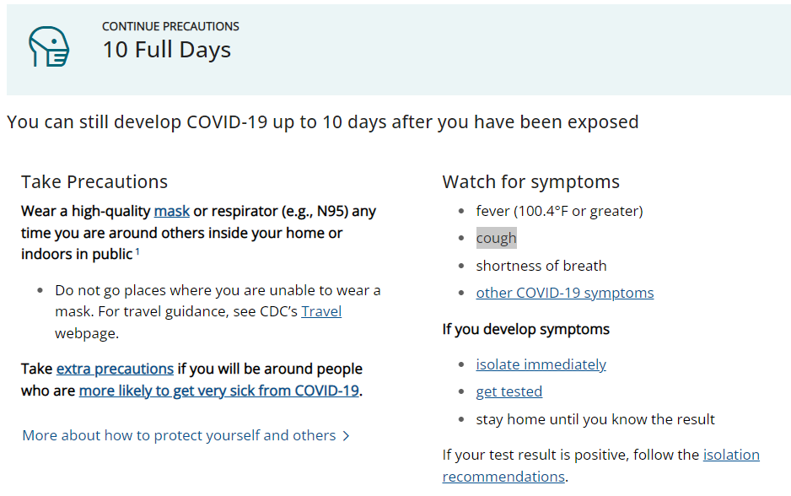
Guidance and Expectations
COVID Guidance – When a person supported is EXPOSED
Notes:
How many
Prescribed and OTC or only prescribed
138 different definitions of polypharmacy (per one systematic review)

Slide 7
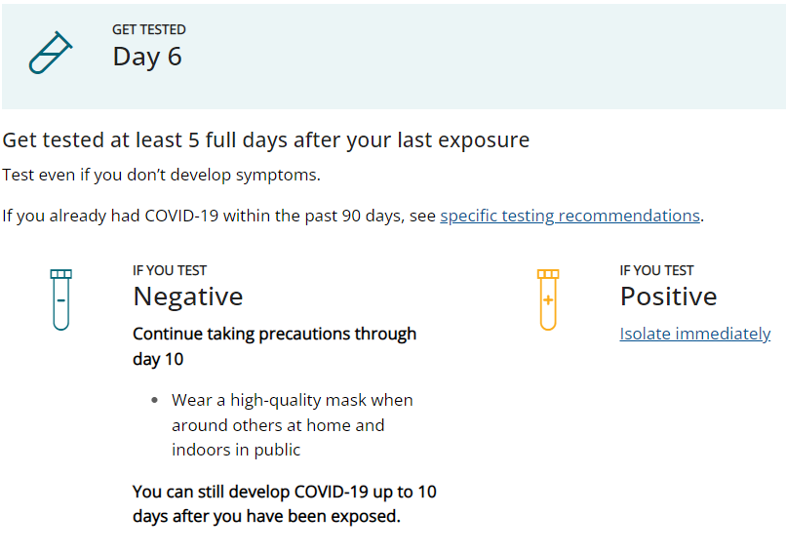
Guidance and Expectations
COVID Guidance – When a person supported is EXPOSED
Notes:
How many
Prescribed and OTC or only prescribed
138 different definitions of polypharmacy (per one systematic review)

Slide 8
Guidance and Expectations
COVID Guidance – When a person supported is EXPOSED
Notes:
How many
Prescribed and OTC or only prescribed
138 different definitions of polypharmacy (per one systematic review)

Slide 9
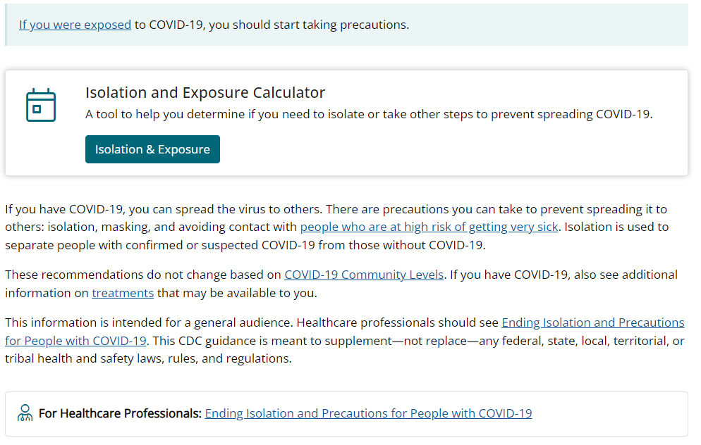
Guidance and Expectations
COVID Guidance – When a person supported tests POSITIVE
Notes:
How many
Prescribed and OTC or only prescribed
138 different definitions of polypharmacy (per one systematic review)

Slide 10
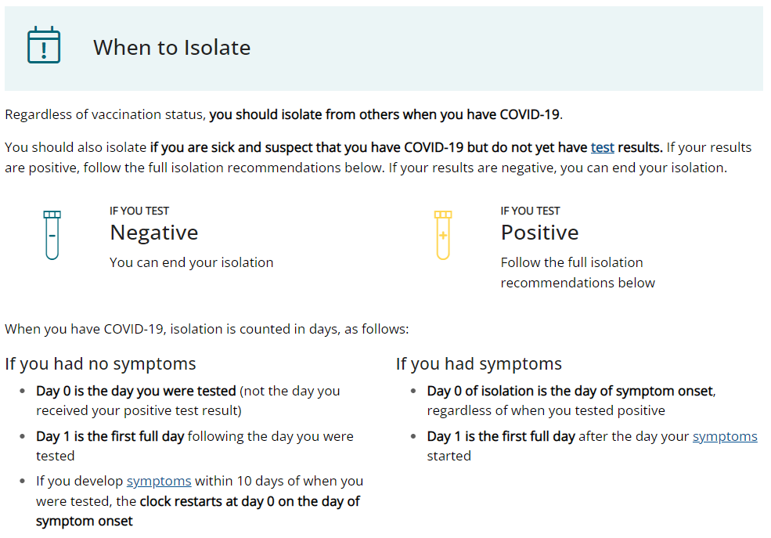
Guidance and Expectations
COVID Guidance – When a person supported tests POSITIVE
Notes:
How many
Prescribed and OTC or only prescribed
138 different definitions of polypharmacy (per one systematic review)

Slide 11
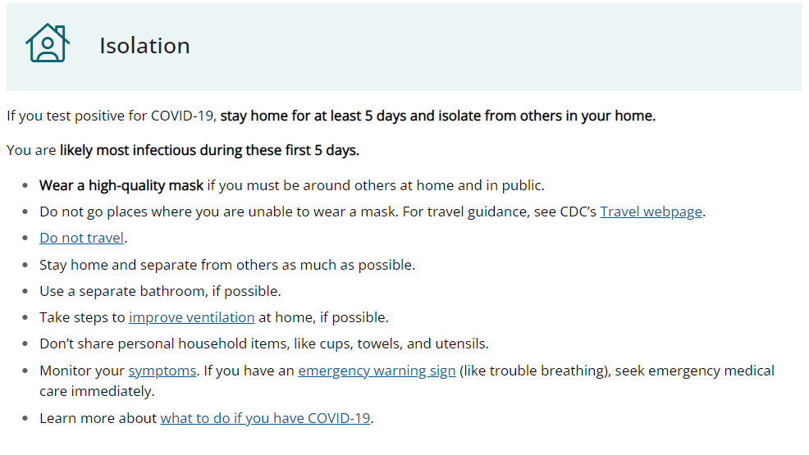
Guidance and Expectations
COVID Guidance – When a person supported tests POSITIVE
Notes:
How many
Prescribed and OTC or only prescribed
138 different definitions of polypharmacy (per one systematic review)

Slide 12
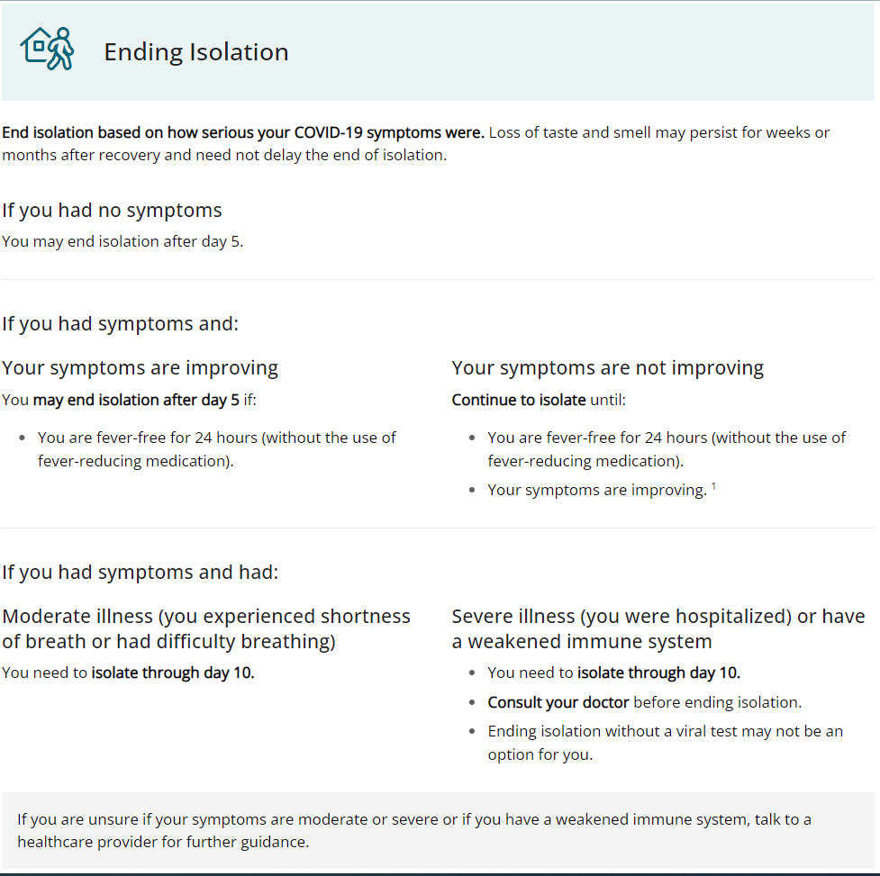
Guidance and Expectations
COVID Guidance – When a person supported tests POSITIVE
Notes:
How many
Prescribed and OTC or only prescribed
138 different definitions of polypharmacy (per one systematic review)

Slide 13
Guidance and Expectations
COVID Guidance – When a person supported tests POSITIVE
Notes:
How many
Prescribed and OTC or only prescribed
138 different definitions of polypharmacy (per one systematic review)

Slide 14
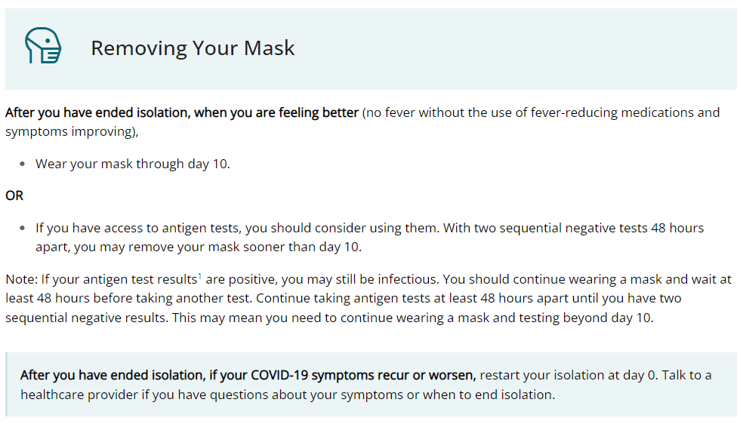
Guidance and Expectations
COVID Guidance – When a person supported tests POSITIVE
Notes:
How many
Prescribed and OTC or only prescribed
138 different definitions of polypharmacy (per one systematic review)

Slide 15
Guidance and Expectations
COVID Guidance – When a person supported tests POSITIVE
On this same webpage, you will find this link
This information is for healthcare professionals providing supports for people in healthcare settings.
The next slide will explain some of the information provided. Please visit the link (in the middle of the webpage) to learn more detailed information.
Notes:
How many
Prescribed and OTC or only prescribed
138 different definitions of polypharmacy (per one systematic review)

Slide 16
Guidance and Expectations
COVID Guidance – When a person supported tests POSITIVE
If you are mildly ill with COVID and are not moderately or severely immunocompromised:
Isolate through Day 5 and wear a mask through Day 10
Loss of taste or smell may continue after other symptoms improve; this should not delay the end of isolation
Wear a high-quality mask
If your symptoms come back or get worse, restart the isolation period at day 0
If you cannot wear a mask, isolate for 10 days
In certain high-risk congregate settings that have high risk of secondary transmission, CDC recommends a 10-day isolation period for residents
Please visit this webpage for more detailed information:
https://www.cdc.gov/coronavirus/2019-ncov/hcp/duration-isolation.html
Notes:
How many
Prescribed and OTC or only prescribed
138 different definitions of polypharmacy (per one systematic review)

Slide 17
Guidance and Expectations
COVID Guidance – When a person supported tests POSITIVE
If you test positive, remain asymptomatic, and are not moderately or severely immunocompromised:
Can discontinue isolation at least 5 days after the first positive viral test (day 0 is the date the test was performed, and day 1 is the next full day after)
Wear a high-quality mask through day 10
If symptoms develop, the 5-day isolation period starts over (day 0 is the first day of symptoms)
If you cannot wear a mask, isolate for 10 days
In certain high-risk congregate settings that have high risk of secondary transmission, CDC recommends a 10-day isolation period for residents
Please visit this webpage for more detailed information:
https://www.cdc.gov/coronavirus/2019-ncov/hcp/duration-isolation.html
Notes:
How many
Prescribed and OTC or only prescribed
138 different definitions of polypharmacy (per one systematic review)

Slide 18
Guidance and Expectations
COVID Guidance – When a person supported tests POSITIVE
If you are moderately ill and not moderately or severely immunocompromised:
Isolation and precautions can be discontinued 10 days after symptom onset (day 0 is the day symptoms appeared, and day 1 is the next full day thereafter)
Please visit this webpage for more detailed information:
https://www.cdc.gov/coronavirus/2019-ncov/hcp/duration-isolation.html
Notes:
How many
Prescribed and OTC or only prescribed
138 different definitions of polypharmacy (per one systematic review)

Slide 19
Guidance and Expectations
COVID Guidance – When a person supported tests POSITIVE
If you are severely ill and not moderately or severely immunocompromised:
Isolation should continue for at least 10 days after your symptoms begin
Some people may remain infectious more than 10 days, and precautions may continue for up to 20 days
Speak with your doctor for further guidance
Please visit this webpage for more detailed information:
https://www.cdc.gov/coronavirus/2019-ncov/hcp/duration-isolation.html
Notes:
How many
Prescribed and OTC or only prescribed
138 different definitions of polypharmacy (per one systematic review)

Slide 20
Guidance and Expectations
COVID Guidance – When a person supported tests POSITIVE
If you are moderately or severely immunocompromised, regardless of symptoms and severity:
You may remain infectious beyond 20 days
CDC states to end isolation by testing and consulting with an infectious disease specialist
Please visit this webpage for more detailed information:
https://www.cdc.gov/coronavirus/2019-ncov/hcp/duration-isolation.html
Notes:
How many
Prescribed and OTC or only prescribed
138 different definitions of polypharmacy (per one systematic review)

Slide 21
Guidance and Expectations
Definitions of severity of symptoms/illness
Clinical Spectrum | COVID-19 Treatment Guidelines (nih.gov)
https://www.covid19treatmentguidelines.nih.gov/overview/clinical-spectrum/
The next slide provides definitions for asymptomatic, mild, moderate, severe, and critical symptoms/illness. Please visit the site above to learn more from NIH’s COVID-19 Treatment Guidelines
Notes:
How many
Prescribed and OTC or only prescribed
138 different definitions of polypharmacy (per one systematic review)

Slide 22
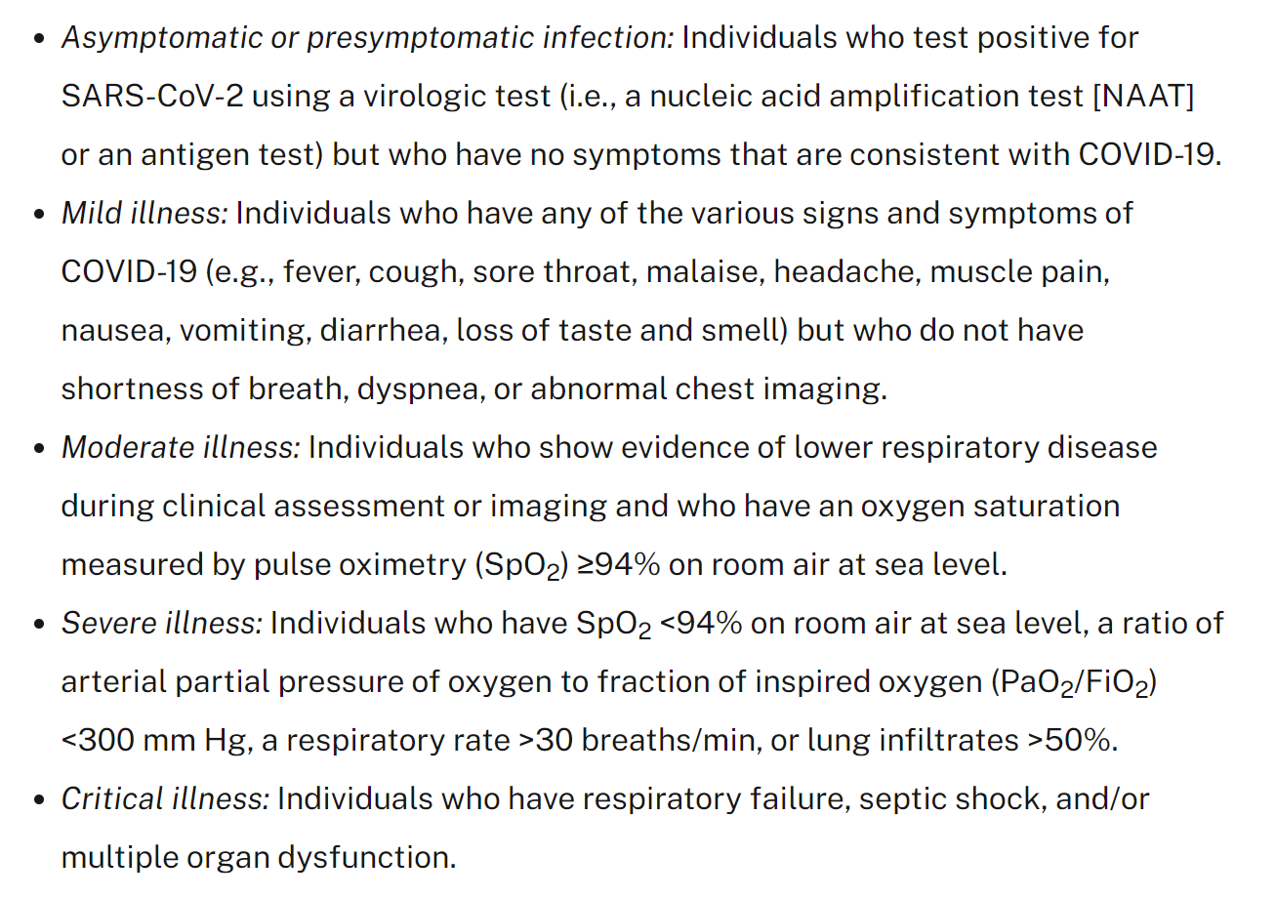
Guidance and Expectations
Definitions of severity of symptoms/illness
Notes:
How many
Prescribed and OTC or only prescribed
138 different definitions of polypharmacy (per one systematic review)

Slide 23
Guidance and Expectations
Guidance for Staff – Coronavirus 2019 (COVID-19): Guidance for Healthcare Personnel Monitoring, Restriction, and Return to Work https://coronavirus.dc.gov/sites/default/files/dc/sites/coronavirus/page_content/attachments/COVID-19_DC_Health_HCP_RTW_11.4.22.pdf
Notes:
How many
Prescribed and OTC or only prescribed
138 different definitions of polypharmacy (per one systematic review)

Slide 24
Guidance and Expectations
Guidance for Staff
COVID guidance for Staff
Seven-page document
Last edited November 4, 2022
Notes:
How many
Prescribed and OTC or only prescribed
138 different definitions of polypharmacy (per one systematic review)

Slide 25
Guidance and Expectations
Guidance for Staff
Key points to reinforce with HCP
Follow facility protocol for sick employees
Remail vigilant for symptoms
Stay home if sick, or notify, isolate, and leave if you become sick
Please visit either of the webpages below for more detailed information, including the specific indications for which type of source control is appropriate based upon community transmission:
CDC COVID Data Tracker: County View
https://covid.cdc.gov/covid-data-tracker/#county-view?list_select_state=District+of+Columbia&data-type=Risk&list_select_county=1100
Notes:
How many
Prescribed and OTC or only prescribed
138 different definitions of polypharmacy (per one systematic review)

Slide 26
Guidance and Expectations
Guidance for Staff
Monitoring for signs and symptoms
Continue to educate employees
Screen more frequently if an outbreak has occurred at your facility
Notes:
How many
Prescribed and OTC or only prescribed
138 different definitions of polypharmacy (per one systematic review)

Slide 27
Guidance and Expectations
Guidance for Staff
See link for guidance if you are experiencing a staffing shortage
Notes:
How many
Prescribed and OTC or only prescribed
138 different definitions of polypharmacy (per one systematic review)

Slide 28
Guidance and Expectations
Guidance for Staff
Defining exposure
Prolonged close contact
Exposure in the context of this guidance is a HCP who had prolonged (≥15 minutes over a 24-hour period) close contact (within 6 feet) with a patient, visitor, or HCP with confirmed COVID-19 AND:
HCP was not wearing a respirator (or if wearing a facemask, the person infected with SARS-CoV-2 is not wearing a mask). OR
HCP was not wearing eye protection if the person with COVID-19 was not wearing a cloth face covering or facemask. OR
HCP was not wearing all recommended PPE while present for an aerosol-generating procedure (AGP).
Any duration is considered prolonged if the exposure occurred during an aerosol-generating procedure where PPE was indicated
Notes:
How many
Prescribed and OTC or only prescribed
138 different definitions of polypharmacy (per one systematic review)

Slide 29
Guidance and Expectations
Guidance for Staff
Determining if someone is infectious:
For persons with confirmed COVID-19 who developed symptoms, the exposure window is 2 days before symptom onset through the time when the individual meets criteria for discontinuation of transmission-based precautions or home isolation.
For persons with confirmed COVID-19 who never developed symptoms, the exposure window is the 2 days prior to the date of specimen collection for the first positive SARS-CoV-2 viral test and will continue through the time when the individual meets criteria for discontinuation of transmission-based precautions or home isolation.
Notes:
How many
Prescribed and OTC or only prescribed
138 different definitions of polypharmacy (per one systematic review)

Slide 30
Guidance and Expectations
Guidance for Staff
Returning to work
Please see the guidance pages 4-7 for people who are:
Exposed
Positive
Symptomatic
Asymptomatic
Notes:
How many
Prescribed and OTC or only prescribed
138 different definitions of polypharmacy (per one systematic review)

Slide 32
Presenter: Michael Sigelman, MSN, RN Nurse educator Department on Disability Services Developmental Disabilities Administration One Independence Square 250 E Street SW, 5th Floor Washington DC 20024-3208 Work number: 202-631-1472 michael.sigelman@dc.gov Website: www.dds.dc.gov
Notes:
Please contact me at any time if you need technical assistance on your PC HCMPs.

