Slide 1
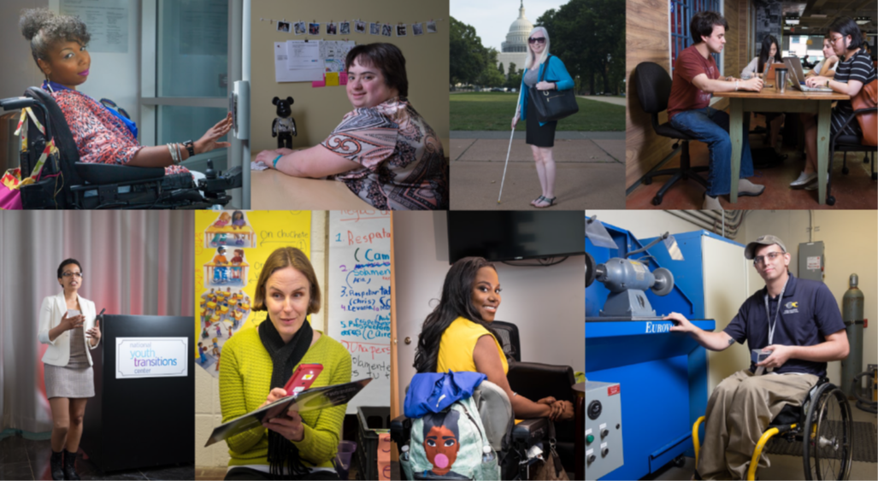
DC’s 2022 Employment First Summit Summary
Image collage of people with disabilities at work. Photos courtesy of Lawrence Roffee Photography.
Presented by: Kevin Wright, DC Developmental Disabilities Council

Slide 2
Employment First Summit Overview
Purpose of the Summit: Celebrate progress and accomplishments in the employment of people with disabilities and identify priorities to support DC’s disability community in employment in the future.
Summit was two days – October 20-21, 2022, at Martin Luther King Jr. Memorial Library and online via Zoom.
Target Audiences included employers, job seekers, employment professionals, service providers, small businesses, advocates, teachers, people with disabilities of all ages, and family members of people with disabilities.
Summit was held in English, Spanish, Amharic, ASL, and English captions were provided.

Slide 3
Employment First Summit Lead Up
DC Developmental Disabilities Council’s (DDC) FY22-26 State Plan strongly focuses on employment - organizing the Employment First Planning Committee for this Summit was the first step in that work.
Employment First Planning Committee met monthly or twice a month starting in January 2022 and included people with disabilities, family members, and professionals. Kevin Wright with the DDC was the Chairperson of this group.
Kevin Wright did a Listening Tour with five groups to get input on what people wanted to learn and experience at the Employment First Summit.
Employment First Leadership Workgroup, a group of 18 DC government entities, reconvened in September 2022 and committed to meeting quarterly to keep pushing Employment First forward.

Slide 4
Listening Tours
Kevin met with these groups on his Listening Tour:
DC Department on Disability Services (DDS) – Community & Provider Forum
Project ACTION!, DC’s self-advocacy coalition – June 18, 2022
Secondary Transition Community of Practice – June 24, 2022
Office of Disability Rights – April 26, 2022
DDS Transition Team Meeting – May 19, 2022

Slide 5
Employment First Leadership Workgroup
EFLW met in September 2022 and agreed to meet quarterly to work on the following:
Identify outcome-focused goals for Employment First in DC.
Collect and share Memorandums of Understanding or Agreement (MOUs, MOAs), to see how DC government agencies are collaborating and identify gaps.
Create a resource where DC government and community members can find programs that support DC residents with disabilities in their careers.
Identify opportunities for collaborative professional development across DC government agencies working toward Employment First.
Identify opportunities for collaborative community engagement and public awareness.
Continue to promote and celebrate the employment successes of people with disabilities and employers who adopt EF policies and practices.

Slide 6
Employment First Summit By the Numbers
222 people registered for the Summit
194 people attended - 120 people attended in person, and 74 people attended virtually
17 exhibitors
3 plenary sessions and 1 listening session
15 breakout sessions
9 awards given to recognize employment champions, innovative ideas, and collaboration
5 raffle prizes given

Slide 7
Employment First Summit Topics
Credit scams and fraud
Customized Employment
DC government hiring
DC’s Learners and Earners Program Outcomes
Entrepreneurs with disabilities
Job Corps
Reasonable accommodations and employee rights
Self-advocacy in employment
Social security benefits and employment
Supporting Deaf employees
Technology supports for employment
Transportation
Video resumes

Slide 8
Employment First Summit Feedback
Overall, most people who completed a survey or gave feedback to Employment First Planning Committee members said they were very satisfied with the Summit.
Participants reported learning a lot from breakout and plenary sessions.
Many attendees wished there were more disability service providers and employers present.
Challenges with ensuring consistent and high-quality language and disability access in a hybrid model.
Food was good!
Employment First Planning Committee and Summit participants expressed admiration for Kevin’s leadership, hard work, and skills – representation of people with disabilities in these leadership positions is important.
Listening session was important to springboard us into the next steps – we want to keep this work going!

Slide 9
Next Steps
Support quarterly meetings and actions of the Employment First Leadership Workgroup
Reconvene Employment First Planning Committee to plan 2023 activities. Possible activities include:
Another large event, like the Summit
Series of smaller activities that target specific groups like job seekers, family members of people with disabilities, employers, service providers, etc.
Advocacy for a DC government hiring program for people with disabilities

Slide 10
Questions for You
What are some creative ways to engage more disability service providers and direct support professionals (DSPs) in this work?
What are you most interested in when it comes to making DC the best place for people with disabilities to get and keep good jobs?

Slide 11
Thank you!
If you have questions, comments, or additional feedback, please get in touch with us!
Kevin Wright, Program Support Assistant, DD Council
kevin.wright@dc.gov, 202-880-7580
Alison Whyte, Executive Director, DD Council
alison.whyte@dc.gov, 202-340-8563

