Slide 1
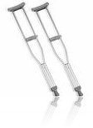
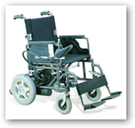
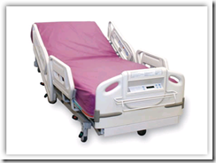
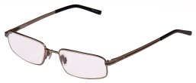
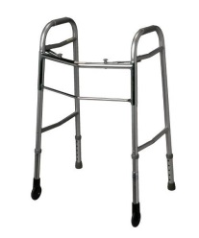
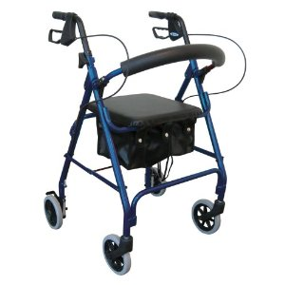
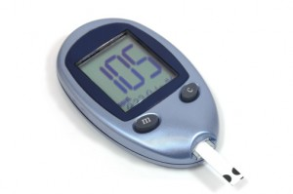
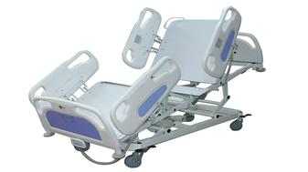
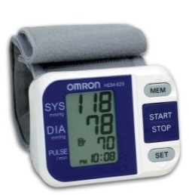
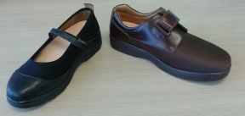
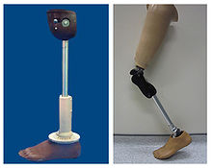
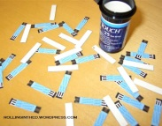
(REVISED) PROCEDURES FOR REQUESTING durable medical equipment, prosthetics, orthotics, and supplies (DMEPOS) VIA Medicare PART B AND DUAL ELIGIBLE/DUAL ELIGIBLE (QMB)

Slide 2
DMEPOS – MEDICARE PART B OR DUAL ELIGIBLE/DUAL ELIGIBLE (QMB) BENEFICIARIES
Beneficiaries who are classified as Medicare Part B or Dual Eligible/Dual Eligible (QMB) must have their prior authorization request(s) for DMEPOS Supplies/Equipment submitted to Medicare first, as Medicare Part B is the first insurer and for Duals--Part B is the first insurer also, with DC Medicaid being the second insurer for Duals.

Slide 3
DMEPOS – MEDICARE PART B OR DUAL ELIGIBLE/DUAL ELIGIBLE (QMB) BENEFICIARIES
Before proceeding with the instructions on the FOLLOWING pages, please verify the beneficiary’s insurance eligibility/coverage via DC Medicaid web portal or via Interactive Voice Response (IVR) at 202-906-8319.

Slide 4
DMEPOS – MEDICARE PART B OR DUAL ELIGIBLE/DUAL ELIGIBLE (QMB) BENEFICIARIES
For all DMEPOS Supplies/Equipment, the beneficiary must obtain a prescription (not a 719A form) from their Attending Physician with medical justification; and in some instances medical chart notes. FOR SOME EQUIPMENT/SUPPLIES, A FACE-TO-FACE WITH THE PCP MAY BE REQUIRED.

Slide 5
DMEPOS – MEDICARE PART B OR DUAL ELIGIBLE/DUAL ELIGIBLE (QMB) BENEFICIARIES
The Beneficiary gives the prescription, medical justification and medical chart notes (if REQUIRED) to a CERTIFIED Medicare DMEPOS Supplier of their choice.
Note: AS A Provider, you should always give the beneficiary the choice of three (3) CERTIFIED Medicare Suppliers to select from.

Slide 6
DMEPOS – MEDICARE PART B OR DUAL ELIGIBLE/DUAL ELIGIBLE (QMB) BENEFICIARIES
The beneficiary should always check with the CERTIFIED Medicare DMEPOS Supplier(s) to make certain that they are still CERTIFIED with Medicare to provide DMEPOS supplies or equipment needed.

Slide 7
DMEPOS – MEDICARE PART B OR DUAL ELIGIBLE/DUAL ELIGIBLE (QMB) BENEFICIARIES
termination of Medicare’s Competitive Bidding Program
PLEASE BE ADVISED THAT as of DECEMBER 31, 2018, THE DMEPOS COMPETIVE BIDDING Program contracts expired and will remain so until approximately December 31, 2020.
Effective, January 1, 2019 any certified dmepos supplier may furnish DMEPOS SUPPLIES OR EQUIPMENT. (see attached detailed information on this new procedure AND A LIST OF MEDICARE’S CERTIFIED SUPPLIERS)
NOTE: INCONTINENCE SUPPLIES AND AUTOMATIC BLOOD PRESSURE MONITORS – DO NOT NEED A DENIAL FROM MEDICARE – ALL CERTIFIED MEDICARE DMEPOS SUPPLIERS CAN PROVIDE THESEE ITEMS FOR MEDICARE BENEFICIARIES.

Slide 8
DMEPOS – MEDICARE PART B or DUAL ELIGIBLE/dual eligible (qmb) BENEFICIARIES
Resource notes
You can also locate a MEDICARE CERTIFIED dmepos supplier by:
Using the Medicare SUPPLIER DIRECTORY (www/medicare.gov/supplier)or by
Calling 1-800-medicare (1-800-633-4227) to ask a question or file a complaint.
ON TUESDAYS AND WEDNESDAYS, you can contact me FOR ASSISTANCE at the office of health care ombudsman and bill of rights (ohcobr)
202-724-4207 (DIRECT LINE)
202-724-7491 (GENERAL LINE)

