Slide 2
Comparison by Years
DDS FY 2022 Proposed Budget
2
FY19 ACTUAL $179,380,927
FY20 ACTUAL $172,200,851
FY21 BUDGET (APPROVED) $193,549,107
FY22 BUDGET (PROPOSED) $196,833,377
(1.7% increase)

Slide 3
Comparison by Years
DDS FY 2022 Proposed Local Budget
3
FY19 ACTUAL $123,037
FY20 ACTUAL $115,176
FY21 BUDGET (APPROVED) $131,048
FY22 BUDGET (PROPOSED) $134,104
(2.3% increase)

Slide 4
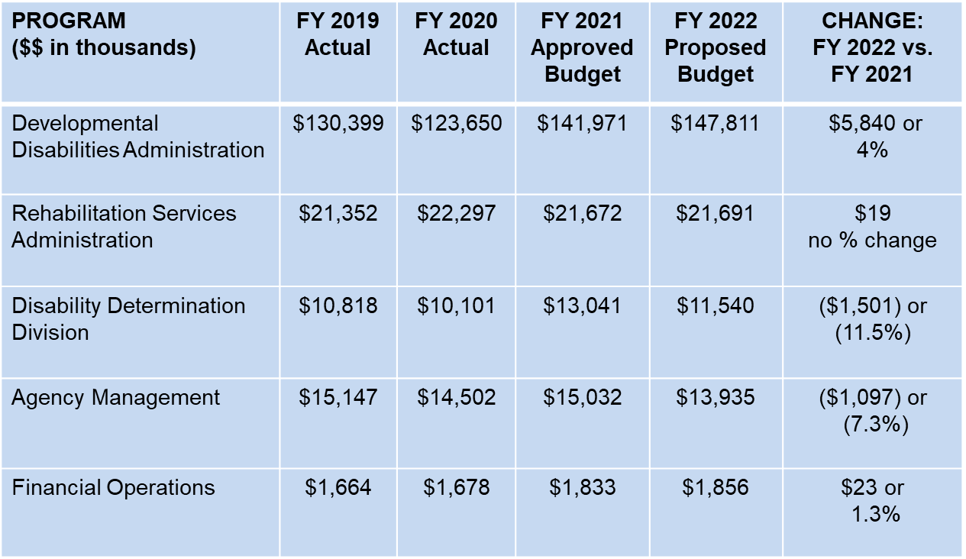
Proposed Budget By Program
4
FY19 ACTUAL $123,037
FY20 ACTUAL $115,176
FY21 BUDGET (APPROVED) $131,048
FY22 BUDGET (PROPOSED) $134,104
(2.3% increase)

Slide 5
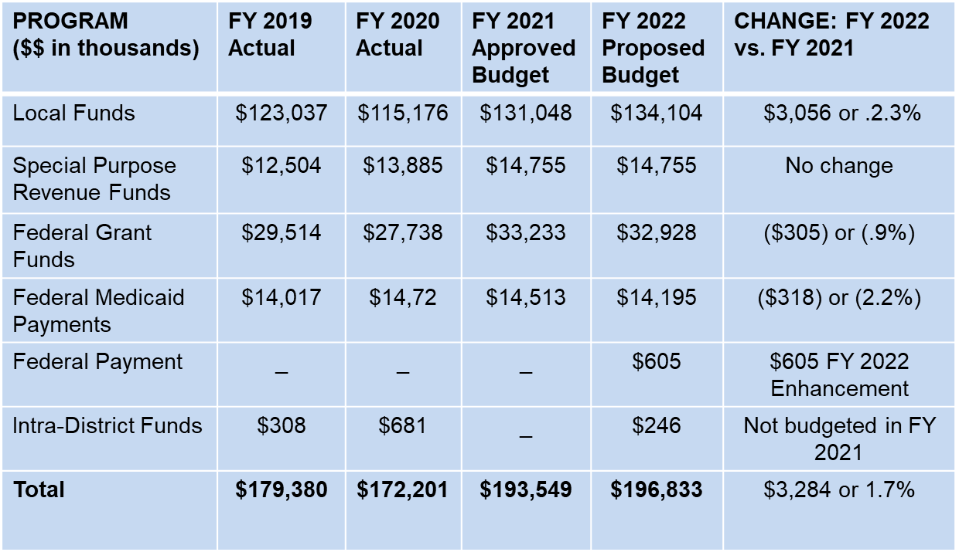
Proposed Budget By Funding Source
5
FY19 ACTUAL $123,037
FY20 ACTUAL $115,176
FY21 BUDGET (APPROVED) $131,048
FY22 BUDGET (PROPOSED) $134,104
(2.3% increase)

Slide 6
DDS Staffing Overview
6
FY 2022 Proposed Staff Size: 428
FY 2021 Approved: 428

Slide 7
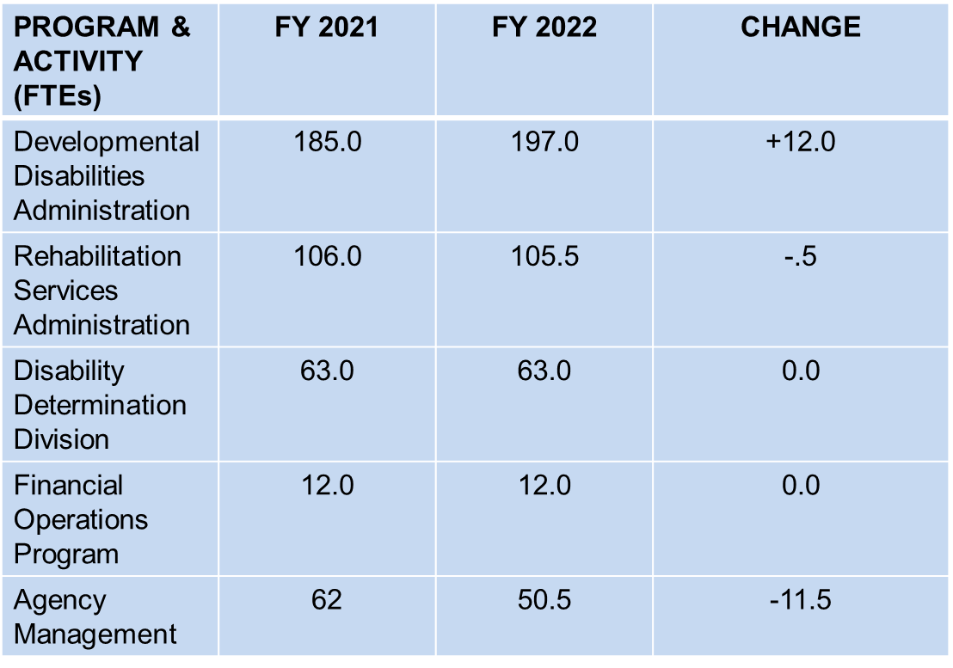
DDS Staffing Overview
7

Slide 8
Title/Description
DDS Budget Per Table 5 of the Budget
8
($3,061) *Amounts in Thousands
$5,995
$1,019
($897)
($305)
($318)
$246
Removal of one – time costs
Align resources with operational spending goals
Align personal services and fringe benefits with projected costs
Align fixed costs with proposed estimates
Align the budget with projected grant awards
Align the budget with projected federal Medicaid reimbursements
Align budget with projected revenues

Slide 9
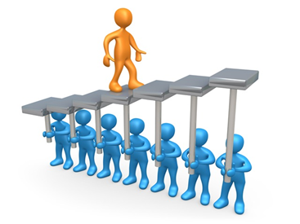
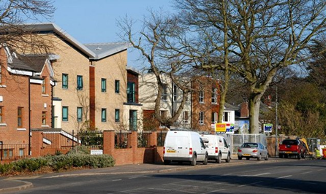
Developmental Disabilities Administration
9
Supports 2,400 adults with intellectual disabilities
Home and Community-Based Services Waiver
23 services & supports for 1,800+ adults
In integrated, community-based settings

Slide 10
HCBS Waiver
10
Two Waivers: IDD Waiver and IFS Waiver
Comprehensive Waiver Participants: 1,825
IFS Waiver Participants: 0
FY 2022 Proposed local share for the waivers $92.8m
Waiver grows steadily, year after year
New users +
More utilization

Slide 11
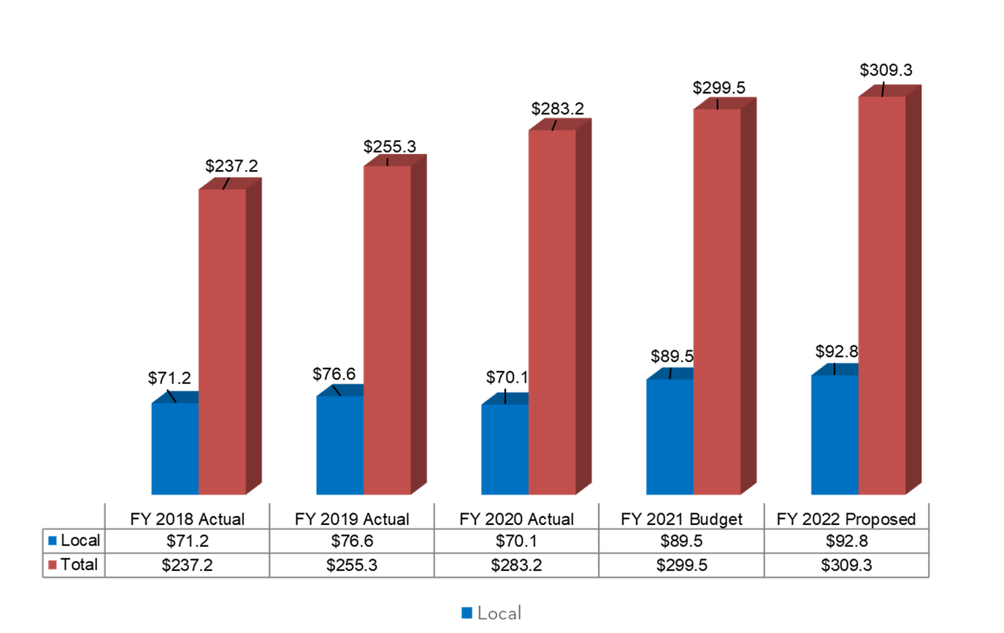
DDS Medicaid Waiver Performance FYs 2018- 2022
11

Slide 12
DDA Residential Costs
12
Total cost: $31,367,133
= $27,270/per person x 1,100 people
+ costs for people who are not Medicaid eligible, or who need a non-Medicaid reimbursable service

Slide 13
Rehabilitation Services Administration
13
RSA helps people prepare for work, find jobs, keep jobs and get better jobs
Budget goes up by $19,000
78.7% federally-funded, with a 21.3% local share and a required maintenance of effort

Slide 14
Disability Determination Division
14
DDD is the D.C. office for the Social Security Administration’s review and determination of disability claims
100 percent federally-funded with a proposed budget of $11,540,000
Currently 13 vacancies, SSA approval required to fill

Slide 15
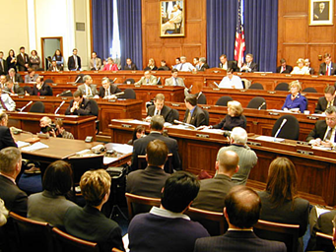
DDS Budget Hearing
15
Monday, June 7, 2021 at 9:00 a.m.
Hearing will be held virtually
Witnesses can sigh up at: https://www.brianneknadeau.com/testify
The Budget Oversight hearing can be seen at: https://dccouncil.us/council-videos/
If you need help preparing your testimony:
Quality Trust for Individuals with Disabilities (202) 448-1450
DC Developmental Disabilities Council (202) 724-8612

Slide 16
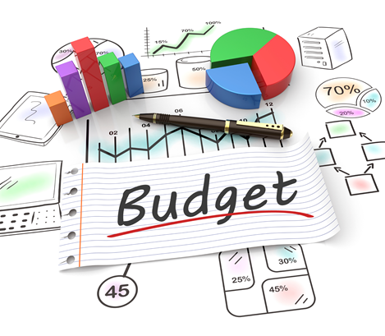
To See the FY 2022 DDS Proposed Budget
16
https://dccouncil.us/2020-2021-performance-oversight-fy-2022-budget-schedules/

Slide 17
Questions and Discussion
17

