Slide 1
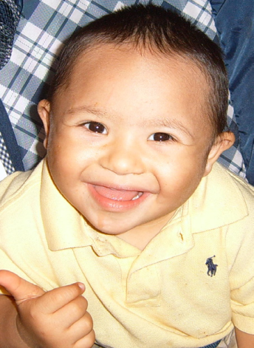
No Wrong Door System Improving Access to LTSS
For All Ages Incomes Disabilities
No Wrong Door System Improving Access to LTSS
For All Ages Incomes Disabilities

Slide 2
What has been your experience?

Slide 3
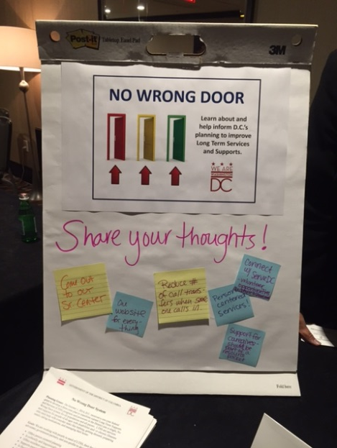
No Wrong Door Stakeholder Input
This is what you have told us you want:
Help navigating the system
Better coordination between government agencies
Great customer service
Support for family caregivers
Community-based (access and services)
On-line with one website for everything
Support to live in the community as independently as possible
Person centered counseling, planning and service delivery

Slide 4
No Wrong Door System
Federally funded grant
Administration on Community Living (ACL)
Centers for Medicare and Medicaid Services (CMS)
Veterans Health Administration (VHA)
One of 5 states awarded to the District for three years
8 additional states also developing NWD system

Slide 5
No Wrong Door System
Vision
To have easy and reliable access to a full range of long-term supports and
services, which are person and family centered, culturally and linguistically
responsive and coordinated across a person’s life.

Slide 6
NO Wrong Door System
NWD 4 main areas:
State Governance and Administration
Public Outreach and Coordination with Key Referral Sources
Person-Centered Counseling/Planning
Streamlined Access to Public Programs

Slide 7
Person-Centered Thinking: “Important To & For” & Integrated
Family
Friends
Neighbors
Co-workers
Church members
Person’s/ Family’s Resources Abilities and Strengths Characteristics
School
Public Transportation
Parks and Recreation
Businesses
Faith-based
Disability Services
Special Education
Medicaid
Vocational Rehab
Behavioral Health
Food Stamps
Housing
Aging
Phone & I-Pad Apps
Remote Monitoring
Adaptive Equipment

Slide 8
Leading Person-Centered Thinking Cross-Systems Change
Cabinet Leadership
Alignment with CMS Rule
Financial Investment-First by DDS & DBH - Now Cross Agency through NWD
Capacity Building
In Public and Private Sectors:
Developing PCT Trainers in DDA, DBH, DHCF, RSA, ADRC
Support and Educate Advocates and Families
PCT!

Slide 9
No Wrong Door System
Public Outreach, Engagement and Coordination
Joint communication, outreach and marketing strategies
Inter-agency collaboration
Public-Private partnerships
Culturally and linguistically responsive
Working with all populations (elderly, veterans, people
with disabilities, low literacy, youth, people with
behavioral health needs and many more)
Web, mobile, print and social media strategies

Slide 10
No Wrong Door System
Current NWD District Government Agencies
Person & Family in need of LTSS
Aging
Behavioral Health
Human Services
Disability Services
Elderly & People with Disabilities

Slide 11
No Wrong Door System
Aging
Disability Services
Behavioral Health
Elderly and People with Disabilities
Child & Youth
Human Services
Education
Veterans
Future NWD Agencies
Person & Family in need of LTSS

Slide 12
No Wrong Door System
BIG PROJECT..........not going to happen overnight

Slide 13
No Wrong Door System
Short-Term Goals
Assess linguistic and cultural competence
Training on Person Centered Thinking
Communicate the NWD systems change

Slide 14
No Wrong Door System
Short-Term Goals
Implement a district wide resource portal
Assess the intake process of 4 NWD District agencies
Help pilot PCT training with families that blends PCT and
Supporting Families Community of Practice (CoP) Life
Course elements to inform the front door design

Slide 15
WORKING TOGETHER!
People in need of LTSS
NWD partner agency staff
Hospital & Primary Care Associations
Independent Living Centers
NWD States
Family Members
Provider Coalitions
Self-Advocacy Groups
Family Support Groups
Advocates
Long Term Care Coalition
DC Supporting Families CoP
Faith-Based
ALL!

Slide 16
No Wrong Door System
THANK YOU!!
NWD Team:
Erin Leveton, Project Director – erin.leveton@dc.gov
Mark Agosto, Program Manager – mark.agosto@dc.gov
Robin Barnes, Business Analyst – robin.barnes@dc.gov
Donald Clark, Program Development Specialist – donald.clark@dc.gov
Vivian Guerra, Program Development Specialist – vivian.guerra2@dc.gov
Emily Price, Program Development Specialist – emily.price@dc.gov

